Slide 1
Reverse Engineering
and
Functional Analysis

Slide 2
Reverse Engineering
Reverse engineering (RE) is the process of taking something apart and analyzing its workings in detail, usually with the intention of understanding its function.
Engineers use this information to prepare documentation, generate electronic data, or construct a new or improved device or program.

Slide 3
Why Perform RE?
Improve the design of a flawed product.
Improve the design of a part to maximize manufacturing techniques and appropriate materials.
Redesign a part to increase a company’s profit margin.
Discover how a competitor’s product functions.

Slide 4
Why Perform RE?
Create documentation and part files that were non-existent.
Continue the development of a well-designed object.
Reduce negative environmental impacts.

Slide 5
Stages of RE
Visual Analysis
Functional Analysis
Structural Analysis

Slide 6
Visual Design Elements
Six integral components in the creation of a design:
Line
Color
Form/Shape
Space
Texture
Value

Slide 7
Line
Types
  Vertical- Represents dignity, formality, stability and strength.
  Horizontal- Represents calm, peace and relaxation.
  Diagonal- Represents action, activity, excitement and movement.
  Curved- Represents freedom, the natural, having the appearance of softness and creates a soothing feeling or mood.

Slide 8
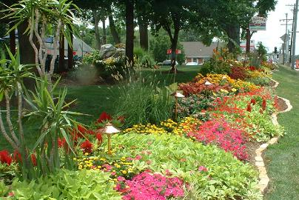
Color
Color has an immediate
and profound effect on a design.
Types
  Warm Colors
    Reds, oranges, yellows
  Cool Colors
    Blues, purples, greens
  Colors can affect how humans feel and act.

Slide 9
Form and Shape
The shape, outline, or configuration of anything.
Examples
  Squares
  Circles
  Ellipses
  Ovals
  Rectangles
  Triangles

Slide 10
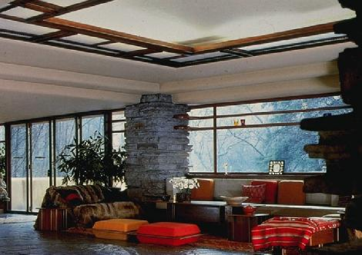
Space
By incorporating the use of space
in your design, you can enlarge or reduce the visual space.
Types
  Open, uncluttered spaces
  Cramped, busy
  Unused vs. good use of space

Slide 11
Texture
The surface look or feel of something.
Types
  Smooth surface
    Reflects more light and, therefore, is a more intense color.
  Rough surface
    Absorbs more light and, therefore, appears darker.

Slide 12
Value
The relative lightness or darkness of a color.
Methods
  Shade
    Degree of darkness of a color
  Tint
    A pale or faint variation of a color
Notes:
Add black to get a shade. Add white to get a tint.

Slide 13
Visual Design Principles
There are five principles that encompass an interesting design.
Balance
Rhythm
Emphasis
Proportion and scale
Unity
Notes:
There are many different lists of design principles used by various occupational areas.

Slide 14
Balance
Parts of the design are equally distributed to create a sense of stability.
There can be physical as well as visual balance.
Types
  Symmetrical or Formal Balance
  Asymmetrical or Informal Balance
  Radial Balance
  Vertical Balance
  Horizontal Balance

Slide 15
Rhythm
Repeated use of line, shape, color, texture or pattern.
Types
  Regular rhythm
  Graduated rhythm
  Random rhythm
  Gradated rhythm
Notes:
This principle is sometimes referred to as repetition.

Slide 16

Emphasis
Points of attention in a design.
The feature in a design that attracts one’s eye.
The focal point.
Emphasis can be achieved through size, placement, color and use of lines.
The most personal aspect of a design.

Slide 17
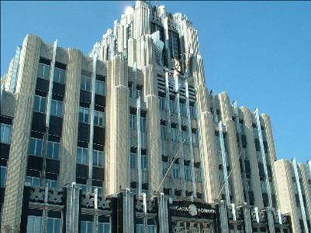
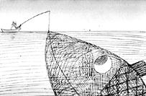
Proportion and Scale
Comparative relationships between elements in a design with respect to size.
3:5 ratio is known as the Golden Mean.
Scale
  The proportions or size of one part of the image in relationship to the other.

Slide 18

Unity
Unity is applying consistent use of lines, color, and texture within a design.
To be harmonious.

Slide 19
Functional Analysis
After a product has been selected, a non-destructive Functional Analysis is performed.
First, the product’s purpose is identified. Next, observations are made to determine how the product functions. These observations are recorded in detail. Lastly, the system’s inputs and outputs are listed.

Slide 20

Functional Analysis Example
The purpose of a toothbrush is to clean teeth and gums to prevent tooth and gum decay. Water and a cleansing paste are also used in conjunction with the brush.

Slide 21
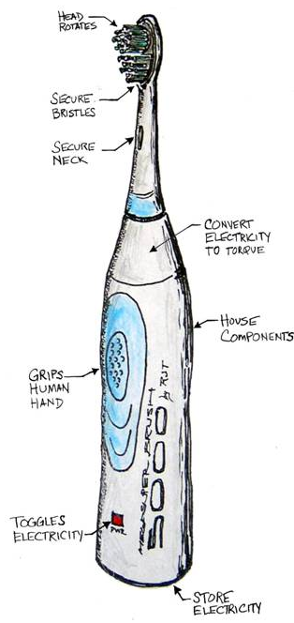
Functional Analysis Example
The engineer makes an annotated sketch of the product and labels all of the visible components.
This information is used to write up a detailed analysis of the object’s sequential operation, or function.

Slide 22
Black Box Systems Model
A black box systems model is used to identify what goes into and out of the product in order to make it work as a system.
Inputs
Output
Product Function

Slide 23
Black Box Systems Model
The “black box” is used to represent the product’s internal components or processes, which are deemed unknown at this point.
Inputs
Output
Product Function

Slide 24
Functional Analysis Example
Sound
Heat
Waste
Clean teeth and gums
Hand motion
Toothpaste
Water
Energy
Inputs
Output
Product Function

Slide 25
Product Disassembly

Slide 26
Product Disassembly
Disassembly or teardown of a product is a major step in the Reverse Engineering process.
It uncovers the principles behind how a product works.
It is always fun to tear apart a product, but nothing will be accomplished if data is not collected during the process.
To gather this data we will use a Product Teardown Chart.
Notes:
Common Changes to Unit:
Revised lessons include Essential Questions that all students should be able to answer as a result of the lesson and completing the related activities. The Essential questions are related directly to the concepts and standards. The Key Terms are linked to Glossary and provide teacher and students with a ready source of information related to the lesson and activities.

Slide 27
Product disassembly will answer the following questions:
    How do the parts interact?
    What are the good and bad features
      …of the product’s form?
      …of the product’s function?
    What has caused the product to succeed or fail?
    Are the materials appropriate?
    What manufacturing process was used?
    What is the estimated cost of the product?

Slide 28
Why do we perform disassembly?
To analyze an existing product and determine its components and interrelationships.
To determine strengths and weaknesses of parts.
To understand how it works.
To develop electronic documentation.

Slide 29
Product disassembly
is a major step in the
Reverse Engineering process.

Slide 30
Why does Industry Reverse Engineer?
The original manufacturer of a product no longer produces a product or replacement parts for the product.
Some bad features need to be “designed out.”
To strengthen the good features of a product.
To analyze the good and bad features of competitors’ products.

Slide 31
Reasons for Reverse Engineering (Cont.)
To create CAD models and documentation that were not available, or sufficient to support new manufacturing processes, such as Computer Numerical Control/CNC.
To update obsolete materials or antiquated manufacturing processes.

Slide 32
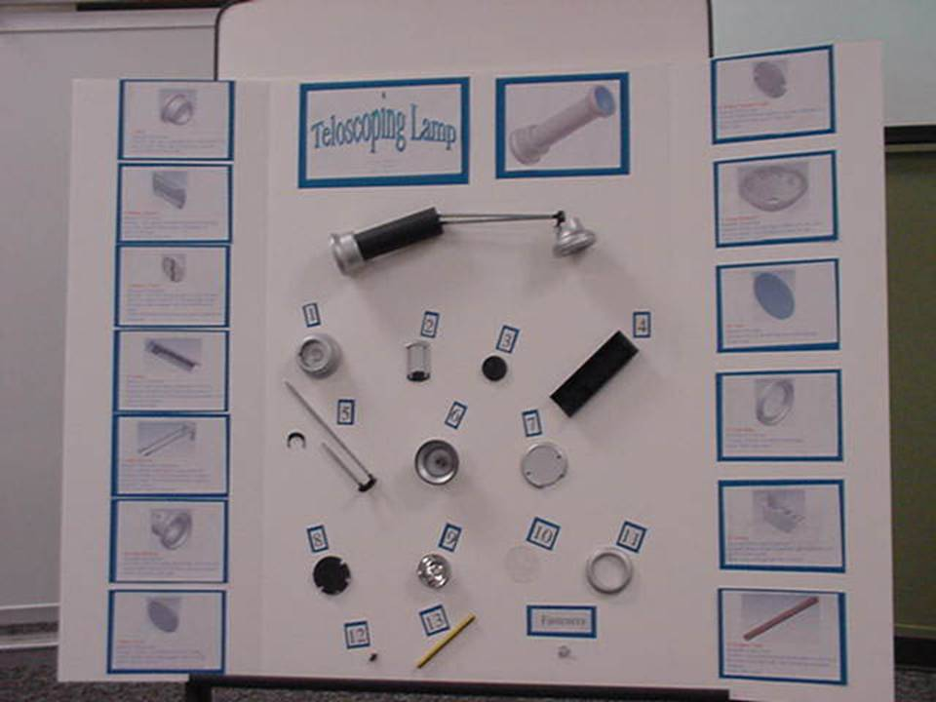
Sample Product Disassembly Display

Slide 33
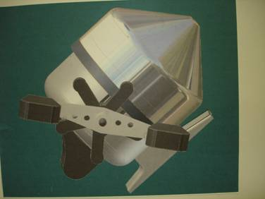
Initial Product Selection
An item to disassemble is selected.
It could be as simple as a children's toy,
or as complex as a fishing reel.

Slide 34


Gathering Data
Carefully disassemble the product.
Measure the parts and record information using the Product Teardown Chart shown on the next slide.
Determine material properties.
inquiry
discovery

Slide 35
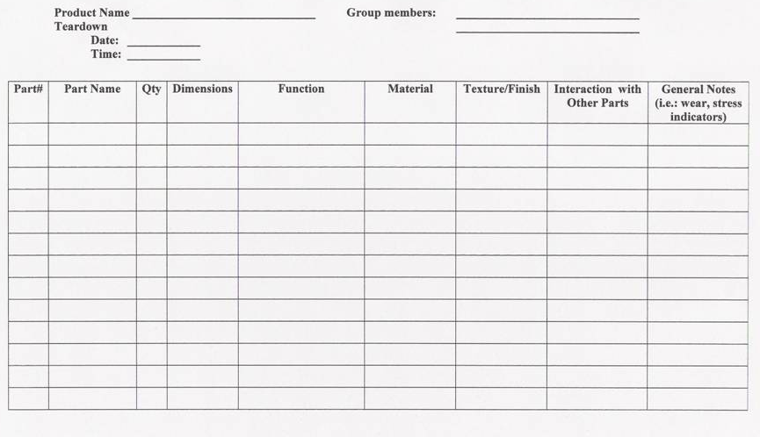

Slide 36
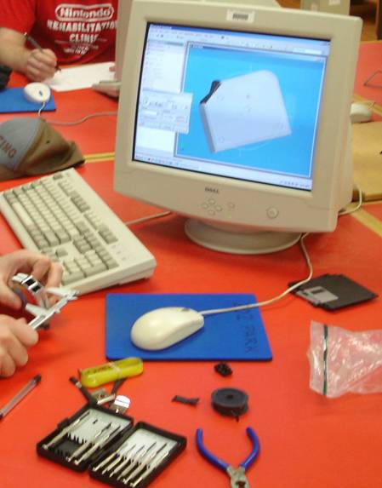
Take measurements and record data…

Slide 37

Visualization
Create thumbnail sketches.
Develop pictorial sketches which are extremely important at this stage to show how the part is assembled, and how the mechanism works.

Slide 38
Compare your theory/hypothesis of how the product functioned to its actual operation.

Slide 39
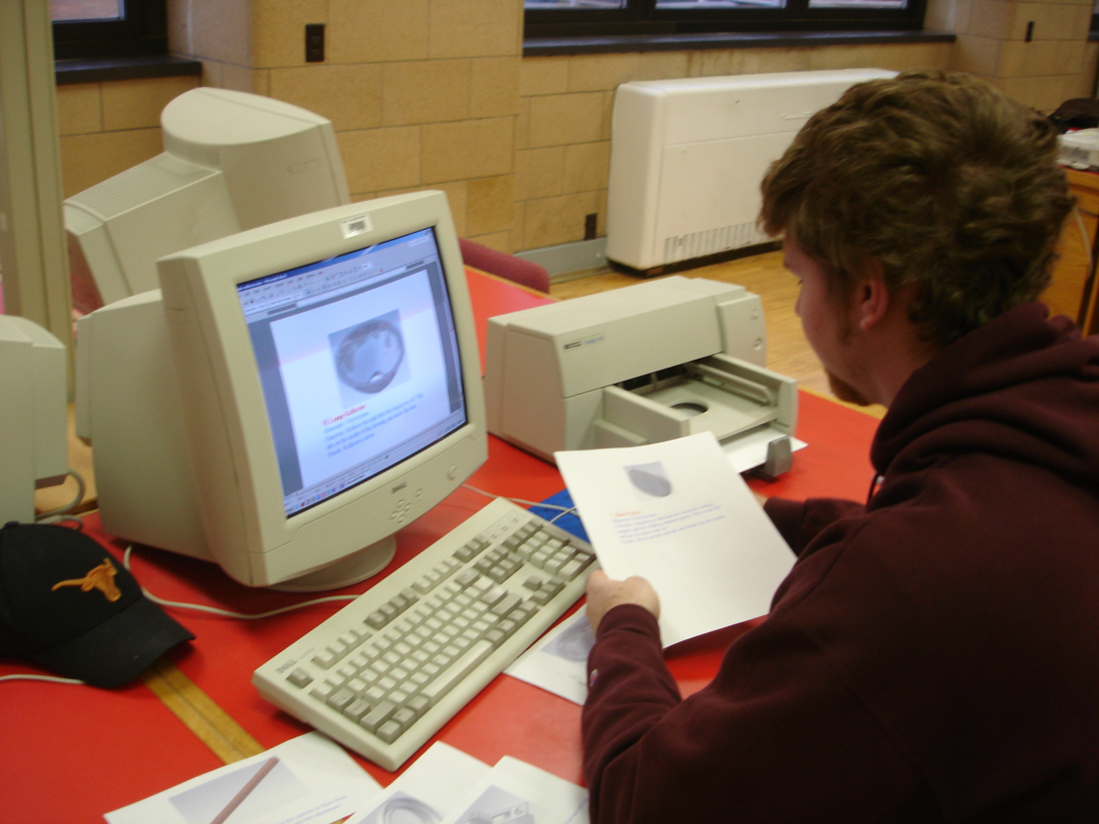
Create solid models of each part for your presentation display.

Slide 40
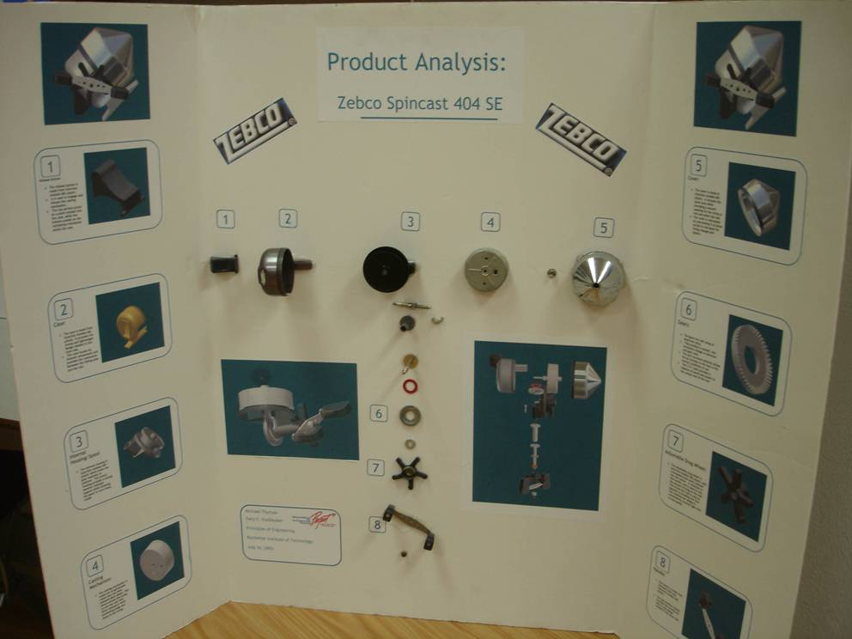

Slide 41
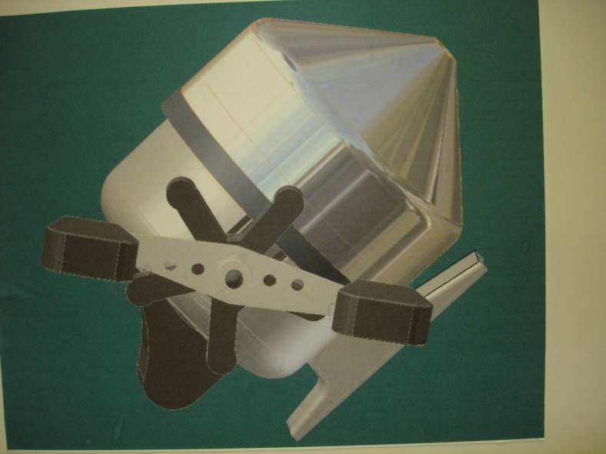
Analyze the product
How do the parts interact?
What are the good and bad features?
What has caused the product to succeed or fail?
Are the materials appropriate?

Slide 42
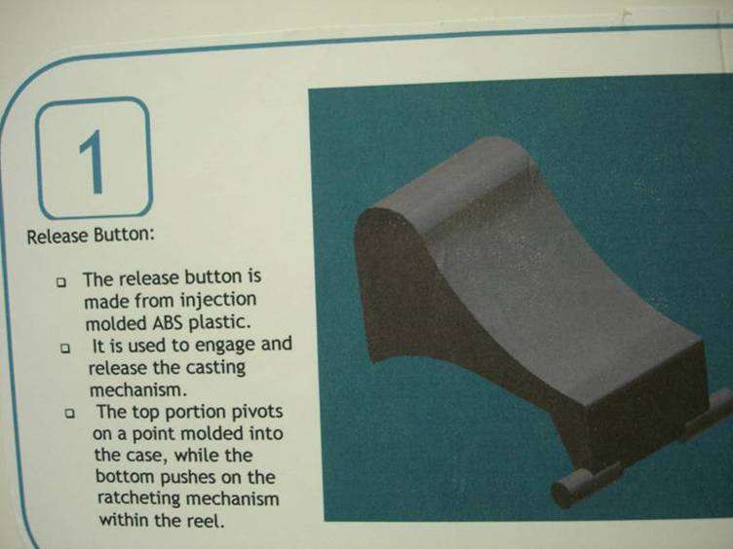
Fully document each part…

Slide 43
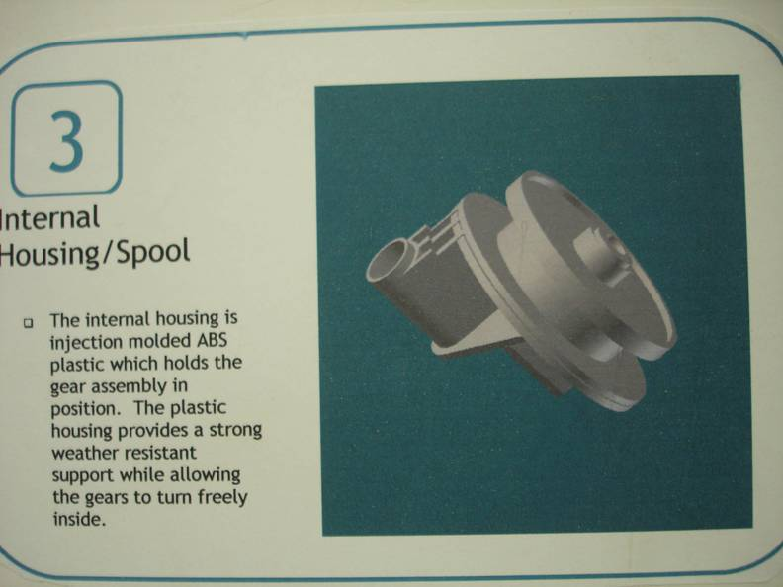
Fully document each part…

Slide 44
Discuss and Brainstorm
Discuss your team’s findings and brainstorm for improvements.
Determine with your team, if more information is needed.

Slide 45
Reflect on the disassembly process
Did the disassembly process help you to understand the product and lead you to ideas for redesign to enhance its marketability?

