Slide 1
Technical Report Writing
Elements and Standards

Slide 2
Associated Lesson Concept
Engineers spend a great deal of time writing technical reports to explain project information to various audiences.

Slide 3
The Importance of Writing
Engineers perform technical writing to communicate pertinent information that is needed by upper management to make intelligent decisions that will effect a company’s future.
Upper Management
Decision Control
Detailed Knowledge
Project Engineer

Slide 4
The Importance of Writing
Many engineers spend between 1/3 and 1/2 of their work time engaged in technical writing. Examples include:
proposals
regulations
manuals
procedures
requests
technical reports
progress reports
emails
memos
Notes:
In order to be successful, an engineer must be able to write effectively.
Poor writing makes the reader question the abilities and dedication of the writer, and can keep an engineer from advancing in his or her career.

Slide 5
Technical Writing
Technical writing is a type of expository writing this is used to convey information for technical or business purposes.
Technical writing is NOT used to:
entertain
create suspense
invite differing interpretations
Notes:
Note: Expository means serving to expound, set forth, or explain. (Random House Webster’s College Dictionary)
Reference:
Newman, J. M. (2006). Resources for technical and business writing: Glossary. Retrieved August 3, 2006 from http://www.lupinworks.com/roche/pages/glossary.php

Slide 6
Technical Reports
Engineers write technical reports (also called engineering reports) to communicate technical information and conclusions about projects to customers, managers, legal authority figures, and other engineers.
A technical report follows a specific layout and format as specified by the American National Standards Institute (ANSI).
Notes:
The American National Standards Institute (ANSI) standard that governs the layout and format of a technical report is ANSI/NISO Z39.18-1995. This standard helps the author and the reader by standardizing where information is found (layout) in a technical report, and how the information is presented (format).
The ANSI/NISO Z39.18-1995 standard states that the primary purpose of a technical report is to “disseminate the results of scientific and technical research and to recommend action.”

Slide 7

Layout and Format
Analogy:
Think of the layout and format of a newspaper.
Stock market information is found in a specific location in a newspaper (layout), and is presented in a table format.
Notes:
Unlike a novel, people who read engineering reports almost never read cover to cover. The same is true with a newspaper. Knowing where to go and how to interpret information in any technical document saves time, which is critical in business.

Slide 8
Technical Report Layout
Front Cover
Title Page
Abstract
Table of Contents
Summary
Introduction
List of Tables and Figures
Appendixes
Methods, Assumptions, and Procedures
Back Cover
Results and Discussion
Conclusion
References
List of Symbols, Abbreviations, and Acronyms
Front Matter
Text
Back Matter
Notes:
A technical report is made up of three major parts: Front Matter, Body, and Back Matter

Slide 9
Front Matter
The front matter is used to help potential readers find the report.
Once found, the front matter will help the reader to quickly decide whether or not the material contained within the report pertains to what they are investigating.
Notes:
The front matter provides information that is needed to catalog the report for bibliographic databases.

Slide 10
Front Matter
Cover*
Label*
Title Page
Abstract
Table of Contents
Lists of Figures and Tables
*May be an optional element
Notes:
The front matter may also contain other optional items which may or may not pertain to a student’s technical report:
6. Forward - an introductory statement that presents background material or that places in context a report that is part of a series. It is written by an authority in the field other than the author of the report. The name and affiliation of the author of the foreword follow the last paragraph.
7. Preface - an introductory statement that announces the purpose and scope of the report and acknowledges the contributions of individuals not identified as authors or editors. Sometimes a preface specifies the audience for whom a report is intended; it may also highlight the relationship of the report to a specific project or program. Material that is necessary for understanding the report belongs in the introduction, not in the Preface. A foreword and a preface are not interchangeable, and the information in them is not redundant. A foreword precedes a preface, if both are included.
8. Acknowledgements - Acknowledgments of technical assistance that contributed to the content of the report are made at an appropriate place in the preface or in the body. However, lengthy acknowledgments are often made in a special optional section titled “Acknowledgments.” This optional section follows the preface, in which case the preface does not contain acknowledgments.

Slide 11

Front Matter: Cover*
A cover and label are used if the report is over 10 pages long.
The cover (front and back) provides physical protection for the printed report. Plastic spiral bindings and thick, card-stock paper are recommended.
*May be an optional element
Notes:
Note: The front and back covers do not have page numbers.
When it is necessary to call attention to certain aspects of a report, such as its security classification, restricted distribution, or proprietary information, appropriate notices appear on the cover.

Slide 12
Front Matter: Label*
A label is placed on the cover to identify:
Report title and subtitle (if a subtitle is appropriate)
Author’s name
Publisher*
Date of publication
*May be an optional element
Notes:
*It is suggested that the school and class title be used in place of the publisher for instructional purposes.
If a report tracking number is used, it should also appear on the label. Many companies and organizations have their own labeling standards.

Slide 13

Front Matter: Title Page
The title page provides descriptive information that is used by organizations that provide access to information resources (i.e., library).
A title page duplicates the information found on the front cover (if one is used).
Notes:
The data contained on the title page is critical to libraries, abstracting services, and other organizations that acquire, store, and provide access to information resources.
Title and Subtitle
In creating the title of a report, an author should:
1. selects words that distinguish the report from any other on the same general topic rather than writing “Report on . . .”
2. use a distinctive subtitle for clarity. Information about the period covered by the report (for example, month, quarter, or year) is included in the subtitle of reports in series.
3. spell out abbreviations and acronyms.
Authorship
The authorship of a report is reserved for the person or persons who originated the scientific or technical information or the text of the report, and who can effectively defend the content of the report to a peer group. The primary author is always identified first. An author’s name appears on the cover and title page in identical form. The preferred order is first name, middle name or initial, followed by surname. Academic degrees are not given. However, authors or contributors can identify themselves by their job titles in the organization (Jane R. Doe, Cost Analyst; Jack T. Doe, Head, Research and Development Division).
The required data elements of a title page that may not be appropriate for a classroom assignment are:
Report Number
Each report requires a unique report number that appears in an upper corner on both the cover and title page (and on the spine of a bound report if space permits so that the user will not have to remove the report from a shelf to read the number). A report number is composed of an alphanumeric report code (2-16 characters) and a numeric sequential group (l-14 digits indicating the year and sequence of report issuance).
Performing and Sponsoring Organizations
The performing organization conducts research; the sponsoring organization funds research and usually controls report publication and distribution. The performing organization and the sponsoring organization may be one and the same. Reports that present the results of research done under contracts or grants identify both a performing and a sponsoring organization. In such cases, the name of the sponsoring organization, the performing organization, or other responsible unit, and the complete address appear on the title page. If there are multiple sponsoring organizations, each is listed, and the functions of each are identified.

Slide 14
Front Matter: Abstract
An abstract (informative style) is a short summary that provides an overview of the purpose, scope, and findings contained in the report.
Purpose - identifies the issue, need, or reason for the investigation
Scope - reviews the main points, extent and limits of the investigation
Findings - includes condensed conclusions and recommendations
Notes:
Abstracts are designed for information databases (such as those found in libraries). They are the messages that are compiled and appear when a person conducts a keyword search on a topic through a computer. It is for this reason that an abstract is very short and to the point.
Definitions:
Purpose - the reason for which something is done or for which something exists.
Scope - the extent of the area or subject matter that something deals with or to which it is relevant.
Findings - something that is found or ascertained.
There are two types of abstracts, descriptive and informative. An informative abstract is the type that is used in a technical report.
An informative abstract identifies the issue or need that led to the report, reviews the main points and major findings, and includes condensed conclusions and recommendations.
Example: Based on a geometric and material analysis of a commercially available garden hose nozzle, this report concludes that a component within the product needs to be redesigned to provide greater structural integrity against the applied forces that are encountered from other moving components.
A descriptive abstract provides a description of the report’s main topic and purpose, along with an overview of its contents. It presents the broadest view, and offers no major facts. This type of abstract is often only a few sentences long, and may be located at the bottom of the title page.
Example: This report provides an analysis of design flaws that exist within a commercially available garden hose nozzle, and makes recommendations for correcting those problems.
References:
Online technical writing: Abstracts URL: http://www.io.com/~hcexres/textbook/abstrax.html
(Pg 127-129) Beer, D. & McMurrey D. (2005). A guide to writing as an engineer (2nd ed.). Hoboken, NJ: John Wiley & Sons, Inc.
(Pg 216-217) Lannon, J. M. (1994). Technical writing (6th ed.). NY: HarperCollins College Publishers.
Abstracts URL: http://www.uwf.edu/writelab/handouts/abstracts.cfm
Language notes: 5.0 Report writing URL: http://www.roma.unisa.edu.au/07118/language/reports.htm
Executive summaries: Common mistakes URL: http://www.korepetycje.com/summaries-mistakes.html
Abstract vs. executive summary URL: http://www.rfp-templates.com/Abstract-vs-Executive-Summary.html
ANSI/NISO Z39.18-1985

Slide 15
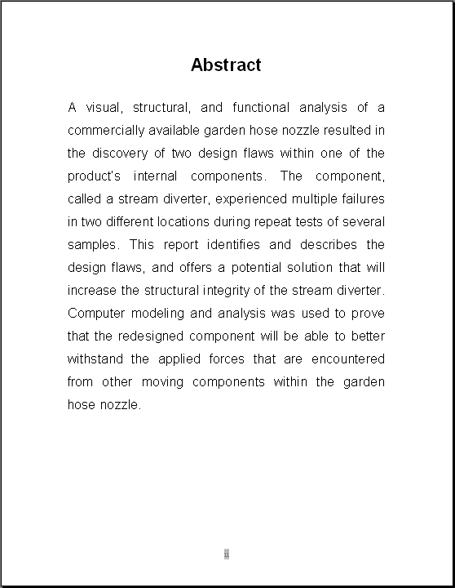
Front Matter: Abstract
no more than 200 words*
provides an “in a nut shell” description without providing underlying details
contains no undefined symbols, abbreviations, or acronyms
makes no reference by number to any references or illustrative material
ii
Notes:
*For reports that are more than 50 pages, an abstract may be up to three pages long.

Slide 16
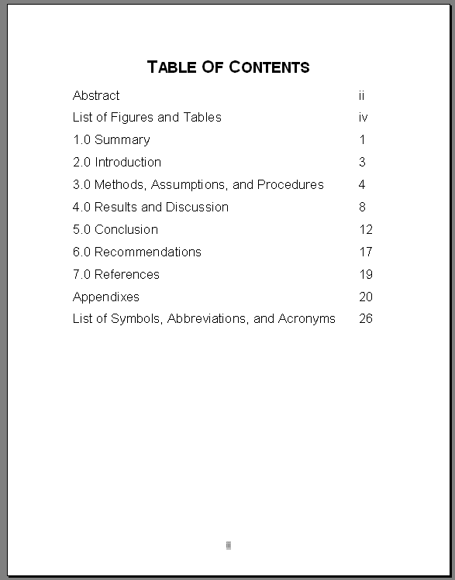
Front Matter: Table of Contents
The table of contents lists the title and beginning page number of each major section within the report (excluding the title page and the table of contents).
iii
Notes:
Not all levels of headings and subheadings have to be in the table of contents. If a sub heading is included in the table of contents then all subheadings which are at the same level have to also be included.
Notes on numbering pages: All pages except the front and back covers are numbered. However, on some pages the numbers are not displayed.
Pages that occur before the Summary (which is the first page of the text) are numbered with lowercase roman numerals (i, ii, iii, iv, etc.). All other pages use Arabic numerals (1, 2, 3, etc.). The recommended location for page numbers is the bottom center of the page.
The Title Page is considered “special pages” and does not show its page number.

Slide 17
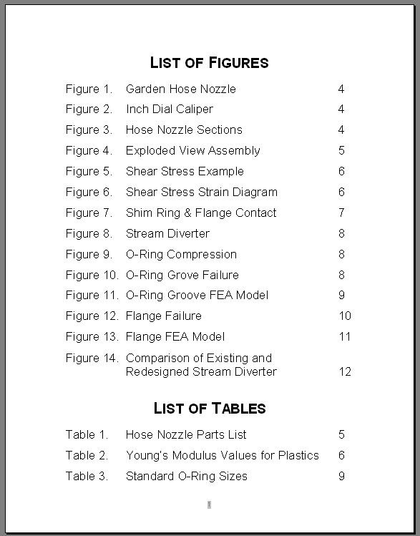
Front Matter: List of Figures and Tables*
A list of figures and tables helps the reader to locate illustrations, drawings, photographs, graphs, charts, and tables of information contained in the report.
iv
*May be an optional element
Notes:
List(s) of Figures and Tables
The lists of figures and tables, titled “Figures” and “Tables” respectively, follow the contents page. If the table of contents fills only half a page, the lists of figures and tables may follow the table of contents on the same page. If lists of figures and tables are included in a report, all figures and tables are listed with their corresponding page numbers. A list of figures precedes a list of tables. If a report has many figures and few tables or few figures and many tables, they can be combined into a single list (“Figures and Tables”) with the figures preceding the tables.
If the report contains fewer than five figures, five tables, or some combination totaling less than five, then a list of figures and tables is not required.

Slide 18
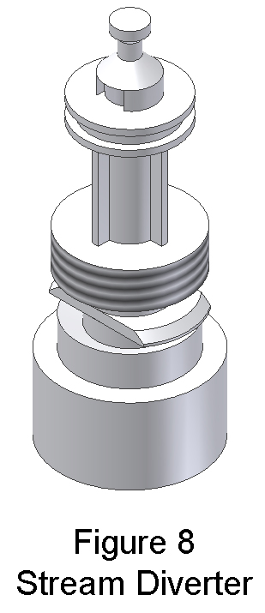
Front Matter: List of Figures and Tables*
A figure is any drawing, photograph, graph, or chart that is used to explain and support the technical information in the text.
The figure number and title will appear below the image.
Refer to a figure or table within the text, and place the image close to the reference.
*May be an optional element

Slide 19
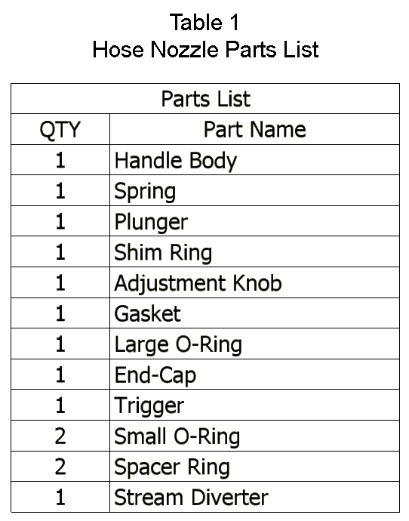
Front Matter: List of Figures and Tables*
A table is an arrangement of detailed facts or statistics that are arranged in a row-and-column format.
The table number and title appear above the table.
*May be an optional element

Slide 20
Text
The text is the part of a technical report in which the author describes the methods, assumptions, and procedures; presents and discusses the results; draws conclusions, and recommends actions based on the results.

Slide 21
Text
Summary
Introduction
Methods, Assumptions, and Procedures
Results and Discussion
Conclusions
Recommendations*
References
*May be an optional element

Slide 22
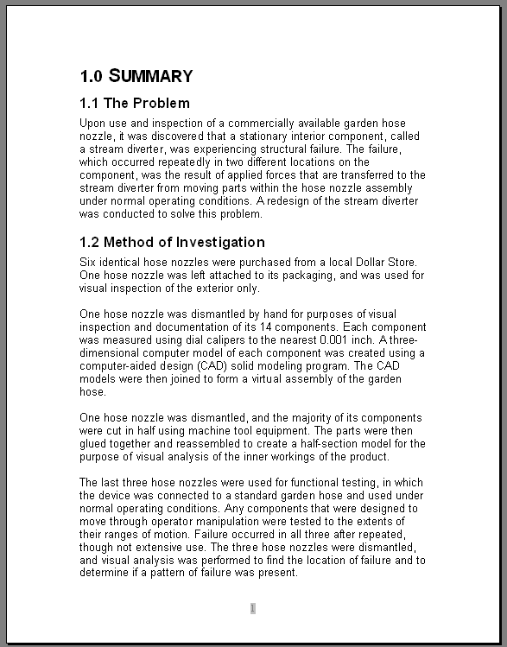
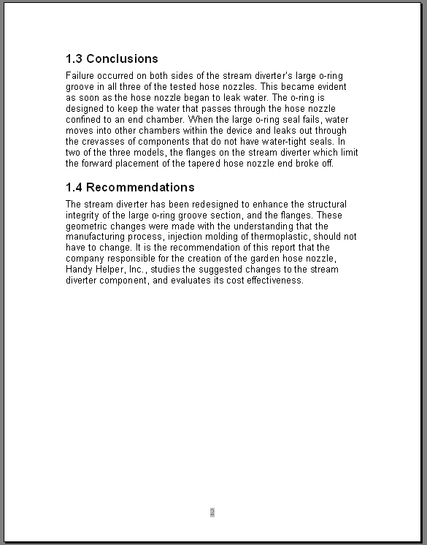
Text: Summary
States the problem, method of investigation, conclusions, and recommendations
Contains no new info that is not contained in the report
Does not contain references
1
Notes:
The summary clearly states the key points of the report, including the problem under investigation, the principal results, conclusions, and recommends a course of action for decision makers. The summary differs from an abstract in purpose, audience, and length. Because the summary restates key points, material not included in the text does not appear in the summary. Introductory material (purpose, scope, limitations), descriptive material (nature and method of investigation), and the most important results and conclusions are summarized with emphasis on the findings of the research and recommendations. The length of the summary typically does not exceed 2% of the body of the report.
Although a summary depends on the text in that it introduces no new information, it is independent of the text from the reader’s point of view; therefore, all symbols, abbreviations, and acronyms are defined and unusual terms are explained. A summary does not contain references.
If a report exceeds 50 pages, a separate executive summary is often prepared for a management-level audience. An executive summary is a nontechnical presentation that provides an adequate level of detail for decision makers who need a basic understanding of a research problem and the major findings but who do not plan to read the report in its entirety.

Slide 23
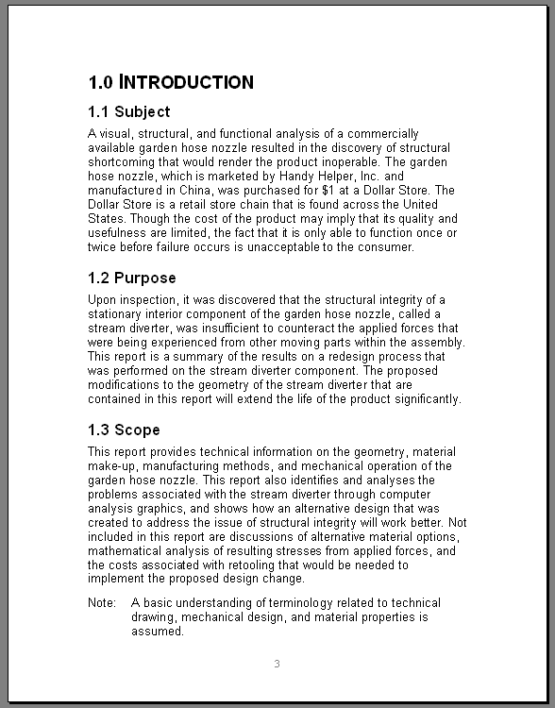
Text: Introduction
The Introduction prepares the reader to read the main body of the report.
This page focuses on the subject, purpose, and scope of the report.
3

Slide 24
Text: Introduction
Subject - defines the topic and associated terminology; may include theory, historical background, and its significance
Purpose - indicates the reason for the investigation
Scope - indicates the extent and limits of the investigation

Slide 25
Text: Methods, Assumptions, and Procedures
The methods, assumptions, and procedures used in the investigation are described so the reader could duplicate the procedures of the investigation.
Information in this section includes:
System of measurement
Types of equipment used and accuracy
Test methods used

Slide 26
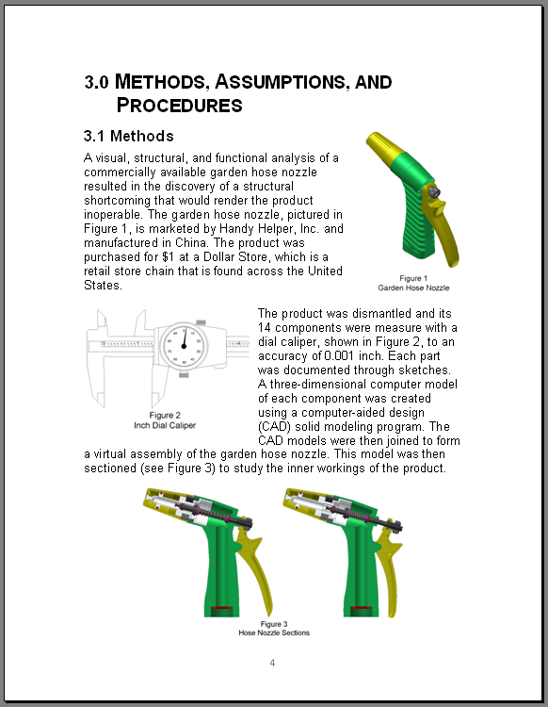
Text: Methods, Assumptions, and Procedures
Methods
How did you discover the problem? What measuring tools were used? What measurement system was used?
Assumptions
What do you think, but cannot substantiate as fact?
Procedures
How did you gain a better understanding of the problem?
4

Slide 27
Text: Results and Discussion
The results and discussion section describes what you learned about the problem as a result of your research, identifies the degree of accuracy related to your findings, and gives the reader your view of the significance of your findings.
Notes:
Results and Discussion
Explanation of the results as to their accuracy and significance
Data essential to understanding the results may appear in numbered tables or figures as near the discussion as possible
Other non-essential data should appear in an appendix in the back material
Discussion section indicates the degree of accuracy and the significance of the results of the research described in the report.

Slide 28
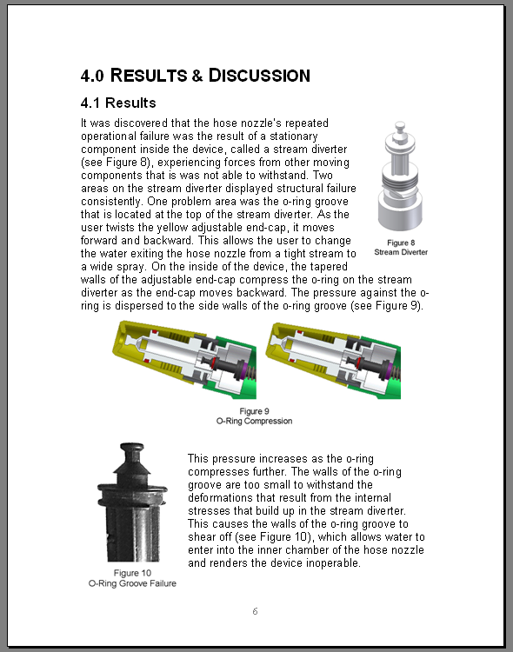
Text: Results and Discussion
Results
What did you learn about the problem through your research?
Discussion
How accurate are your findings? What is the significance of the results of the research?
6

Slide 29
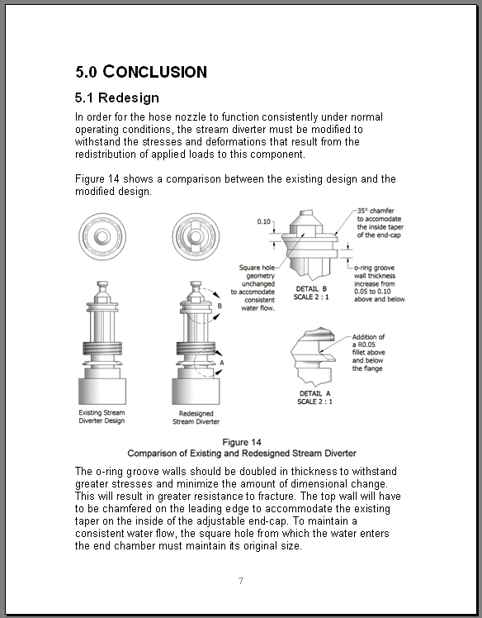
Text: Conclusion
Restatement of Results
What are the factual findings that resulted from your research? What are you implying as a result of these findings?
Concluding Remarks
What are your opinions based on the findings and results?
9
Notes:
Conclusions
No new information is presented
Conclusions - deductions made from the findings and results
Restatement of Results – statement of factual findings specific to the investigation are given
Concluding Remarks - opinions are included in addition to findings and conclusions.

Slide 30
Text: Recommendations*
A section called recommendations is often included in reports that are the result of tests and experiments, field trials, specific design problems, and feasibility studies.
The author may recommend additional areas of study and suggest a course of action, such as pursuing an alternate design approach.
*May be an optional element

Slide 31
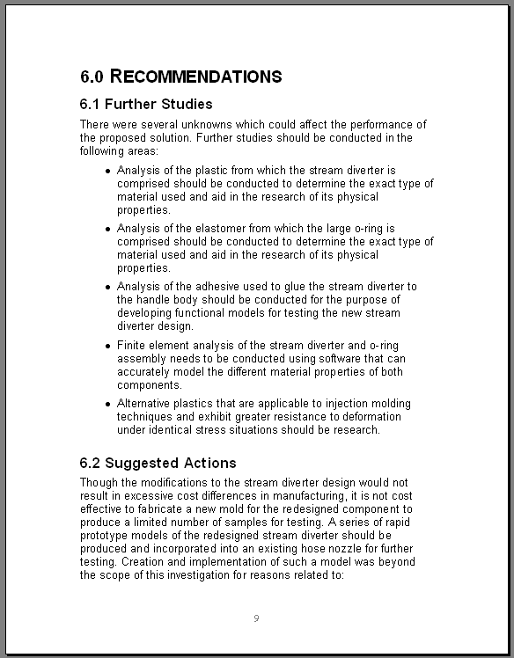
Text: Recommendations*
Additional Studies
Is there information that still needs to be learned?
Suggested Actions
What does the author want the reader to do with the information?
12
*May be an optional element

Slide 32
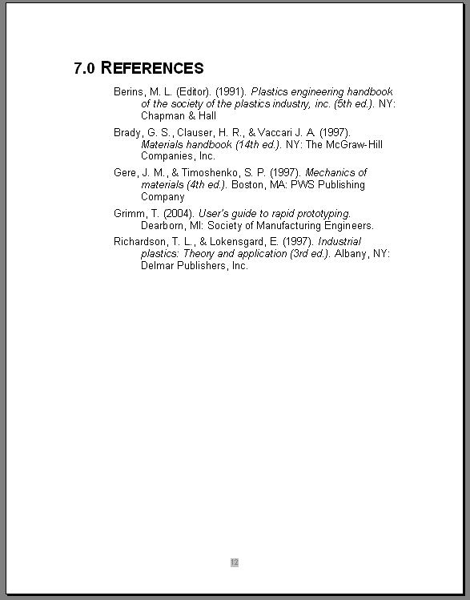
Text: References
The references section is the place where the author cites all of the secondary research sources* that were used to…
develop an understanding of the problem
support the information contained in the report
14
Notes:
*Refer to the Introduction to Research presentation in Lesson 1.1
References
May also be called “Sources” or “Works Cited.” The “APA” style will be used for technical reports. Refer to the Publication Manual of the American Psychological Association.

Slide 33
Back Matter
The back matter supplements and clarifies the body of the report, makes the body easier to understand, and shows where additional information can be found.

Slide 34
Back Matter
Appendixes*
Bibliography*
List of Symbols, Abbreviations, and Acronyms
Glossary*
Index*
Distribution List*
*May be an optional element
Notes:
Optional Elements:
Appendixes
Bibliography
A bibliography lists additional sources of information that are not referenced in the report.
Glossary
A glossary is a place where terms are defined. If more then five unfamiliar terms appear in the report, they should appear with their definitions in a glossary. If five or fewer exist, then they are defined the first time they are used in the report.
Index
Lists all major topics in alphabetical order
Provides references to the pages within the report where the topic appears.
Optional for reports under 50 pages
Distribution List
If included, the distribution list follows the index (or glossary, if no index appears in the back matter). The list indicates the complete mailing address of the individuals and organizations receiving copies of the report and the number of copies received. The Privacy Act of 1974 forbids federal agencies from listing the names and home addresses of individuals, so a distribution list contains business addresses only. Distribution lists provide a permanent record of initial distribution.

Slide 35
Back Matter: Appendixes*
Anything that cannot be left out of a report, but is too large for the main part of the report and would serve to distract or interrupt the flow belongs in the appendixes. Examples include:
Large tables of data
Flowcharts
Mathematical analysis
Large illustrations
Detailed explanations and descriptions of test techniques and apparatus
Technical drawings
*May be an optional element
Notes:
Appendixes
Information essential to the understanding and defending of the text appears in the text. Information necessary for the defending the text that would make the text harder to read should be found in an appendix.
Each new type of data or procedure/technique should be found in it’s own appendix.

Slide 36
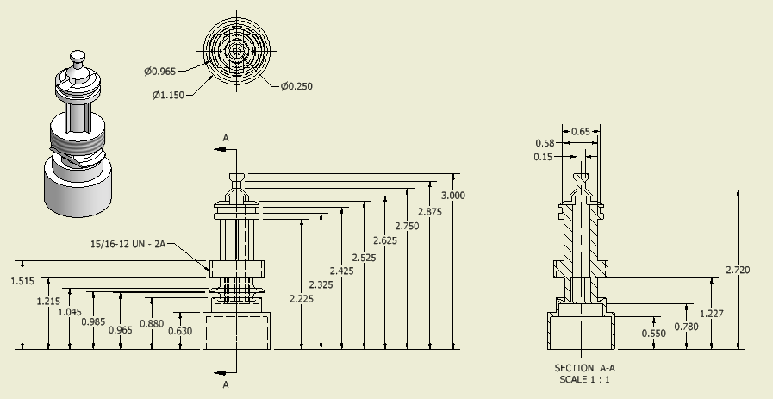
Back Matter: Appendixes*
Appendix A
Hose Nozzle Part Drawings
*May be an optional element
Notes:
Technical Drawings would be placed in the Appendixes.
Each appendix is referred to in the text. If the report contains more than one appendix, each is identified with a capital letter (i.e., Appendix A, Appendix B, etc.) in the order in which it is mentioned in the report. A single appendix is labeled “Appendix.”
In appendixes, figures and tables are oriented vertically (portrait format).
Note: The graphic in this slide is missing some dimensions and is not intended to be a complete technical drawing. It is given as an example only.

Slide 37
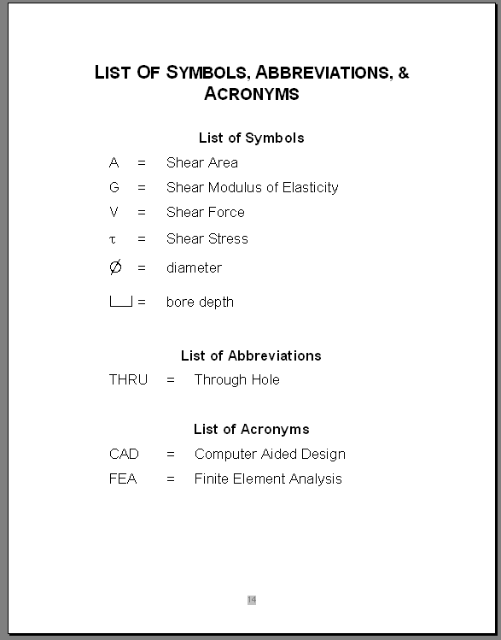
Back Matter: List of Symbols, Abbreviations, and Acronyms*
If more than five symbols, abbreviations, or acronyms are used in the report, they are to be listed with their explanation.
*May be an optional element
Notes:
If five or fewer symbols, abbreviations, or acronyms exist, then they are to be defined the first time they are used in the report and lists are not required.
When they occur in lists, symbols, abbreviations, and acronyms are presented in descending order, as follows:
Roman (English) alphabet capital letters
Roman (English) alphabet lowercase letters
Greek alphabet capital letters
Greek alphabet lowercase letters
Subscripts
Superscripts
Special notes

Slide 38
Tips for Writing
Create an outline of your report before you write it.
Write the body of the report first. Then write the front and back matter.
Have someone proofread your report.

Slide 39
References
National Information Standards Organization. Scientific and Technical Reports - Elements, Organization, and Design. ANSI/NISO 239.18-1995 (R1987).
Alley, M. (1996). The craft of scientific writing. (3rd ed.). New York: Springer-Verlag
Day, R. A. (1998). How to write & publish a scientific paper. (5th ed.). CT: The Oryx Press.
Beer, D., McMurrey, D. (2005). A guide to writing as an engineer (2nd ed.). Hoboken, NJ: John Wiley & Sons, Inc.
Lannon, J. M. (1994). Technical writing. NY: Harper Collins College Publishers
Newman, J. M. (2006). Resources for technical and business writing: Glossary. Retrieved August 3, 2006 from http://www.lupinworks.com/roche/pages/glossary.php

