Slide 1
Building Graphical User Interfaces
6.0
Notes:
Replace this with your course title and your name/contact details.

Slide 2
Overview
Constructing GUIs
Interface components
GUI layout
Event handling

Slide 3
GUI Principles
Components: GUI building blocks.
Buttons, menus, sliders, etc.
Layout: arranging components to form a usable GUI.
Using layout managers.
Events: reacting to user input.
Button presses, menu selections, etc.

Slide 4
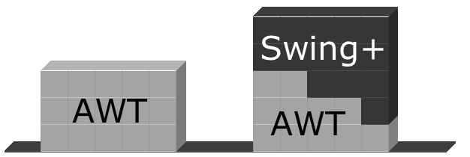
AWT and Swing

Slide 5
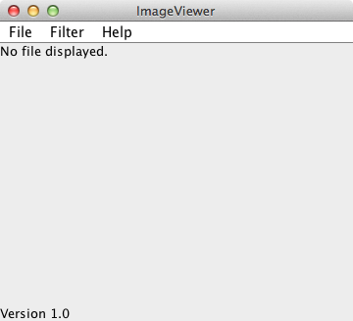
Elements of a frame
Window controls
Title
Menu bar
Content pane

Slide 6
Creating a frame
import java.awt.*;
import java.awt.event.*;
import javax.swing.*;
public class ImageViewer
{
private JFrame frame;
/**
* Create an ImageViewer show it on screen.
*/
public ImageViewer()
{
makeFrame();
}
// rest of class omitted.
}

Slide 7
The content pane
/**
* Create the Swing frame and its content.
*/
private void makeFrame()
{
frame = new JFrame("ImageViewer");
Container contentPane = frame.getContentPane();
JLabel label = new JLabel("I am a label.");
contentPane.add(label);
frame.pack();
frame.setVisible(true);
}

Slide 8
Adding menus
JMenuBar
Displayed below the title.
Contains the menus.
JMenu
e.g. File. Contains the menu items.
JMenuItem
e.g. Open. Individual items.

Slide 9
private void makeMenuBar(JFrame frame)
{
JMenuBar menubar = new JMenuBar();
frame.setJMenuBar(menubar);
// create the File menu
JMenu fileMenu = new JMenu("File");
menubar.add(fileMenu);
JMenuItem openItem = new JMenuItem("Open");
fileMenu.add(openItem);
JMenuItem quitItem = new JMenuItem("Quit");
fileMenu.add(quitItem);
}

Slide 10
Event handling
Events correspond to user interactions with components.
Components are associated with different event types.
Frames are associated with WindowEvent.
Menus are associated with ActionEvent.
Objects can be notified when an event occurs.
Such objects are called listeners.

Slide 11
Centralized event receipt
A single object handles all events.
Implements the ActionListener interface.
Defines an actionPerformed method.
It registers as a listener with each component.
item.addActionListener(this)
It has to work out which component has dispatched the event.

Slide 12
ActionListener
public interface ActionListener
{
/**
* Invoked when an action occurs.
* @param ev Details of the event.
*/
public void actionPerformed(ActionEvent ev);
}

Slide 13
public class ImageViewer implements ActionListener
{
…
public void actionPerformed(ActionEvent e)
{
String command = e.getActionCommand();
if(command.equals("Open")) {
…
}
else if (command.equals("Quit")) {
…
}
…
}
…
private void makeMenuBar(Jframe frame)
{
…
openItem.addActionListener(this);
…
}
}

Slide 14
Centralized event handling
The approach works.
It is used, so you should be aware of it.
However …
It does not scale well.
Identifying components by their text is fragile.
An alternative approach is preferred.

Slide 15
Lambdas as event handlers
Review earlier material if necessary:
Chapter 5 introduces lambdas.
Chapter 12 introduces functional interfaces.
Many event handler interfaces consist of a single abstract method.
They are functional interfaces.
Suited to implementation as lambdas.

Slide 16
Lambda for ActionListener
JMenuItem openItem = new JMenuItem("Open");
...
openItem.addActionListener(
(ActionEvent ev) -> { openFile(); }
);
General form
item.addActionListener(ev -> { actions });

Slide 17
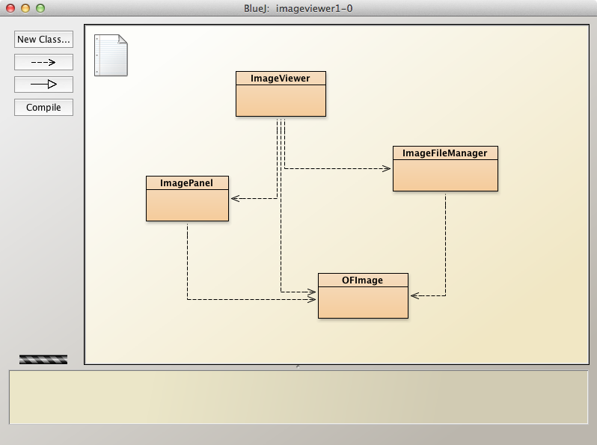
The imageviewer project

Slide 18
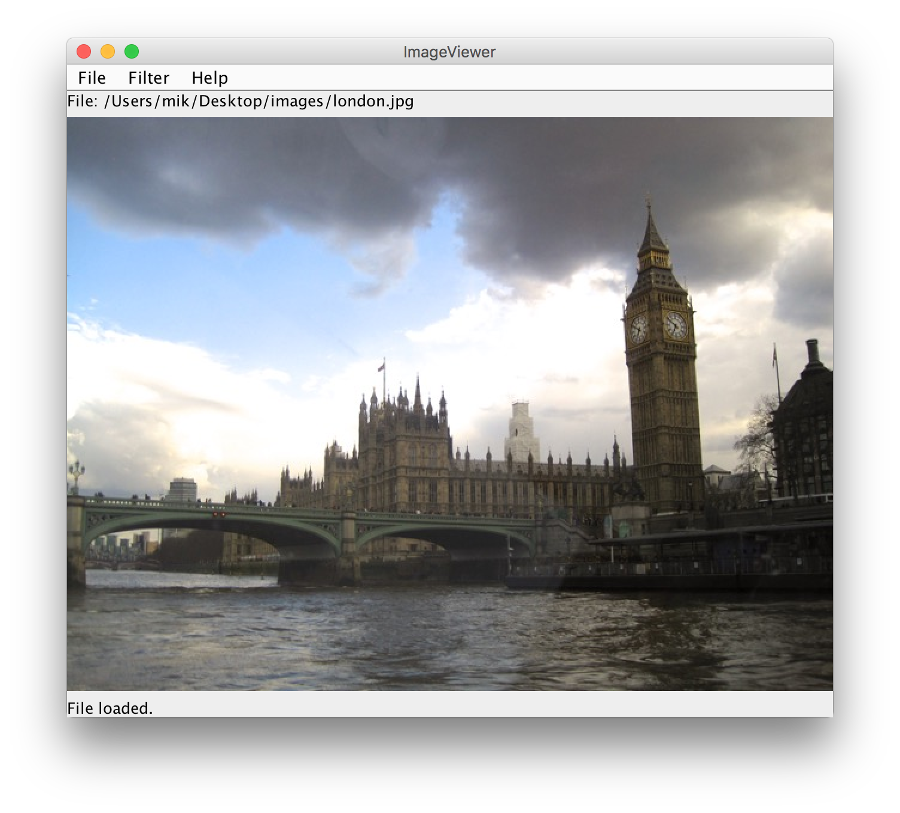
Image processing

Slide 19
Class responsibilities
ImageViewer
Sets up the GUI structure.
ImageFileManager
Static methods for image file loading and saving.
ImagePanel
Displays the image within the GUI.
OFImage
Models a 2D image.

Slide 20
OFImage
Our subclass of BufferedImage.
Represents a 2D array of pixels.
Important methods:
getPixel, setPixel
getWidth, getHeight
Each pixel has a color.
We use java.awt.Color.

Slide 21
Adding an ImagePanel
public class ImageViewer
{
private JFrame frame;
private ImagePanel imagePanel;
…
private void makeFrame()
{
Container contentPane = frame.getContentPane();
imagePanel = new ImagePanel();
contentPane.add(imagePanel);
}
…
}

Slide 22
Loading an image
public class ImageViewer
{
private JFrame frame;
private ImagePanel imagePanel;
…
private void openFile()
{
File selectedFile = …;
OFImage image =
ImageFileManager.loadImage(selectedFile);
imagePanel.setImage(image);
frame.pack();
}
…
}

Slide 23
Layout managers
Manage limited space for competing components.
FlowLayout, BorderLayout, GridLayout, BoxLayout, GridBagLayout.
Manage Container objects, e.g. a content pane.
Each imposes its own style.

Slide 24
FlowLayout

Slide 25
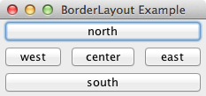
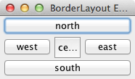
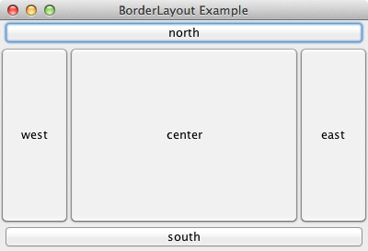
BorderLayout

Slide 26
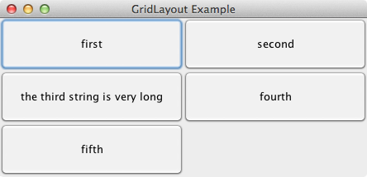
GridLayout

Slide 27
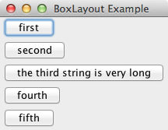
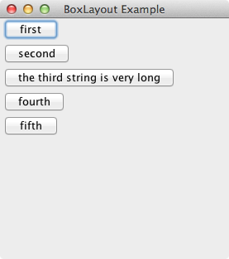
BoxLayout
Note: no component
resizing.

Slide 28
Nested containers
Sophisticated layouts can be obtained by nesting containers.
Use JPanel as a basic container.
Each container will have its own layout manager.
Often preferable to using a GridBagLayout.

Slide 29
Struts and Glue
Invisible components used as spacing.
Available from the Box class.
Strut: fixed size.
Component createHorizontalStrut(int width)
Component createVerticalStrut(int height)
Glue: fills available space.
Component createHorizontalGlue()
Component createVerticalGlue()

Slide 30
Dialogs
Modal dialogs block all other interaction.
Forces a response from the user.
Non-modal dialogs allow other interaction.
This is sometimes desirable.
May be difficult to avoid inconsistencies.

Slide 31
JOptionPane standard dialogs
Message dialog
Message text plus an OK button.
Confirm dialog
Yes, No, Cancel options.
Input dialog
Message text and an input field.
Variations are possible.

Slide 32
A message dialog
private void showAbout()
{
JOptionPane.showMessageDialog(frame,
"ImageViewer\n" + VERSION,
"About ImageViewer",
JOptionPane.INFORMATION_MESSAGE);
}

Slide 33
Image filters
Functions applied to the whole image.
int height = getHeight();
int width = getWidth();
for(int y = 0; y < height; y++) {
for(int x = 0; x < width; x++) {
Color pixel = getPixel(x, y);
alter the pixel's color value;
setPixel(x, y, pixel);
}
}

Slide 34
Adding further filters
private void makeLighter()
{
if(currentImage != null) {
currentImage.lighter();
frame.repaint();
showStatus("Applied: lighter");
}
else {
showStatus("No image loaded.");
}
}
Code duplication?
Refactor!
private void threshold()
{
if(currentImage != null) {
currentImage.threshold();
frame.repaint();
showStatus("Applied: threshold");
}
else {
showStatus("No image loaded.");
}
}

Slide 35
Adding further filters
Define a Filter superclass (abstract).
Create function-specific subclasses.
Create a collection of subclass instances in ImageViewer.
Define a generic applyFilter method.
See imageviewer2-0.

Slide 36
imageviewer2-0

Slide 37
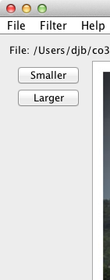
Buttons and nested layouts
A GridLayout inside
a FlowLayout inside
a BorderLayout.

Slide 38
Borders
Used to add decoration around components.
Defined in javax.swing.border
BevelBorder, CompoundBorder, EmptyBorder, EtchedBorder, TitledBorder.

Slide 39
Adding spacing
JPanel contentPane = (JPanel)frame.getContentPane();
contentPane.setBorder(new EmptyBorder(6, 6, 6, 6));
// Specify the layout manager with nice spacing
contentPane.setLayout(new BorderLayout(6, 6));
imagePanel = new ImagePanel();
imagePanel.setBorder(new EtchedBorder());
contentPane.add(imagePanel, BorderLayout.CENTER);

Slide 40
Other components
Slider
Spinner
Tabbed pane
Scroll pane

Slide 41
Nested class syntax
Class definitions may be nested.
public class Enclosing { … private class Inner { … } }

Slide 42
Inner classes
Instances of the inner class are localized within the enclosing class.
Instances of the inner class have access to the private members of the enclosing class.

Slide 43
Anonymous inner classes
Obey the rules of inner classes.
Used to create one-off objects for which a class name is not required.
Use a special syntax.
The instance is always referenced via its supertype, as it has no subtype name.

Slide 44
Anonymous action listener
JMenuItem openItem = new JMenuItem("Open");
openItem.addActionListener(new ActionListener() {
public void actionPerformed(ActionEvent e) {
openFile();
}
});
Compare with the lambda version

Slide 45
Anonymous class elements
Anonymous object creation
openItem.addActionListener(
new ActionListener()
{
public void actionPerformed(ActionEvent e)
{
openFile();
}
}
);
Class definition
Actual parameter

Slide 46
Exit on window close
frame.addWindowListener(new WindowAdapter() { public void windowClosing(WindowEvent e) { System.exit(0); } });
WindowAdapter provides a no-op implementation of the WindowListener interface.

Slide 47
Review
Aim for cohesive application structures.
Endeavor to keep GUI elements separate from application functionality.
Pre-defined components simplify creation of sophisticated GUIs.
Layout managers handle component juxtaposition.
Nest containers for further control.

Slide 48
Review
Many components recognize user interactions with them.
Reactive components deliver events to listeners.
Lambdas are commonly used to implement listeners.
Anonymous inner classes are used where lambdas are not possible.

