Slide 1
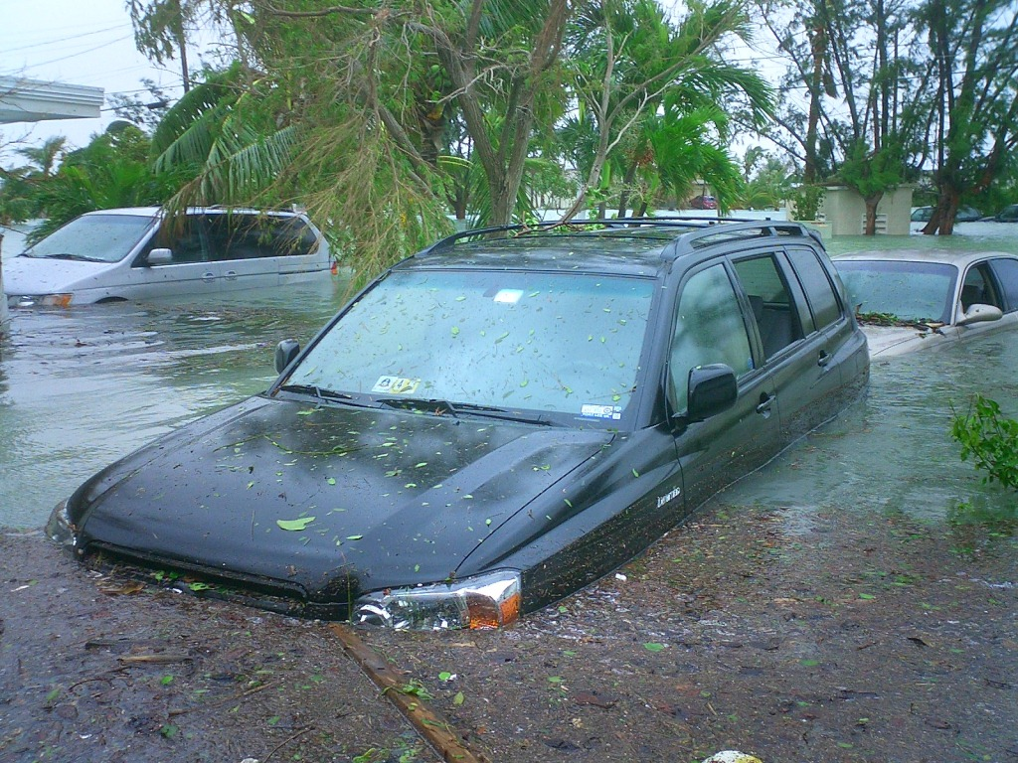
Stormwater
Introduction
Bioinfiltration
Stephen Duda
Porous Concrete
Douglas Cleary
upload.wikimedia.org

Slide 2
Introduction
Hydrologic Cycle
Watersheds
Implications with Development
Stormwater Management
History
Importance

Slide 3
Hydrologic Cycle
http://ga.water.usgs.gov/edu/watercycle.html

Slide 4
Watersheds
Groundwater Storage
Precipitation
Runoff
Evapotranspiration
Groundwater Withdrawals
http://science.howstuffworks.com/environmental/conservation/issues/watershed1.htm

Slide 5
Storm Water
Pre development
Trapped in puddles, or
Overland flow impeded by vegetation, and
Infiltration into ground
Plenty of evapotranspiration
Stream Result:
Post development
Impervious surfaces reduce all of these
Stream Result:

Slide 6
Land Use Changes
Image source: Maryland DEP

Slide 7
Stream Flow
Flow
Time

Slide 8
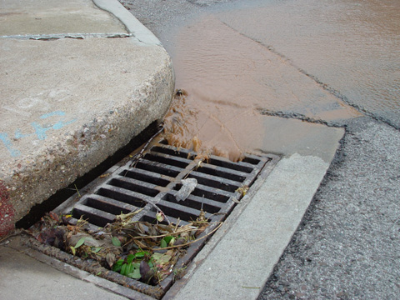
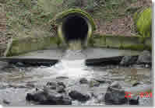
Early Stormwater Management
Collect
Convey
Dump
http://www.acogok.org/Programs_and_services/Water_Resources/Storm_Water.asp
http://www.cityofpa.us/stormwater.htm

Slide 9
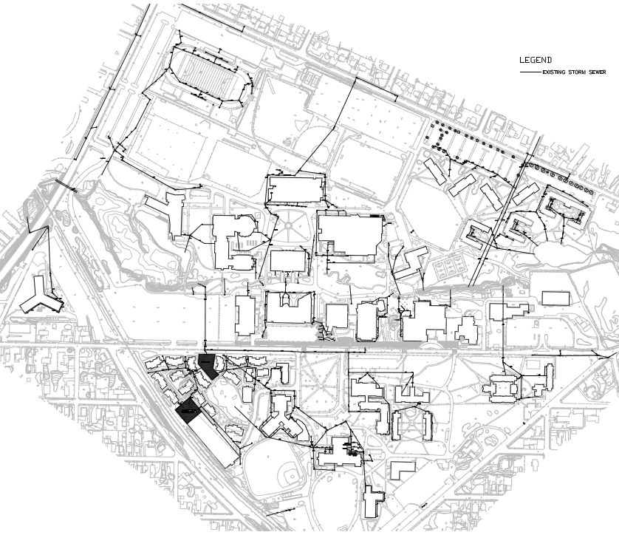

Slide 10
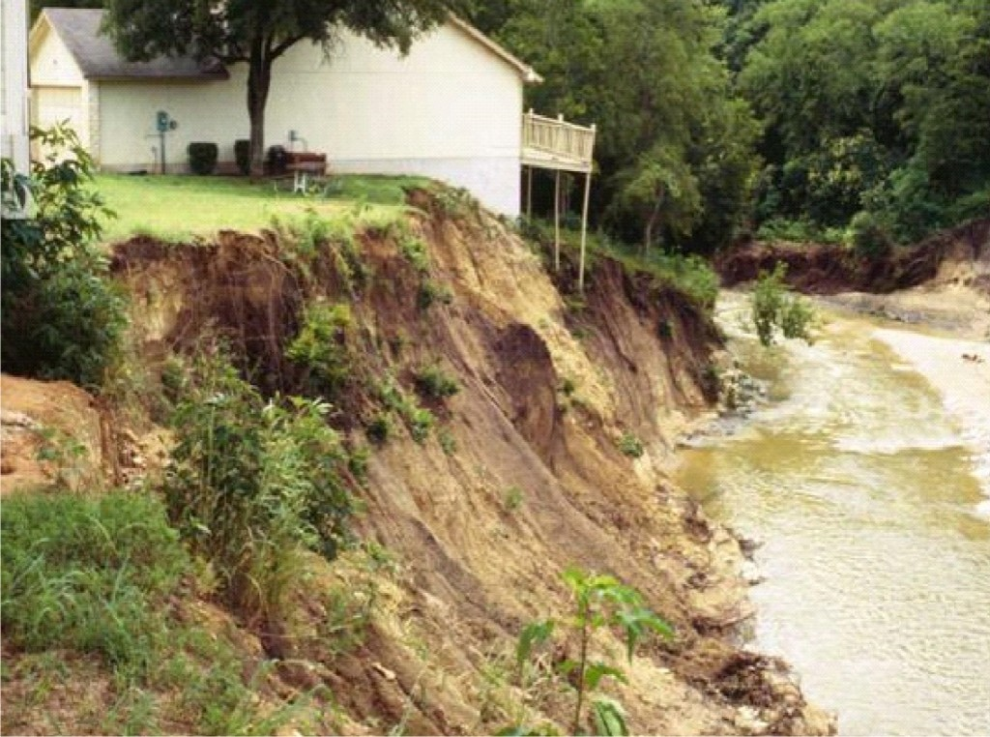
Stormwater Quantity
enviroloknw.com

Slide 11
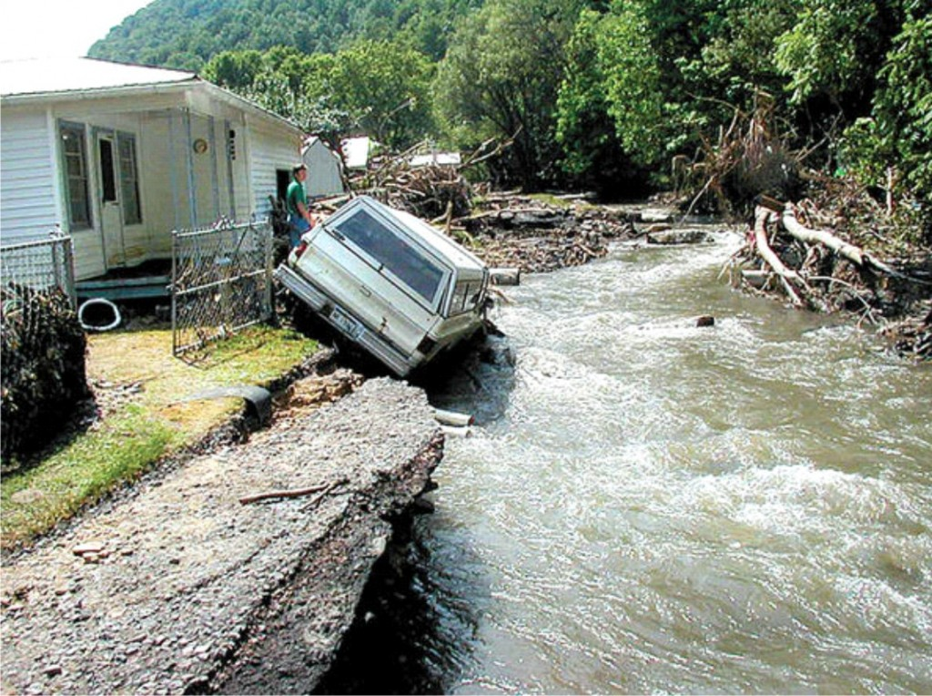
Stormwater Quantity
enviroloknw.com

Slide 12
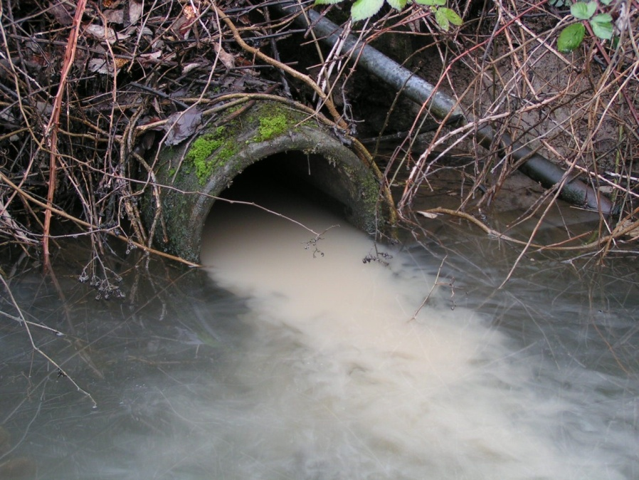
Stormwater Pollution
http://www.flickr.com/photos/columbiariverkeeper/6153168831/
http://www.niskayuna.org/Public_Documents/NiskayunaNY_DPW/Stormwater

Slide 13
Stormwater Pollutants
Pollutant | Typical Concentration
Total Suspended Solids | 80 mg/L
Total Phosphorus | 0.30 mg/L
Total Nitrogen | 2.0 mg/L
Total Organic Carbon | 12.7 mg/L
Cadmium | 0.002 mg/L
Copper | 0.010 mg/L
Lead | 0.018 mg/L
Zinc | 0.14 mg/L
Chlorides (winter only) | 0.230 mg/L
NJ Stormwater BMP

Slide 14
Stormwater Pollution
Stormwater pollution shown on left
Saint Lucie Inlet Florida
http://www.cityofpsl.com/npdes/

Slide 15
What can we do?

Slide 16
Stormwater Options
Outdated
Collect, convey, dump in stream
Traditional
Retention / Detention Pond
Dry Well
More Recent
Bioinfiltration Basin / Rain Garden
Porous Pavement

Slide 17
Retention Pond
Notes:
Retention Basin - a storage site similar to a detention basin but the water in storage is permanently obstructed from flowing downstream. -http://wordnetweb.princeton.edu/perl/webwn?s=retention basin
Most are detention basins, less effective in protecting streams when considered on a watershed basis.

Slide 18
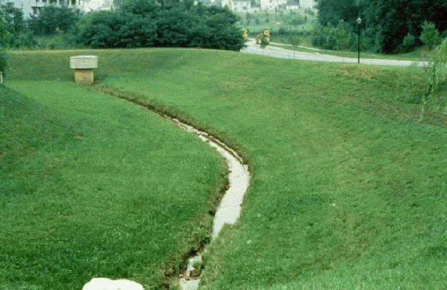
Detention Basin
iowacedarbasin.org

Slide 19
Retention/Detention Basins
Typical Pollutant Removal Rates
Detention Basin
TSS | 40 - 60%
Phosphorus | 20%
Nitrogen | 20%
Retention Basin
TSS | 50 – 90%
Phosphorus | 50%
Nitrogen | 30%

Slide 20
Dry Well

Slide 21
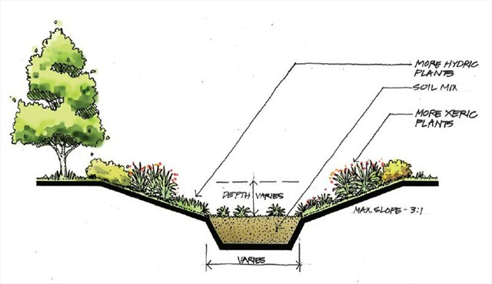
Bioinfiltration Basin
www.geocaching.com

Slide 22
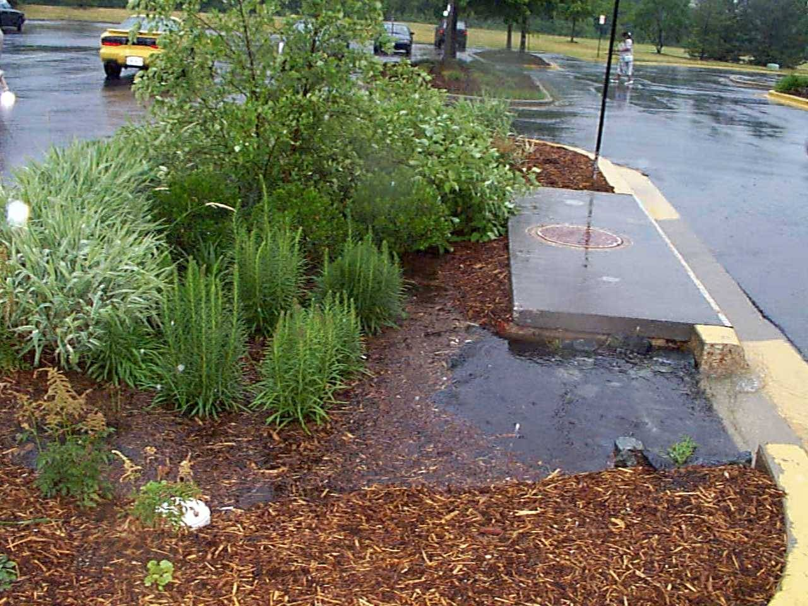
Parking Lot
dnr.wi.gov
Wisconsin DNR

Slide 23
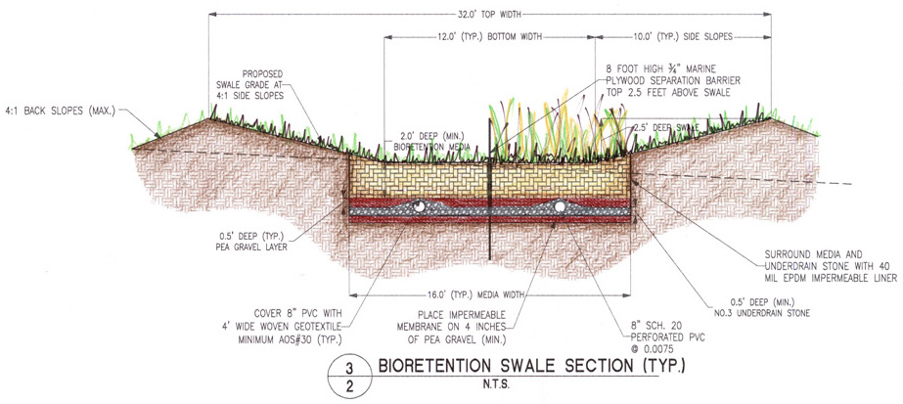
Bioretention Swale
www.esc.rutgers.edu
Notes:
A shallow troughlike depression that carries water mainly during rainstorms or snow melts. - www.thefreedictionary.com

Slide 24
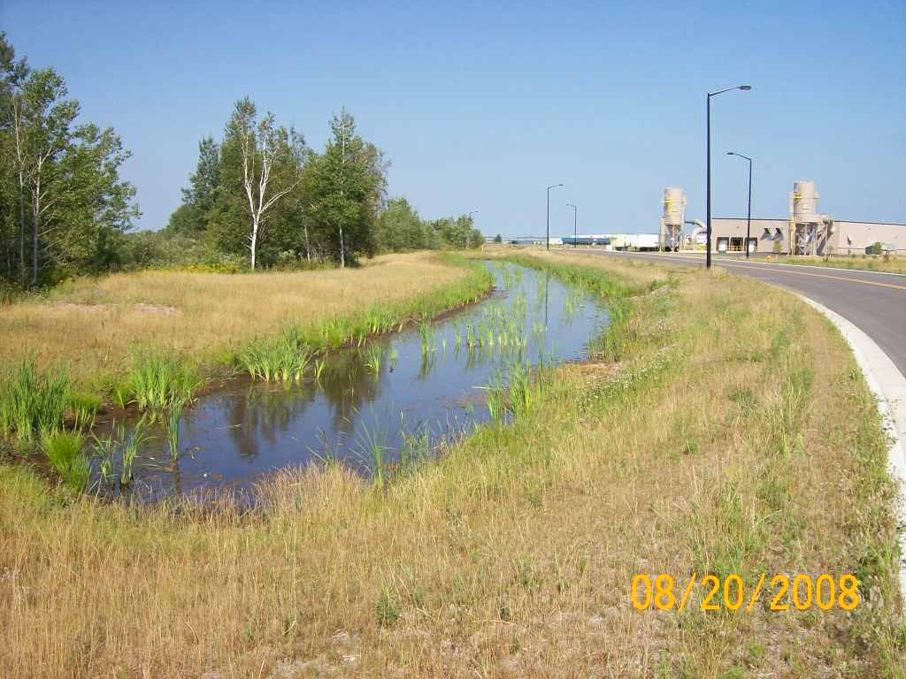
Road-Side
dnr.wi.gov
Wisconsin DNR

Slide 25
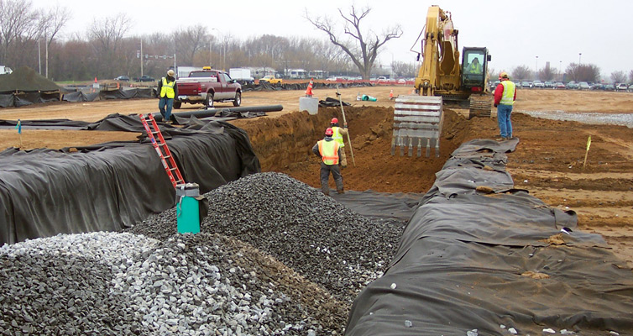
Under Construction
www.jjaconstruction.com

Slide 26
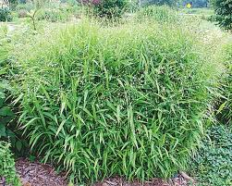
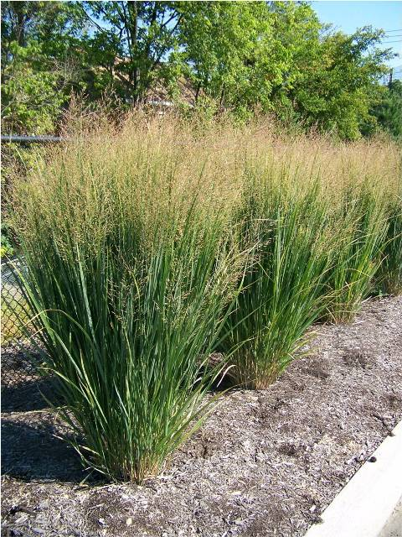
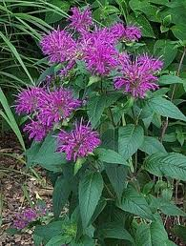
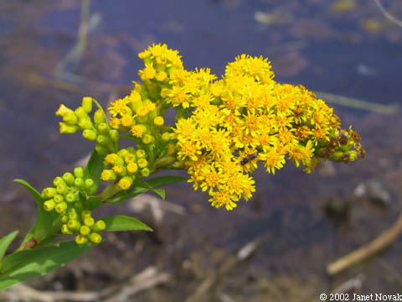
Plants
Raydons Favorite Aster
Shenandoah
Switchgrass
Northwind Switchgrass
Dark Ponticum
Bee Balm
Seaside
Goldenrod
Orange
Coneflower

Slide 27
Bio-Infiltration Basins
Typical Pollutant Removal Rates
TSS | 90%
Phosphorus | 60%
Nitrogen | 50%

Slide 28
Economics http://www.ipa.udel.edu/wra/docs/EconomicValueStormwaterDelawareDraftSummary.pdf
California: 1,000 trees reduce stormwater runoff by 1M gallons
Denver: 0.1 ac bioinf basin costs 17% less than traditional retention pond
Philadelphia: every $1 off green stormwater management saves $2
Seattle: green stormwater management costs $280,000 per block
versus $425,000 for traditional
Notes:
California: 1,000 trees reduce stormwater runoff by 1 million gallons & save $7,000
Denver: 0.1 ac bioretention basin cost $75,976, 17% less than traditional stormwater pond
Philadelphia: every $1 spent on green stormwater management saves $2
Museum of Science in Portland, Oregon: saved $78,000 in stormwater management by constructing green stormwater structures
Seattle: green stormwater management costs $280,000 per block
versus $425,000 for traditional stormwater management

Slide 29
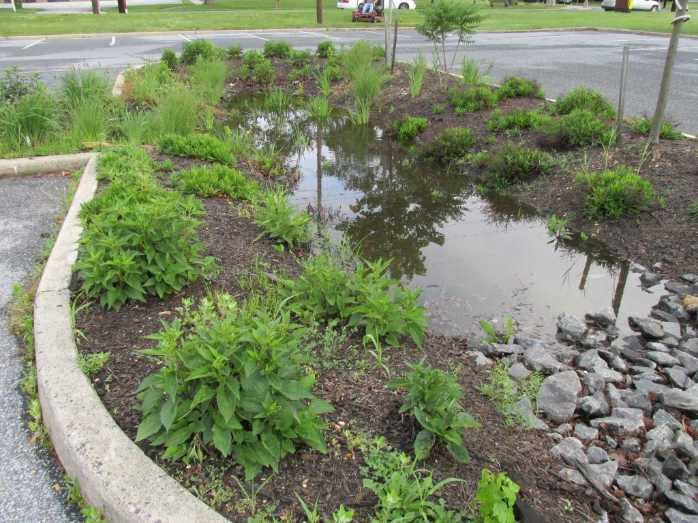
Rowan University

Slide 30
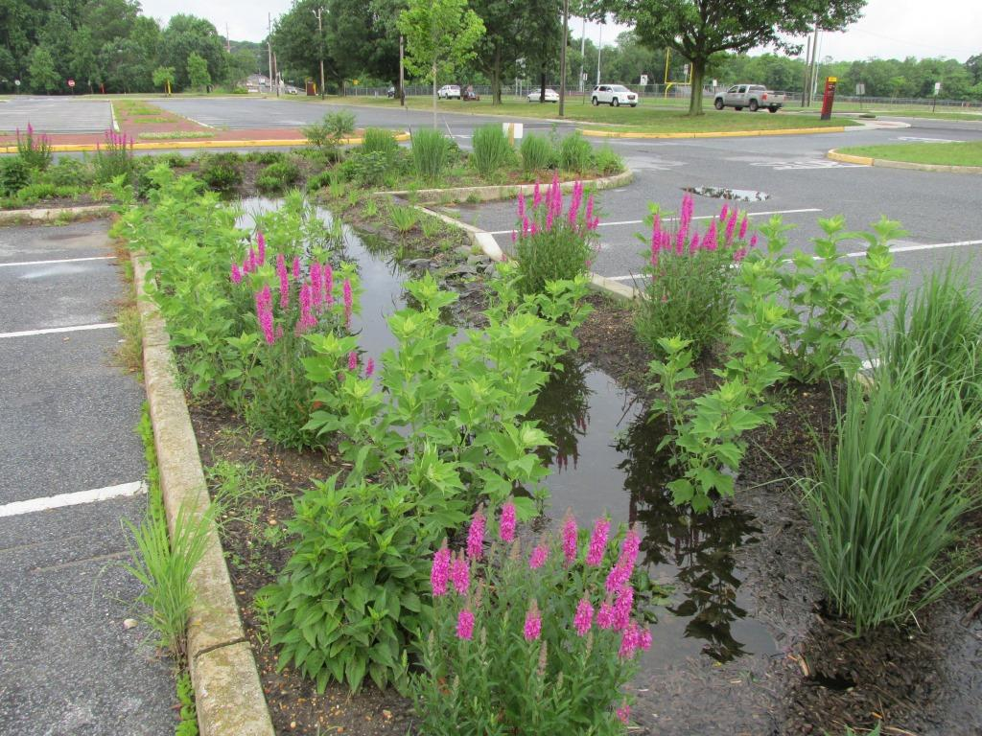
Rowan University

Slide 31
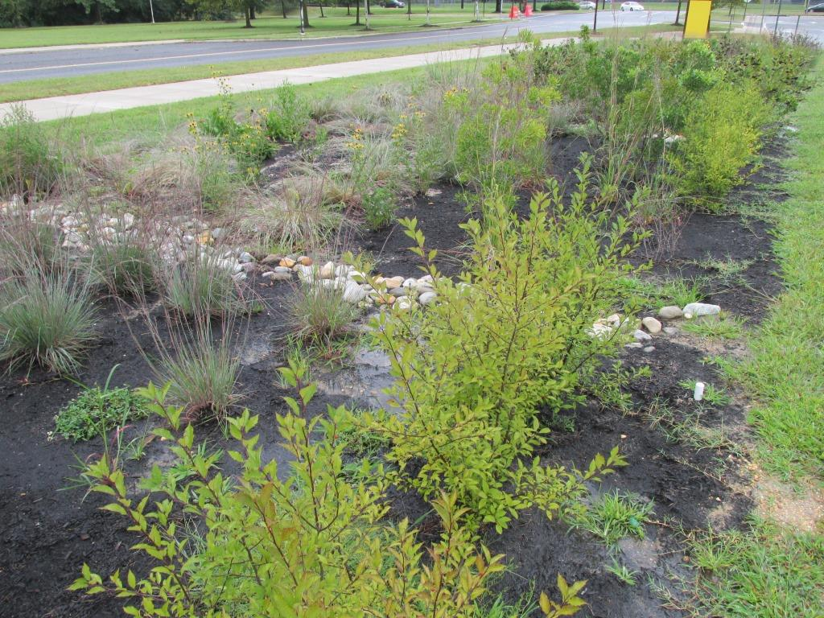
Rowan University

Slide 32
Effectiveness
November 8, 2012
 |  | First Flush | Lysimeter | Percent Reduction
TSS (mg/L) |  | 37.3 | 12.7 | 66%
Phosphorus (mg/L) |  | 0.98 | 0.41 | 58%
Nitrogen (mg/L) |  | 3.00 | 0.60 | 80%
Zinc (mg/L) |  | 0.06 | 0.05 | 17%

Slide 33
Bio-Infiltration Basin Design Basis
Output = Infiltration through basin bottom
Assume → constant rate, as soon as basin begins to fill
Input = Runoff from contributing area
Q = P =
I_{a} =
S =
{
0
for P ≤ I_{a}
for P > I_{a}
Q =
(P – I_{a})²
P - I_{a} + S
Notes:
Runoff begins before maximum retention
Write on side board

Slide 34
More Equations
I_{a} = 0.2 S
(Some say more like I_{a} = 0.05 S)
S = 1000/CN – 10
CN = Curve Number
Empirical parameter for predicting runoff or infiltration
Unitless, range: 0 to 100
Lower number → more permeability
[P – 0.2(1000/CN – 10)]²
P + 0.8(1000/CN – 10)
Q =
Notes:
Method was done for internal use of Soil conservation service. Original work / data a bit obscure.
I_{a} = 0.05 S results in different design equations for CN and Q

Slide 35
Curve Number Chart https://engineering.purdue.edu/mapserve/LTHIA7/documentation/scs.htm
Soil Type | Infiltration Rate
A | > 0.3 in/hr
B | 0.30-0.15 in/hr
C | 0.15-0.05 in/hr
D | 0-0.05 in/hr
Proper selection of CN is very important!
More CN tables
Beyond scope of this course
Notes:
The runoff curve number (also called a curve number or simply CN) is an empirical parameter used in hydrology for predicting direct runoff or infiltration from rainfall excess - Wikipedia

Slide 36
Equations
V_{r} = Q ⋅ A_{l}
V_{r} = Volume of Runoff; A_{l} = Area of Lot;
Ignores → ALL rain falling on basin enters basin
V_{i} = I ⋅ T ⋅ A_{b}
V_{i} = Volume of Infiltration During Storm; I = Infiltration rate; T = Storm Duration, A_{b} = Area of Basin
V_{b} = Volume of Basin = V_{r} – V_{i}
D_{b} = Depth of Basin = V_{b} / A_{b}

Slide 37
Bio-Infiltration Basin Example
Determine bio-infiltration basin depth
1. Undeveloped, wooded, 1 acre
2. Residential, Two ½ acre lots
Lot Area
Basin
Notes:
Don’t need a basin for undeveloped wooded, included just to see difference.

Slide 38
Given Information
Bio Basin Example
Lot Area, A_{l} = 1 acre
Basin Area, A_{b} = 0.10 acre
Max Basin Depth (must drain in 72 hr)
Infiltration Rate = I = 0.5 in/hr (assumed)
Max Basin Depth = 72 hrs * 0.5 in/hr = 36 inches
Example Design Storm → Hurricane Irene
Precipitation = P = 6 in; Time = T = 18 hr
Notes:
Regulations – must drain in 72 hours

Slide 39
Undeveloped, Wooded
Bio Basin Example
Curve Number = CN = 30
Pot. Max. Retention = S = (1000/CN) – 10
S =
Init. Abstraction
I_{a} =
Runoff = Q = (P – 0.2S)²/(P + 0.8S)
Q =
Very low, do not need a basin

Slide 40
Residential, Two ½ acre lots
Bio Basin Example
Curve Number = CN = 54
Pot. Max. Retention = S = (1000/CN) – 10
S =
Init. Abstraction
I_{a} =
Runoff = Q = (P – 0.2S)²/(P + 0.8S)
Q =

Slide 41
Residential Continued
Bio Basin Example
Volume of Runoff
V_{r} =
Volume of Infiltration
V_{i} =
Volume of Basin
V_{b} =
Depth of Basin
D_{b} =

Slide 42
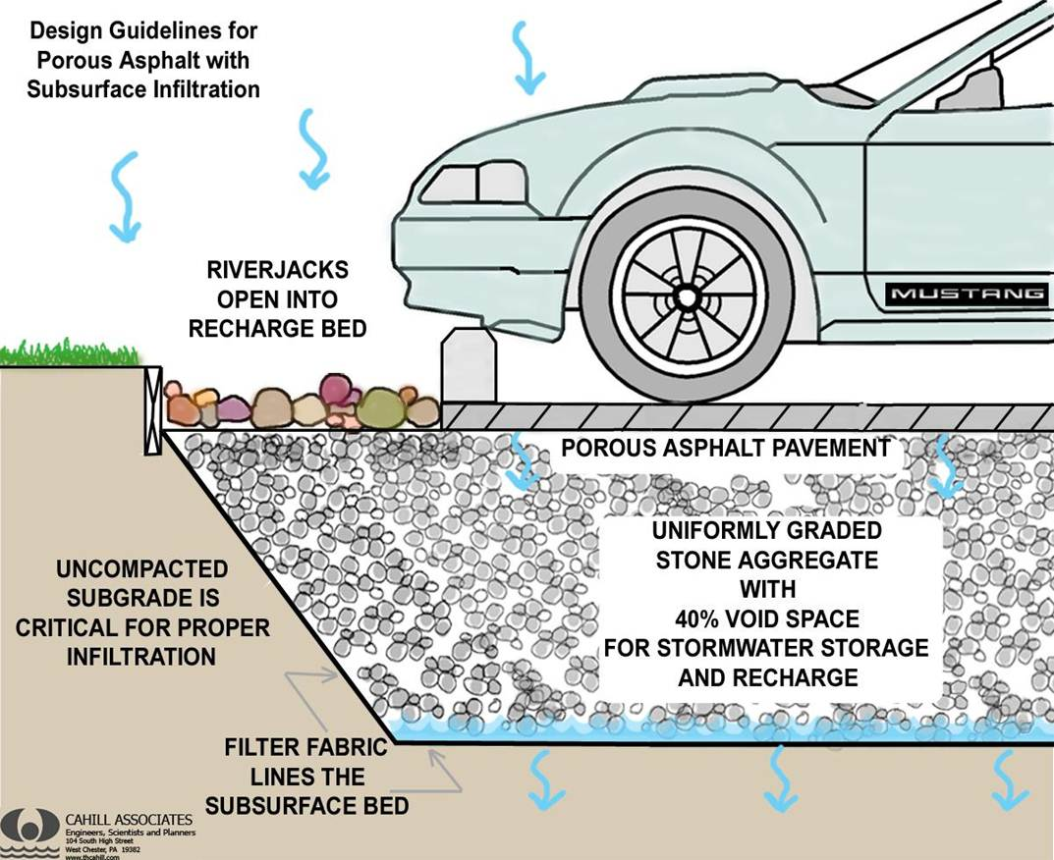
Porous Pavers
Porous Pavement
extension.umd.edu
Notes:
Porous Pavement (Mass Low Impact Development Toolkit)
Porous asphalt and pervious concrete appear to be the same as traditional asphalt or concrete pavement. However, they are mixed with a very low content of fine sand, so that they have 10%-25% void space and a runoff coefficient that is almost zero.
Paving stones (aka unit pavers) are impermeable blocks made of brick, stone, or concrete, set on a prepared sand base. The joints between the blocks are filled with sand or stone dust to allow water to percolate downward. Runoff coefficients range from 0.1 – 0.7, depending on rainfall intensity, joint width, and materials. Some concrete paving stones have an open cell design to increase permeability.
Grass pavers (aka turf blocks) are a type of open-cell unit paver in which the cells are filled with soil and planted with turf. The pavers, made of concrete or synthetic, distribute the weight of traffic and prevent compression of the underlying soil. Runoff coefficients are similar to grass, 0.15 to 0.6.

Slide 43
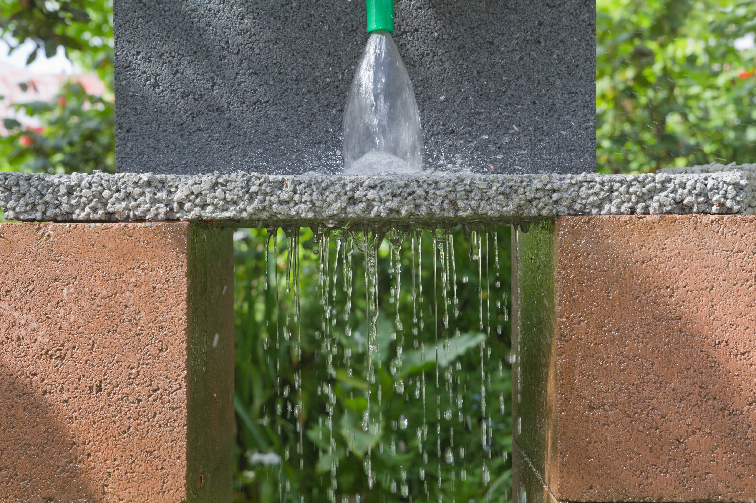
Porous Pavement
upload.wikimedia.org

Slide 44
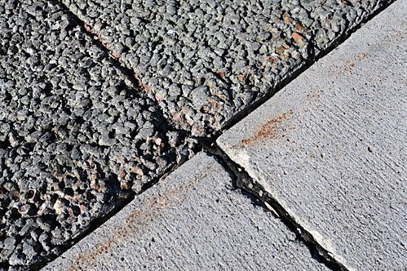
Concrete
Porous
Cement
Large Aggregate
Result:
Normal
Cement
Large Aggregate
Small Aggregate
Result: few voids
archive.inside.iastate.edu

Slide 45
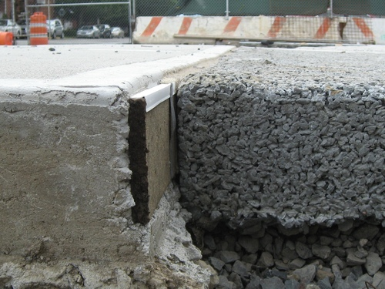
images.huffingtonpost.com

Slide 46
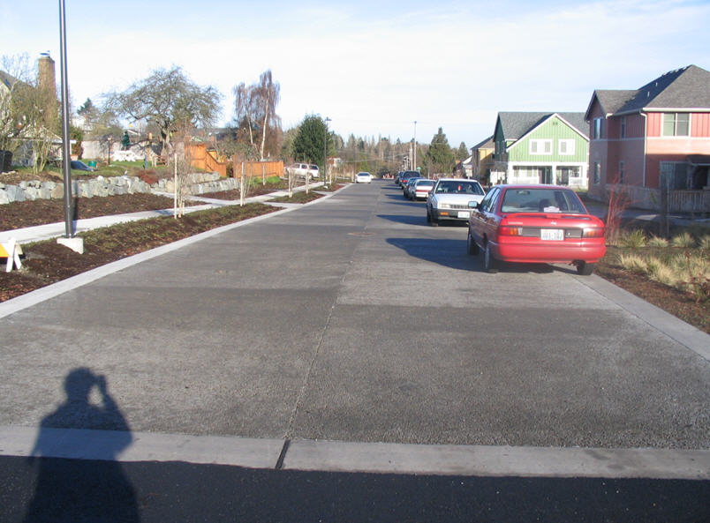
www.lowimpactdevelopment.org
Notes:
Permeable Pavement: Permeable pavement comes in four forms: permeable concrete, permeable asphalt, permeable interlocking concrete pavers, and grid pavers. Permeable concrete and asphalt are similar to their impervious counterparts but are open graded or have reduced fines and typically have a special binder added. Methods for pouring, setting, and curing these permeable pavements also differ from the impervious versions. The concrete and grid pavers are modular systems. Concrete pavers are installed with gaps between them that allow water to pass through to the base. Grid pavers are typically a durable plastic matrix that can be filled with gravel or vegetation. All of the permeable pavement systems have an aggregate base in common which provides structural support, runoff storage, and pollutant removal through filtering and adsorption.

Slide 47
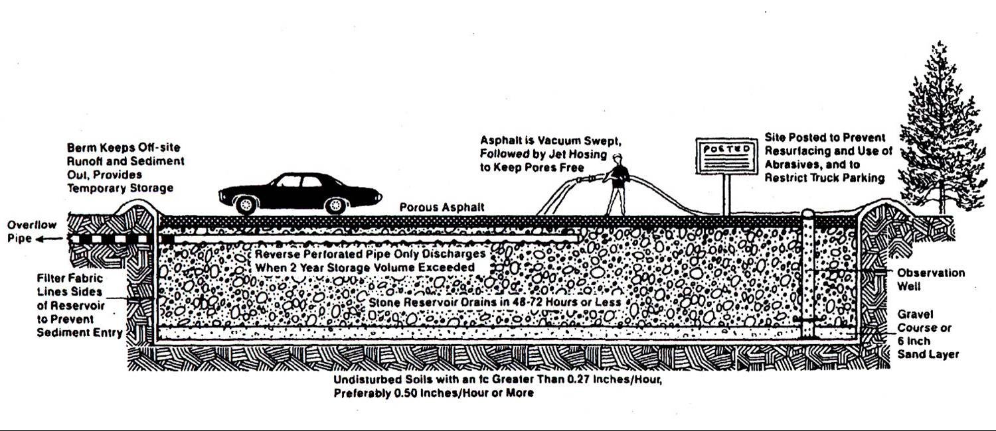
Porous Pavement Storage & Infiltration
www.capecodgroundwater.org

Slide 48
Typical Profile
Porous Concrete
Storage (Typical void space = 15 %)
Subbase – Compacted Stone Aggregate
Storage
High void space, up to 40 %
Subgrade – Compacted Soil
Infiltration
Looking for infiltration rate ~ 0.5 in/hr

Slide 49
Porous Pavement Benefits

Slide 50
Passive versus Active
Passive
Only handles rain that falls on the porous pavement
Active
Can handle runoff from surrounding areas

Slide 51
Rainfall Duration
Design can be based on:
Precipitation during 24 hour period
Precipitation during 2 hour period
Design storm depends on how often one can accept system overflow
Every two years? Five? Ten?

Slide 52
Glassboro
Recurrence Interval, Yr | 2 Hour Precipitation, in | 24 Hours Precipitation, in
2 | 1.75 | 4.26
10 | 2.55 | 5.08
50 | 3.41 | 7.39
And storms are getting bigger as a result of climate change

Slide 53
Design Basis
Permeability of Porous Concrete
Typically NOT an issue: 288 in/hr!
Storage Capacity
Porous Pavement – Typical is 15 % porosity
Subbase – as high as 40 % porosity (#67, 1” Top Size)
Infiltration into Subgrade
Typical rule of thumb is the subgrade should infiltrate ~0.5 in/hr
System should drain within 5 days
I’ve seen specifications of 2 – 3 days as well
Notes:
We assume the bottom of subbase is level!

Slide 54
Active Porous Concrete Example
Given
Contributing area is as big as porous pavement area
Surrounding contributing area is impervious
What if it was not?
Porous concrete is 4 in thick with 15 % porosity
D_{c} = 4 in; P_{c} = 0.15
Subbase has 25 % void space
P_{sb} = 0.25
Subgrade infiltration rate is 0.5 in/hr
I = 0.5 in/hr
Design for 2 yr storm
T₂ = 2 hr; P₂ = 1.75 in
T₂₄ = 24 hr; P₂₄ = 4.26 in
Calculate depth of subbase
Contributing Area
Porous Concrete Area

Slide 55
APC Example Continued
Porous Concrete Example
2 hr Rainfall
Volume stored in Porous Concrete
V_{c} =
Subgrade Infiltration Volume
V_{I} =
Volume to be stored in Subbase:
V_{sb} =
Subbase Depth
D_{sb} =

Slide 56
APC Example Continued
Porous Concrete Example
24 hr Rainfall
Volume stored in Porous Concrete
V_{c} =
Subgrade Infiltration Volume
V_{I} =
Volume to be stored in Subbase:
V_{sb} =
Subbase Depth
Subbase depth controlled by 2 hr storm

Slide 57
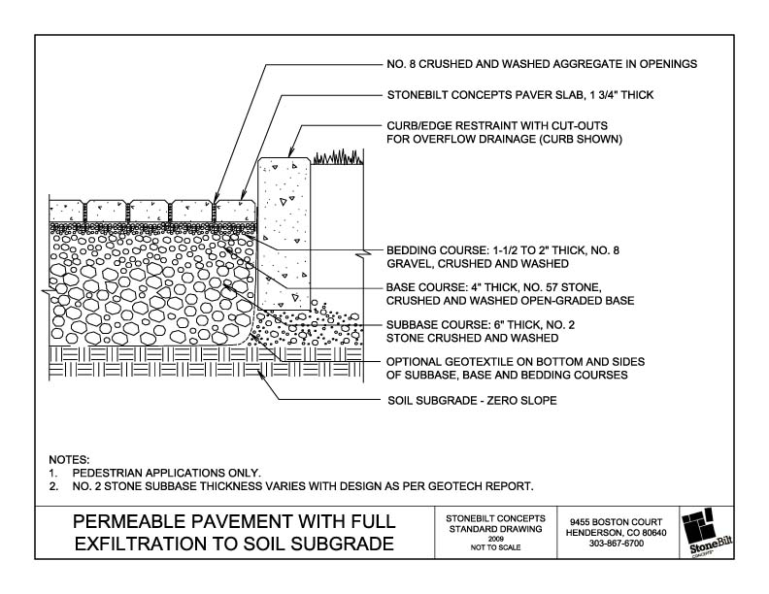
Pavers
www.stonebiltconcepts.com

Slide 58
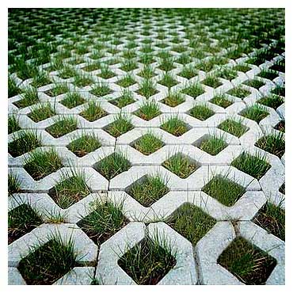
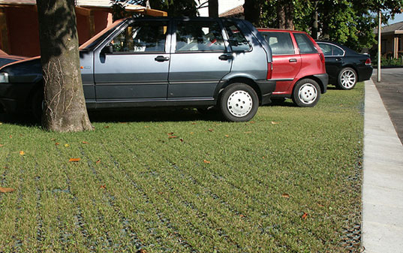
Eco Pavers
4.bp.blogspot.com
static.flickr.com

