Slide 1
Production of Acrolein from the Catalytic Oxidation of Propylene in a Fixed Bed Reactor
Team 1
Michael Glasspool
Sarah Wilson
Nicole Cosgrove

Slide 2
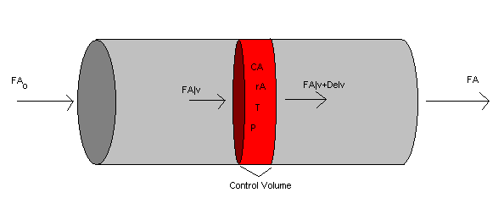
Production Goals
Produce 30,000 Metric Tonnes / year
Operate for 350 days / year
Produce acrolein at 0.0177 kmol / s

Slide 3
Allowable Process Conditions^{1,2}
Process typically run between 320 – 390 ̊C
Run between atmospheric pressure and 303.975 kPa (3 atm)
Use air as an oxygen source
Typical Conversion between 65 – 90 %
Propylene flammability range 2 – 11.1 %

Slide 4
Process Optimization
Process was optimized in a series of reports
Modeling started off simple and became more complex
Pressure drop calculations and energy balances were added over the course of the semester to accurately model the system

Slide 5
Material Balance
Assume an 80 % propylene conversion
Flow enough air to stay below LFL of 2%
C₃H₆ + O₂ C₃H₄O + H₂O

Slide 6
Preliminary Energy Balance
This model assumes a single reaction
Adiabatic and Isothermal cases were modeled

Slide 7
Simple Kinetic Expression³
Rate expression was first order in propylene and half order in oxygen

Slide 8
Simple Kinetics Results
Assuming steady-state, isothermal plug flow, the reactor was modeled in POLYMATH and Aspen Plus

Slide 9
Simple Kinetics Results

Slide 10
Major Findings
The reactor volume was too large
Increasing the temperature can drastically decrease the reactor volume
Reactor temperature would be raised to 663.15 K, the maximum temperature

Slide 11
Pressure Drop Calculation
A pressure drop calculation was added using the Ergun Equation, assuming an isothermal plug flow reactor with a catalyst void fraction of 0.40 ⁴

Slide 12
Pressure Drop Results
By increasing the inlet pressure to 3 atm, the reactor size was minimized and pressure drop was more easily modeled

Slide 13
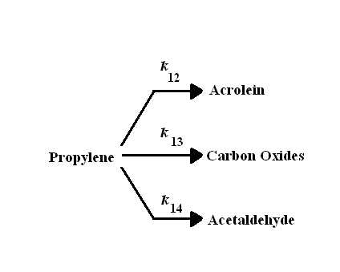
Reaction Kinetics
Real reaction kinetics were found as modeled by Tan et al ⁵

Slide 14
Kinetic Development
Rate constants were given at different temperatures

Slide 15
Kinetic Development

Slide 16
Kinetic Modeling Assumptions
The reaction was assumed to take place in a steady state, isothermal plug flow reactor
The catalyst void fraction was assumed to be 0.45 with a bulk density of 1565.5 kg/m³ ⁶

Slide 17
Kinetic Modeling Results
The new kinetics reduced the volume necessary to produce an 80 % conversion
This allowed the reaction to take place in only one reactor
The best acrolein selectivity was found at the higher end of the temperature range (390 ̊C)

Slide 18
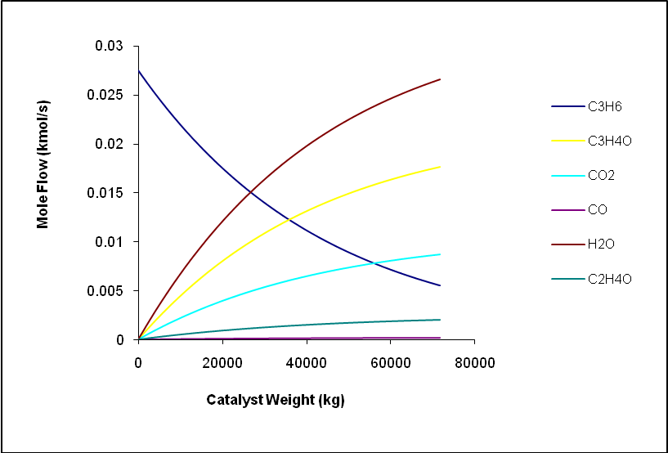
Molar Flow Rate throughout Reactor

Slide 19
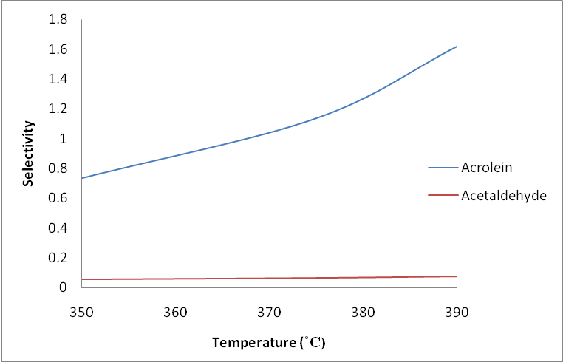
Acrolein Selectivity

Slide 20
Incorporation of an Energy Balance
An energy balance was added to account for temperature changes throughout the reactor
Molten salt (Ua = 227 W/m²-K) was used as a coolant to prevent a runaway reactor temperature⁷

Slide 21
Energy Balance Assumptions
The flow rate of coolant was kept high enough to maintain a constant coolant temperature of 658.15 K
Heat capacities and heats of reaction were assumed to be constant

Slide 22
Energy Balance Results
The addition of the energy balance reduced the overall volume necessary to reach 80 % conversion
The pressure drop was also reduced from 10.64 % to 9.98 %

Slide 23
Reactor Temperature Profile
The temperature throughout the reactor was modeled to determine the reactor hotspot
The effect of changes in the inlet and coolant temperatures were also explored
For the base case, the reactor hotspot occurred at the beginning of the reactor and reached a temperature of 672.5 K

Slide 24
Reactor Temperature Profile

Slide 25
Reactor Gain
The reactor gain was analyzed to determine the thermodynamic stability of the reactor ⁷
For a 1 ̊C change in inlet temperature, the gain was found to be 0.0754

Slide 26
Reactor Gain Profile

Slide 27
Energy Balance Results
The coolant temperature effected the selectivity of the reactor
The highest selectivity was found when the coolant temperature and the inlet temperature were equal

Slide 28
Final Reactor Design

Slide 29
Temperature Profile in Final Reactor Design

Slide 30
Flow Rate Profile in Final Reactor Design

Slide 31
References
Guest, H.R.. "Acrolein and Derivatives." Kirk-Othmer Encyclopedia of Chemical Technology. 4th ed.
Machhammer, et al. “Method for Producing Acrolein and/or Acrylic Acid.” US Patent 7,321,058. January 2008.
Dr. Concetta LaMarca. “Memo 2: Simple Kinetics.” 2008.
Fogler, H. Scott. “Elements of Chemical Reaction Engineering.” 4th Ed. Prentice Hall. 2006.
Tan, H. S., J. Downie, and D. W. Bacon. "The Reaction Network for the Oxidation of Propylene over a Bismuth Molybdate Catalyst." The Canadian Journal of Chemical Engineering 67(1989): 412-417.
"Bismuth molybdate, powder and pieces." CERAC Online Catalog Search. CERAC Incorporated. 05 Mar 2008 <http://asp.cerac.com/CatalogNet/default.aspx?p=msdsFile&msds=m000443.htm>.
Dr. Concetta LaMarca. “Memo 5: Energy Balance.” 2008.

Slide 32
Any Questions?

