Slide 1
Product Development
Freshman Engineering Clinic II
Section 17
Notes:
Product Development (equivalent to one un-lecture period ~ 75 minutes)
Power Point file should be downloaded from Drive as the notes and some of the images do not show up in the online view mode within Google Drive
Please modify the Course Reminders & Deadlines to reflect your specific section requirements
PathFinder Before Exercises on Intellectual Property and Engineering Communication II should be completed by start of 1st class (either lab or un-lecture on week of January 22nd)
GameLab Deadline will depend on the day your lab section runs. It should be the day your lab meets during the week of February 12th.
Outline:
Product Development Affinity Diagram and Activity Network (Slides 4-7; 7-10 minutes)
“Trash” to Treasure Activity (Slides 8-9; 60 minutes)
Have students form teams of 3-4
Students inspect the “trash” that is available for the prototyping exercise (5 minutes)
Students identify a potential customer for the desk organizer within engineering (can be staff, faculty, other students)
Students go out and speak to their potential customer (10-15 minutes)
Students create an affinity diagram based on customer input (5 minutes)
Students use the “trash” to create a prototype of their desk organizer (15-20 minutes)
Student groups present out to the class demonstrating how their prototype links back(10-15 minutes)

Slide 2
Course Reminders & Deadlines
Pathfinder
Before exercises (on 1/29) due by 11:55PM
Universal Design
3D Game Lab
1st deadline of 350 XP midnight Feb. 12th
Notes:
Note: GameLab Deadline will depend on the day your lab section runs. It should be the day your lab meets during the week of February 12th.

Slide 3
Today’s Plan
Product development
Affinity Diagram
Activity Network

Slide 4
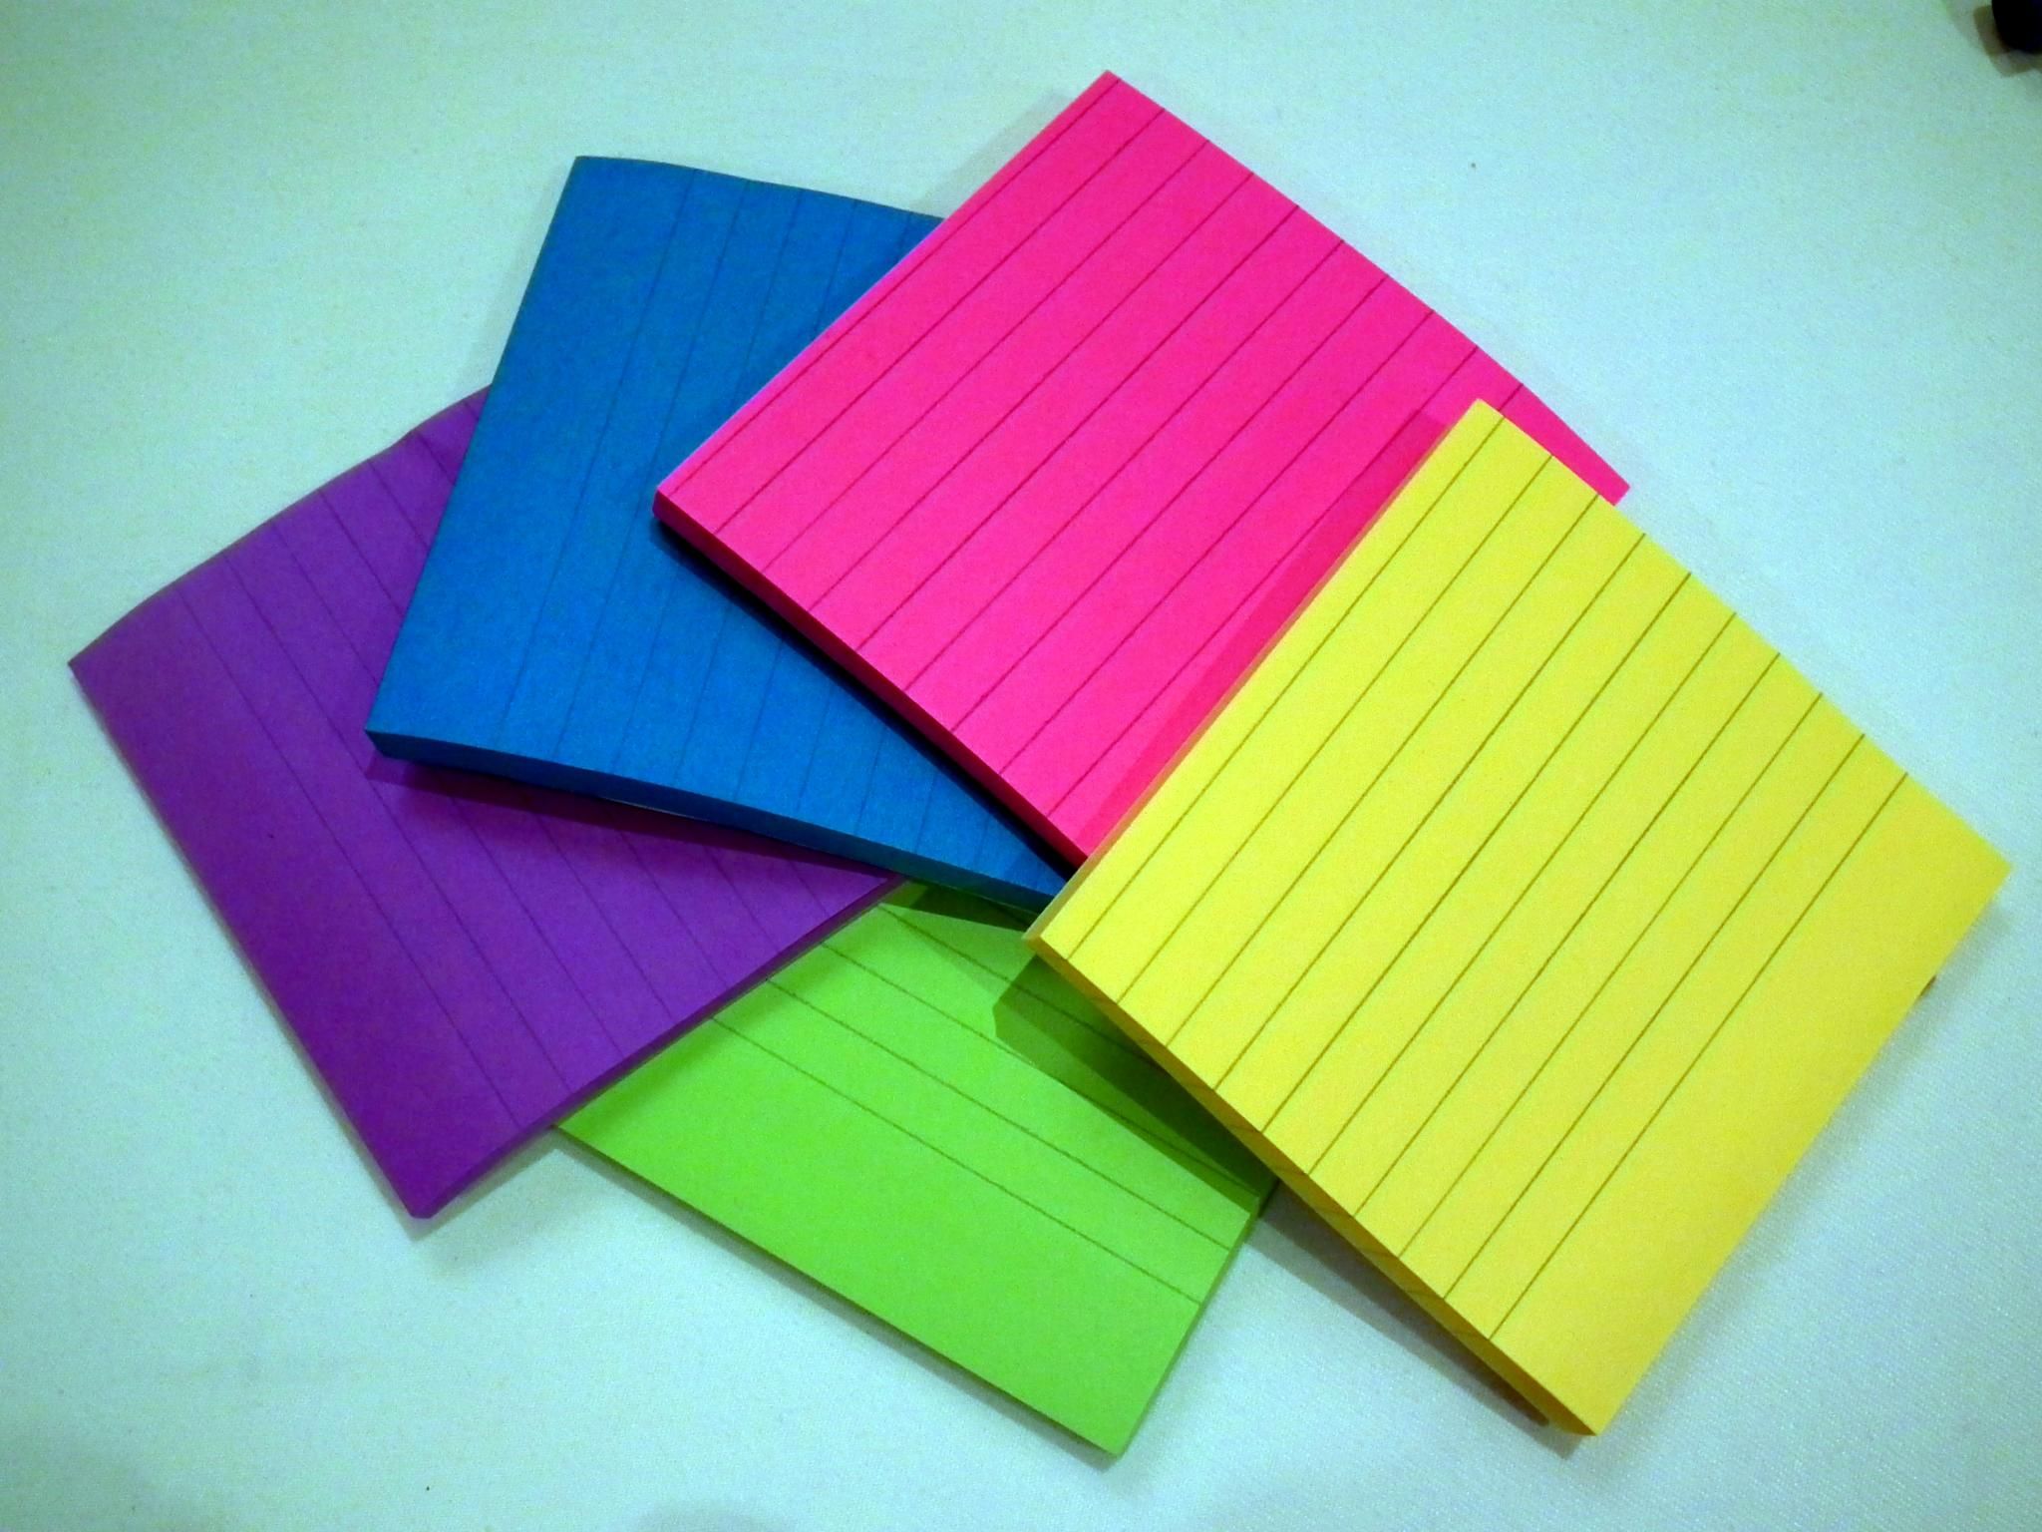
Product Development: Affinity Diagram
Each customer need is placed on a post-it note
Post-it notes are added one by one to a board
Post-it notes that have similar themes go under one another
New themes are presented in a separate column
Image accessed from: https://upload.wikimedia.org/wikipedia/commons/1/11/Sticky_Notes_in_different_colors.jpg. Accessed December 1th, 2017.
Notes:
This slide summarizes the key points from Pathfinder about Affinity Diagrams. Essentially they are one form to capture customer needs based on interviews or surveys. The needs should be organized based on themes for ease of identification of potential product solutions.

Slide 5
Product Development: Affinity Diagram for One Pocket Backpack
Thick Material
Easy to Adjust Straps
Durable Zipper
Large Top Opening
Water Proof
Two Zipper Pulls
Stretchable Opening
Aesthetic Design
Accommodates Books and Electronics
Comfortable Material
Notes:
This slide provides an example of customer needs for a one pocket backpack. The first column lists all customer needs for the material of the backpack. The second column lists example needs for the straps of the backpack. The third column deals with the zipper mechanism. Finally, the fourth column deals with the opening of the backpack itself and its size. Keep in mind that this list is not exhaustive but meant to provide an additional point of reference to what they have seen in Pathfinder.

Slide 6
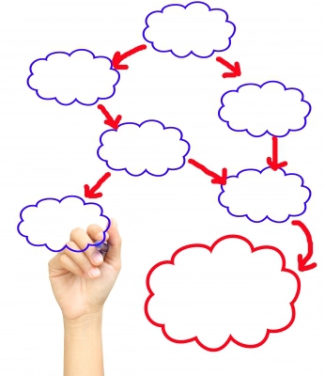
Product Development: Activity Network
Flow chart that describes how a customer uses a product
Uses placed in boxes and arrows indicate potential order of uses
Customer needs lead to the development of the activity network
Image accessed from: https://thebpmfreak.files.wordpress.com/2012/02/402740a6fvggxc2.jpg?w=593. Accessed December 1th, 2017.
Notes:
This slide summarizes the key takeaways on Activity Networks from Pathfinder. It should help students think through how to construct an activity network.

Slide 7
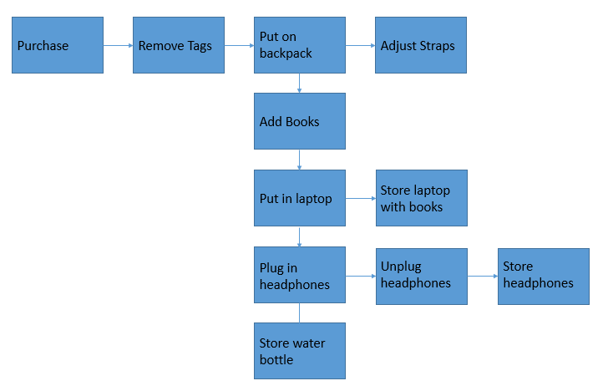
Product Development: Activity Network for One Pocket Backpack
Note: This Activity Network is profiled in the 3D GameLab Quest “Activity Networks” that is available at the Coffee Runner Level
Notes:
Building off the last example for the affinity diagram, this activity network also looks at a one pocket backpack. The actual diagram is included as part of a quest description in 3D GameLab which is why this cross-reference is highlighted here.

Slide 8
Design Challenge – “Trash” to Treasure
Create a team of 3-4 students
Inspect “trash” for ideas on how to create a desk organizer
Determine a potential customer within the engineering building for your desk organizer
Get out of class and get customer input about needs for the desk organizer
Create an affinity diagram based on customer input
Image obtained from: http://thediymommy.com/wp-content/uploads/2015/06/trash-to-treasure.jpg. Accessed on Jan. 27th, 2017.
Notes:
This activity charges students with the task of looking at miscellaneous materials (wires, old cell phone parts, old clock parts, construction materials, craft materials) and try to see a new purpose in them. They will also build upon what they have learned about affinity diagrams by going out and speaking to actual potential customers in the building to create a list of needs that their prototype must fulfill.

Slide 9
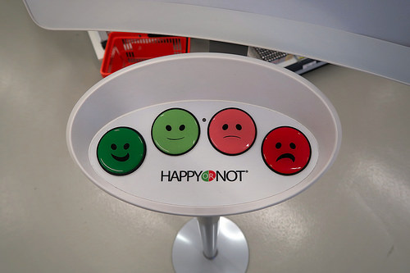
Design Challenge – “Trash” to Treasure Design and Prototype
Create a concept and prototype it using the “trash” materials
Teams will then need to present their “best” idea to the class and describe how it meets the customer needs from the affinity diagram
Image obtained from: https://c4.staticflickr.com/8/7782/18146364972_0c9d47bd11.jpg. Accessed on Jan. 27th, 2017.
Notes:
The key to selecting the best design will be how well the prototype reflects the needs of the customer as they are listed in the students’ affinity diagram.

