Slide 1
Intellectual Property
Freshman Engineering Clinic II
Section 17
Notes:
Intellectual Property (equivalent to one un-lecture period ~ 60 minutes)
Power Point file should be downloaded from Drive as the notes and some of the images do not show up in the online view mode within Google Drive
Please modify the Course Reminders & Deadlines to reflect your specific section requirements
PathFinder Before Exercises on Universal Design should be completed prior to the start of the project in class
GameLab Deadline will depend on the day your lab section runs. It should be the day your lab meets during the week of February 12th.
Outline:
Intellectual Property Background (Slides 3-6; 7-10 minutes)
Two Truths and a Lie (Slide 7; 50 minutes)
Have students form teams of 3-4
Distribute to student groups two patents from the file entitled “Absurd Patents”. Each group should get a different set of two patents.
Students are given the next 15-20 minutes to come up with a patent of their own that seems reasonable given the two other patents they were provided. They also need to prepare a presentation that showcases all three of the patents for the class
Student teams present their three patents to the class (each presentation will be 5-7 minutes)
All of the students in the class will then vote on which patent wasn’t real (faculty can use Kahoot for this, an audience response system like polleverywhere or they can do it manually using just a show of hands)
The group that convinces the most students that their patent is real can get some type of token for congratulations. In the past I have used candy, pencils or erasers as tokens in these types of activities.

Slide 2
Course Reminders & Deadlines
Pathfinder
Before exercises (on 1/29) due by 11:55PM
Universal Design
3D Game Lab
1st deadline of 350 XP midnight Feb. 12 at midnight
Notes:
Note: GameLab Deadline will depend on the day your lab section runs. It should be the day your lab meets during the week of February 12th.

Slide 3
Intellectual Property: What is it¹?
According to the World Intellectual Property Organization:
"creations of the mind: inventions, literary, and artistic works, and symbols, names, images, and designs used in commerce.”
Two categories:
Industrial Property
Patents, Designs, Trademarks, etc.
Copyright
Novels, Poems and Plays, Musical Work, Paintings, etc.
1. Crawford, M. (2012). Intellectual Property and Engineers. ASME Website. Accessedon February 25th, 2016.
Notes:
This slide just walks students through the definition of intellectual property and how it is broken down

Slide 4
Key Things to Know¹
Important to seek patent protection
Can seek a patent for any non-obvious invention within a field
Comparison test for whether it is obvious is made against someone of ordinary skill in the art under investigation
Avoid public disclosure of invention
Need to file the patent before any public disclosure such as paper, or presentation
Also need to avoid disclosing invention to friends or colleagues outside of the company
1. Crawford, M. (2012). Intellectual Property and Engineers. ASME Website. Accessed on February 25th, 2016.
Notes:
The important point to emphasize for this set of slides is that there are a lot of inventions that could be patentable but many people (engineers especially) don’t realize that they could be patented at first review. The invention just has to be non-obvious in comparison to the average person not necessarily in comparison to someone with STEM training.
Another point to make clear is that students should never present their ideas at a public presentation if they think they might want to patent it. They can however present if they get all individuals in attendance to sign a waiver.

Slide 5
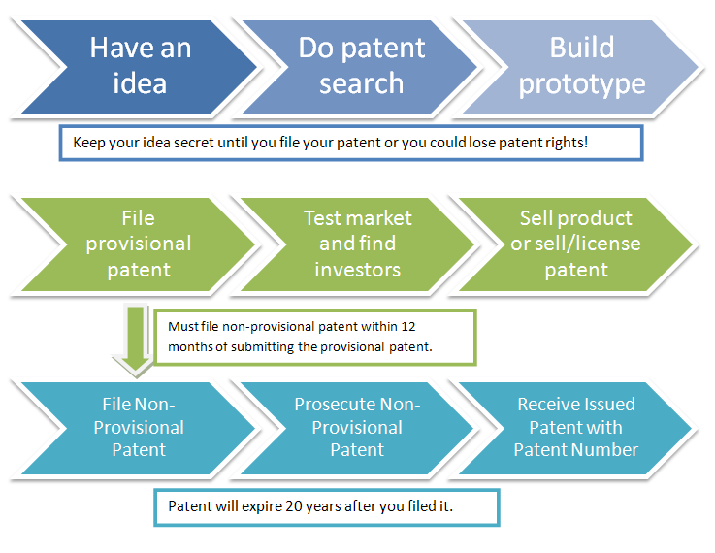
Patent Application Process
Accessed from patentfile.org on Feb. 25th, 2016
Key change to process is that the America Invent Acts (effective March 16, 2013) changed the patent process from “first to invent” to “first to file”
Notes:
One of the examples that I always use with this slide is pharmaceutical companies. Typically the drug development process can take between 10-13 years which usually means by the time they are able to start selling the drug they only have ~7 years left on the patent. This is why these companies are continuously performing R&D to try and get ahead. You can also always tell when a patent is no longer effective as that is when the generic brands of the drug will become available on store shelves.

Slide 6
Patent Structure¹
Six key components:
Title
Background
Summary of invention
Drawings
Detailed description
Claims
1. What is a Patent? Accessed from http://www.burdlaw.com/whtispat.htm on February 25th, 2016
Notes:
Important parts of the patent for students to be aware of are the date of patent and the filing date. The patent is only effective for 20 years from the filing date unless otherwise stated. In this case, the term of the patent is only 14 years but this provides an opportunity to show students where they should be looking for this information.

Slide 7
"The innovation demonstrated by this patent will help to cost effectively address pressing needs for improved technology for wastewater treatment." - Dr. LeChevallier
Notes:
Savings in Energy and Chemical Usage for Treatment

Slide 8
Patents: 2 Truths and 1 Lie
In groups of 3-4:
Review the two patents that you have been provided with
Develop a third patent that you feel is believable
Discuss how you will present these 3 patents to other groups in the class to convince them that one of the real patents is a fabrication
As a class:
Each group will present all three of their patents
Students individually vote on which patent is fabricated
Tally the votes and determine which team has convinced the highest number of individuals in the class that their patent is real

