Slide 1
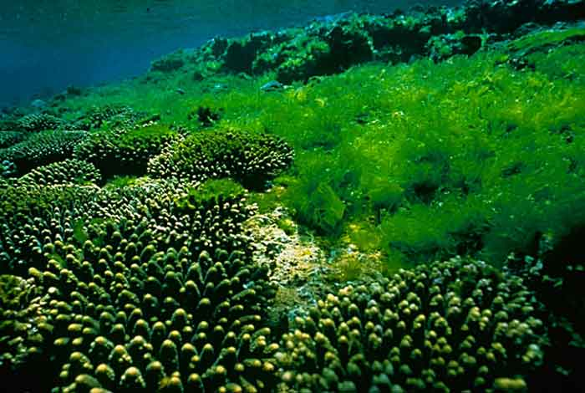
Algae Grows the Future
Dr. Kauser Jahan, P.E.
Professor, Civil & Environmental Engineering

Slide 2
Grand Challenges Facing the World
NAE Grand Challenges

Slide 3
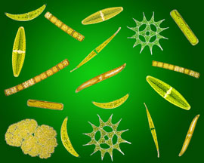
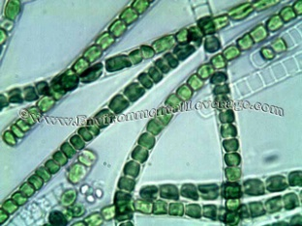
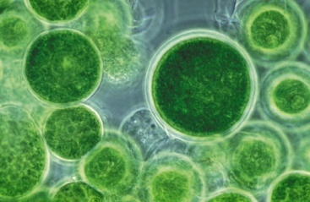
What are Algae?
Aquatic, plant-like, eukaryotic (well defined nucleus) microorganisms
Can be simple unicellular species or complex multicellular species
Use photosynthesis to turn light energy into chemical energy
CO₂ + H₂O + Light Energy → Biomass
Important role in aquatic food chain
Range from microscopic sizes to 50 meters long
Produce 70% of air we breathe
Negatively charged organic matter with lipid/oil and protein

Slide 4
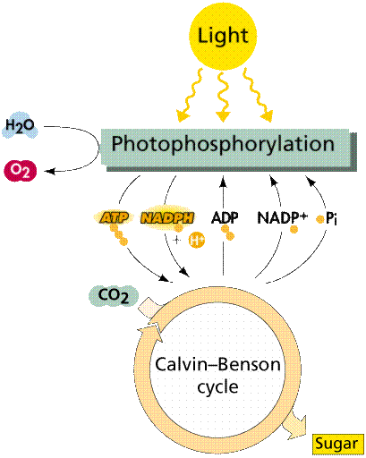
Growth Needs of Algae
Light
WATER
CO₂ (available in air 0.04%)
Nitrogen
Phosphorus
Temperature
pH
Trace nutrients including potassium, calcium, iron, magnesium, etc.
Aeration and mixing
Needs lots of water
Greenhouse gases
Pollution
Water quality impairment
NUTRIENTS

Slide 5
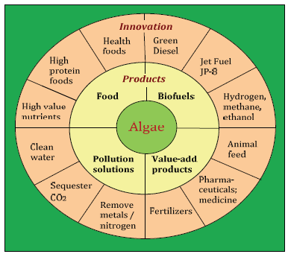
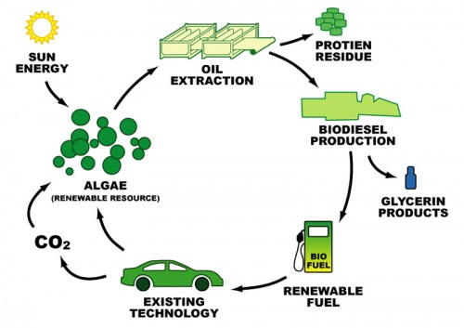
The Algae Use Cycle
Sharma, P.D. website accessed 12/17/2011 http://saferenvironment.wordpress.com/about/

