Slide 1
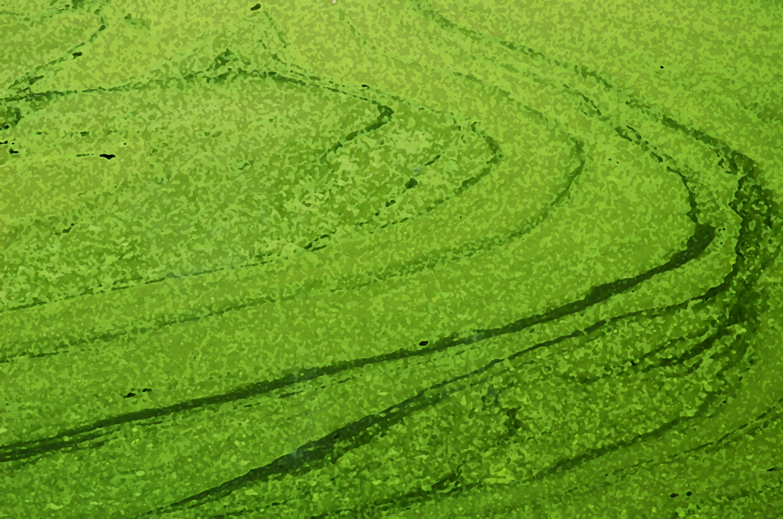
Algae Based Engineering Education
Kauser Jahan ¹
Roisin Breen, Patricia Hurley, Megan Mittenzwei and Dennis Boileau
¹ Professor
Civil and Environmental Engineering
Rowan University
Glassboro, NJ 08028, USA

Slide 2
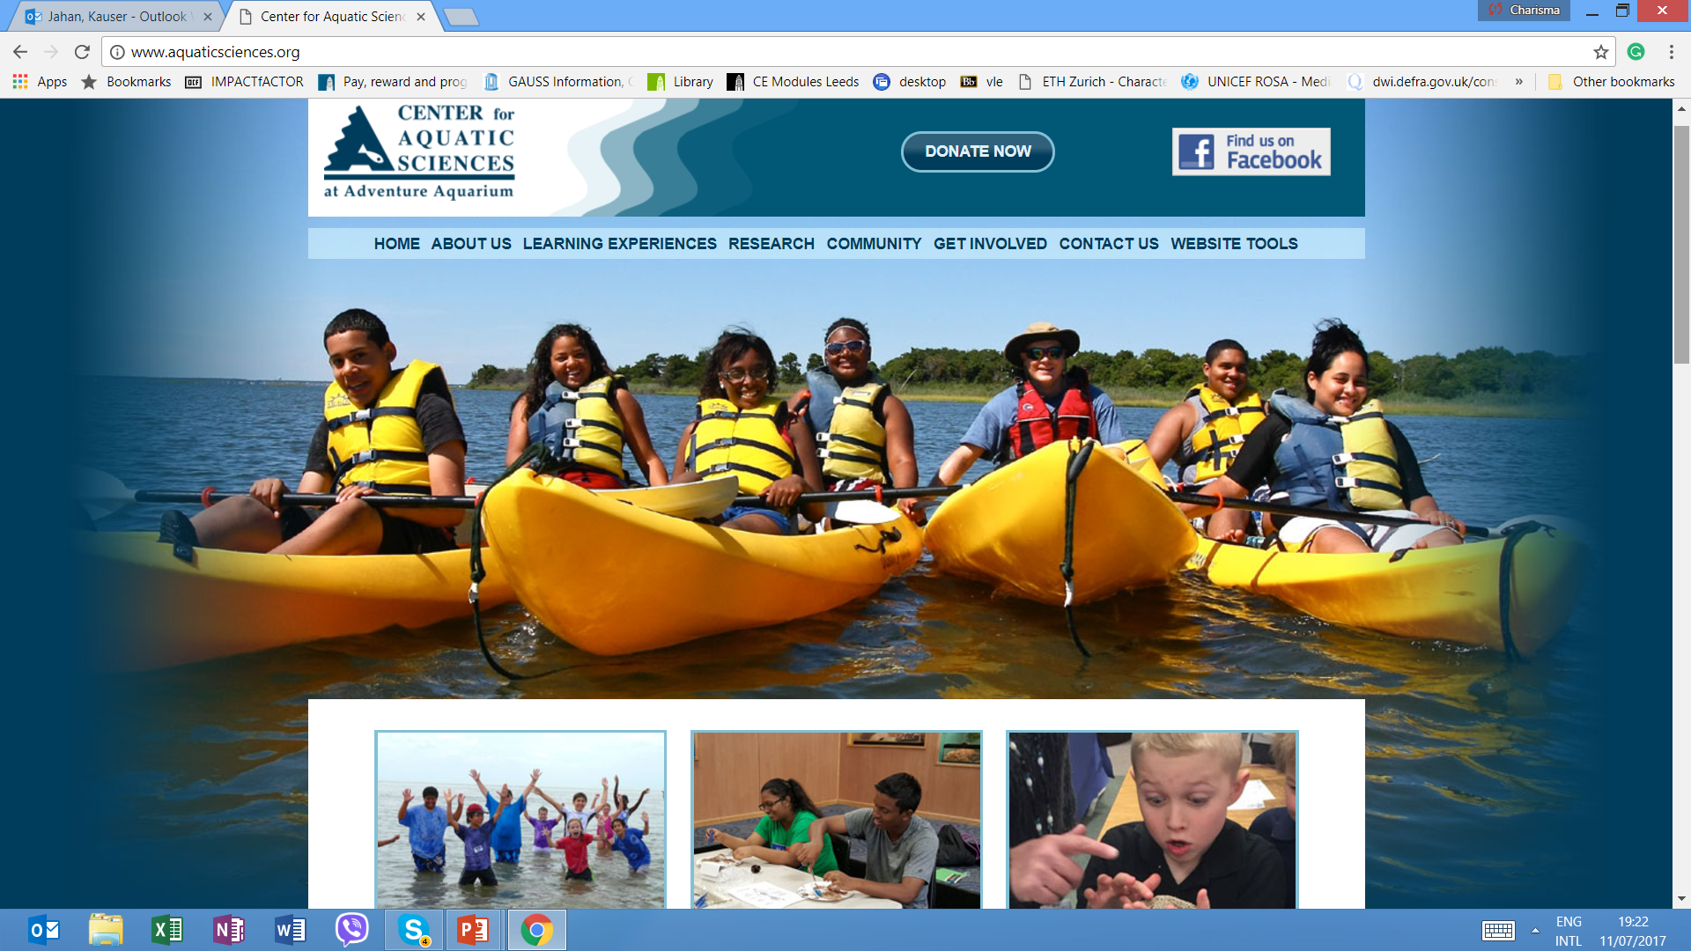
Introduction of the Project
3 Year Project funded by the NSF titled “Algae Grows the Future”for developing STEM activities entwined with the Humanities and Social Sciences
Innovative initiative between the Center for Aquatic Sciences at Adventure Aquarium in Camden, New Jersey
Notes:
DENNIS
CAS promotes the understanding, appreciation, and protection of aquatic life and habitats through research, education, and youth development plans. This partnership could allow us to reach the over 50,000 students and educators that the CAS works with.
Ensure the highest quality of STEM education
Develop multidisciplinary curricula
Improve student learning
Prepare Global Citizens
Increase participation of underrepresented minorities

Slide 3
Globally Conscious Topics
United Nations Millennium Development Goals
Create ‘Global Engineers’
Energy
Clean Water
Environment
Food
Global Health
Education
Poverty
Security
Notes:
ROISIN

Slide 4
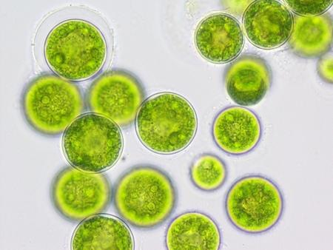
Objectives
Develop hands on activities that focus on engineered applications of algae for freshman engineering students and K-12 educators and students
Develop lesson plans, website and videos
Develop algae games for K-12 educators and students

Slide 5
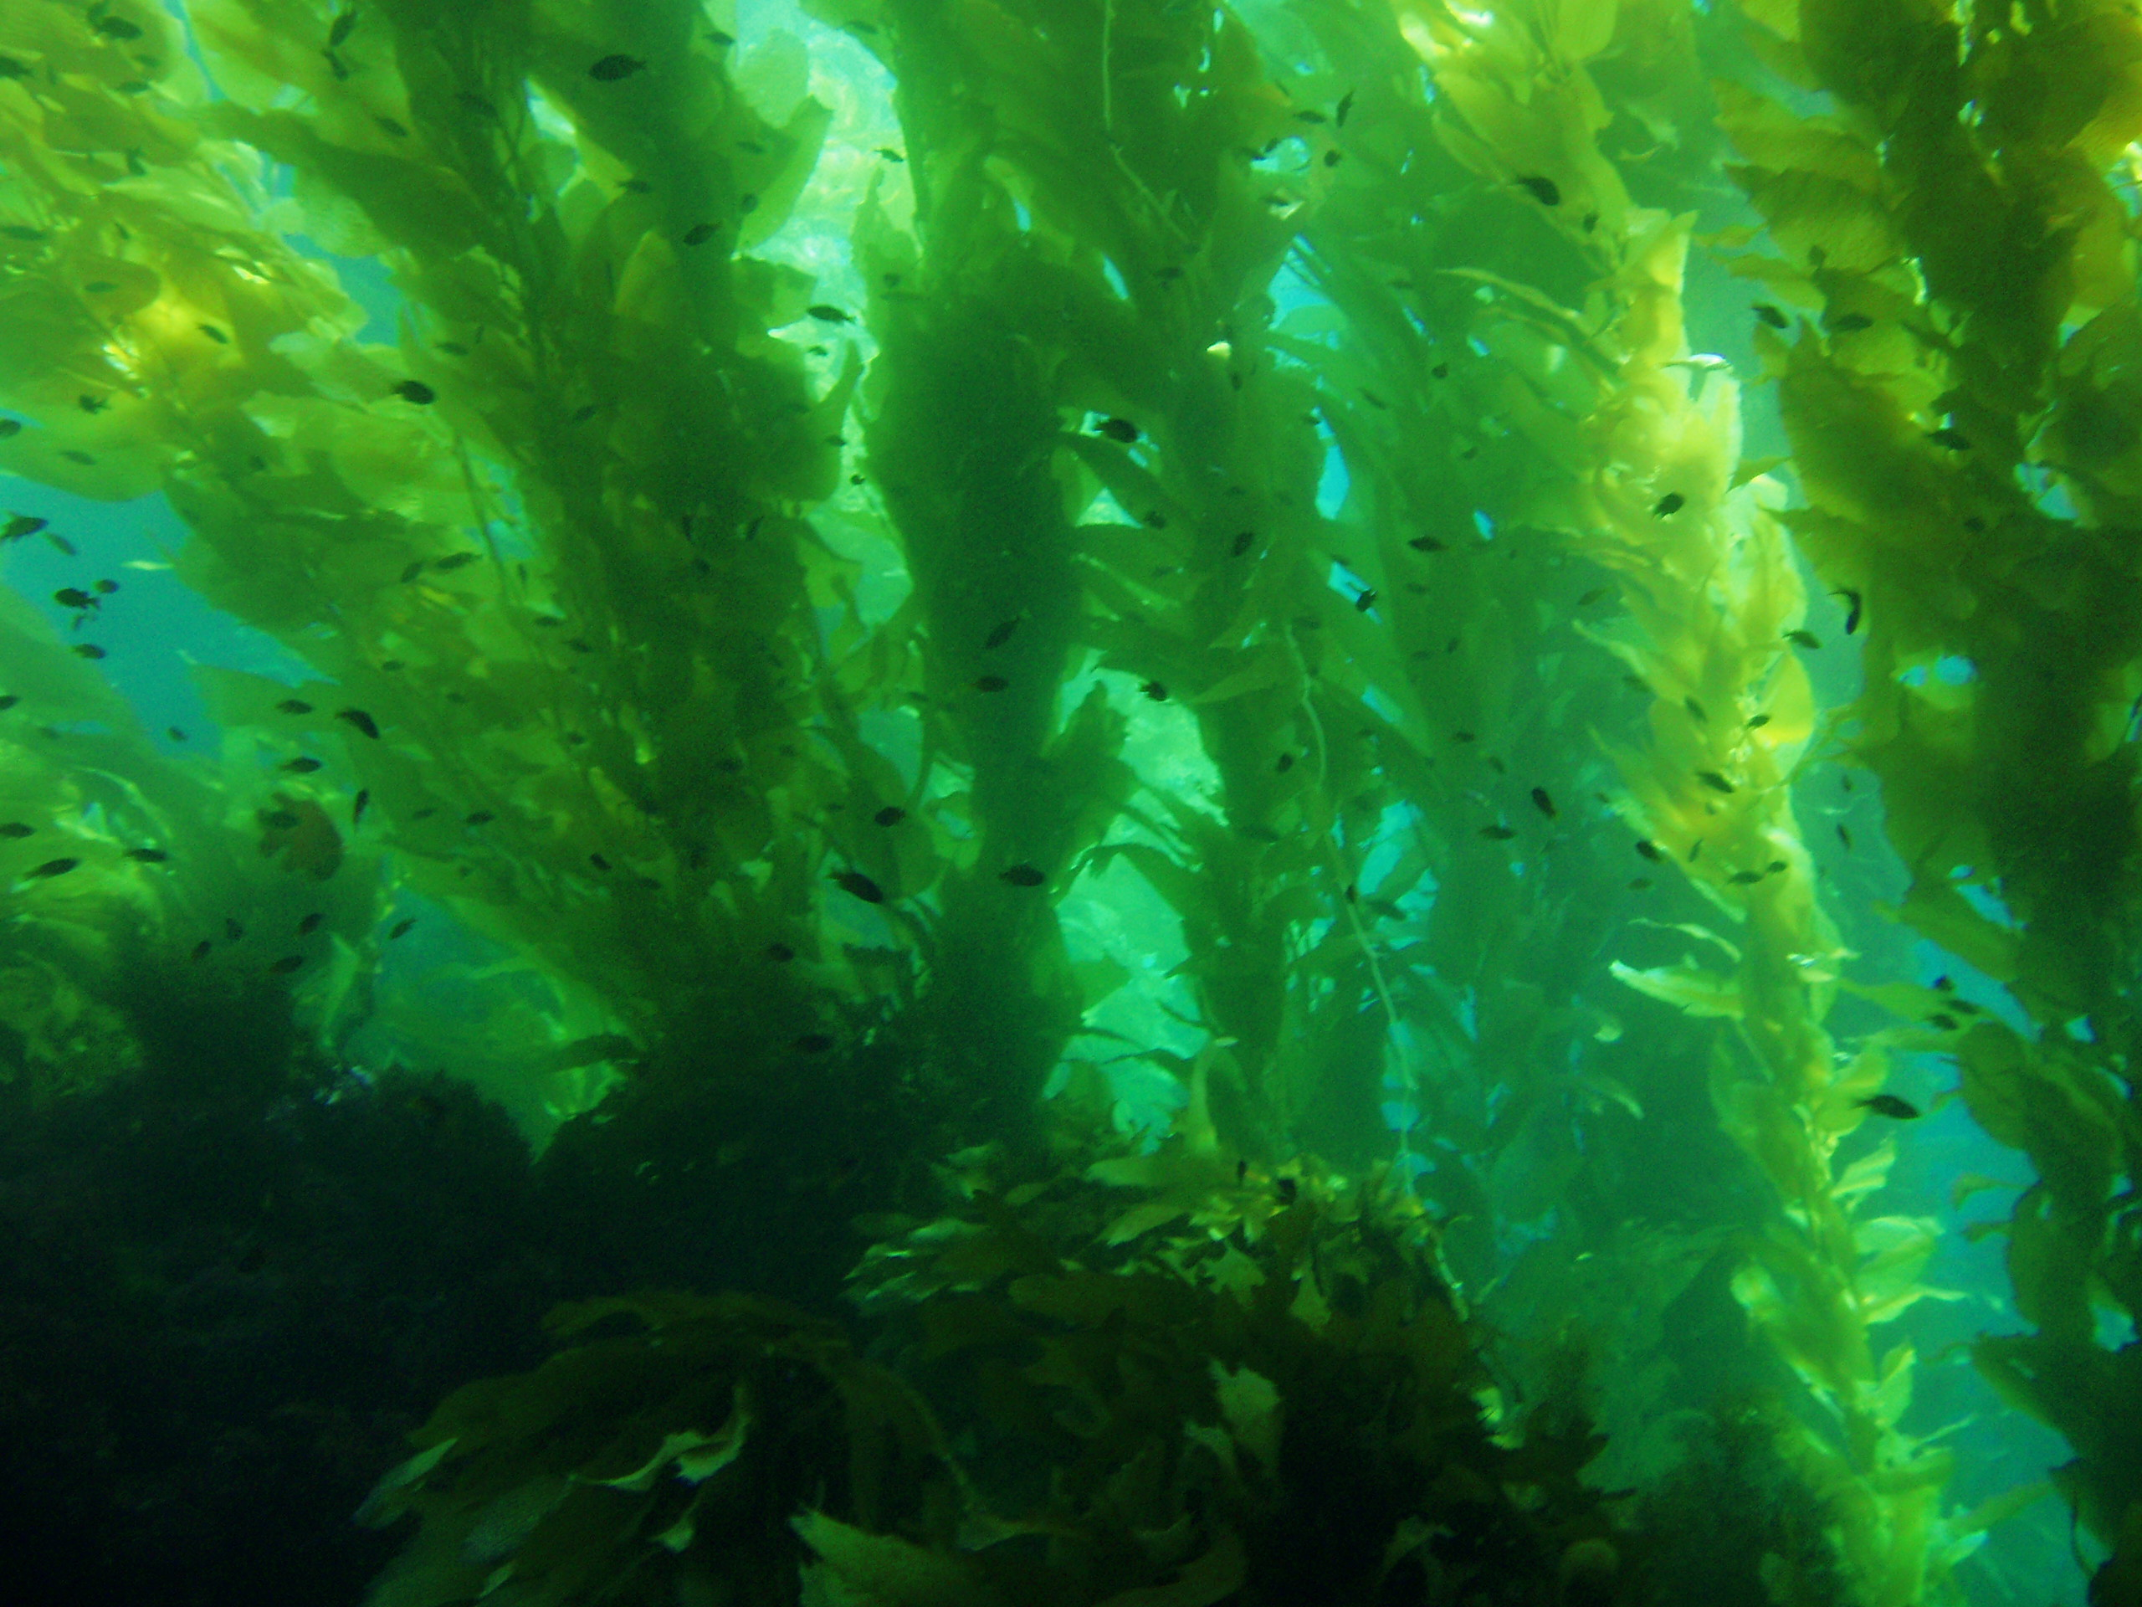
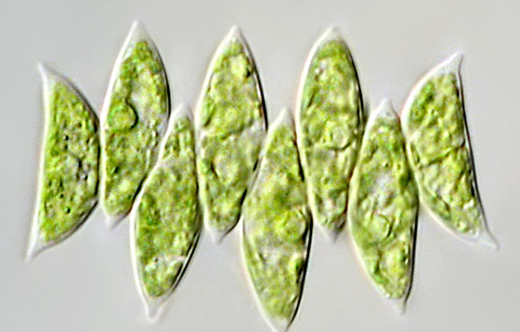
Why Algae?
Algae are very diverse and found almost everywhere on the planet. They play an important role in many ecosystems.
Algae are simple microbes that can range from the microscopic (microalgae), to large seaweeds (macroalgae), such as giant kelp more than one hundred feet in length.
Algae can be grown using water resources such as brackish-, sea-, and wastewater unsuitable for cultivating agricultural crops.
Most microalgae grow through photosynthesis – by converting sunlight, CO₂ and a few nutrients, including nitrogen and phosphorous.
Rich in lipids (35%) and proteins (45%)
Notes:
PATRICIA
SIngle cell photosynthetic organism with a wide variety of applications.

Slide 6
Algae Derived Biofuel

Slide 7
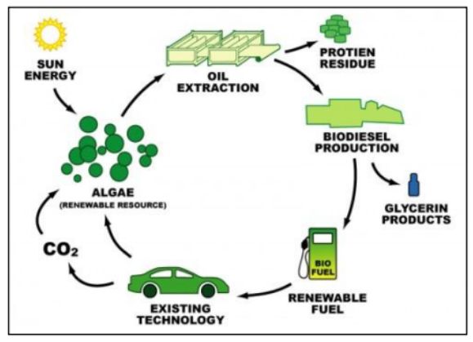
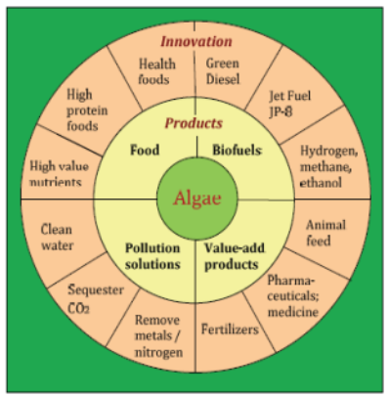
Algae Applications
Notes:
PATRICIA
SIngle cell photosynthetic organism with a wide variety of applications.

Slide 8
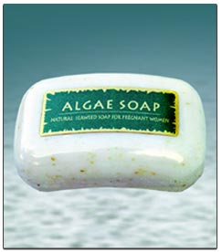
Experiments:
Growth and Development Studies
Growing Algae
Photosynthesis Lab
Gas Transfer Lab
Dewatering Lab-Jar Test, Centrifuge, Filtration
Applications of Algae
Biofuels Sodium Alginate Slime
Cosmetic Engineering
Calorimetry
Materials-Surfboards
Medical - Healing wounds
Electric battery
Notes:
MEG
Experiments were carefully chosen to be implemented in K-12 programs as well as under the more technical conditions of a freshman clinic.
All experiments will teach data colleciton skills, plotting, technical writing, as well as implementing concepts from both biology and chemistry

Slide 9
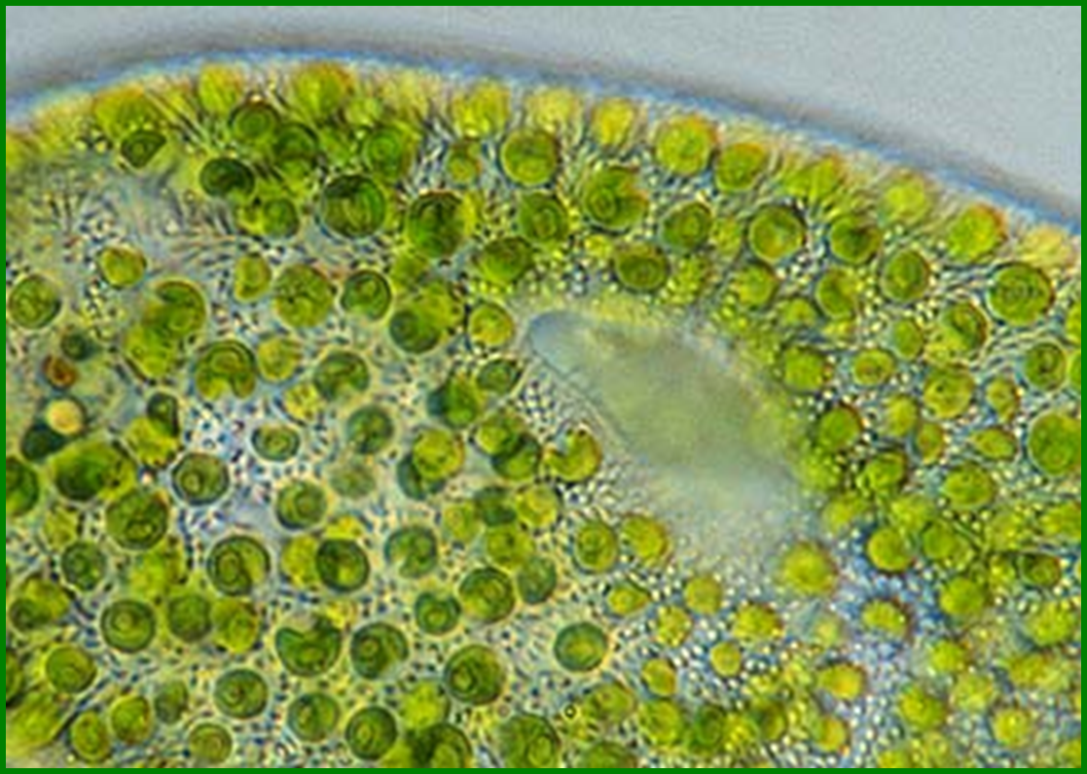
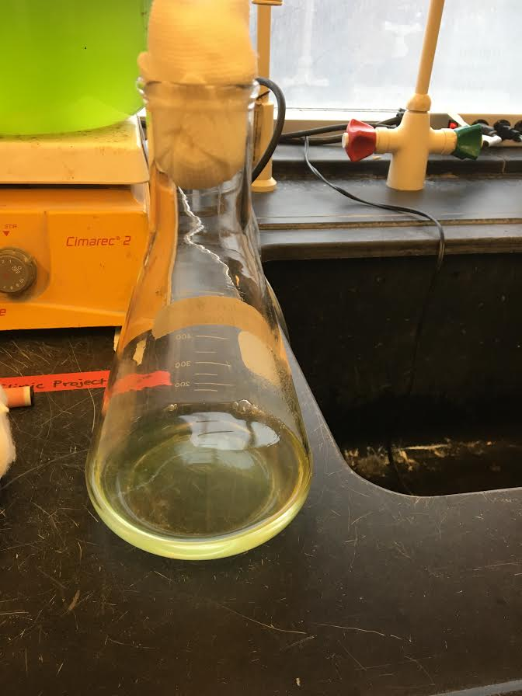
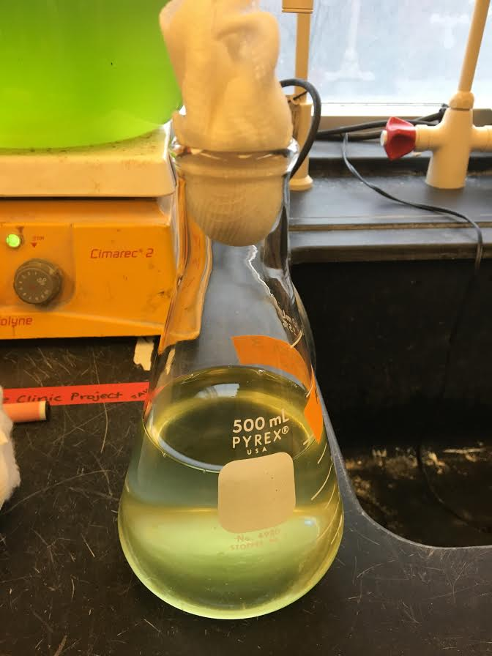
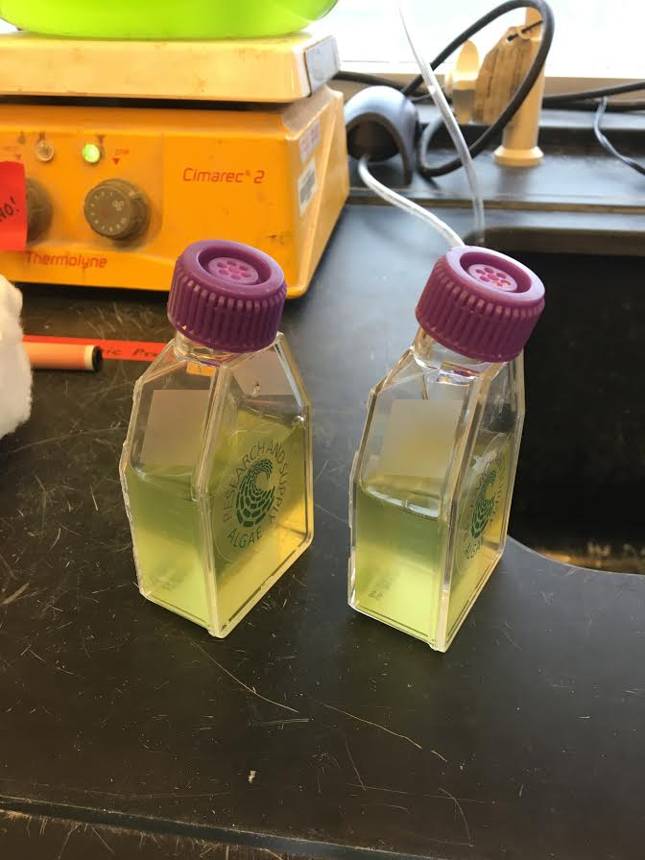
Growing Algae
Chlorella vulgaris
Step 1: 50 mL
Step 2: 100 mL
Step 3: 200-300mL

Slide 10
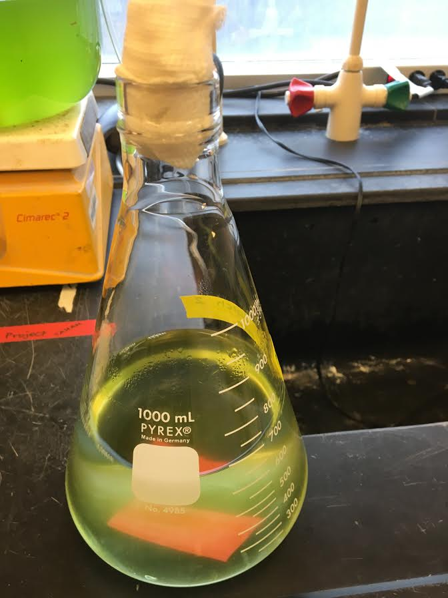
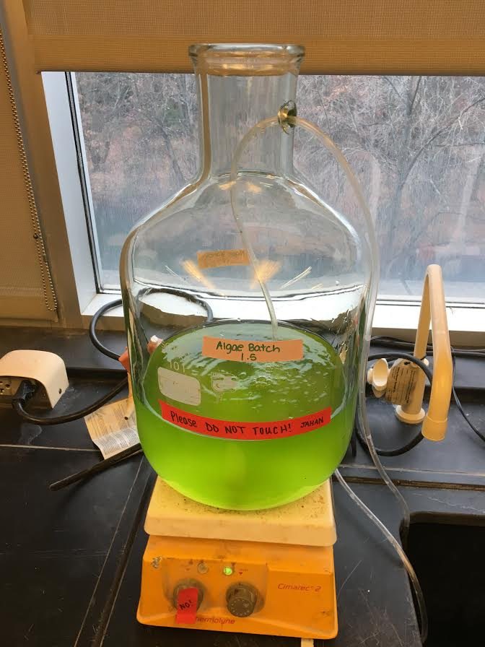
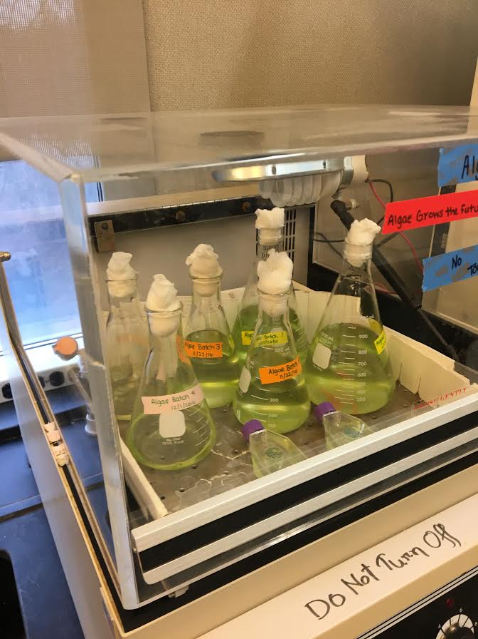
Growing Algae
Step 4: 500 mL
Step 5: 2L and up
Used Environ Shaker to Mix and Aerate

Slide 11
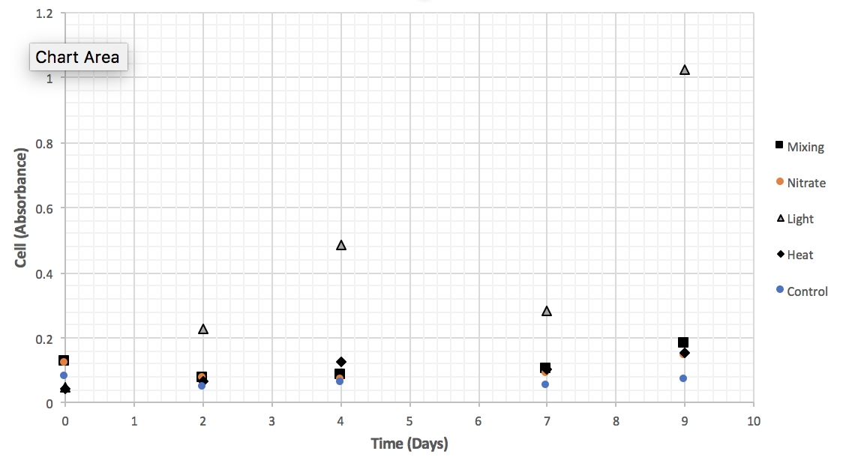
Algae Growth Studies
Algae growth was measured periodically with different variables and controls.
There was four variables and a control group for each variable. The variables were mixing, nitrate, light and heat.
Data Collection
Plotting
Statistics: Error Bars, t-tests
Comparison of data
Calculation of growth rates
Report (Technical Writing)

Slide 12
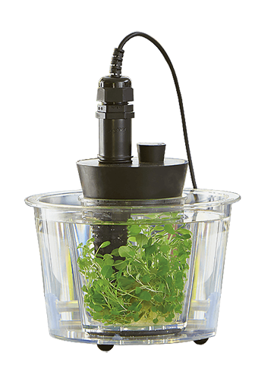
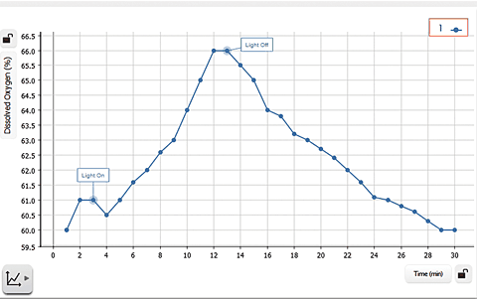
Photosynthesis Lab
Uses photosynthesis tank and dissolved oxygen meter .
Algal photosynthesis uses carbon dioxide, meaning it could be used to remove CO₂ from the air.
Dissolved oxygen levels are studied as changes occur from photosynthesis and respiration.
6CO₂ + 6H₂O → C₆H₁₂O₆ + 6O₂
Notes:
PATRICIA

Slide 13
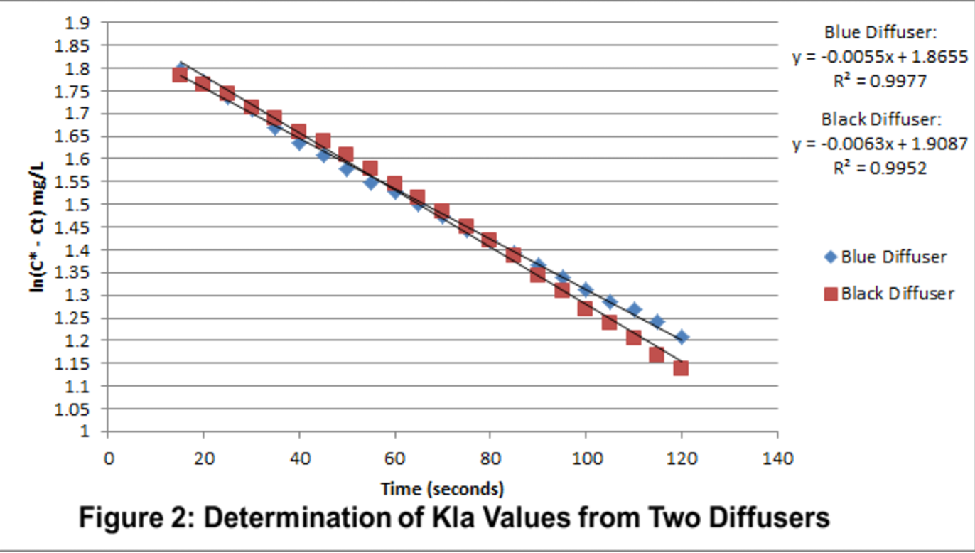
Gas Transfer
Vital in environmental engineering processes
Oxygen transfer for water/wastewater treatment
Oxygen transfer for maintaining DO levels in surface waters
Oxygen transfer to promote bacterial growth for wastewater treatment
CO₂ transfer in algae reactors for promoting algae growth
Notes:
DENNIS

Slide 14
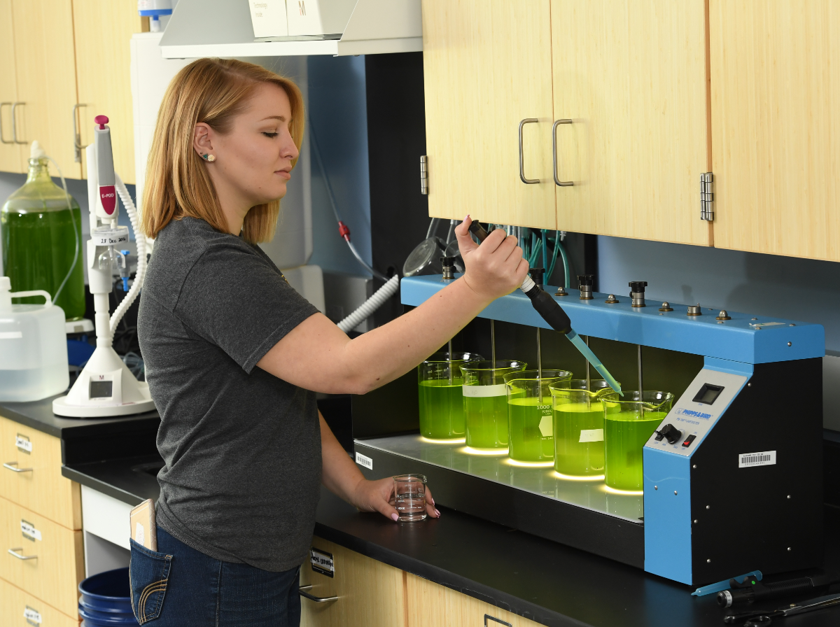
Algae Dewatering
Coagulation/Flocculation using chemicals (Trivalent salts Iron & Aluminum)
Students perform the standard Jar Test experiment with a focus on removal of algae in water using chemicals such as alum or ferric chloride
Physical treatment using evaporation, centrifugation and filtration
Notes:
DENNIS
Chemical process

Slide 15
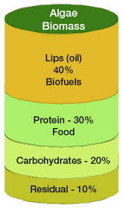
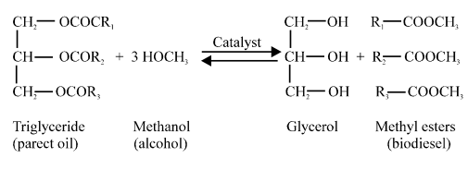
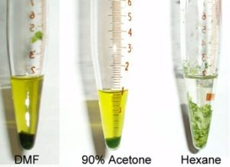
Algae Lipids
Algal oil is converted into biodiesel through a transesterification process. Oil extracted from the algae is mixed with alcohol and an acid or a base to produce the fatty acid methylesters that makes up the biodiesel.
In the cosmetic industry, lipids and oils are often utilized in products.

Slide 16
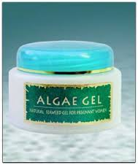
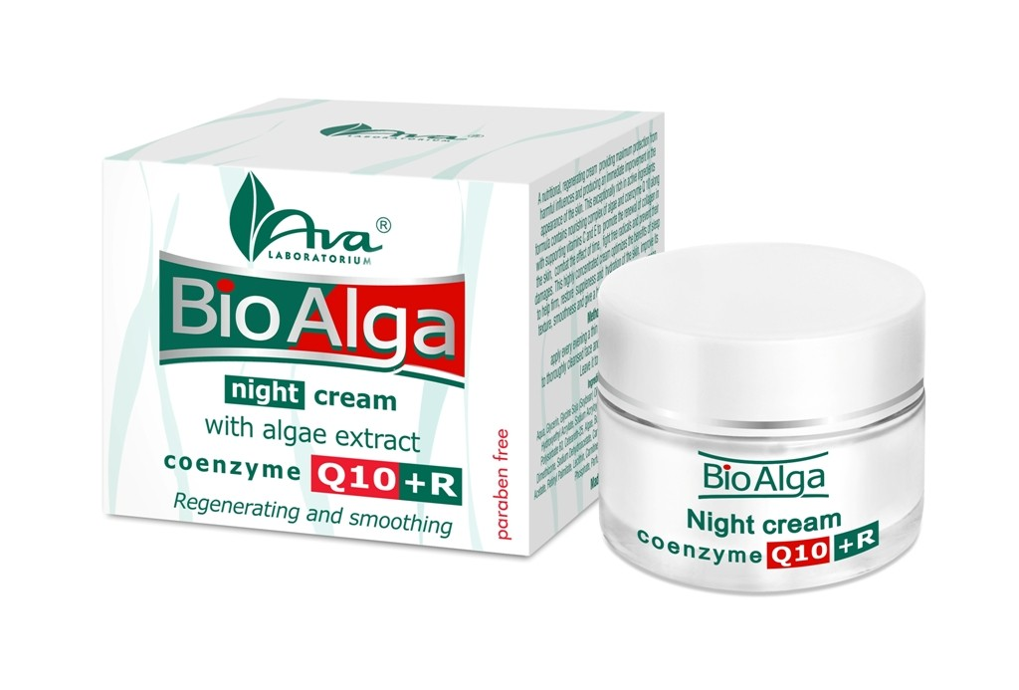
Cosmetics Industry
Benefits of Algae in Skin Care
Algae are a good source of Omega3 fatty acids, which can treat the following acne, eczema, wrinkling, and dryness.
Algae regulate the production of sebum, which can prevent skin dehydration.
Algae aid in the production of collagen, which are essential to firmer skin.
Algae are rich in essential minerals and vitamins. This helps rejuvenate the skin, prevent skin aging, and repair skin damage.
Experiment
Make lip gloss using algae oil and other ingredients
Learn the function of each ingredient
Students develop a marketing plan for their algae lipgloss

Slide 17
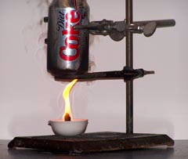
Algae Used as Food Source
Algae has high potential in the global food industry with its high protein and fat content.
About 1 of 9 people in the world are undernourished.
Also feed for aquaculture industry.
Calorimetry experiment allows students to determine the energy content of various different foods while utilizing principles of energy conservation and energy transfer.
Notes:
ROISIN

Slide 18
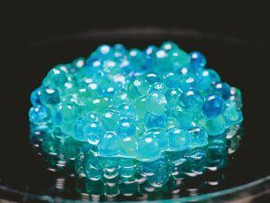
Algae Derived Gel
Fun experiment that can help show the relationship between algae, chemistry, and engineering for future chemical engineers.
Sodium Alginate from brown seaweed (kelp) is a polymer of glucose molecules
When combined with calcium acetate, a non-soluble calcium alginate is formed, creating a gel-like slime
Typically this product is used in the food industry to create artificial caviar
Notes:
DENNIS

Slide 19
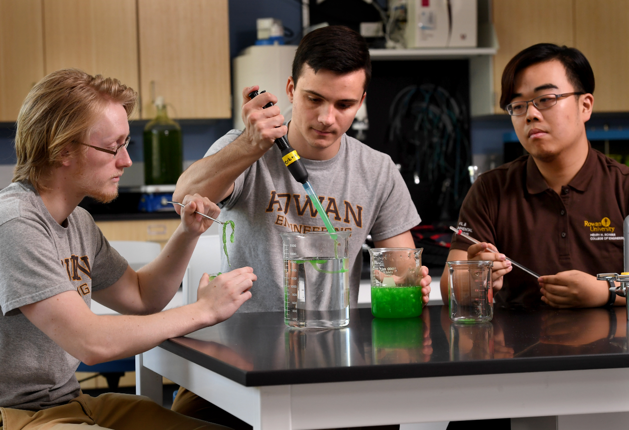
Algae Derived Gel
Materials Industry
Stress, Strain, Young’s Modulus, Viscosity
Notes:
DENNIS

Slide 20
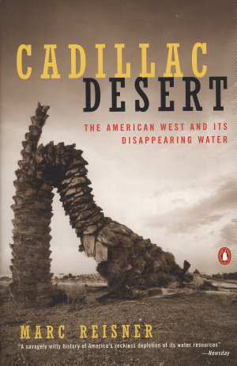
HUMANITIES INTEGRATION
Ethics Social Injustices Gender Bias Public Policy
Diversity & Inclusivity Civilization
Other Assignments
Movies/Documentaries
Water Wars
Erin Brockovich
Civil Action
Whale Rider
Bhopal Express
Rabbit Proof Fence
Good Intentions
The Hidden Figures
The Wind Rises
Other Assignments
Select Readings
Dark Lady of DNA
Flint Drinking Water Crisis
Ford Pinto Case Study
Cadillac Desert
An Inconvenient Truth
Billions in Change
Semester Project
Divide teams and assign a state (USA) or a country
Teams research government, religion, society, culture, resources and the status of science & technology
Teams research how algae can help “Grow the Future” of their assigned community. They will identify challenges - both scientific and social that can deter use of algae.

Slide 21
Algae City Game
A mixed-reality game series "AlgaeCity" for K-12 students, educators and freshman engineering students is currently under development.
AlgaeCity will allow players to utilize algae for various purposes in the city’s day to day functions, including life cycle analyses of various energy sources in comparison to algae-based biofuels, and carbon footprint calculation of various algae product processes, etc
Notes:
DENNIS

Slide 22
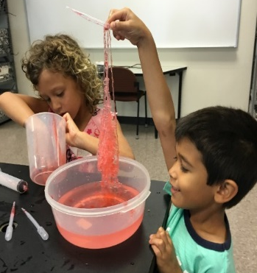
K-12 Outreach
Teacher Training
Middle School Pilot Project
Perfect for project based learning
Easy link between biological sciences & engineering
Cost effective experiments
Hands on visual experiments
Can map activities to the NJ Next Generation Science Standards

Slide 23
Project Website
Designed to host future experiment outlines
Video tutorials for laboratories
A place students can go to find fun and interesting supplementary material
http://users.rowan.edu/~jahan/sophclinic/slides/algaegrows.html
http://users.rowan.edu/~jahan/hunter/algae_workshop/algae_resources.htm
Notes:
Patrica

Slide 24
Conclusions and Future Plans
The Algae Grows the Future project offers a curriculum that can be easily implemented in freshman engineering courses.
Elements of the project can also be easily adapted for K-12 students and educators to promote engineering as a career choice.
Activities are cost effective.
Students can learn about all branches of engineering and the social sciences while strengthening the skills required for scientific inquiry and experimentation.

Slide 25
ACKNOWLEDGEMENTS
NSF: IUSE 1610164
CAS at Adventure Aquarium
Rowan University Students/Faculty

