Slide 1
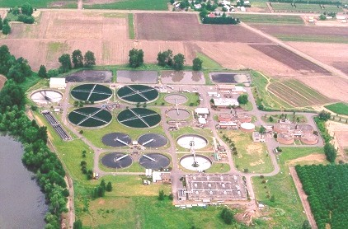
Wastewater Feasibility Study
Select Communities of Cumberland
Dr. K. Jahan
The Delaware Bayshore communities of Commercial, Down, Greenwich and Maurice River Townships face major challenges for their wastewater treatment due to failing septic/holding tank systems and lack of a centralized wastewater management plan.
The following tasks will be conducted for each township:
Collect data on each township (# of households, population, existing wastewater treatment options, groundwater and surface water quality, meteorological data, land type and use)
2. Investigate options for contemporary wastewater treatment systems for single households (septic tanks, composting toilets etc)
3. Investigate the feasibility for contemporary package wastewater treatment systems for centralized wastewater treatment for select communities
4. Investigate the feasibility of connecting communities to existing centralized wastewater treatment plants (WWTPs) such as the Bridgeton, Millville and Bayside Prison WWTPs

Slide 2
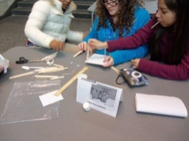
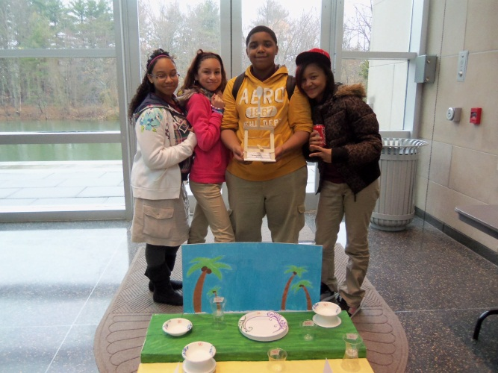
Experiments & Demonstrations for STEM Outreach
Dr. Jahan and Melanie Basantis
Develop hands on activities for K-12 outreach
Demonstrations at Rowan Hall
Goal:
Research/design a device that could be used as demonstration equipment which would be directly applicable to increasing interest in engineering to 6-12 grade students. Can be easily used for K-12 visits & Open Houses.
Constraints:
Stand-alone device, showy, portable, user-friendly, cost-effective

Slide 3

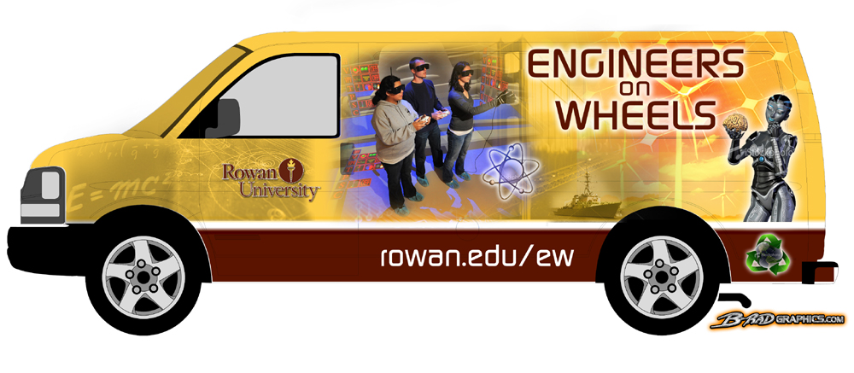
Engineers on Wheels
Dr. Jahan and Dr. Nancy Dejarnette
Develop hands on activities for K-12 outreach
Travel to select schools for hands-on demonstrations for middle school students

Slide 4
Trade-Offs for PHEV Adoption
Dr. Riddell and Dr. Bhatia (need 2 CEE, 2 ME)
Examine the effect of Plug-In Hybrid Electric Vehicle (PHEV) integration on emissions, electric generation, gas tax revenue and other factors in New Jersey
  Quantify commuter behavior in NJ
  Investigate electric generation in NJ – especially the contrast between peak and off demand
  Evaluate pollutants resulting from vehicles and powerplants
Develop recommendations to best utilize PHEV’s
  Are there regions in NJ they will be most effective?
  Encourage at-work recharging or not?
  What to do about lost gas tax revenue?

Slide 5
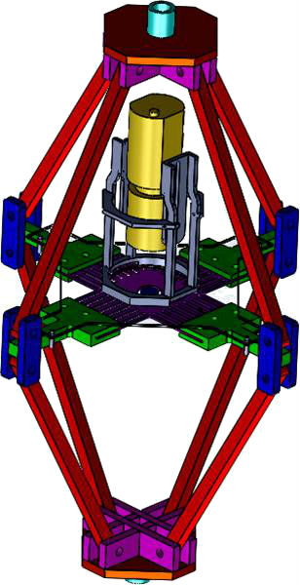
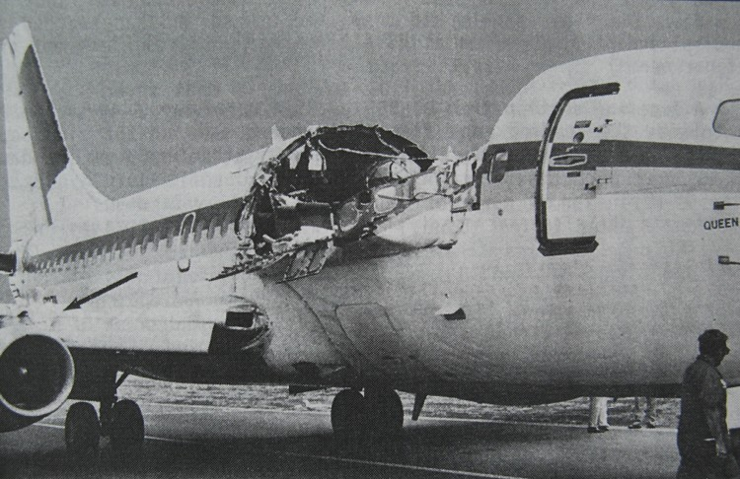
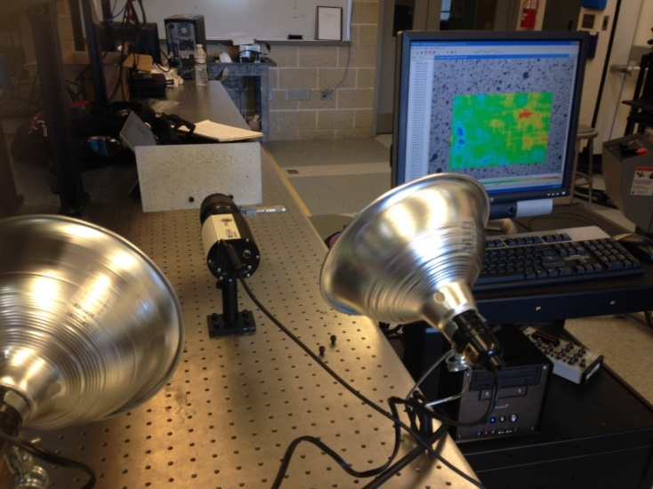
Design and Validation of a Biaxial Stress Test Stand
(Riddell – need 2 CEE, 2 ME)
Existing stand can apply biaxial stress state, σ_{xx} = σ_{yy}; τ_{xy} = 0
We want a stand that can develop other ratios of σ_{xx} / σ_{yy}
Use models from solid mechanics to create design modifications.
Manufacture modified stand
Use digital image correlation and strain gages to validate the results in the lab.
Ultimate application is to study fatigue near stress concentrations, like that found in aircraft.

Slide 6
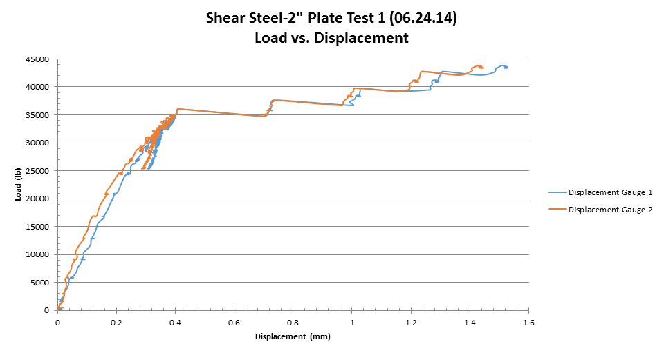
Structural Testing of Armatherm Thermal Barrier
Cleary and Riddell
(Need 3 to 4 students – CEE and ME)
Construction material used to reduce thermal flows when steel penetrates façade.
Compression, shear, and flexural testing.
Fabrication
Data collection and reduction
Report preparation

Slide 7
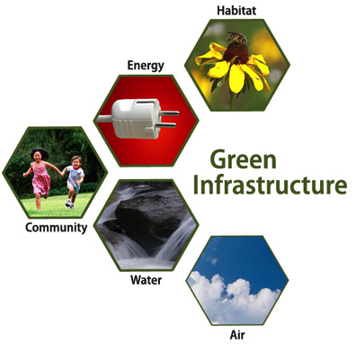
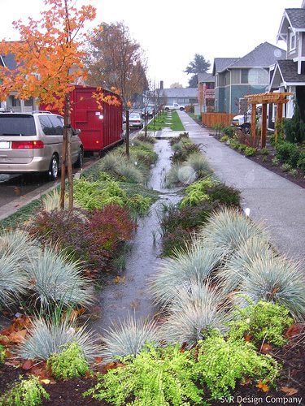
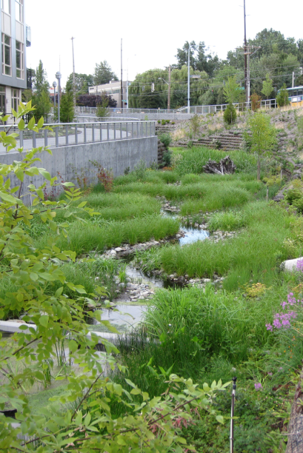
EPA Campus Rainworks Challenge
Dr. Daraio
3-5 CEE students
Create innovative green infrastructure design for the new engineering building
  Green infrastructure uses vegetation, soils, and natural processes to manage stormwater and create healthier urban environments
Show how managing stormwater can benefit the campus community and the environment
Winning teams earn a cash prize
http://water.epa.gov/infrastructure/greeninfrastructure/crw_challenge.cfm

Slide 8
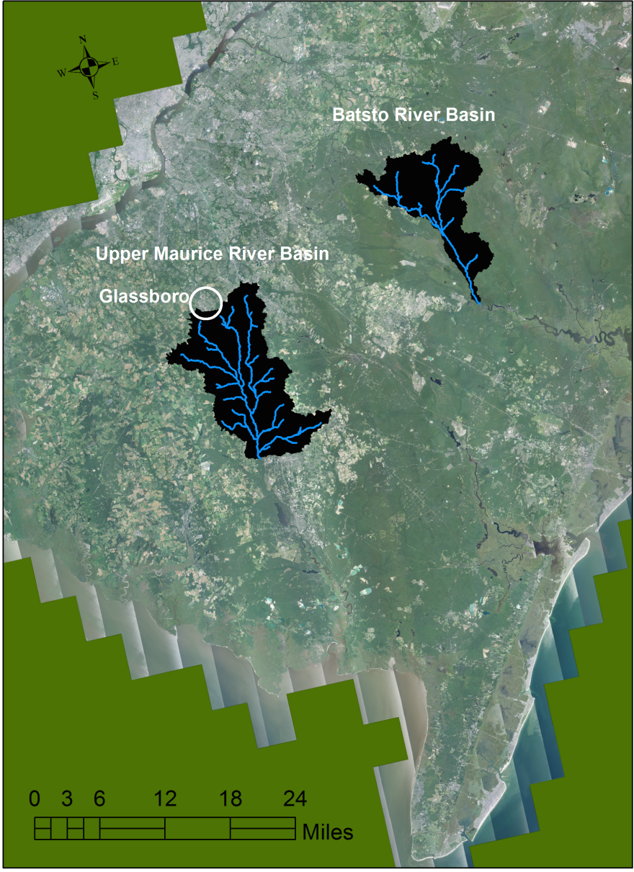
Need 3-5 CEE students
Climate and Land-Use Change Impacts in Two New Jersey Watersheds
Dr. Daraio
Assess the potential impacts of climate and land-use change on stream flow from 2025 – 2100
Use General Circulation Model (GCM) climate change data and
Land-use change projections
Hydrologic model simulations in the Batsto watershed (in the Pinelands National Reserve) and the upper Maurice watershed

Slide 9
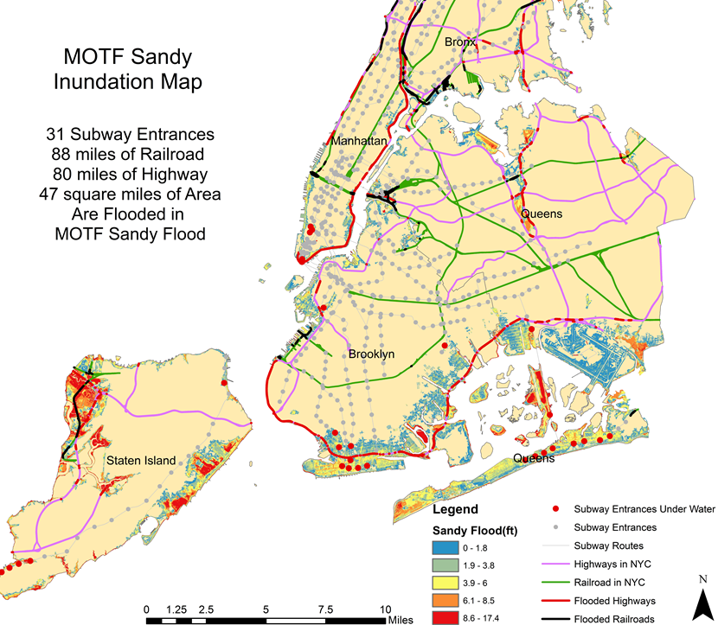
Impact Assessment of Predicted Sea‐level Rise And Extreme Storm Events on The Transportation Infrastructures
Rouzbeh Nazari, Need 3 CEE Students
To identify impact of predicted sea level rise and extreme events on transit at the system and at component level, where users are potentially most impacted, and recommend changes in system configurations and retrofits, usage and scheduling, proximity and elevation of transportation elements relative to water bodies.
Goals:
Locating the areas with high risk
of flooding
Identifying the transportation
structures located in these regions
Risk assessment of transportation
structures located in the floodplain
Studying the extent of the damage
in the following cases:
  Potential Life losses
  Potential Damages to properties
  and houses

Slide 10
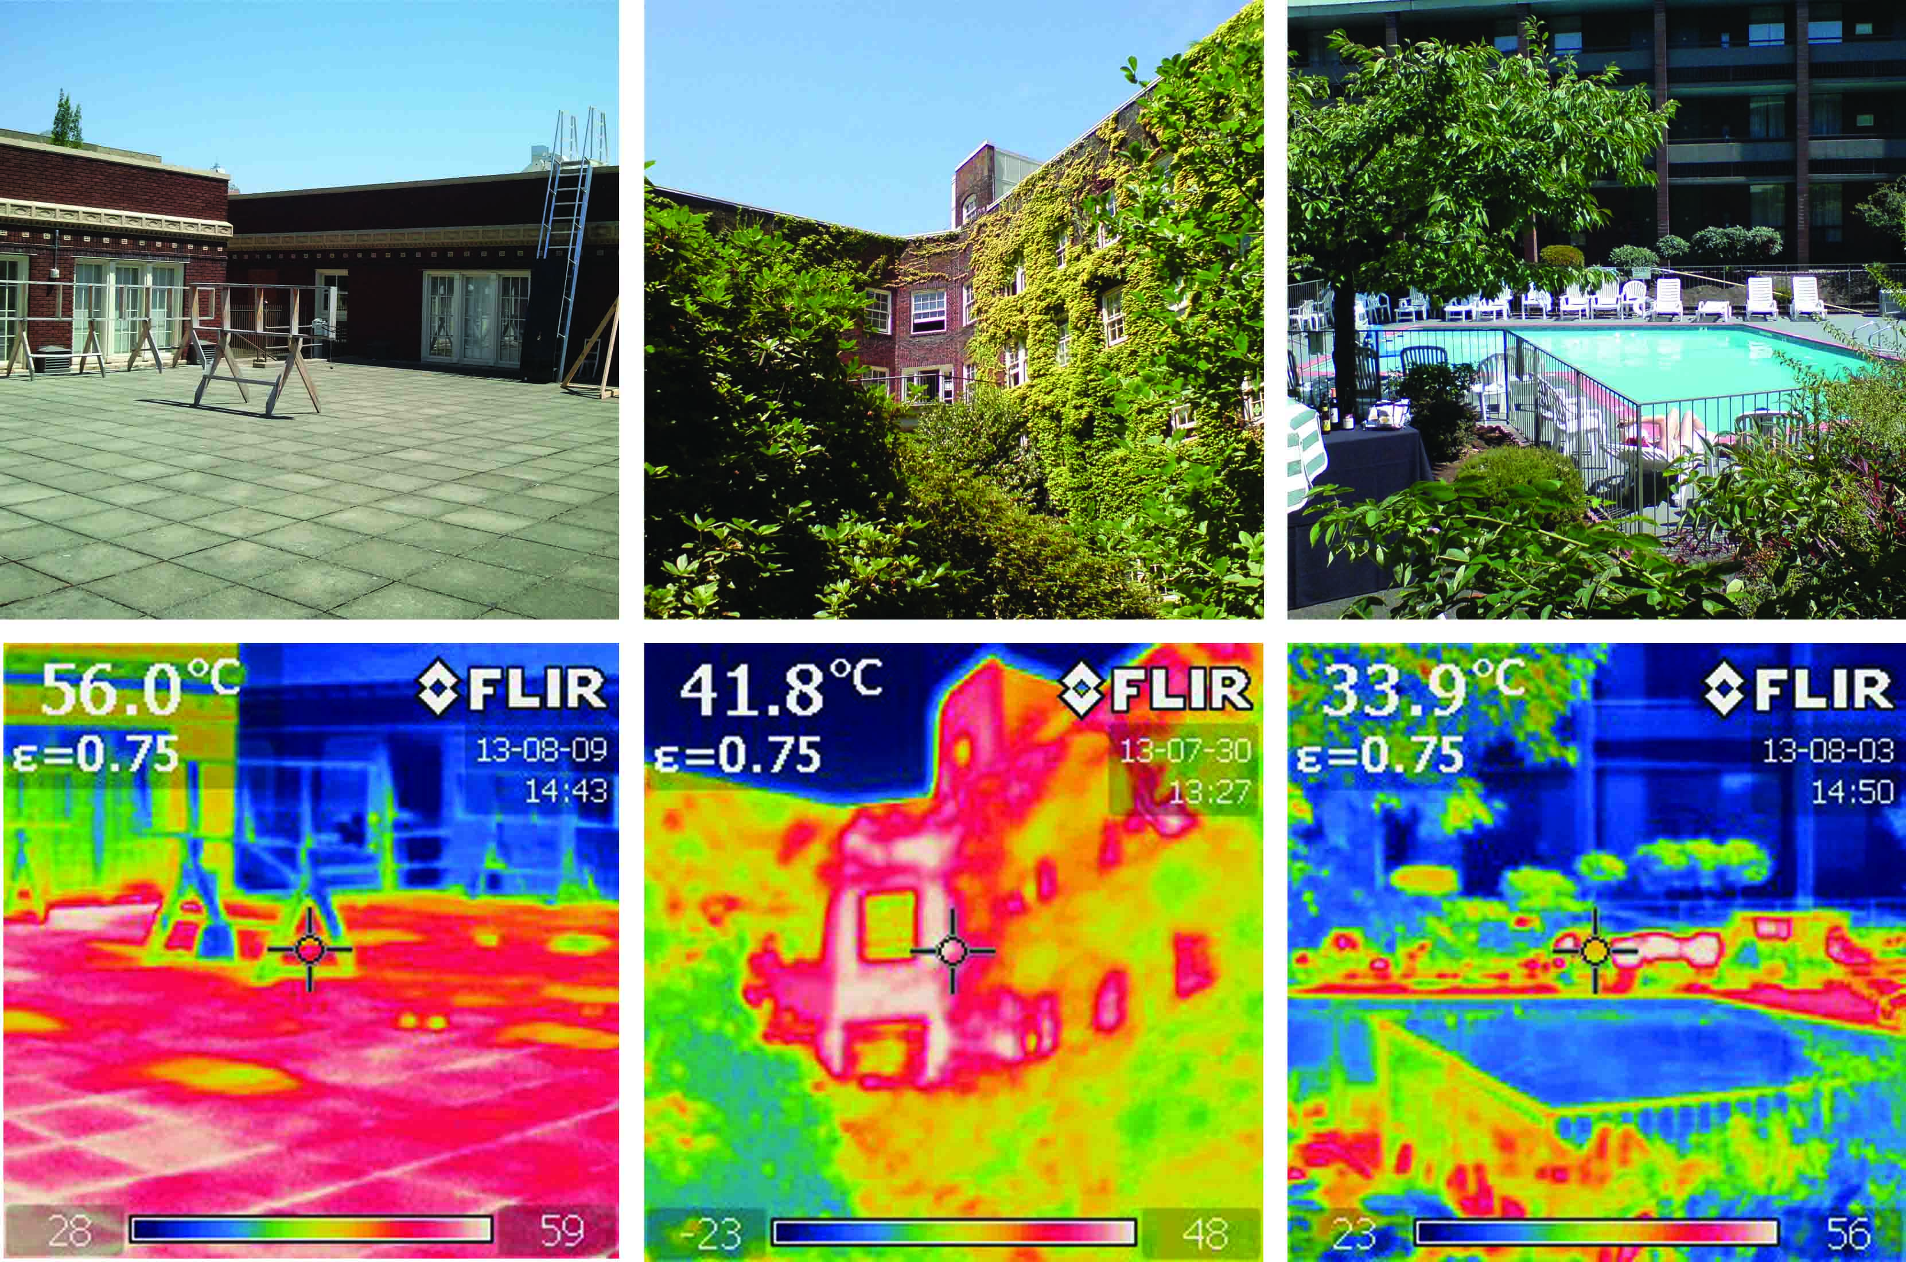
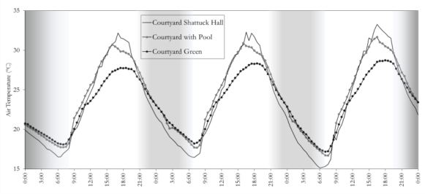
A Parametric Study of Heat Mitigation Strategies For Improvement of Urban Design, Open Spaces And Common Areas
Rouzbeh Nazari
Need 2 CEE & 1 ECE Students
Courtyard vegetation, high albedo surfaces, and courtyard ponds were investigated as
potential heat mitigation strategies using field measurements and simulations in a university
campus environment.
Reducing indoor building energy demand
Increasing Building Thermal Efficiency
Mitigation of urban heat island
Improvement of Urban Design, Open Spaces and Common Areas
Utilizing the Cooling effect of Vegetation and Water
Maximum Temp. Difference= 4.7°C (16:30 PM)

Slide 11
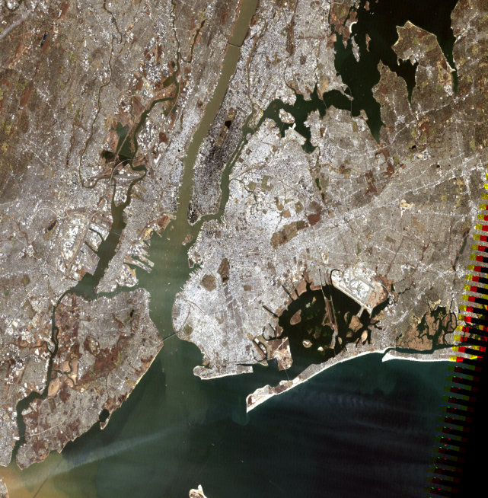
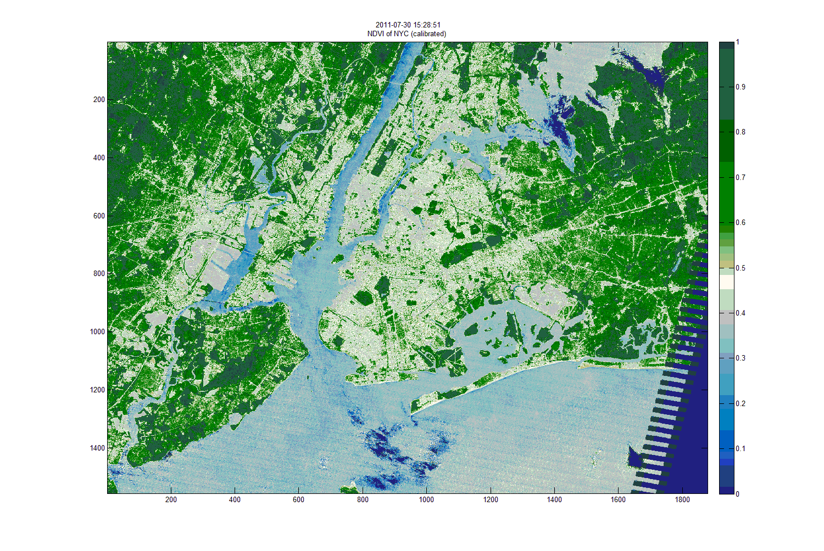
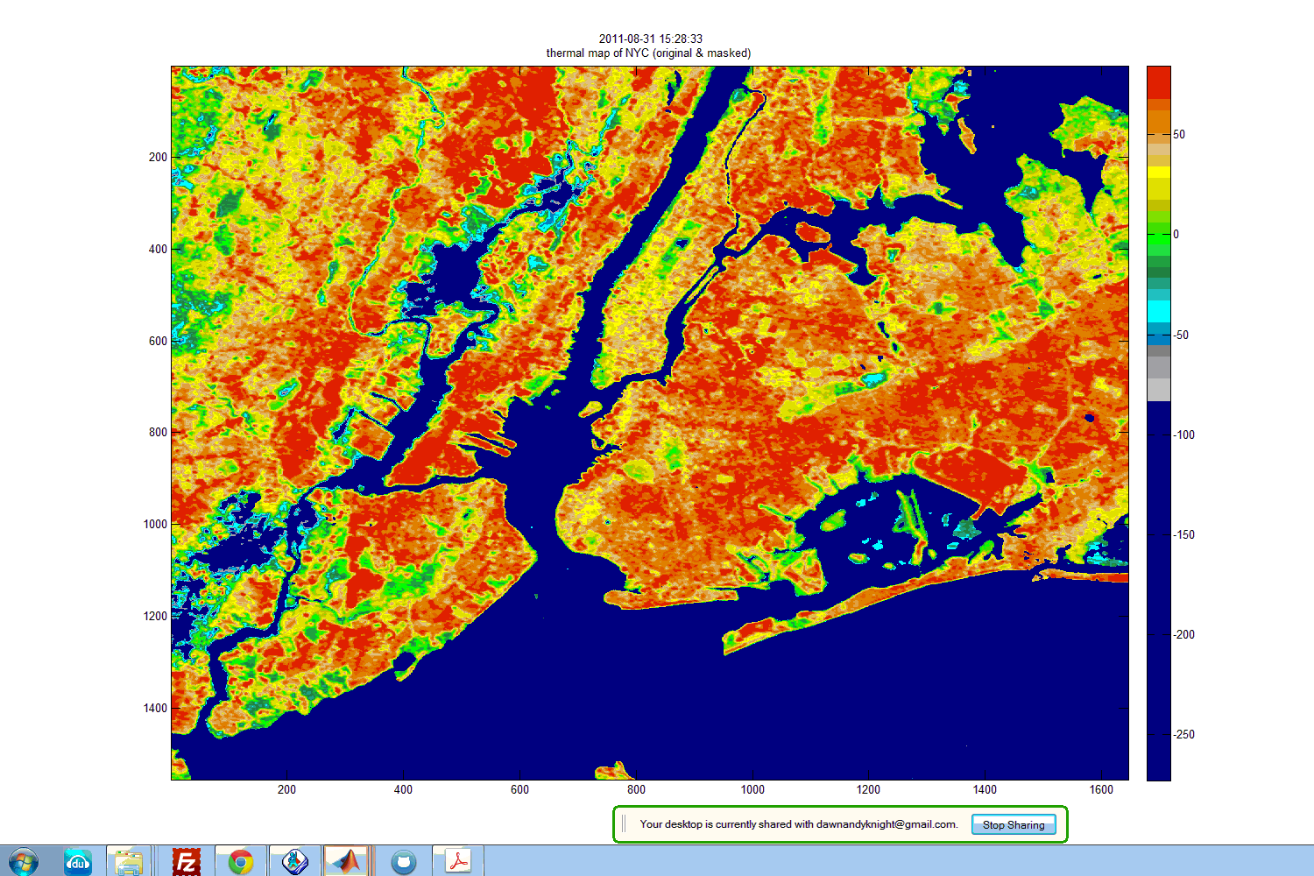
Calibration of Satellite IR Brightness Temperatures to Estimate Land Surface Temperature Variations within Urban Environment for Health Impacts
Rouzbeh Nazari, Need 2 CEE & 2 ECE Students
Since cities feature a wide variety of urban settings, it is expected the temperature response and resulting heat stress to vary. The main goal of this research is developing neighborhood based temperature and to study the long term variation of skin temperature of the city. Skin temperature retrieval model for Landsat will be developed for New York City and the Land Surface Temperature (LST) maps will be developed based on the best fitted model. Students will work with satellite images, remote sensing software and preform programing to develop and run various models.

Slide 12
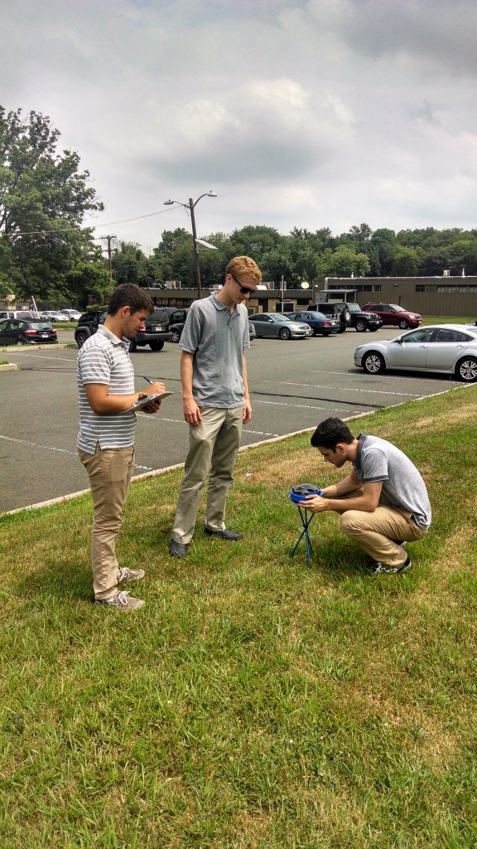
NJ DMAVA Energy & Water Interns
Everett, Riddell, Krchnavek
Need CEEs, ECEs and MEs
NJ Military & Vet. Affairs
  Energy & water master plan
    Data analysis
  Energy awareness & education plan
    Reduce costs by 20 %
    Incentivize energy saving
  Case studies
    Solar arrays, LED lighting,…
Can lead to paid internships!

Slide 13
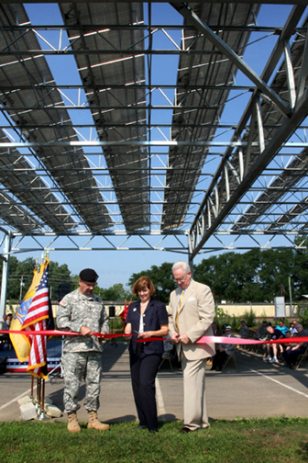
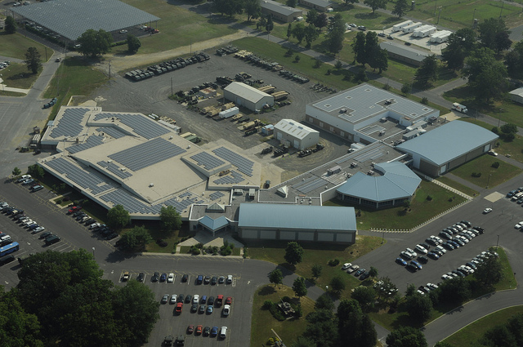
NJ DMAVA Energy Audit Center
Everett, Riddell, Bhatia, Krchnavek
Need CEEs, ECEs and MEs
NJ National Guard Facilities
  Model energy consumption
  Model HVAC systems
  Size solar systems
  Test building envelop
Can lead to paid internships!

Slide 14

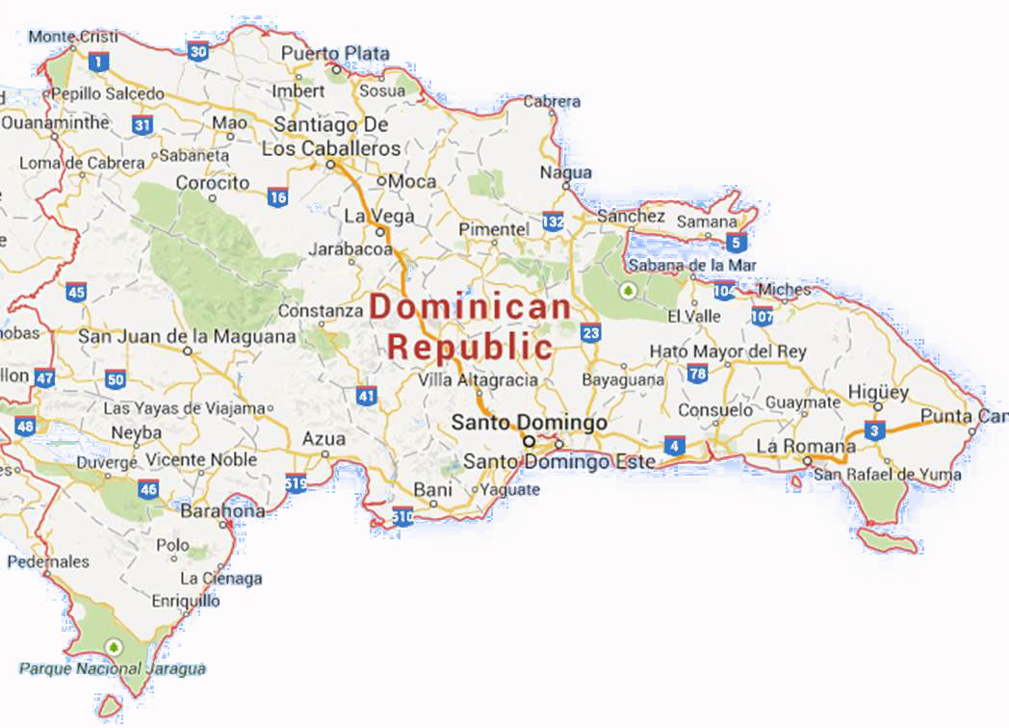
Engineers Without Borders
Everett & Mehta
Need ALL majors
Valle Verde, Dominican Republic
  Community needs access to Water
  Assess Alternatives
  Begin Design

Slide 15

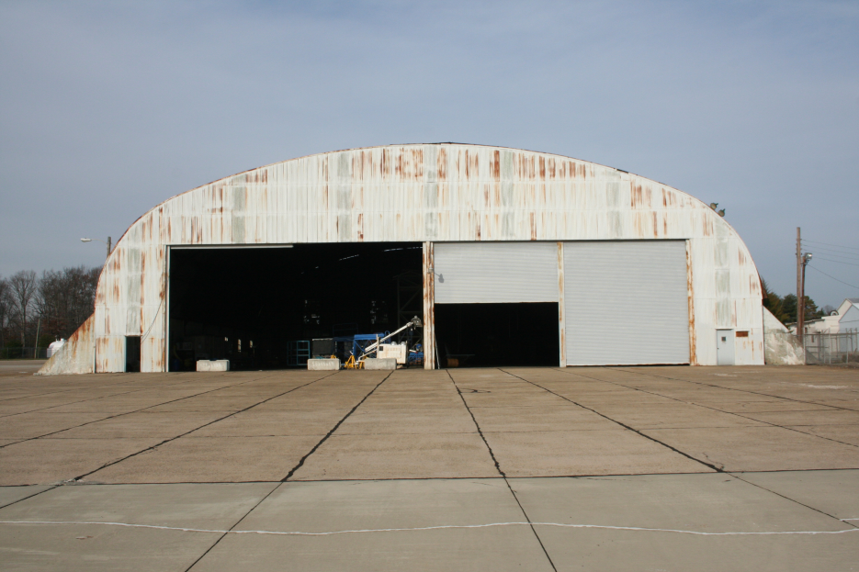
Aircraft Hanger Project
Dr. Dusseau
Better-define the chosen alternative for reconstruction of steel arch hanger Q.
Complete the cost analysis of the chosen alternative .
Complete the permit analysis for the chosen alternative.
Complete the computer model and analysis for the chosen alternative.
Begin development of preliminary design drawings for the chosen alternative.

Slide 16
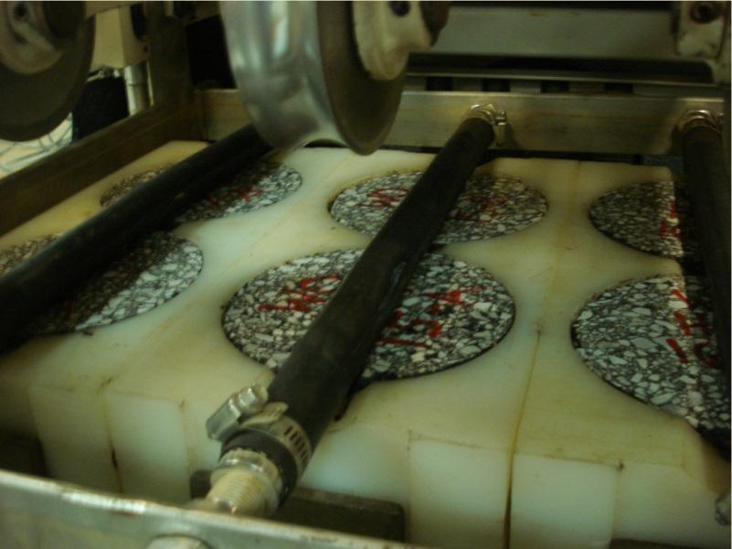
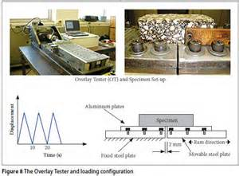

Design of High RAP mixes
Yusuf Mehta, 3 CEE
Goal:
Design high RAP mixes (>30%) for NJDOT
Any high RAP mixes in the state must meet:
Rutting in APA (AASHTO T340) less than 4mm at 64C, at 100 psi
AND Overlay tester (NJDOT B-10) > 125 cycles
in addition to Superpave
30
60
Source: http://asphaltscientist.com/asphalt-mixture-performance-tests/asphalt-pavement-analyzer-apa/asphalt-pavement-analyzer/
90
Source: http://www.scielo.org.za/scielo.php?pid=S1021-20192010000200004&script=sci_arttext

Slide 17
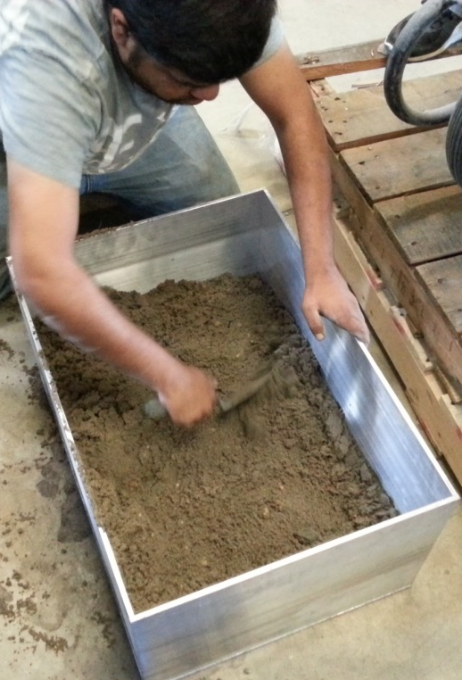
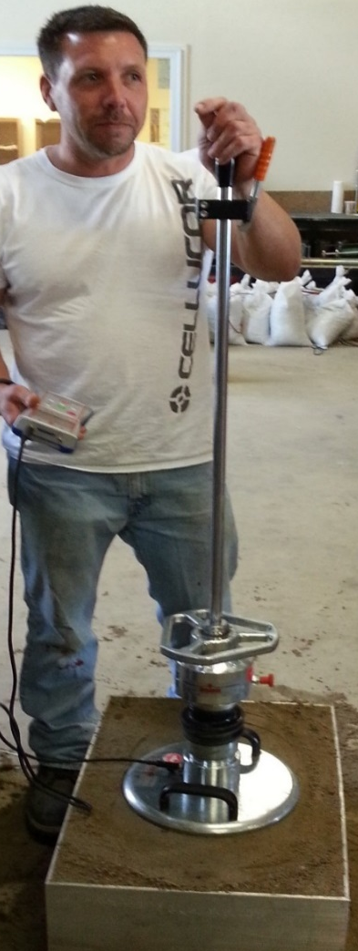
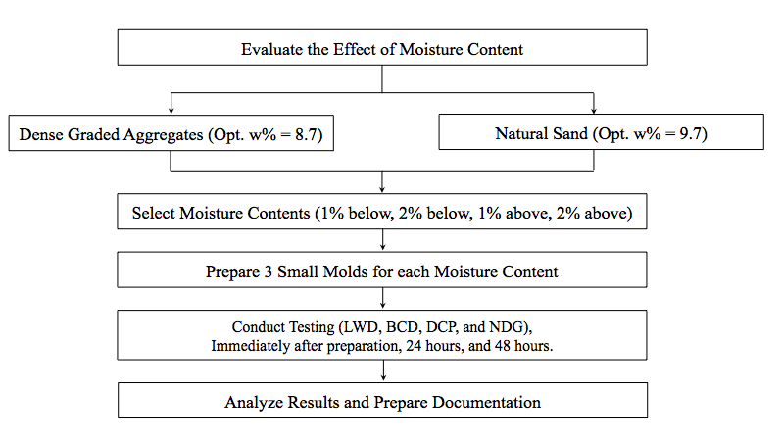
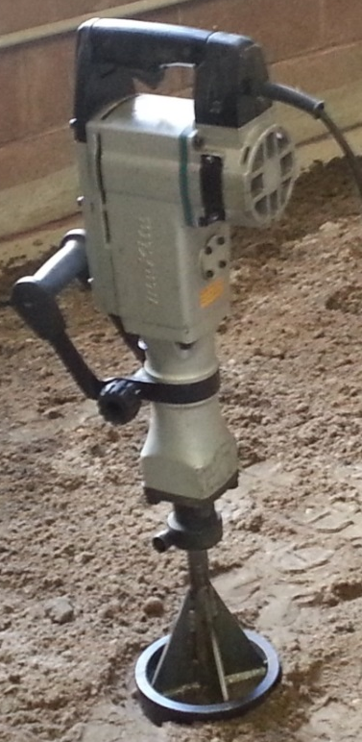

Alternative to Nuclear Density Testing
Yusuf Mehta, 2 CEE
The overall goal of this research project is to develop alternative methods for non-nuclear density testing for accepting soil and quarry produced aggregate compaction
Pilot testing was conducted in summer. Goals for fall:

Slide 18

Environmental Impact of RAP
Yusuf Mehta 3 CEE students
NJDOT would like to USE RAP for above ground applications.
Whether there is any toxicity associated with the freshly collected RAP materials;
Whether there is any toxicity associated with aged (weathered) RAP materials;
Whether there is any respiratory effects after inhalation of pollutants from RAP applications;
If any toxicity is observed, the research team will seek to determine which classes of contaminants are associated with toxicity; and finally
Whether there are engineering solutions that minimize potential toxicity of RAP material.

Slide 19
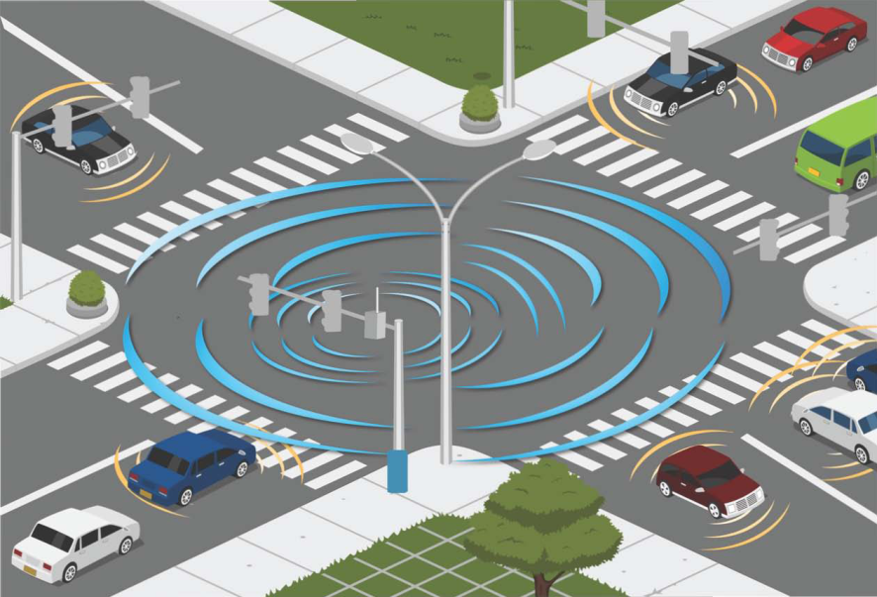
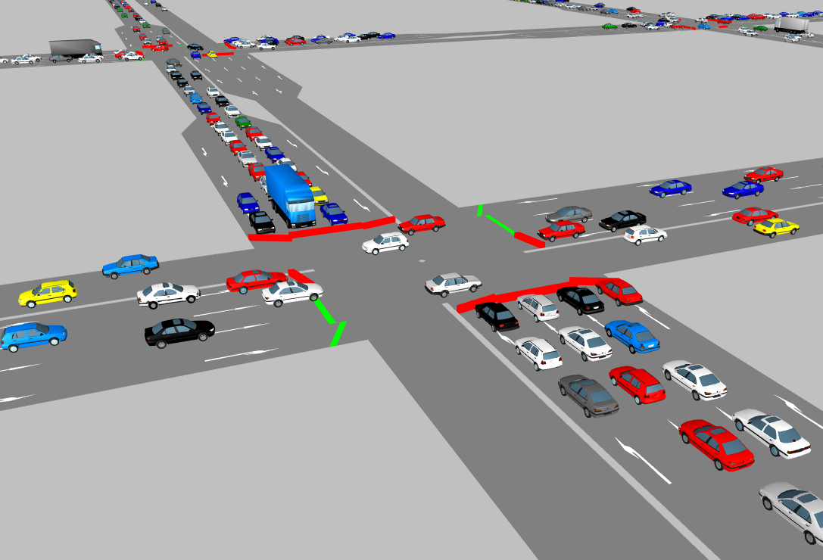
Evaluating impacts of connected vehicle applications
Dr. Bhavsar, Parth (2CEE, 2ECE, 2ME)
Goal
  Evaluate impacts of connected vehicle technology applications using traffic simulation
Skills required
  Basic knowledge in traffic engineering
  Basic programming skills
Goal
  Evaluate impacts of connected vehicle technology applications using traffic simulation
Skills required
  Basic knowledge in traffic engineering
  Basic programming skills
Develop traffic simulation network
  Identify congested corridors
  Collect traffic and roadway geometric data
  Develop network in VISSIM
Calibrate traffic simulation network
  Compare field data with simulation results
  Adjust model parameters
Identify potential connected vehicle applications
Select Measures of Effectiveness (such as speed, queue length, etc.)
Evaluate selected applications

Slide 20
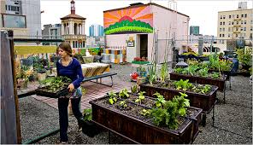
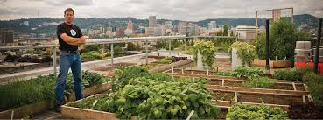
Rooftop Gardens
Cleary -need CEE and others
Townhomes with flat roofs are common in urban communities
Opportunity to reduce energy use and water pollution while improving nutrition
Develop an EPA P3 proposal to implement rooftop gardens in urban environments
  Understand plant needs and various garden systems
  Develop structural assessment system; …

Slide 21
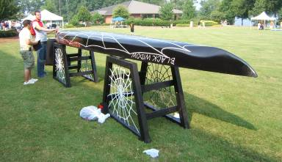
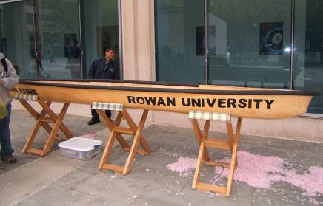
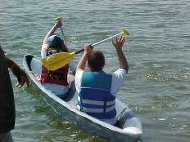
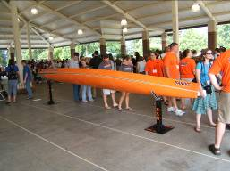
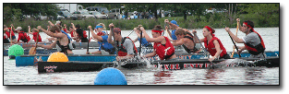
Concrete Canoe Competition
Cleary must be willing to participate in weekend work sessions

Slide 22
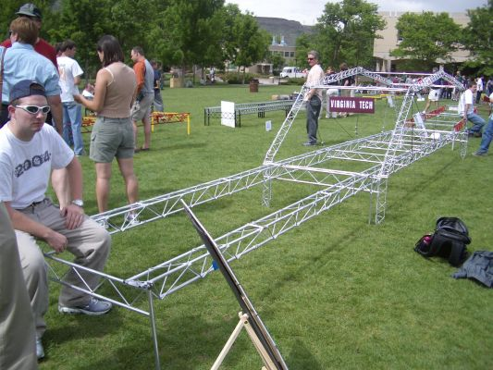
Steel Bridge Competition
Cleary
(Need 3 CEE can also use interested ME; must be willing to participate in weekend work sessions)
Design and build a steel bridge for competition
Project management skills needed
Competition Categories
  Construction Speed
  Lightness
  Aesthetics
  Stiffness
  Construction Economy
  Structural Efficiency
  Overall

Slide 23
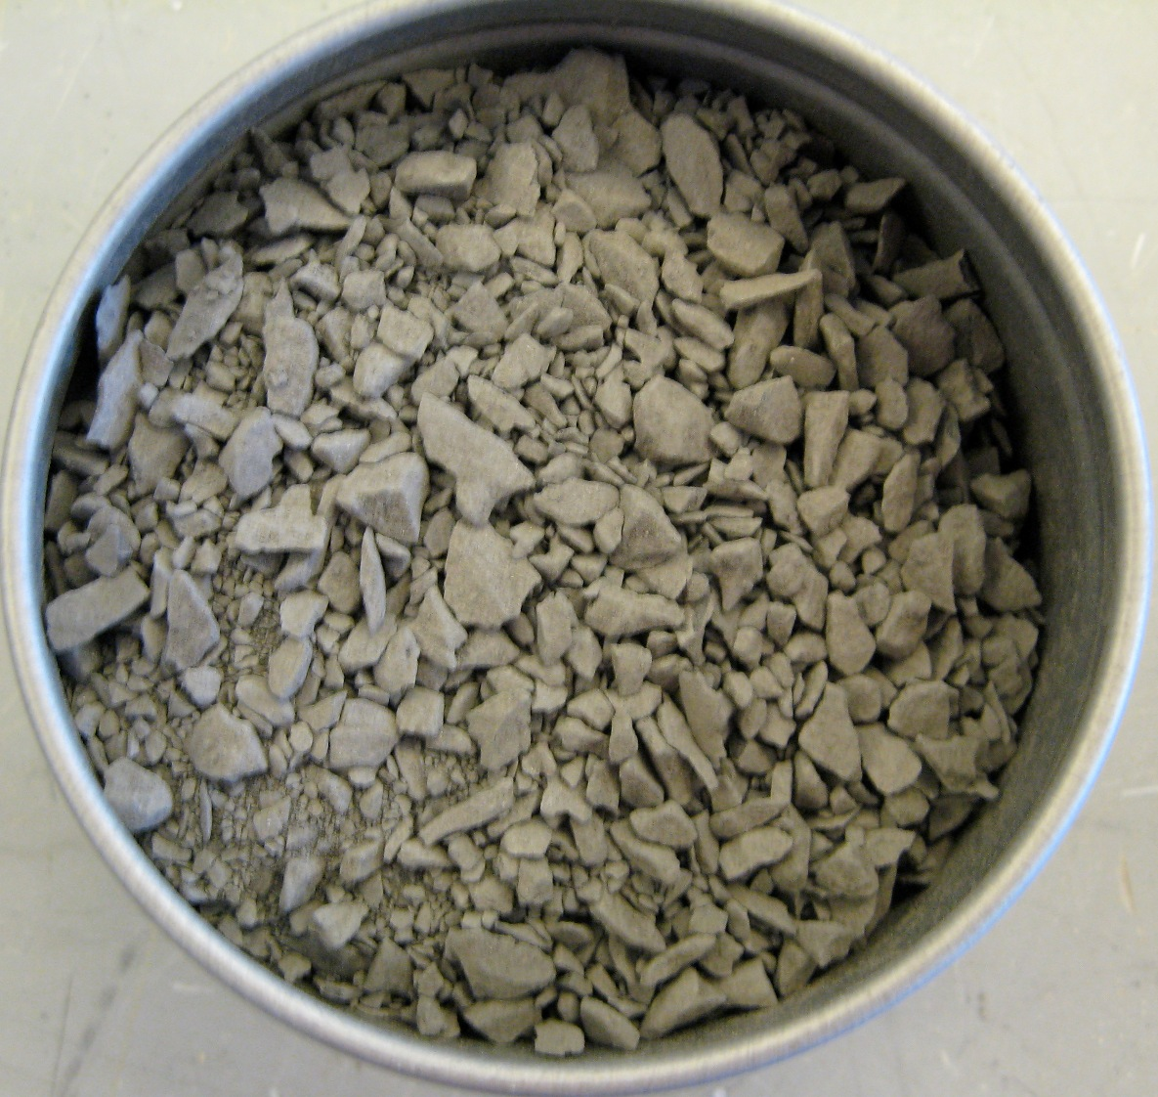
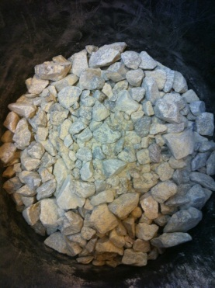
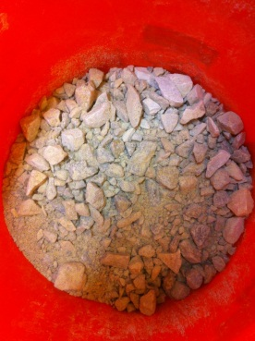
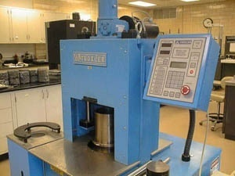
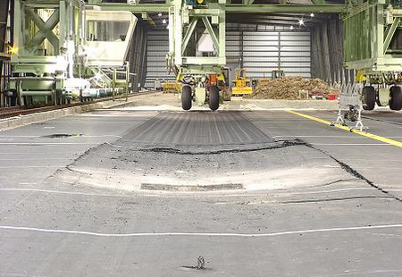
Flexible Airport Pavement Analyses and Aggregate Crushing
Dr. Sukumaran, Graduate student: Danilo Zepilli
Compare full-scale pavement data and gyratory data.
Obtain an approximate measure of field energy.
Investigate the feasibility of measuring energy during field compaction.
Conduct triaxial tests on different sands and
  Measure influence of crushing on shear strength.
  Determine the influence of sample length on shear strength.
Work collaboratively with the FAA.
Laboratory data
Field data
Fall 2014 outcomes
Continue publication, analysis and report writing.
Need 4 CEEs

Slide 24
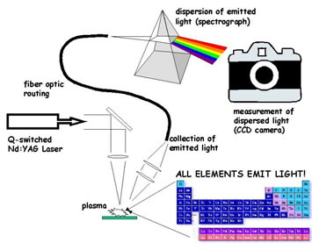
Laser Analysis of Aggregates
Dr. Sukumaran, Dr. Ramachandran and Dr. Lim
Graduate Student: Andrew Branin and Bless Ann Varghese
The goals of the project for the semester are:
Purchase and install laser holography system for analyzing particle morphology.
Calibrate and refine laser-spectra models to identify real-time aggregate properties such as mineralogy; and
Determine the feasibility of laser technology as a tool for identification of real time aggregate properties such as mineralogy and particle morphology.
Tools to be used:
Laser ablation equipment
Matlab
Need 2 CEEs and 2 ECEs
Will work on IEEE paper

Slide 25
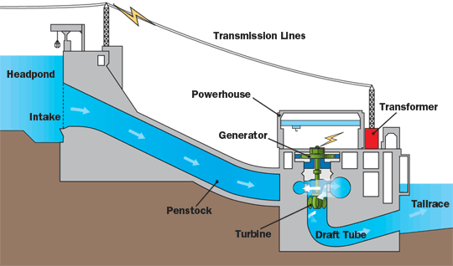
Engineering Innovators without Borders – Development of a mini water turbine and battery storage unit for the developing world
Dr. Sukumaran and Patrick Downey with assistance from Caitlin Terry
The goals of the project for the semester are:
Develop a sustainable mini-turbine utilizing stream or river power.
Develop a battery storage unit that is affordable.
Submit proposal to EPA-P3 for funding.
http://www.nbpower.com/html/en/safety_learning/learning/electricity_generated/hydro/hydro-anim-en.gif
Need CEE, ME

Slide 26
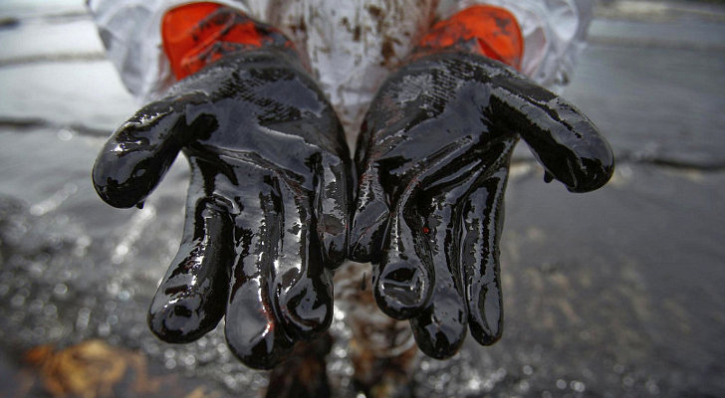
Oil biodegradation on shorelines
Jagadish Torlapati
Need 2 CE students
Project goals:
Develop a numerical model to simulate oil biodegradation on shorelines
Study the effect of salinity on oil biodegradation
Study the effect of temperature on oil biodegradation
Validate the numerical model using published dataset

Slide 27
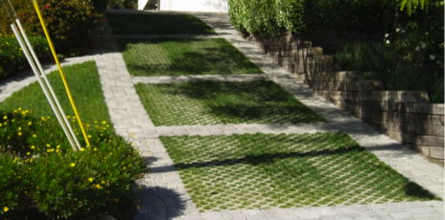
Green infrastructure and LID
Jagadish Torlapati
Need 1 CE student
Project goals:
Identify an urban catchment in NJ
Predict the change in runoff after using green infrastructure or low-impact development (LID) methods
Conduct scenarios using EPA SWMM software

