Slide 1
Beginner adults getting into the gym
Joe Paul

Slide 2
Benefits
Decreases risk for disease
Lowers blood pressure and cholesterol
Get the healthy you, that you have always wanted
Builds and maintains healthy muscles, bones, joints
Strengthen immune system
Improves memory/mental acuity

Slide 3
Benefits Cont.
Build up confidence
Increase energy for everyday living
Reduce stress, depression, and anxiety
Improves sexual performance
Decreases your “inner” age
http://www.askmen.com/top_10/fitness/top-10-benefits-of-exercise-for-men.html

Slide 4
What to do at the gym?
Cardiovascular- strengthening your heart
Strength/Resistance Training- toning or bulking up your muscles
Circuit Training- combination of both Cardio and Strength training

Slide 5
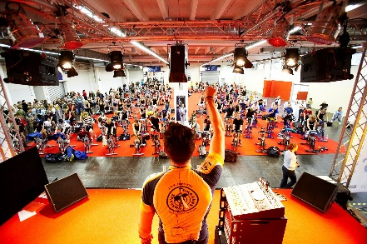
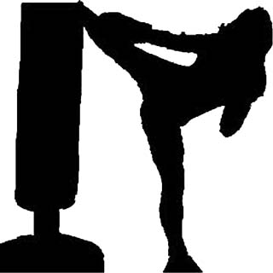
Cardiovascular Training
Two types- Aerobic (with oxygen) and Anarobic (without oxygen)
Aerobic Training- lower intensity, steady state exercise
Anarobic Training- high intensity, short burst of max exercise
Way more than just running or biking
Zumba
Spin
Kickboxing
Etc.

Slide 6
What’s best for you?
Aerobic
Anarobic
Low intensity optimal fat burn
Best for weight loss
Increase endurance/Stamina
More cardio based
Better for decreasing risk of disease
Increase force and muscular mass
Best way to train is strength training
Helps the most with increasing metabolism
Burn more calories while not working out

Slide 7
Strength/Resistance Training
More traditional way of working out
Can be made more advanced or less traditional
Not just lifting weights
Some of the best workouts are body weight workouts
Great for activities of everyday living

Slide 8
Ways to break up Strength Training
Each day do a different muscle group
This will equal more days in the gym
Each day combine two muscle groups
Either agonist (muscle being work) to antagonist (muscle that aids muscle being worked)
Or complimentary muscles- muscles that are being worked as you do a different muscle group
Shoulders-triceps, back-biceps etc.
Finally Push/Pull days
Full body workout but you only do exercises that pull one day and push the next

Slide 9
Circuit Training
Best way to optimize your time at the gym
8-12 exercises with no rest in-between
Workouts can be done in as little at 30 min
Great way to disguise cardio at the gym
Training with a trainer=most bang for your dollar

Slide 10
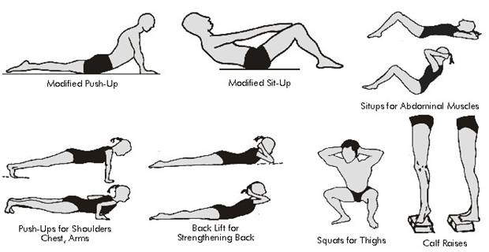
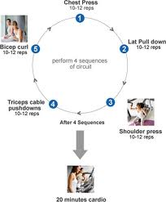
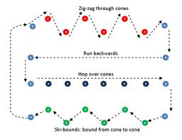
Circuit Training
Basic Circuit without weights
Basic Circuit with weights
Basic Agility Circuit

Slide 11
What we need before exercise program
First and most important Medical history & Readiness to exercise questionnaire
This will tell me if you can/how hard you can exercise
If needed get clearance from your doctor
Once cleared we can do fitness testing to see were you are

Slide 12
Fitness testing
Muscular strength- asses overall strength of your muscles
Muscular endurance- asses number of reps you can do in period of time
Flexibility- how flexible your muscles are
Body composition- asses your obesity rate
Aerobic testing- how well you can exercise with oxygen

Slide 13
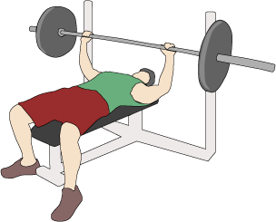
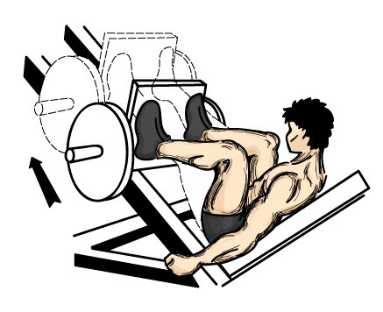
Muscular Strength
Muscular strength will asses what you lift at your max level
1 RM (rep maximum) bench
1 RM leg press

Slide 14
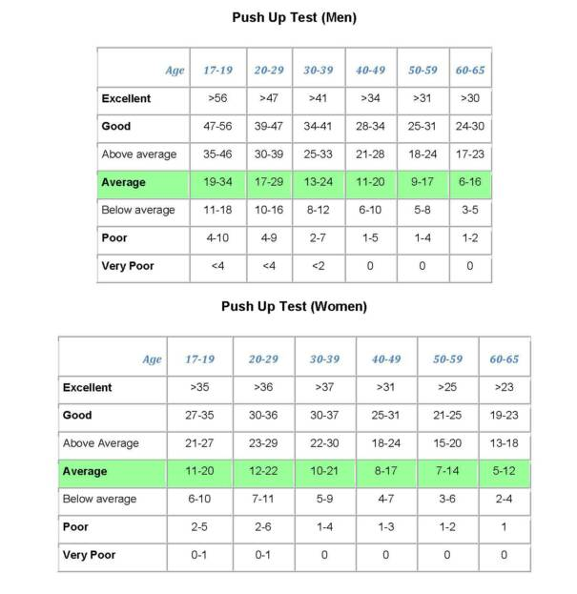
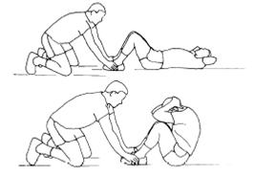
Muscular Endurance
1 minute push up test- how many push ups can you do in one min
1 min crunch test- how many sit ups can you do in one min

Slide 15
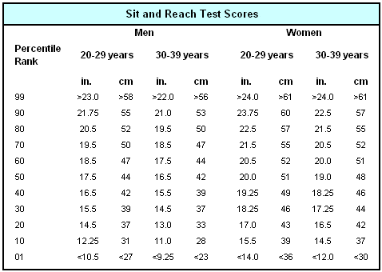
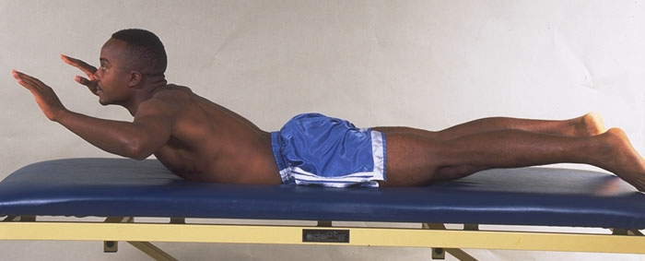
Flexibility
Sit & Reach- measurement of hamstring flexibility
Trunk extension- lower back flexibility
Shoulder extension- shoulder flexibility

Slide 16
Body Composition
Skin Fold- percentage of body fat from different parts of the body
Triceps, Chest, Upper hip, Abdomen, Quadriceps, Subscapular (shoulder blade)
BMI- Body Mass Index
Hydrostatic Weighing (underwater)- Gold star of fat percentage on body
Hip to waist- ratio of hip circumference to waist circumference
Bioelectrical Impedance- small electrical currents pushed through your body

Slide 17
Skin Fold
Very accurate measure if person does it right
People can feel that it is personal
Different sites for men and women
Men- triceps, chest, quadriceps
Women- triceps, upper hip, quadriceps
For a fourth site for both you can do the subscapular (shoulder blade)
Exrx.net

Slide 18
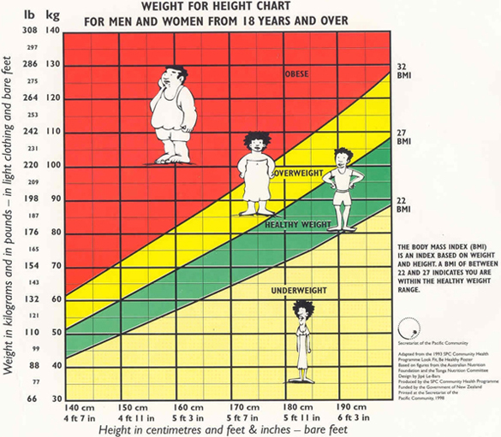
BMI (Body Mass Index)
Measure of the human body shape based on the individuals height and weight
Measured in mass (kg)/height (m²)
Not the most accurate if
you are very muscular

Slide 19
Aerobic Testing
How well your body uses oxygen during exercise
Two different types
Maximal- go until you can’t go anymore
Submaximal- go as hard as you can for the allotted time

Slide 20
Aerobic Testing
Maximal
Submaximal
Vo2 Max- done on treadmill or a bike
1 mile run
1 minute step test- step up & down on boxes 16.4 in off the ground

