Slide 1
Digital Image Processing
ECE.09.452/ECE.09.552
Digital Image Enhancement
Dr. Shreekanth Mandayam
Electrical & Computer Engineering
Rowan University

Slide 2
Plan
Pixel Operations
    Point processing
    Histogram equalization
    Connectivity
Lab Project 1
individual pixels
all pixels
neighboring pixels

Slide 3
DIP: Details

Slide 4
Recall: Sampling & Quantization
Sampling
  demos/demo_sampling.m
Quantization
  demos/demo_quant.m

Slide 5
Image Preprocessing
Enhancement
Restoration
Inverse filtering
Wiener filtering
Spatial
Domain
Spectral
Domain
Filtering
>>fft2/ifft2
>>fftshift
Point Processing
>>imadjust
>>histeq
Spatial filtering
>>filter2

Slide 6
Point Processing
(Intensity Transformation)
s(x,y) = T{ r(x,y)}
Transformed
Gray Level
Original
Gray Level
Transformation
Function
>>imadjust

Slide 7
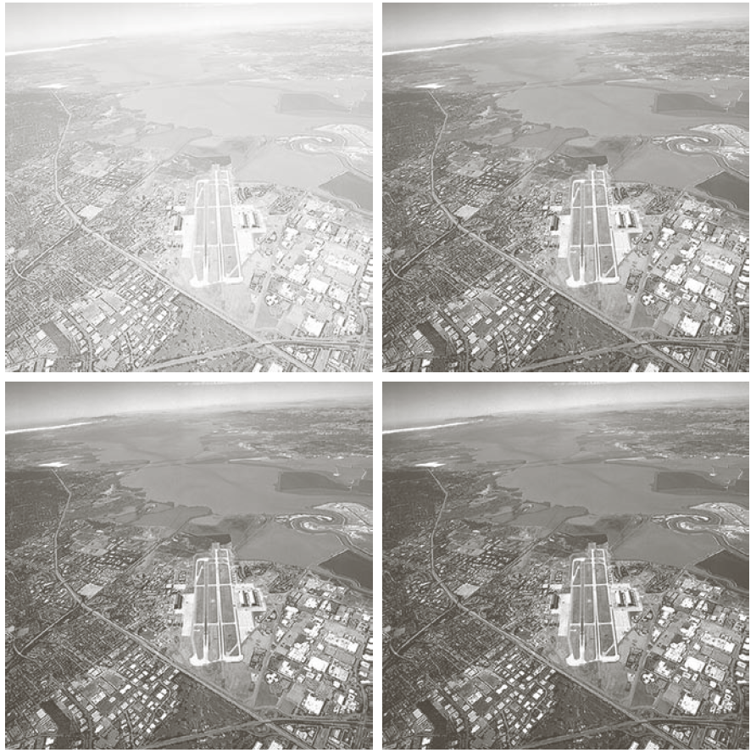
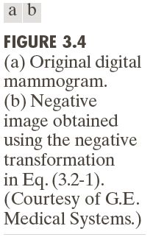
Point Processing
L-1
L-1
s₂
s
s
γ
s₁
0
0
r₁
r
0
r
L-1
0
r₂
L-1
>>imadjust

Slide 8
Image Histogram
>>imhist

Slide 9
Histogram Equalization
(Balancing)
>>histeq

Slide 10
Pixel Connectivity
x
(x-1,y-1)
(x,y-1)
(x+1,y-1)
y
(x-1,y)
(x,y)
(x+1,y)
(x-1,y+1)
(x,y+1)
(x+1,y+1)

Slide 11
Labeling of Connected Components
Begin scan
Update
position (x,y)
Position: (x,y)
p(x,y) = 1?
All positions
scanned?
y
p(x-1,y) = 1?
y
class(x,y) = class(x-1,y)
p(x,y-1) = 1?
y
class(x,y) = class(x,y-1)
y
End scan
p(x-1,y) AND p(x,y-1) = 1
y
class(x-1,y)
= class(x,y-1)
p(x-1,y) AND p(x,y-1) = 0
y
class(x,y) = new class

Slide 12
Image Preprocessing
Enhancement
Restoration
Inverse filtering
Wiener filtering
Spatial
Domain
Spectral
Domain
Filtering
>>fft2/ifft2
>>fftshift
Point Processing
>>imadjust
>>histeq
Spatial filtering
>>filter2

Slide 13
Lab 1: Pixel Operations
http://users.rowan.edu/~shreek/spring20/dip/labs/lab1.html

Slide 14
Summary

