Slide 1
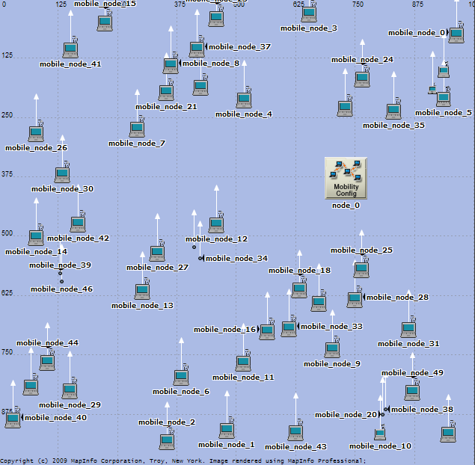
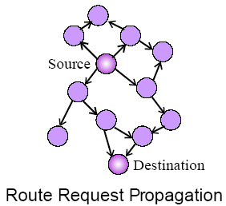
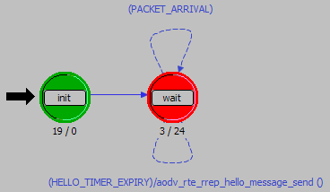
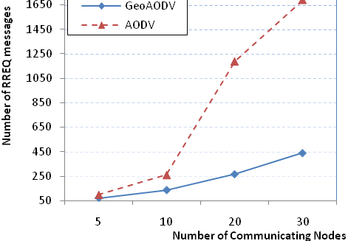
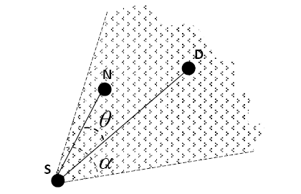
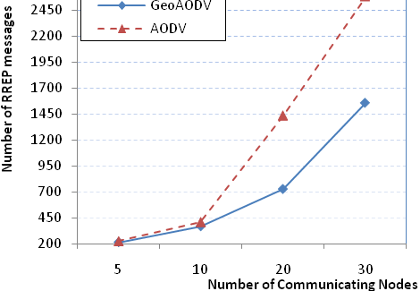
GeoAODV implementation using OPNET Modeler
Hristo Asenov¹, Vasil Hnatyshin², Andrew Fabian³
{Computer Science, Mathematics} Department, Rowan University
¹{hristo.s.asenov}@gmail.com, ²{hnatyshin}@rowan.edu, ³{fabian78}@students.rowan.edu
Motivation and Contribution
OPNET Modeler implementation
Simulation Set-up
Mobile Ad-Hoc Networks broadcast routing messages to discover routes
Results in unnecessarily large control traffic overhead in the network
Using GPS coordinates of destination, restrict broadcasting to an area
Network Level
Simulation details
AODV parameters
Node
Level
Node modules
IP module deals with routing
Process Model
Level
ip_dispatch invokes manet_mgr
manet_mgr invokes aodv_rte
OPNET’s aodv_rte Process Model
Results
Route Requests
Solution Idea
Send RREQ messages that carry the flooding angle
If node is within the forwarding area defined by flooding angle then forward RREQ
If node outside the forwarding area defined by flooding angle then discard RREQ
Introduced Changes
Modified RREQ and RREP packet structure
Implemented tables for maintaining GPS coordinates
Developed and implemented algorithms for
Computing flooding angle
Computing forwarding area
Processing new RREQ and RREP packets
Route Replies

