Slide 1
Elwha Dam
Elana Amir, Jacob Dicks, Michael Mosley, Mario Romano, Jon D’Amico

Slide 2
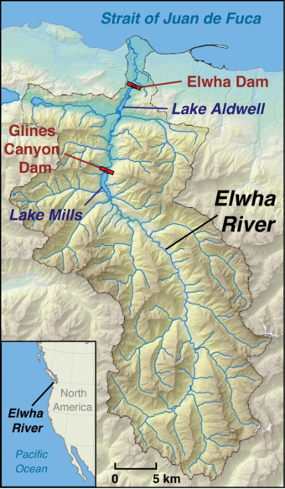
Background
Located in Washington State
Flows north 45 miles to Strait of Juan de Fuca
Construction began in 1910.
During this time small towns without electricity existed in area, they produce lumber for surrounding cities like seattle
Dam broke down in 1912 before finished but was rebuilt
Dam completed in 1927
USGC

Slide 3
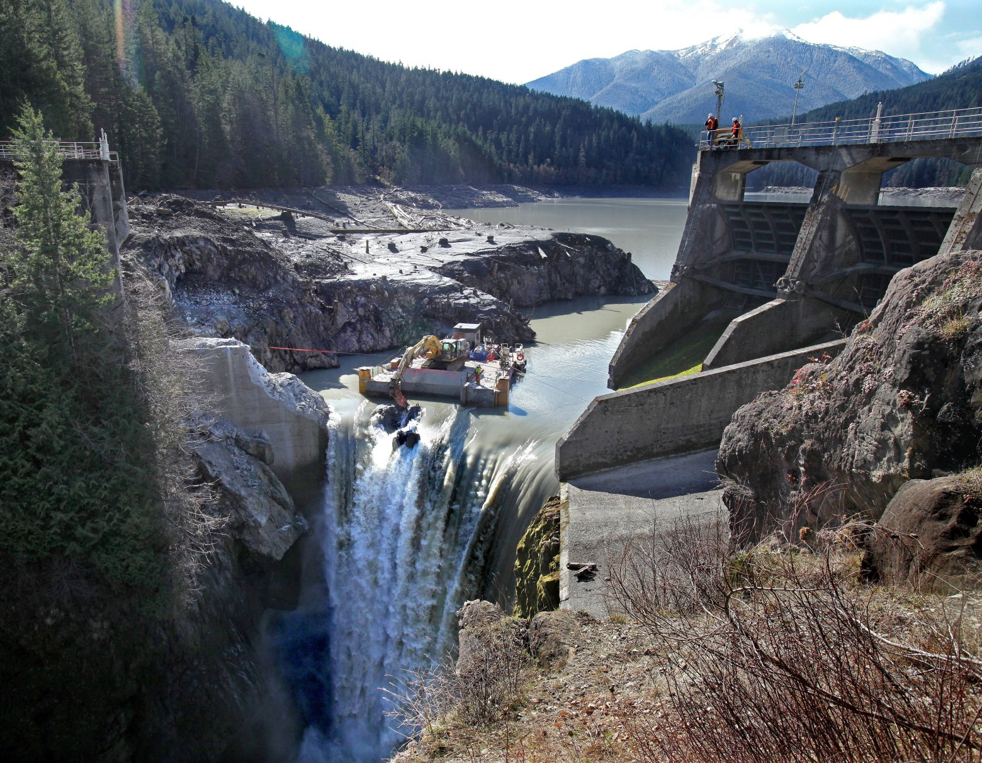
Background
Caused severe impacts on surrounding environment
Power produced wasn’t as vital as time went on
1992 George H Bush signs Elwha act to remove dam
Removal began in september 2011 and finished in March 2012
Largest environmental recovery project
www.seattletimes.com

Slide 4
Significance
The addition of the dam caused a decrease in fish population and damaged the environment
Largest dam removal in US history
Nearshore habitat has positively increased leading to new species of fish coming in for salmon to feed on
Fish, crabs, and birds have all taken the Elwha as home again
Herring and smelt travel to the ocean which are consumed by killer whales

Slide 5
Properties of Contaminant
Stored fine-grain sediments were released during the dam removal
Kelp beds were covered with sediment
Roughly 18 Mt of sediments were released
Current monitoring will reveal how to handle the sediments

Slide 6
Construction Impacts
The construction of both Elwha and Glines Canyon dams in the early 1900’s had various impacts in the environment surrounding the area.
Sedimentation collection in Lake Aldwell and Lake Mills caused increased erosion in the riverbed following the dams.
Hundreds of species of plants and animals were affected by construction.
The dams blocked fish from traveling upstream to their natural nesting grounds.
Salmon are affected the most due losing 70 miles of upstream migration area.
Number of fish plummeted from 400,000 to 3,000 just after Dam built.
Local wildlife population suffered through lack of food. Various species of birds and mammals abandoned the area.

Slide 7
Demolition Impacts
The deconstruction of both Elwha and Glines Canyon dams began in September 2011. They were taken apart simultaneously and over an extended period of 3 years to minimize environmental impacts. Nonetheless, this caused multiple impacts in the watershed post destruction.
Removal of the dams allow the river to restructure its sedimentation displacement. Causing less erosion of the riverbed.
90% of sediment makes it to the coastal area increasing the mouth of the river. In turn, restoring an estuary for marine life to call home.
In just a short period of time, many new species of fish begin to migrate in the 70 additional miles of nesting grounds leaving nutrients for plant and wildlife growth.
The new population of fish and fresh vegetative growth allow for birds and mammals to begin repopulating the area.

Slide 8
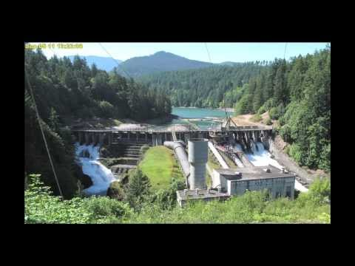
Video of Demolition Process

Slide 9
Unique Features
There was not much unique in the design of the dam. During the expansion of the American west hydroelectric dams like Elwha appeared in plenty
Corners were cut when the dam was originally built by the contractor in order to speed up the process
The big controversial cut corner was the lack of fish ladders so native fish like salmon could pass through the dam

Slide 10
Engineering Features
When the dam’s construction began in 1910 the contractors did not anchor the dam into bedrock which led to a failure in 1912 before the dam was even complete
The hydroelectric plant inside the dam was a key part to powering the olympic peninsula in Washington state

Slide 11
Environmental Issues
Geomorphic processes
Elwha dam prevented gravel from moving down stream
This lead to shoreline erosion along Strait of Juan De Fuca
This increased flood risk and reduced anadromous fish habitat
Hydrologic processes
Dams transform free flowing water to a non flowing reservoir habitat
Prevented fish migration
Biological processes
Change in temperature, chemical composition, dissolved oxygen level, ect.
Not suitable for aquatic plants and animals
Allows for algae growth and invasive specie populations

Slide 12
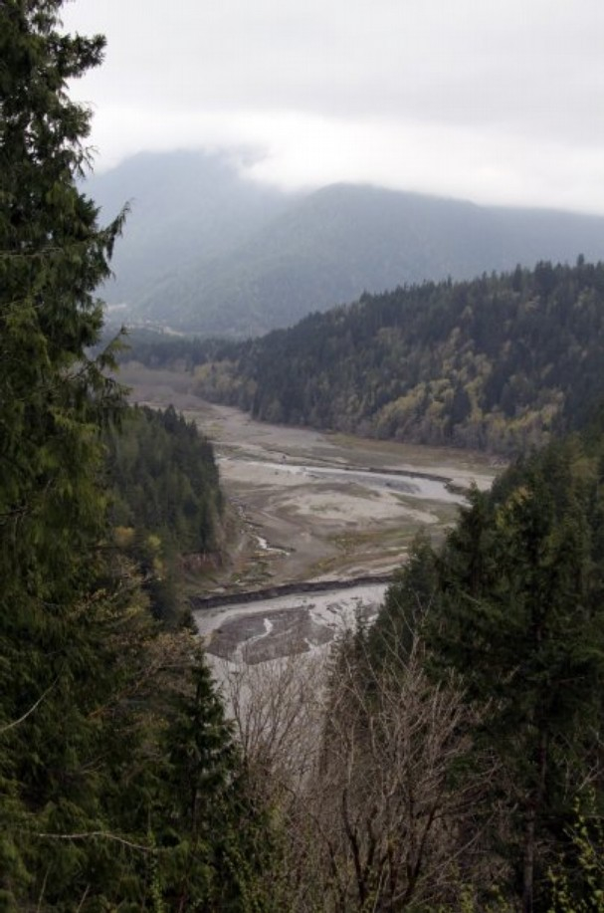
Ethical Issues
In 1912, Elwha dam failed and was given the needed repairs
The dam was not licensed by FERC which prevented local tribes from receiving millions of dollars from US Department of Housing and Urban Development
Drove away salmon
Food source for local tribes taken away
Figure: Lake Aldwell reservoir drained
Notes:
anadromous fish ex: salmon, born in fresh water. Lives in seas, comes back to fresh water to spawn

Slide 13
Social Issues
Hydroelectric power was used locally
Destroying the dam could have effected 7% of the counties workforce
Water Quality
The Washington Department of Ecology rates the Elwha River’s water as Class AA;
Cost to remove dam was estimated from $66 to $307 million
Fishing became hard
Lack of food for native tribes
Hurt local economy
Notes:
AA = extraordinary quality

Slide 14
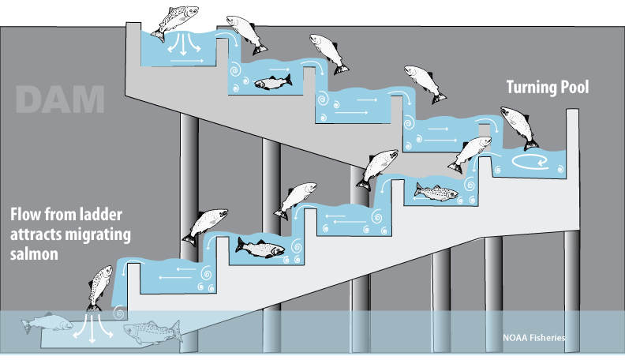
Regulations
Illegal to not build fish ladders
Allows fish to move up and down dam
In place before elwha
Endangered Species act (ESA)
1973
protect ecosystems
dependent wildlife
Federal energy regulatory commission (FERC)
Periodic dam inspections
1977
www.westcoast.fisheries.noaa.gov

Slide 15
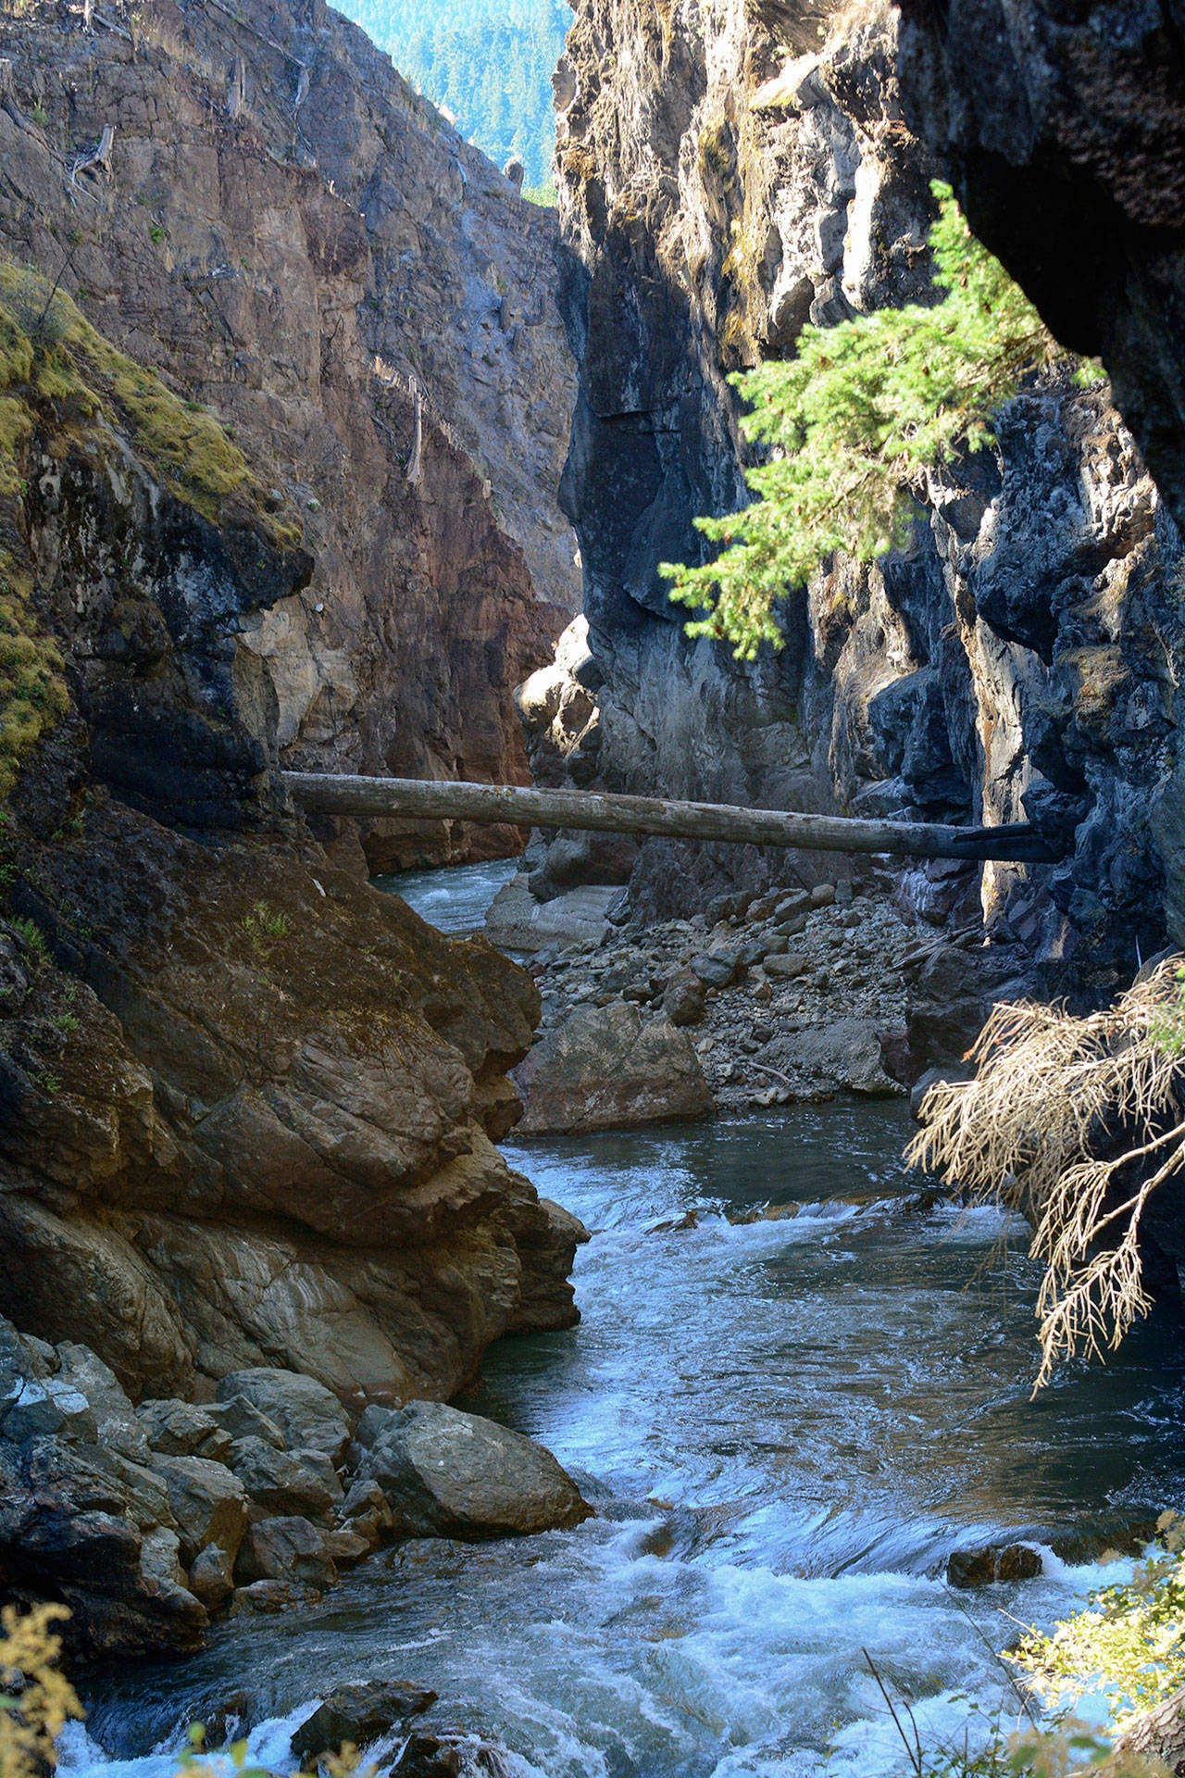
Environmental recovery
Fish recolonizing areas upriver
Most species came back
Ahead of schedule
Numbers are what expected
Moved further up river than expected
Fishing closed until June 1, 2019
Still to early to make significant comparisons
http://www.peninsuladailynews.com

Slide 16
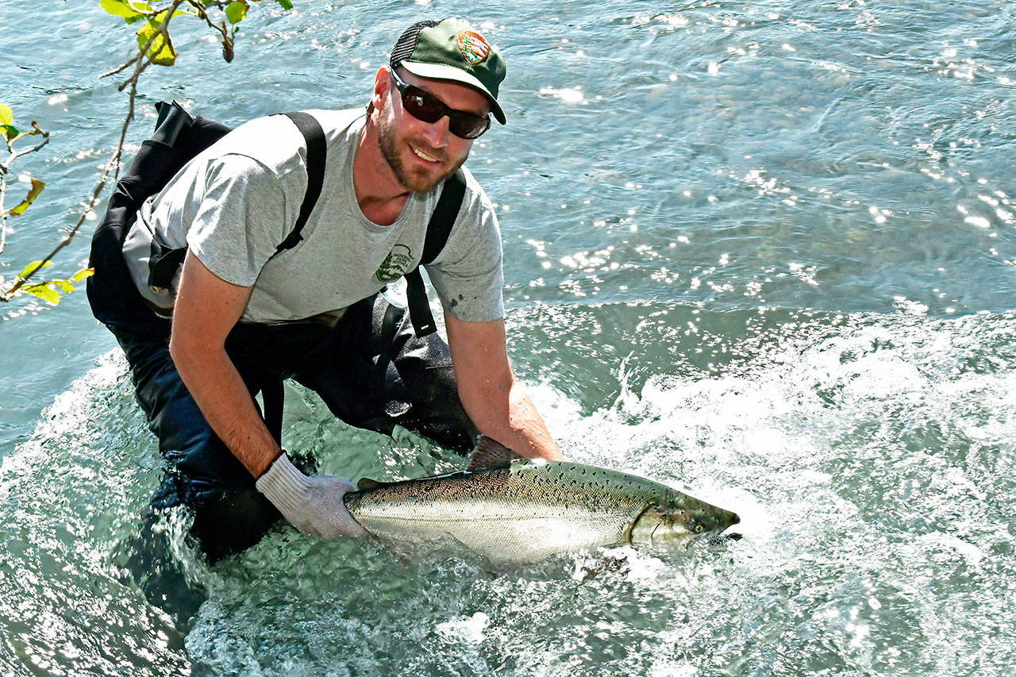
Conclusion
Dams while useful can have catastrophic effects on their surrounding environment
Species can be killed off
Communities can impacted
Regulations should be followed
Will take time but river is recovering
http://www.peninsuladailynews.com

Slide 17
References
https://therevelator.org/elwha-dam-removal/
https://www.youtube.com/watch?v=2yM5m5-1-I0
http://www.uvm.edu/~shali/elwha.pdf
https://news.nationalgeographic.com/2016/06/largest-dam-removal-elwha-river-restoration-environment/
https://blogs.uw.edu/sediment/elwha-river-delta/
http://biology.kenyon.edu/courses/envs461/02%2028%20BOWMAN_MARGARET_B%20dam%20removal.pdf
http://www.peninsuladailynews.com/news/fish-recolonizing-areas-upriver-of-former-dam-sites-on-elwha-river/

