Slide 1
Flint Michigan Water Crisis
Luke Anderson, Stephen Palmer, Kyle Taylor, and Will Weise

Slide 2
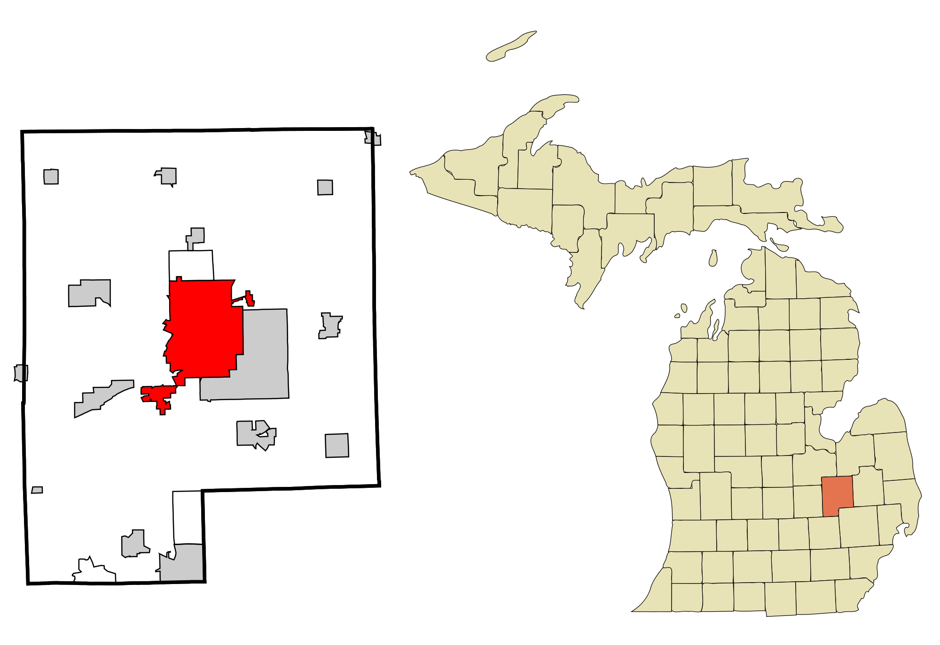
Background
Seventh biggest city in Michigan with a population of around 96,000 spanning 34 square miles.
Located in Genesee County
Home to one of the largest manufacturing complexes of General Motors.

Slide 3
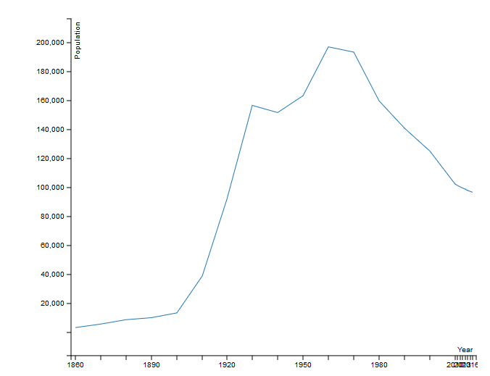
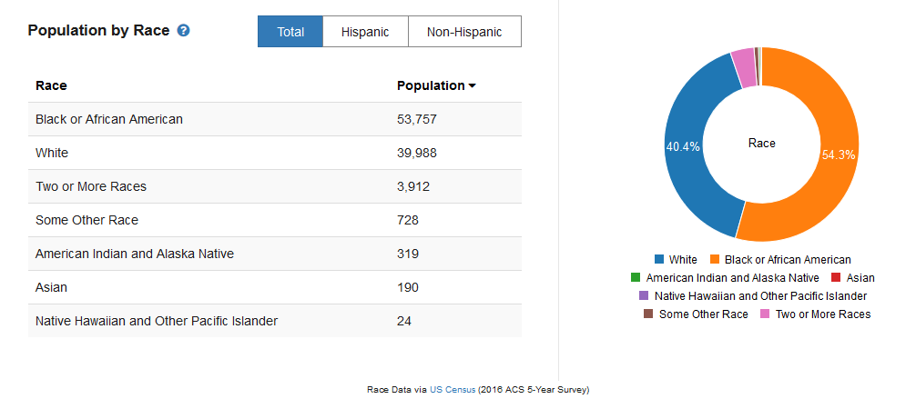
Demographic

Slide 4
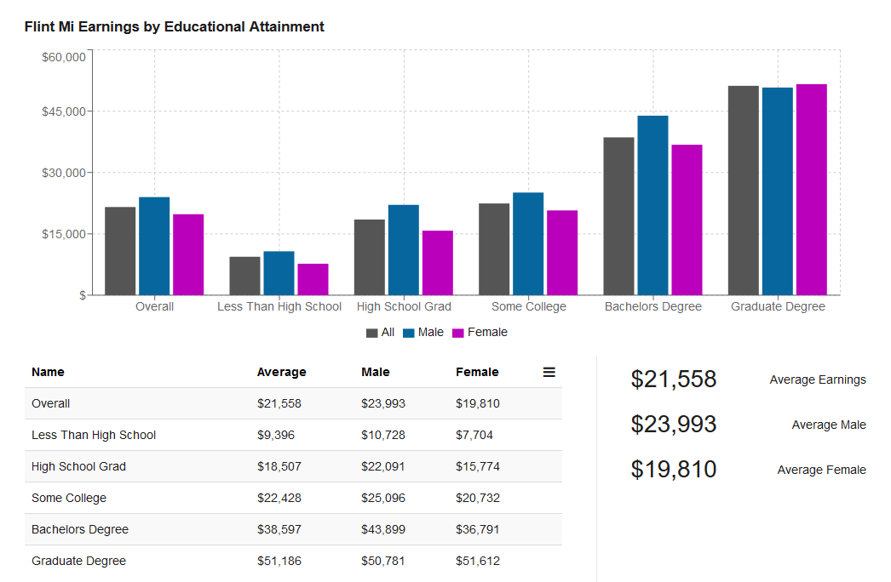
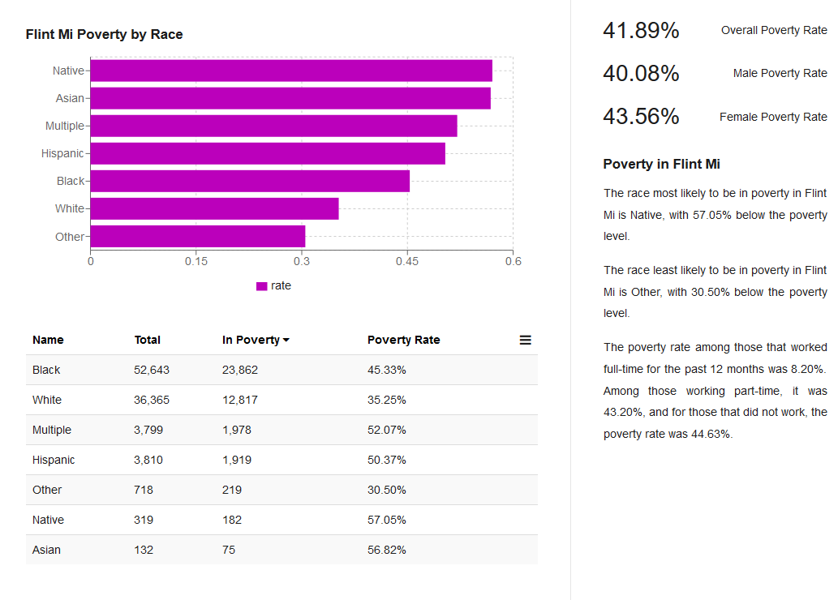
Demographic

Slide 5
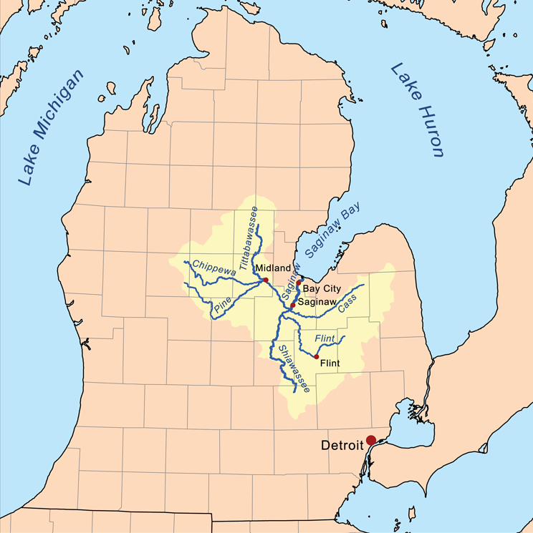
The Plan
Reduce costs by switching from Detroit Water and Sewerage (DWSD) to Karegnondi Water Authority
Crisis started when supply line switched for the first time since the 1960’s
Notes:
This new plan was designed to reduce costs by switching the city’s supplier from Detroit Water and Sewerage Department to the Karegnondi Water Authority.
Water Crisis started because of this new planned supply line when Flint turned back to the Flint River temporary in April 2014 for the first since they switched away from it in the 1960’s.

Slide 6
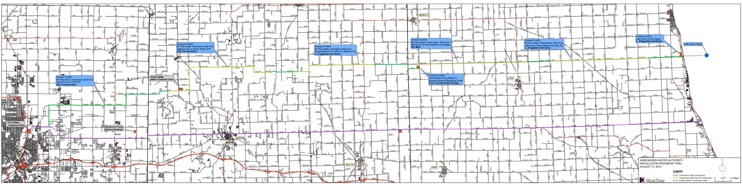
Proposed Pipe
KAREGNONDI PIPE
LAKE HURON
FLINT
EXISTING DWSD PIPE

Slide 7
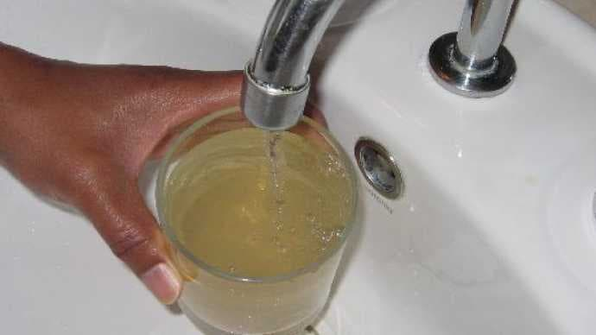
Timeline
2011: State of Michigan takes over Flint’s budget
March 22, 2012: Plan for new pipeline from Lake Huron to Flint is announced
April 25, 2014: City temporarily switches to water from Flint River
Sept. 5, 2014: Citizens advised to boil water due to fecal coliform bacteria
Feb. 26, 2015: Hazardous levels of lead detected in Flint
Sept. 11, 2015: VA Tech study finds that river water is corroding old pipes and lead is leaching into the water
Oct. 15, 2015: City switches back to DWSD
Notes:
Flint River water is high in corrosive chloride, due to years of dumping automotive factory waste into river, maybe because of salting roads?

Slide 8
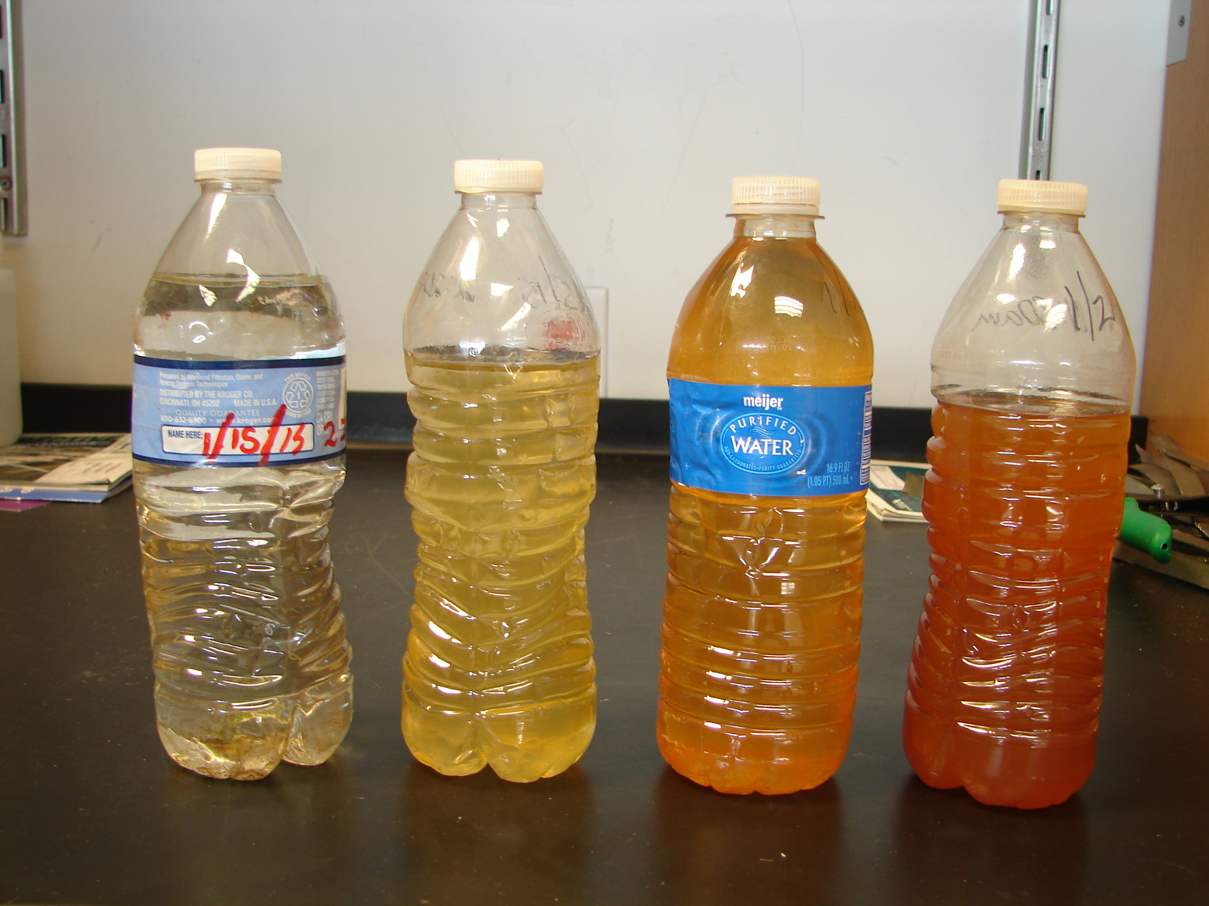
The Exposure of Bacteria
After switching the water source to the Flint River, water becomes smelly and discolored.
August 2014, E coli and coliform bacteria increases, residents boil their water.
City adds more chlorine to the water
Jan. 2015, Flint violates the SDWA total trihalomethanes (TTHM) levels
High levels of TTHM leads to city using bottled water.
Notes:
Iron released from corroded pipes reacted with chlorine, making it unavailable to function as a disinfectant. In turn, bacteria levels spiked. More chlorine added, which reduced coliform count, but lead to formation of THHM https://theconversation.com/the-science-behind-the-flint-water-crisis-corrosion-of-pipes-erosion-of-trust-53776

Slide 9
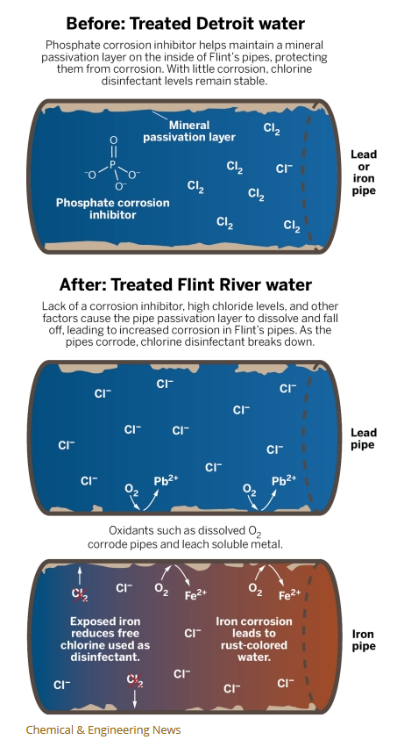
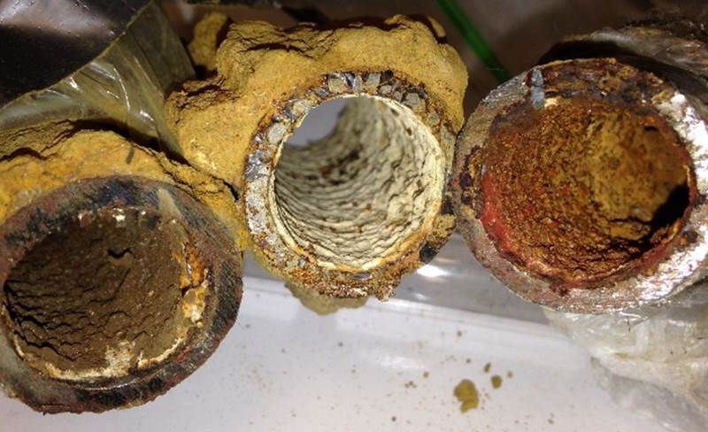
Lead
Feb. 2015, a city test is conducted.
Officials didn’t use a corrosion-control like phosphoric acid treatment to maintain the stability of rust layers inside the service lines which contained lead.
As a result, families started to report that they were getting sick (lead is a neurotoxin)
Flint resident LeeAnne Walters contacted VA Tech engineer Marc Edwards
Notes:
Test conducted by EPA and VA Tech. Lead is a neurotoxin, especially dangerous to children.

Slide 10
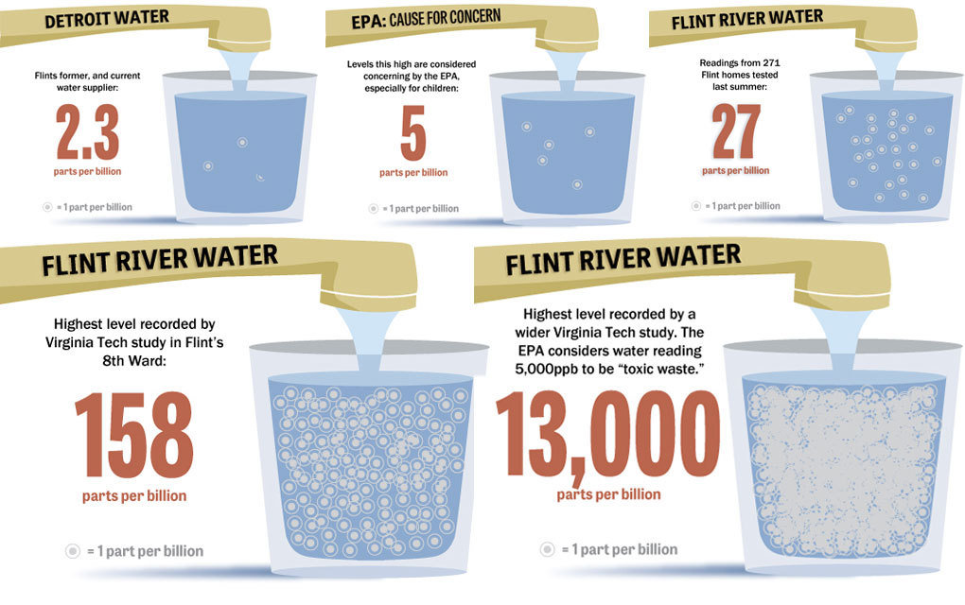
Regulations
32 samples were sent from Walters’ home to Edwards.
EPA MCL on lead in water is 15 ppb.
All samples were above this mark
Four were above 5000 ppb, which is the threshold for hazardous waste.
One sample contained 13200 ppb of lead.

Slide 11

Significance
The Bad-
- Cost $350 million dollars in michigan taxpayer money
- $100 million from the federal government
- 90 people became sick and 12 died from exposure to legionella bacteria
The Good-
- Mayor Karen Weaver planned to invest in redoing the cities pipes (15,000 water service lines)

Slide 12
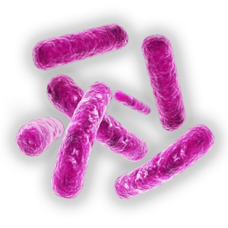
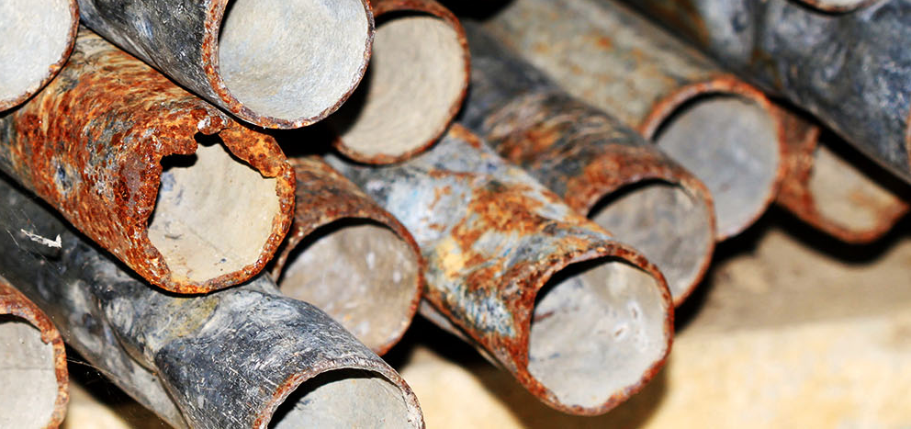
Properties of Contaminants
Lead
- A very soft malleable metal (useful for pipe manufacturing)
- Can cause permanent brain damage
- Long-term health problems including high blood pressure and kidney damage
Legionella
- Can cause Legionnaires’ Disease
- It is a strictly aerobic bacterium
- Found naturally in freshwater

Slide 13
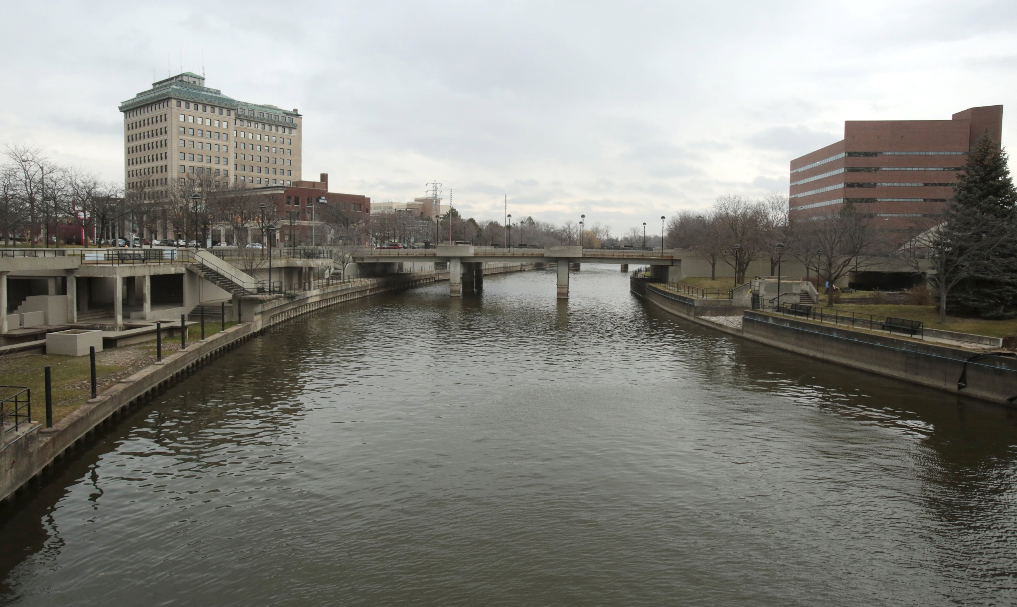
Mistakes Made
Flint Water Treatment Plant did not properly treat Flint River water
  Flint River is high in corrosive chloride
    Due to factory waste
  10 month engineering effort undertaken to prepare plant for Flint River water
    This process normally takes 2-3 years
  No record of corrosion control strategies tests
No corrosion control added to pipes
Replacing Flint’s lead pipelines could cost $1.5 billion

Slide 14

Moral Issues
Greed
  DWSD offered to reconnect Flint to their pipes and waive restoration fee.
  City declines citing concerns that water rates will rise more than $12 million
  “The increase in costs would not be in the best interests of the city or its water users.” - City of Flint
October 2014- GM stops using Flint River water in plant, costs city $400,000.
  Why didn’t Flint investigate this?
  Why didn’t GM warn Flint of toxic water?
“Wait and see” approach
  Governor’s Chief of Staff indicated his frustration with lack of attention to Flint Water Crisis in an email

Slide 15
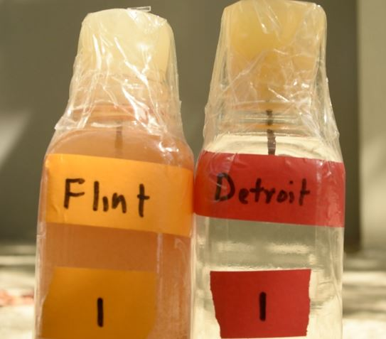
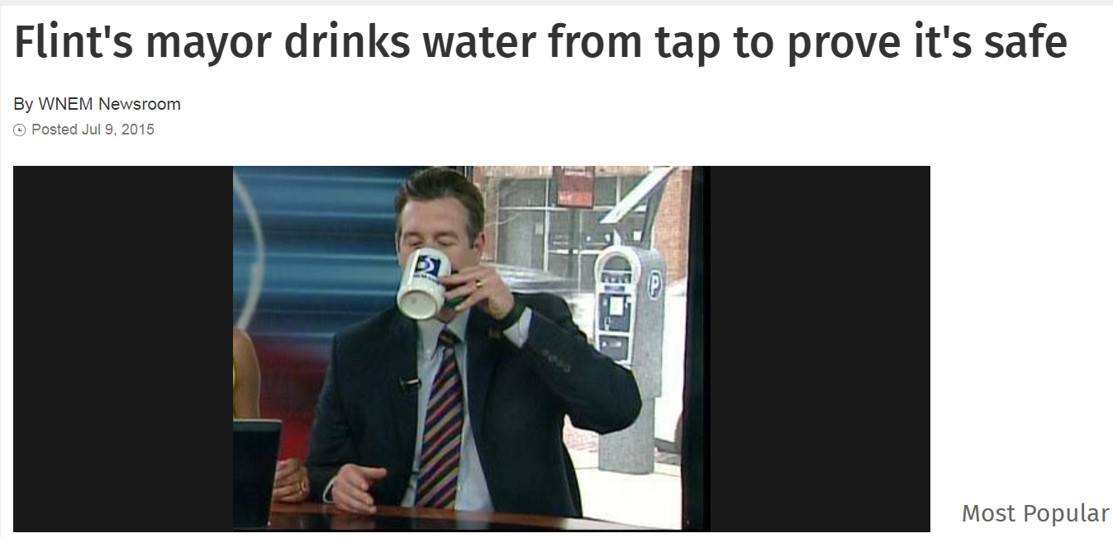
Ethical Issues
City may have had knowledge of need for corrosion control
  Since DWSD used corrosion control
  They did not use any because of cost
  By not adding corrosion inhibitor, Flint would save $140 per day
Governor Rick Snyder says TTHM levels are not of concern because risk of disease only increases after years of consumption
Water quality workers tampered with evidence

Slide 16
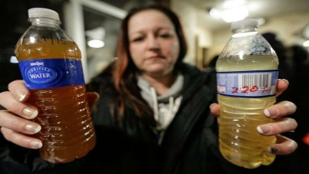

Social Issues
Lead severely affects children
  Permanent effects on cognitive abilities, IQ
  Effects are nearly permanent
    Especially in a poor community
    Poor nutrition
  25.7% of population under 18 years old
  7.6% under 5 years old
  24,672 children affected
41.2% of population below poverty line
  Flint was already downtrodden
  Median income (13-17): $26,330
12 people died from Legionnaires disease
Notes:
Governor's COS emailed frustrated with lack of attention to this issue. Michigan radio show

Slide 17
Aftermath
New pipeline still under construction
Many lawsuits
  Many charged with conspiracy, misconduct, false pretenses
  A couple charged for tampering with evidence
  Two engineering firms for negligence and fraud
March 17, 2017- EPA awards $100 million to Flint for water infrastructure upgrades
State responsible for replacing 18,000 household connections to the street main
  5,854 replaced as of Nov. 30, 2017
Health and Human services director on trial for failing to alert public about Legionnaires outbreak
  Caused by bacteria

Slide 18
References
https://www.npr.org/sections/thetwo-way/2016/04/20/465545378/lead-laced-water-in-flint-a-step-by-step-look-at-the-makings-of-a-crisis
https://www.sciencedaily.com/releases/2017/02/170201092656.htm
https://www.cnn.com/2016/03/04/us/flint-water-crisis-fast-facts/index.html
https://docs.wixstatic.com/ugd/60e74e_3a1b40a31a444f9ebd7aa084240225cf.pdf
https://www.freep.com/story/news/local/michigan/2016/01/07/governor-meet-morning-flint-mayor/78402190/

Slide 19
References
https://theconversation.com/the-science-behind-the-flint-water-crisis-corrosion-of-pipes-erosion-of-trust-53776
https://www.census.gov/quickfacts/fact/table/flintcitymichigan/PST045217
https://www.cnn.com/2016/01/21/health/flint-water-mona-hanna-attish/

