Slide 1
PFA
Ashley Ferrante, Samantha Price, Eric Stiner and Jed Vergara

Slide 2
What are PFAs?
PFAs are per- and polyfluoroalkyl substances
  Man-made
  Persistent
    Don’t break down
    Accumulate over time

Slide 3
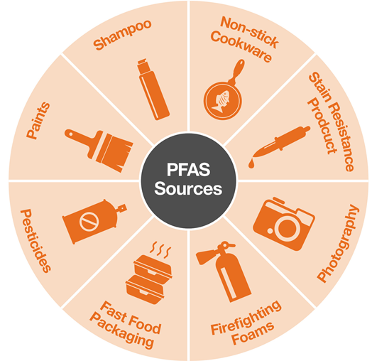
Where are PFAs found?
Food
  Packaging materials, processing equipment, soil or water
Commercial household products
  Paints, cleaning products, stain and water-repellent fabrics
Drinking water
Living organisms
  Fish, humans and animals
Different workplace facilities and industries
  Electronics manufacturing or oil recovery
Figure 1: Sources of PFAs
Notes:
Contaminated water supply
Figure Source: https://www.michaelbest.com/Newsroom/171506/States-Adopting-PFAS-Standards-to-Reduce-Exposure

Slide 4
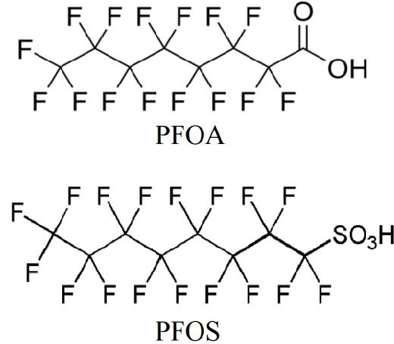
Contaminant Properties
Water soluble
Bioaccumulative
Fluoropolymer
Perfluorooctanoic Acid (PFOA)
Perfluorooctane Sulfonate (PFOS)
Fire resistant
Repels grease, oil, and stains
Figure 2: Chemical Composition of 2 Types of PFAs

Slide 5
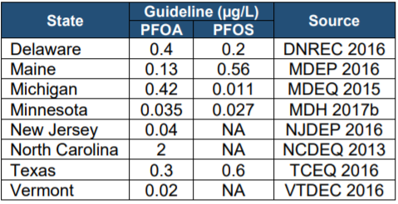
Regulations
No EPA Maximum Contaminant Level for PFAs
  Not under Safe Drinking Water Act
Health Advisory Level of 0.07 ppb in water
  Nonregulatory, unenforced
  Level where negative effects occur
EPA determining if MCL is required
State guidelines have been set
Notes:
No actual enforceable epa limit, or maximum contaminant level, on the amount of PFA substances, specifically PFOA and PFOS which are the most common types
Not under the 90+ substances regulated in drinking water by the Safe Drinking water act
There is a health advisory level of 70 parts per trillion or 0.07 ppb for drinking water, but not enforceable, no real regulation
Unlike certain compounds like lead, enforced at 15 ppb
Pretty much just an information pamphlet for the effects of the chemicals to assist local and state governments about the chemicals
According to EPA website, currently in the process of determining if a maximum contaminant level is needed for the PFAS chemicals, specifically PFOA and PFOS
There are alot of others also being monitored under the unregulated contaminant monitoring rule
Guidelines have been set in some countries including new jersey

Slide 6
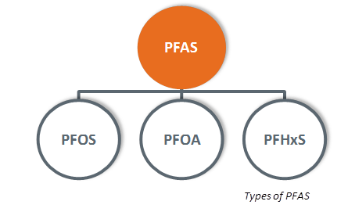
Human Health Effects
Adverse health impact
Different types of PFAs
  PFOAs and PFOs
Reproductive effects
  Pregnancy, horomones
Developmental progress in children
Immune system
Cancerous
Figure 3: Types of PFAs
Notes:
Increase cholesterol levels
Effect on growth, behavior and learning
Figure Source: http://www.defence.gov.au/Environment/PFAS/pfas.asp

Slide 7
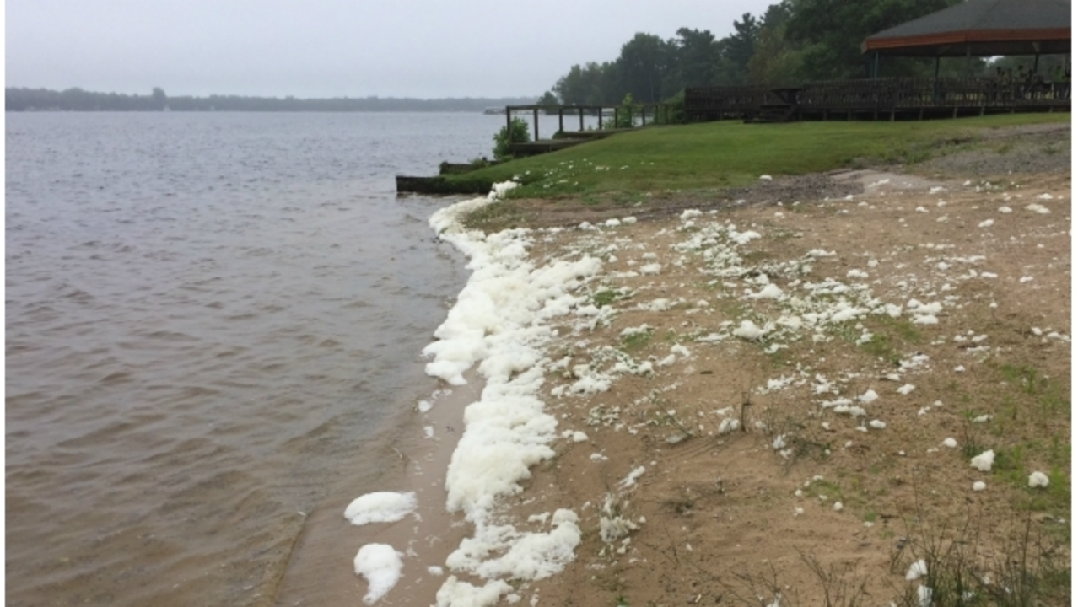
Environmental Impacts
Found in water sources affecting fish, bird, seals, and dolphins
Not only affects the quality of life of the animals but for certain species of anchovies and perch, the PFAs are then consumed by humans.
As they are bioaccumulative they remain in the water and soil indefinitely
Presenting issues in water sources near industrial cities

Slide 8
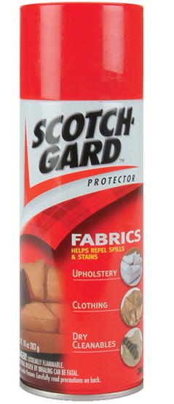
3M versus the State of Minnesota
3M is sued by the State of Minnesota for dumping
toxic chemicals for 40 years
  Production of Scotchgard fabric protector
  The states says 3M hid evidence from regulators
Prior to the lawsuit
  The company stopped making PFAs in 2002
  In 2004, trace amounts of the chemicals were found in
  groundwater near one of 3M’s dumping sites
  3M spent millions to clean up landfills and provide clean drinking
3M considers the regulations set by the EPA 2016 “cautionary”

Slide 9
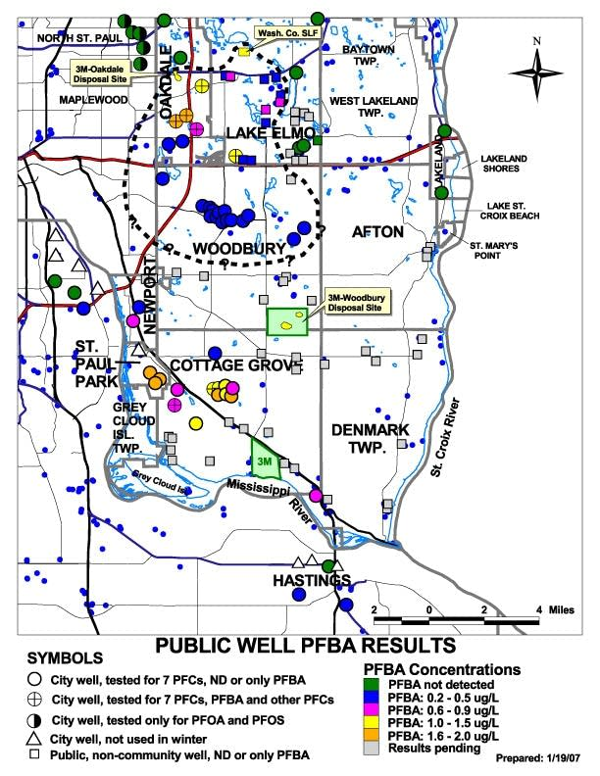
Results of a PFA testing in 2006 in public wells surrounding 3M disposal site in Oakdale and Woodbury, Minnesota.

Slide 10
The Verdict
3M owes the State of Minnesota $850 million after an 8 year trial
No adverse human health correlations were ever proven
  Minnesota 2006 results correlate to:
    Cancers, leukemia, premature births, and lower fertility in the suburbs of St. Paul
“We have our own problems in Minnesota with regulatory agencies captive to the industries they are supposed to regulate” - Lori Swanson MN Attorney General

Slide 11

Additional Contamination
Contamination is an issue across the country:
  Colorado & Pennsylvania - firefighter foam
  Michigan - State of Emergency in Kalamazoo for PFA levels 20 times higher than regulation
  North Carolina -
  an investigation for high
  levels of PFA from airport
  and industrial complex
No one wants to pay for the
remediation of the
“Forever Chemicals”

Slide 12

PFOA Stewardship Program
2006: EPA invited 8 major companies to join this program
  2 major goals
    95% reduction in emissions and product levels by 2010
    Elimination of chemicals by 2015
Companies included
  Arkema
  Asahi
  BASF Corporation
  Clariant
  Daikin
  3M/Dyneon
  DuPont
  Solvay Solexis
All have met the goals

Slide 13
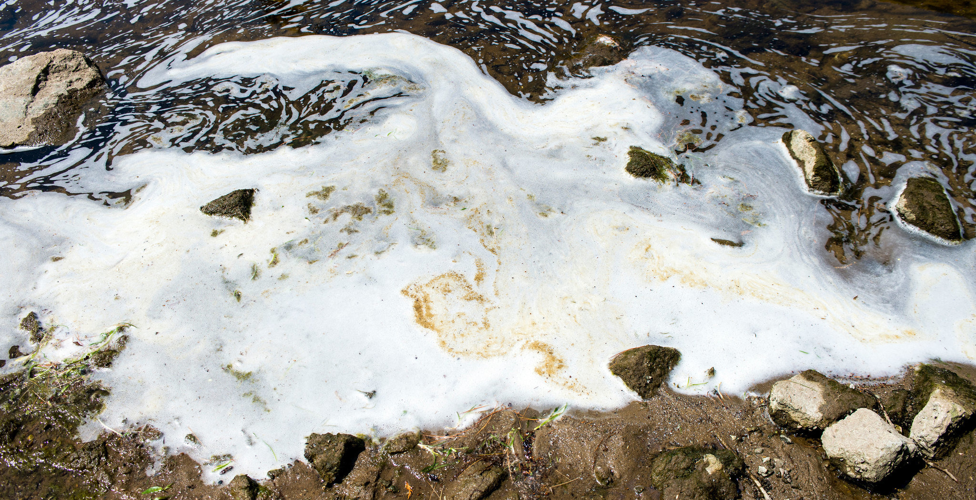
Water Remediation Methods
Activated Carbon Adsorption
Ion Exchange Resins
High Pressure Membranes
Plumestop
pfasCARE
Notes:
In surface water, PFAs, this picture is from michigan
As mentioned before, PFA substances are incredibly hard to get rid of, but there are ways, mostly take a long time and costs alot of money so far
Resistant to heat, water, oil, and general degradation.
Becasue they dissolve in water and their natural properties, they do not get cleaned by tradiational methods of water treatment
Some of these common methods I’ll be going over

Slide 14
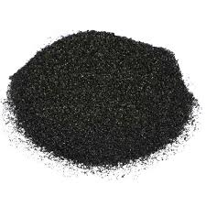
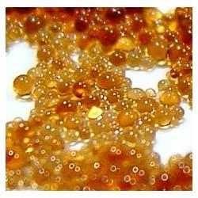
Ex Situ Remediation Methods
Activated Carbon Treatment
  Highly porous filter
Ion Exchange Treatment
  Use ion exchange resins
  Attract PFAS particles
High Pressure Membranes
  Nanofiltration
  Reverse osmosis
  Ultrafiltration
Notes:
Methods that deal with having to pump out water to be treated
Activated Carbon Treatment is usually used for adsorb natural organic compounds, things that change odor and taste for water treatment
Particularly granular activated carbon
Bascially filtration through activated carbon or activated coal
Very porous, large surface area for adsorption of PFAS chemicals
Most commonly used method to remove PFAS from drinking water
Ion exchange treatment is very similar
Pourous resins, like a filter
Negatively charged PFAS attracted by positively charged resins as water passes through
High Pressure Membranes, again, a sort of filtration
Water pumped through the membranes with very very small pores
reverse osmosis membranes much more effective
90% effective at removing most PFAS
Better for at home because of the amount of waste that the filter can receive
These methods require pumping
Not good against plumes, or wide, diluted regions of PFAS

Slide 15
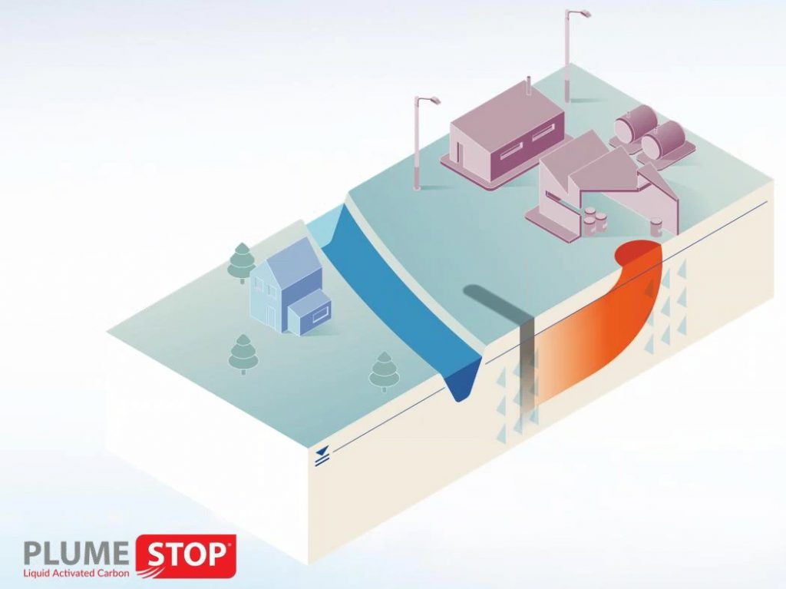
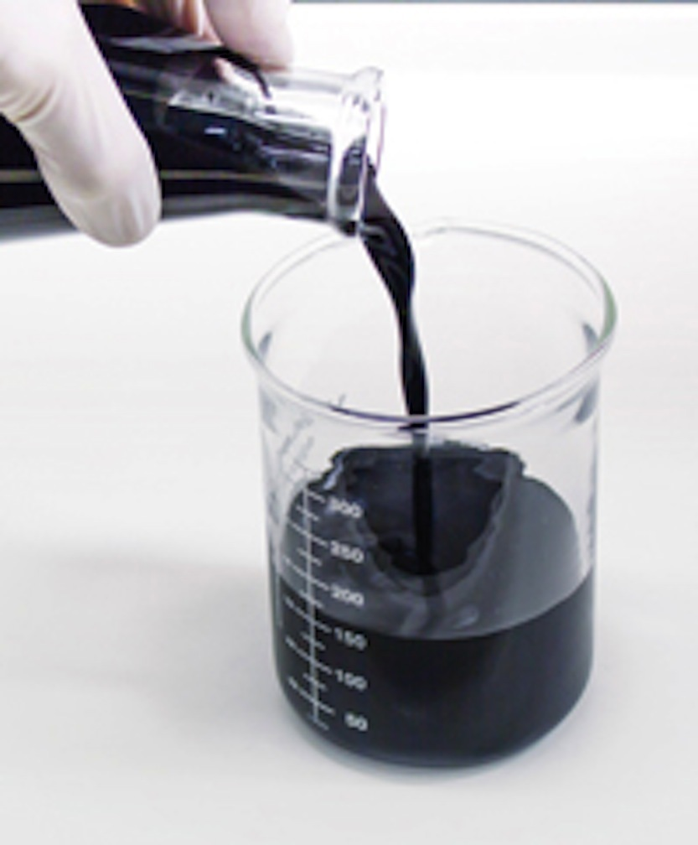
Plumestop Liquid Activated Carbon
New In Situ method
  No pumping required
  Injected into the ground
Sorbs PFAs and other contaminants
Bacteria grow on the particles
  Biodegrade the contaminants
Notes:
Fairly new technology/method to get rid of PFAS in groundwater
Colloidal Biomatrix
Network of highly sorbent particles
Effective against PFAS plumes, which are large areas of diluted PFAS
Highly dispersive
Injected into the ground with pressure
Sorbs and captures the contaminants or the PFA substances from the groundwater
Bacteria that can degrade the PFAs grow on the plumestop and feed on the contaminants
Accelerates biodegradation
Soprtion sites free up after biodegradation, more contaminants can be treated
Initial groundwater cleanup acts within days
Lower cost

Slide 16

pfasCARE
From a Australian Tech Company CRCCare
Use electricity to produce extremely strong oxidising agents
Strip PFAs of electrons
  Breaks down contaminants
Now Cheaper
  Previously required diamonds
Notes:
Last remediation method I will talk about is pfasCARE
Not too many details about the process
Use electricity treatment to create very strong oxidising agents that strip PFAs and other contaminants of electrons
Basically breaks down
Product of breaking down is carbon dioxide and fluoride, which can be easily managed

Slide 17
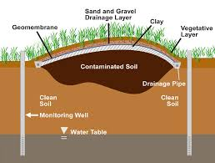
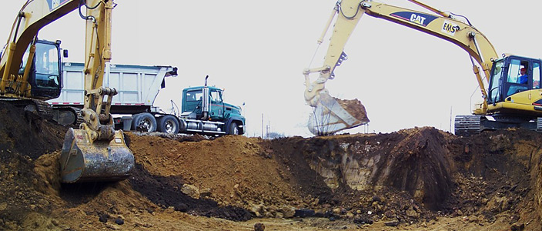
Soil/Solid Remediation
Capping
  Isolate PFAS contaminated material
Excavation and Disposal
  Removing contaminated soil
Sorption and Stabilization
  Additives in soil to reduce PFAS mobility
Thermal
  Heat to destroy the chemicals
  Still developing
Notes:
First, a few of the remediation techniques for soil, or its called solids treatment
Capping isolates a contaminated material by putting some sort of layer on top of contaminated area in order stop the spread
Does not destroy or remove contaminants
Next theres excavation and removal which is exactly as it sounds,
Contaminated soil is removed and put into a landfill or incinerated
Area is refilled
Does not destroy PFAS
Sorption and Stabilization
Additives added to the soil to stabilize it and prevent it from leaking into groundwater
Use resins, biomaterials, minerals
Success varies based on site and PFAS type
Thermal
Heat is directly applied to the soil that is contaminated
Requires really high temperature (450- 900 celsius) to be effective
Requires alot of energy
For alot of these, no real way to destroy the contaminants, just isolating it, preventing it from moving, putting it somewhere else, and current technology isn’t ready to fully destroy it

Slide 18
References
“Basic Information on PFAS.” (2018). EPA, Environmental Protection Agency, <https://www.epa.gov/pfas/basic-information-pfas>
(Dec. 8, 2018).
Brueck, H. (2018). “Dangerous 'forever chemicals' have been found in US drinking water at alarmingly high rates - here's what to know about
PFAS.” Business Insider, Business Insider, <https://www.businessinsider.com/what-are-pfas-chemicals-2018-8>Benson, L., and Bloomberg.com, Bloomberg,
<https://www.bloomberg.com/news/articles/2018-02-20/3m-is-said-to-settle-minnesota-lawsuit-for-up-to-1-billion> (Dec. 9,
2018).
Finley, B. (2016). “Drinking water in three Colorado cities contaminated with toxic chemicals above EPA limits.” The Denver Post, The Denver
Post, <https://www.denverpost.com/2016/06/15/colorado-widefield-fountain-security-water-chemicals-toxic-epa/> (Dec. 7,
2018).
Hughes, A. (2007). “3M chemicals found in drinking water of east metro cities.” Minnesota Public Radio News,
<https://www.mprnews.org/story/2007/01/19/morepfc> (Dec. 9, 2018).
McDaniel, J., and McCrystal, L. (2016). “Tainted: How Navy bases contaminated Pa. drinking water.” http://www2.philly.com, The
Philadelphia Inquirer, Daily
News and Philly.com,
<http://www2.philly.com/philly/news/20160619_Tainted__How_Navy_bases_contaminated_Pa__drinking_water.html> (Dec. 9, 2018).
Press, A. (2018). “Minnesota's $5B case over 3M chemicals heads to trial.” The Washington Post, WP Company,
<https://www.washingtonpost.com/national/minnesotas-5b-case-over-3m-chemicals-heads-to-trial/2018/02/19/a4d50df0-
15b5-11e8-930c-45838ad0d77a_story.html?noredirect=on&utm_term=.300031d5ae9d> (Dec. 10, 2018).
“Risk Management for Per- and Polyfluoroalkyl Substances (PFASs) under TSCA.” (2018). EPA, Environmental Protection Agency,
<https://www.epa.gov/assessing-and-managing-chemicals-under-tsca/risk-management-and-polyfluoroalkyl-substances-pfass#tab-3
> (Dec. 8, 2018).

Slide 19
References
Regenesis. (n.d.). “PlumeStop® Liquid Activated Carbon™.” REGENESIS Remediation Solutions,
<https://regenesis.com/en/remediation-products/plumestop-liquid-activated-carbon/#1515095751951-7880b2 b5-ffa0> (Dec. 9, 2018).
CRC CARE. (n.d.). “World-first technique for eliminating toxic chemicals linked to firefighting foam contamination.” CRC
CARE,
<https://www.crccare.com/news/world-first-technique-for-eliminating-toxic-chemicals-linked-to-firefighting-foa
m-contamination> (Dec. 9, 2018).
Mueller, R., and Yingling, V. (2018). “Remediation Technologies and Methods for Per- and Polyfluoroalkyl Substances (PFAS).” Interstate Technology Regulatory Council,
<https://pfas-1.itrcweb.org/wp-content/uploads/2018/03/pfas_fact_sheet_remediation_3_15_18.pdf>
US EPA. (2018). “Reducing PFAS in Drinking Water with Treatment Technologies.” EPA, Environmental Protection
Agency, <https://www.epa.gov/sciencematters/reducing-pfas-drinking-water-treatment-technologies> (Dec. 9, 2018).

