Slide 1
Course Reminders & Deadlines
Pathfinder
Before Exercise for Design for the Other 90% - Water Use
Before exercises on Engineering Econ 1 due 3/5
3D Game Lab
2nd deadline of 700 XP midnight March 5th
GameLab is 15% of your course grade
No activity on the platform = B or less for your course grade
CATME – Complete UD Peer Eval. (2/27-3/6)
Design for the Other 90% Project
Tech Transfer Presentation due by 5 PM on March 19th
Tech Transfer Memo, Mat Lab and Whitepaper on April 2th

Slide 2
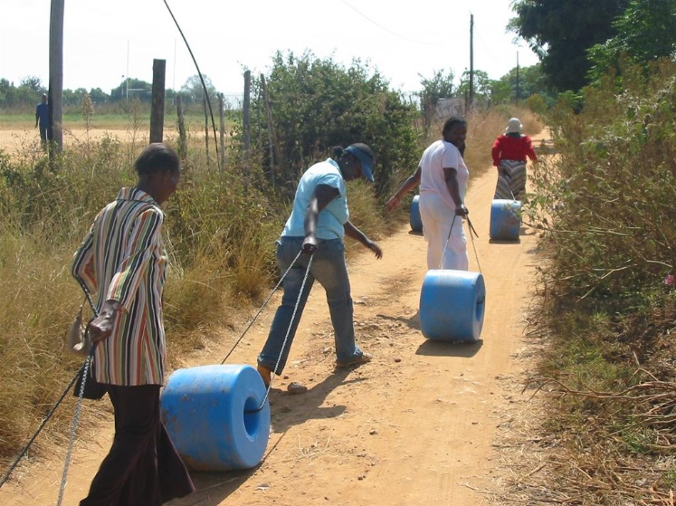
Design for the Other 90 %
FEC II
Rowan University
www.meldrenachapin.com/blog/wordpress/wp-content/uploads/2013/05/Qdrum3.jpg
Notes:
Q drum, Johannesburg, South Africa, 50 liters.
The Q Drum is a durable, donut-shaped plastic container which when full holds 50 litres of water. Its uniqueness lies in the design of the longitudinal shaft or central hole, through which a rope is tied, to pull or roll the drum along all terrain types.
Due to the linear low-density polyethylene (LLDPE) it is made from, the drum is also practically indestructible and has no removable handles or other metal attachments that could detract from the Q Drum's intended purpose if lost or broken.
The rope can be repaired on the spot or easily, if lost, be replaced by a leather thong, woven plant substance or any other appropriate material. The simplicity of the design ensures the ease of use.
JWE - Not sure this is better than carrying water in jug on head. Probably only works if moving the water on level or down-slopig ground.

Slide 3
Design for the Other 90 %
Engineers often focus on the affluent (us) ignoring ~90 % of the world population
Can Engineering be directed to the Other 90 %?

Slide 4
Needs of the Other 90 %
(UN Sustainable Development Goals)
www.un.org/sustainabledevelopment/sustainable-development-goals

Slide 5
Some Facts about the other 90%
What do people use for energy?
Where do people get food, water?
How do people deal with waste?
What are homes like?
What medical care do people get?
How do people get around?
-> 1.2 billion w/o electricity,
-> 2.5 billion use biomass for cooking
-> 840 million are food insecure
-> 2.1 billion lack access to safe drinking water
-> 2.4 billion lack adequate sanitation
-> 1.6 billion live in inadequate housing
-> 400 million lack essential health care
-> 3.4 million, mostly children, die each year due to water-born diseases
-> Over 4 million die each year due to indoor air pollution (wood fire cooking)
-> Many lack access to mechanized transportation and rely on walking
Notes:
Ask for comments before giving facts. Regarding how people get around – note that many people travel by food along foot paths.

Slide 6
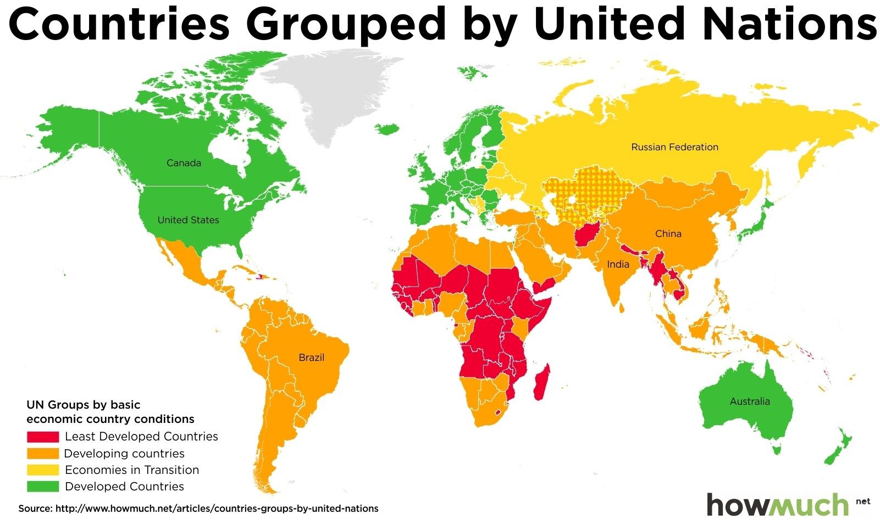
Who are the other 90%?
Notes:
The other 90% are generally from least developed and developing countries

Slide 7
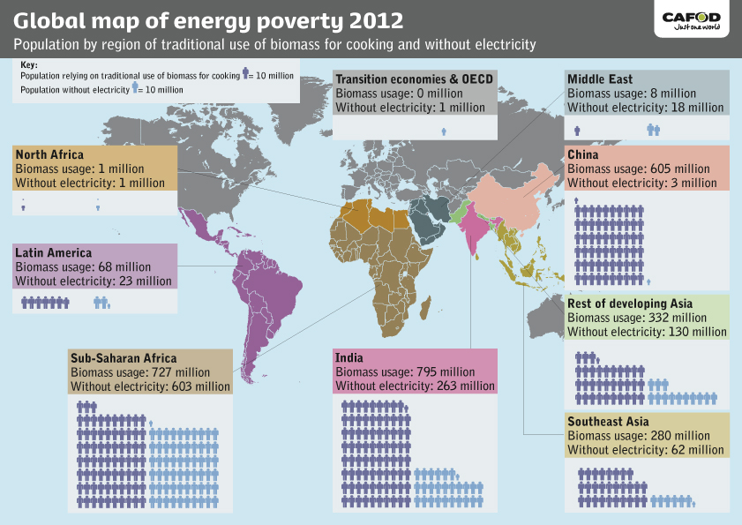
Energy Poverty Worldwide
Source: CAFOD. Based on UN, Sustainable Energy 4 All, Global Tracking Framework. 2013
Notes:
5.7 / 7 - ~80 percent, so why 90 %? There are poor people living in developed countries.

Slide 8
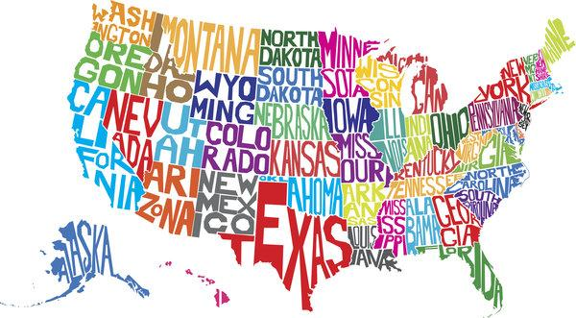
US exceptionalism
US is 4.4% of world population, BUT responsible for ~
22 % of world prison population
23 % of world energy consumption
25 % of world Gross Domestic Product
33 % of carbon production
37 % of military expenditures
48 % of civilian owned guns
You’ll be a better engineer if you understand more than just the US.
img.huffingtonpost.com
Notes:
You’ll be a better engineer if you understand more than just the US. And the US is not a typical country.
GDP is the total value of everything produced by all the people and companies in the country. It doesn't matter if they are citizens or foreign-owned companies. If they are located within the country's boundaries, the government counts their production as GDP. (www.thebalance.com)

Slide 9
The Developing World is Dynamic
‘Large families, short lives’ no longer characterizes most of developing world
Millions have moved out of poverty
> 1 B people lifted out of extreme poverty since 1990
But > 800 M still live in extreme poverty.
Between 1990 & 2015, percent living on less than $1.25 a day went from 50 to 14 %.
Notes:
For more on the ‘large families, short lives’ myth, see the TED at Talk https://www.ted.com/talks/hans_rosling_shows_the_best_stats_you_ve_ever_seen
Poverty Stats - http://www.un.org/millenniumgoals/poverty.shtml.

Slide 10
Why Design for the Other 90%?
Social Justice
Personal Connections
Altruism
Sustainable Development
Interest in learning/training
Greed
Notes:
Social Justice - Engineering for the other 90% addresses social inequities and can help restructure society
Personal - You, family members, or friends, might be part of the other 90%
Altruism - Billions live in poverty, with poor access to shelter, food, water, sanitation, information, etc.
Greed – Small profits add up when selling to millions and billions of people
Sustainability - Promote development that uses environmentally friendly and sustainable technologies
Training – Become a better engineer by understanding more potential customers

Slide 11
TED Talk
Professor Christopher Mattson describes what made the difference between his team's successful and unsuccessful designs for developing world https://www.youtube.com/watch?v=6wbuvdAe6Yg

Slide 12
In Class Activity
Rethink a product for someone living on ≤ $1.25 a day (~800 M in 2017 including >3M in US!)
Teams pick one: Toothbrush, Pillow, Shoes, Plate/Bowl, Utensils
Individuals - Write down your thoughts (5 min)
Inventions, goals, problems, issues, consequences, etc.
Search the web!
Teams - Discuss what you’ve learned (5 min)
One team member present findings (10 min)
Notes:
Get students to estimate how much of an US citizen’s daily wage it takes to buy one of these products, then do the same for someone living on $1.25 a day. See if students can find alternatives in the developing world. In some cases they may find that people just don’t use the item (sleep without pillow, eat food with hands...), or they find/make it themselves (chewing stick for toothbrush, waste foam packaging for pillow). Can any of these products be redesigned to be affordable to someone living on $1.25 a day (reduce materials going into a toothbrush by making it shorter)? Don’t forget about waste management/litter. Many of these people have no access to trash cans or waste management services. Packaging will end up as litter which may be periodically burned off. Students should consider litter!
NOTE: many of the people living on $1.25 a day are subsistence farmers or hunters and are able to procure food, etc. without monetary exchange. Systems that help them sell goods can raise their earnings.
>3M in US statement come from World Back, according to https://www.huffingtonpost.com/entry/trump-budget-fine-print_us_5a820d8ae4b01467fcf06af8?ncid=inblnkushpmg00000009

Slide 13
Example Groups
Engineers Without Borders (EWB) - Rowan has a Chapter
Engineers for a Sustainable World (ESW) - Universities
Engineering for Developing Communities (MC-EDC) - University of Colorado at Boulder
Practical Impact Alliance / MIT D-Lab
Peace Corps
Sustainable Energy 4 All - United Nations
Light Up the World Foundation (LUTW) - Non Profit Org.
Engineering for Change (E4C) - Non Profit Org.
Many other non-profits and faith based groups

Slide 14
Cautionary Tales
PlayPump failure
https://www.youtube.com/watch?v=PTJgAK7e9ro
One LapTop per child failure
https://prezi.com/eeoc7q-bwlqo/failure-of-one-laptop-per-child-olpc/
Learning from failures
https://www.youtube.com/watch?v=HGiHU-agsGY

Slide 15
Strategies for Success
Think, Pair, Share
Community Engagement
Involve/Train Local Experts
Use Locally Based Materials
Design for Affordability
Provide Support / Maintenance
Long Term Involvement
Notes:
5 min for Think, Pair, Share. Then review the list of suggestions. Note: This is not a comprehensive list

Slide 16
Strategies for Success
The best way to ensure your designs for the other 90 % are appropriate are:
Spend time with your potential customers and get feedback
Live in the communities you design for, if possible
Partner directly with communities and/or professionals with direct experience
Know the appropriate design principles
Notes:
5 min for Think, Pair, Share. Then review the list of suggestions. Note: This is not a comprehensive list

Slide 17
FEC II – Design for the other 90%
Week Plans
Week 1 – Intro (PPT), Begin Projects
Week 2 – Design Principles, Work on Projects
Week 3 – Complete Projects, Presentations
Notes:
Ask for comments before giving facts. Regarding how people get around – note that many people travel by food along foot paths.

Slide 18
FEC II – Design for the other 90%
Deliverables
Technology Transfer
Presentation (Week 3)
White Paper (Week 4)
Water Supply Exercise
Matlab Code – Sizing Pump/Array/Generator (Week 2)
Excel File – Present Worth, Payback, Rate of Return
Memo – Matlab Code & Excel File(Week 4)

Slide 19
FEC II – Design for the other 90%
Technology Transfer
Topics :
Water Supply, Lighting, Refrigeration, Medical Devices, Batteries, others
Research:
Compare Developed /Developing World use of the technology
Use Case Studies

Slide 20
FEC II – Design for the other 90%
Water Supply Exercise
Matlab Based Design: Off grid water pumping system powered by
Case 1) Photovoltaic power
Case 2) Diesel Generator
Excel Based Economic Analysis
Present Worth
Simple Payback
Rate of Return

