Slide 1
Welcome to Freshman Engineering Clinic II
Section 17
Professor Margaret Hunter
hunterm@rowan.edu
Office Phone: (856) 727-6148
SECTION 17 Instructor

Slide 2
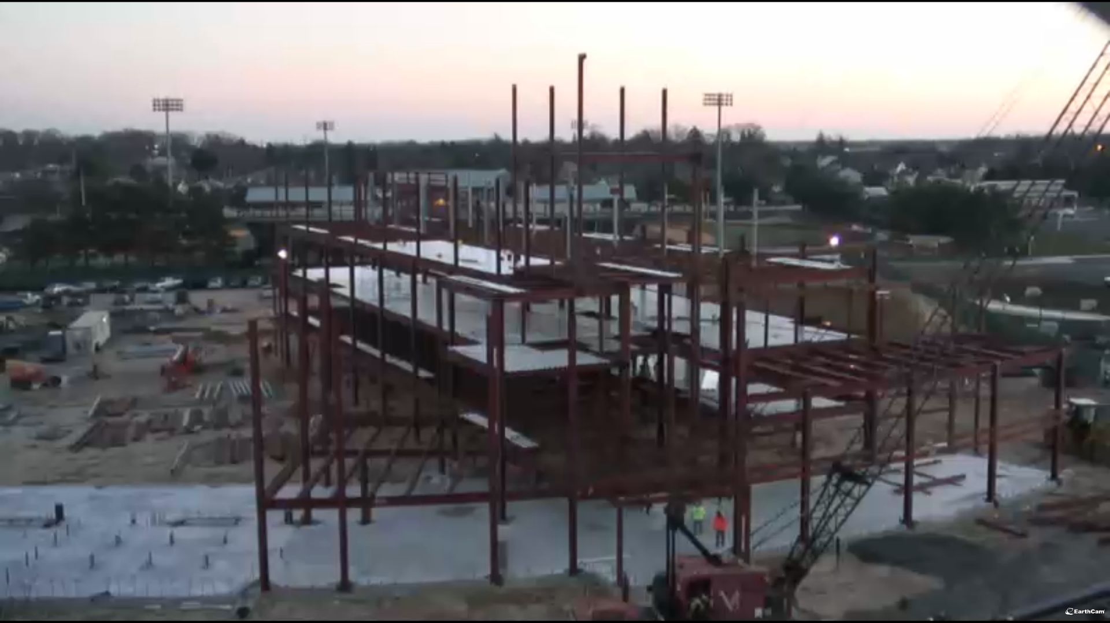
Freshman Engineering Clinic II
News
Syllabus
PathFinder
GameLab
Internships
Break out
www.rowan.edu/adminfinance/facilities/capitalprojects/index2.html
TODAY

Slide 3

Note Taking
Still need to do it!
Notebook
  old school
Laptop or
Tablet
  But avoid
  distractions
tusb.stanford.edu

Slide 4
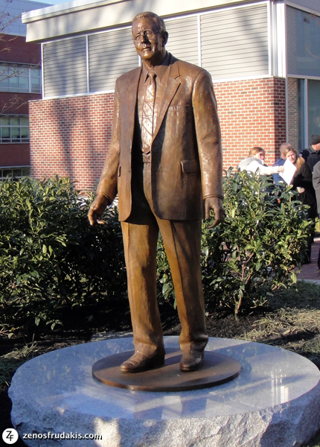
News
FEC II Syllabus emailed
Create FEC II web-book
  Price included in FEC I web-book -FREE
  Course code for YOUR section
  No PathFinder account? Use Course Code
Change of Major deadline
  Fall transfer: April 1
Notes:
Price included in FEC I web-book – Do not pay for FEC II web-book!
Course code for YOUR section – Your Professor will email it to you.
No PathFinder account? Use Course Code as well

Slide 5



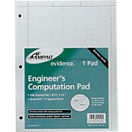
Supplies – Same as FEC I
Freshman Clinic Web-book
Large 3-ring binder
Laboratory notebook
Engineering Paper
www.zazzle.com
vbschools.schoolnet.com
Amazon.com
Staples.com
Notes:
Purchase ebook at Barns&Noble on-line or at the store on Rowan Blvd.
Lab notebook – Any one will do, just needs identically numbered perforated carbonless transfer pages that create copies as you write

Slide 6
Rowan Engineering
Clinic Sequence
Freshman
  Fall: Introduction, Measurement, Rowan Seminar
  Spring: Product Development & Customers
Sophomore
  Fall: Design & Technical Writing
  Spring: Design & Public Speaking
Junior/Senior
  Real World Projects - Small Groups
It’s a Hallmark!
Notes:
Product Development - entire process of creating a new or improved product

Slide 7
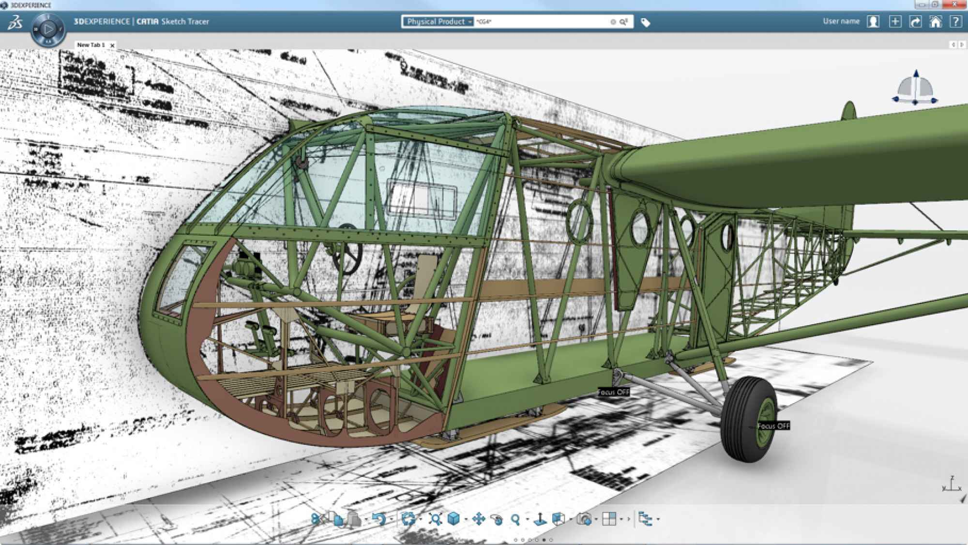
Product Design
Design for all focus
  Design engineering products for different and diverse customers
www.popsci.com

Slide 8
Freshman Clinic II Objectives
Evaluate work of practicing designers
Introduce engineering science principles
Introduce product (process) development
  Customers, intellectual property, data, cost, ethics,
Continue development of technical communication skills
Continue development of time management, and critical thinking skills
Notes:
Introduce students to the science and art of design by evaluating the work of practicing designers;
Introduce multidisciplinary teams of engineering students to unifying engineering science principles such as mass, momentum and energy balances; materials; thermodynamics, and electricity/magnetism using a consumer product or engineering process as a test bed;
Enable students to determine how scientific principles, material properties, manufacturing techniques, cost, safety requirements, environmental considerations and intellectual property rights impact product design, within the context of ethical engineering behavior;
Continue development of technical communication skills in written, oral, and graphical formats, and
Continue development of time management, and critical thinking skills.

Slide 9
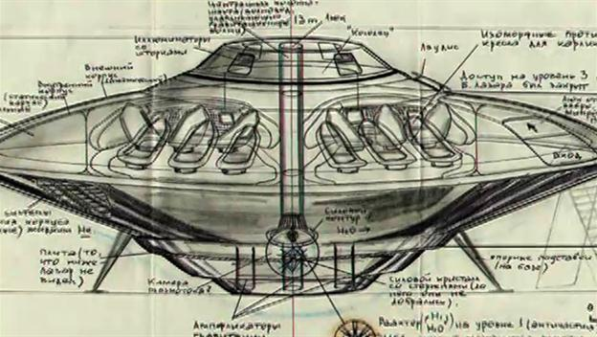
FEC II - Major Activities
Un-Lectures
  Active Learning: Physical Challenges, Problem Solving, Discussions…
  Laboratory
    Universal Design
    Design for the Other 90 %
    Instructor-selected Project
  Computers
    MATLAB
    Word, Excel,
    PowerPoint, …
cosmostvstream.info
Notes:
Some sections may do un-lecture activities during the lab period and vice versa.

Slide 10
Grading
Description | Percentage
Engineering Projects (Reports, Memos, Annotated Bibliographies, Presentations, Lab notebook, In class performance, …) | 50
Homework (Other than GameLab) (PathFinder exercises, Traditional homework, In-class assignments or quizzes, etc.) | 10
GameLab | 15
Professionalism/Ethics | 5
Midterm Exam | 10
Final Exam | 10
Total | 100
Notes:
Engineering Projects
(Reports, Memos, Annotated Bibliographies, Presentations, Lab notebook, In class performance, etc.)
50%
Homework (Other than GameLab)
(PathFinder exercises, Traditional homework, In-class assignments or quizzes, etc.)
15%
GameLab
15%
Professionalism/Ethics
5%
Midterm Exam
5%
Final Exam
10%
Total
100%

Slide 11
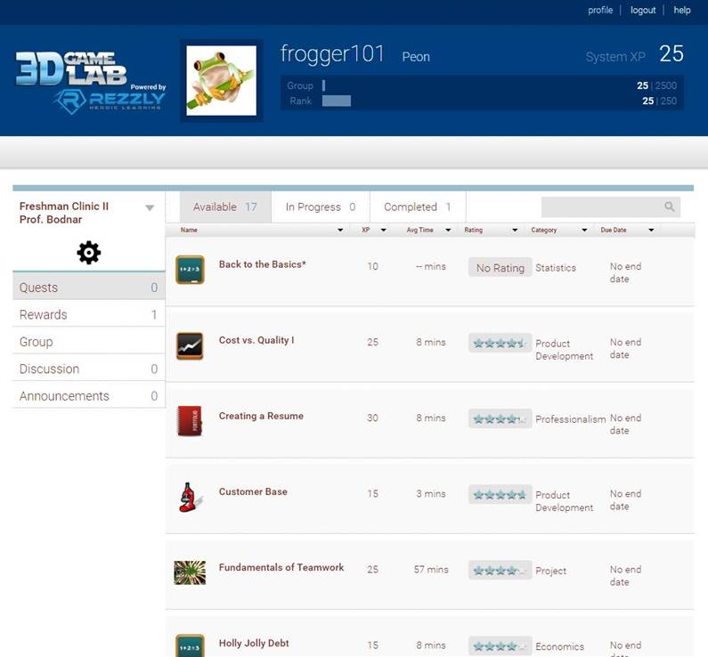
Game Based Homework Portal –
3D Game Lab¹
http://www.youtube.com/watch?v=wsen5rg7Lb0
Deadlines (Due Dates Correspond to Day of your Lab Section) XP Deadline – Week of Feb. 12th 700 XP Deadline – Week of March 5th 1,050 XP Deadline – Week of April 2nd 1,250 XP Goal for an “A” by last day of class at 5 pm
1. 3D Game Lab. http://3dgamelab.com/
Notes:
This platform provides the opportunity for students to personalize their learning experience in FEC II. The platform is designed so that students complete homework assignments as individual “quests” or activities. Students are provided with the opportunity to select their path through the system (more on this on the next slide). Have students watch the short YouTube video that describes the platform. It is also important to let students know that although the platform is called 3D GameLab, this system is not a game but rather an online homework system that is designed with game-based properties (leaderboard, points, badges/rewards). Students should also be told that there are 3 deadlines for GameLab throughout the semester (see blue box on slide). They need to reach these targets by midnight on the day of their lab period during the designated week. If they don’t reach these benchmarks then they will lose 10% of their total homework grade i.e. 1.5 out of 15 points. These deadlines are set in place as historically they have been found to help students stay on track for meeting deadlines associated with the course. After the 1,050 XP deadline (equivalent to a 12.6 out of 15 on their homework if no deadlines are missed) there are no further point deductions. It is up to the students at this point to determine if they would like to reach the final goal or go beyond this goal. Also, mention that no additional points are given even if they exceed 1,250 XP (there is up to 2,200 XP on the platform). The additional quests are there for student personal development and it is up to them to take advantage of them if they would like.

Slide 12
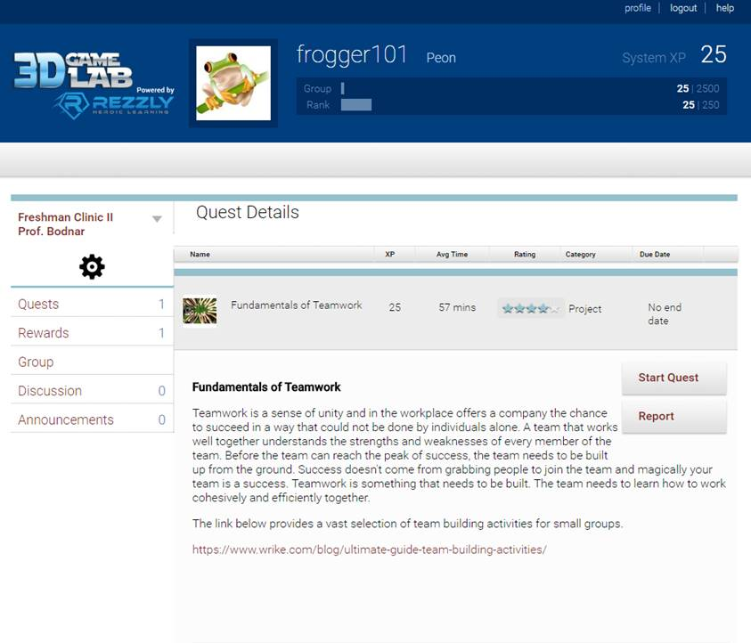
3D Game Lab – Student Freedom
Allows students to personalize their learning journey
Students are initially given access to 16 quests after completion of the gateway “Who Will You Be?” quest
Students choose quests they want to complete to reach 250 XP and level up
More quests become available based on pre-requisites and level in the platform
Notes:
As mentioned on the prior slide, 3D GameLab provides the opportunity for students to personalize their learning experience. On the first day of their class they will receive an e-mail from Rezzly asking them to sign in to an account on GameLab. GameLab now accepts Google login so students do not need to create a new username and password but can in fact use their Rowan credentials to access their account. They will then see the “Who Will You Be” quest that serves as the gateway to the platform. This quest allows students to learn about Rowan’s policy for online communication and to create their own avatar for use with the course. After this quest has been approved students will have access to 16 different quests on topics that cover all of the learning objectives for the course. They can pick and choose which quests to do based on topic, interest and type of activity. As the quests are completed and approved students will earn points and be able to progress through the system and gain access to a larger selection of quests based on pre-requisites completed and the level upon which they find themselves.

Slide 13
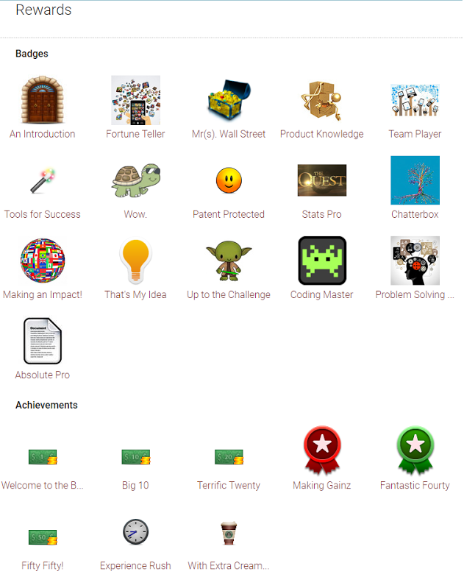
3D Game Lab – Badges and Achievements
Badges and Achievements supply bonus XP to students
Badges are awarded for completing milestones within a specific category
Achievements are awarded for various reasons such as completing a certain number of quests in a given time period
Notes:
This last slide is just meant to demonstrate to students that the system has a lot of opportunities that they can leverage to get additional bonus points. For instance, students can target completing a badge by looking at what quests need to be completed and then working through those quests first. They can also seek to up their XP by going after achievements that ask them to complete a certain number of quests or reach a specified level within a given time frame.

Slide 14
GameLab Intro
Hi Everyone,
This semester in FEC II we will be using a new platform for homework assignments entitled GameLab. This homework platform allows you the opportunity to personalize your learning experience and although it has “game” in the title it is really more of a digital homework platform with game-based elements (points, badges and leaderboard). You will learn a lot more about this platform during your first class this week.
To provide you with access to GameLab you will receive an e-mail from Rezzly asking for you to create an account on the platform. I will be sending out these e-mails today for all students registered in FEC II. I ask that you do not delete the e-mail and just wait to register until your first FEC II class this week where your professor as well as either Dr. Streiner or myself will tell you more about the system.
I look forward to a great semester and providing each of you the chance to personalize your FEC II learning journey.
Sincerely,
Dr. Bodnar

Slide 15
GameLab Invitation from “Rezzly”
Dear Student,
I am using Rezzly, an online quest-based learning platform, in our class this year. It provides an overlay for teachers and students to turn an infinite variety of learning activities into a quest-based format, where "players" game their way through the curriculum, students have choice in their learning activities Players earn experience points, achievements, and levels.
To sign up for Rezzly and accept the invitation to join my Group, please click on the link below and follow the instructions to complete your online profile. Please register using the email address at which you received this invitation as it has been added to our database to allow you access.
Click Here to Accept Invitation
Thank you and I will see you online!
Cheryl Bodnar

Slide 16
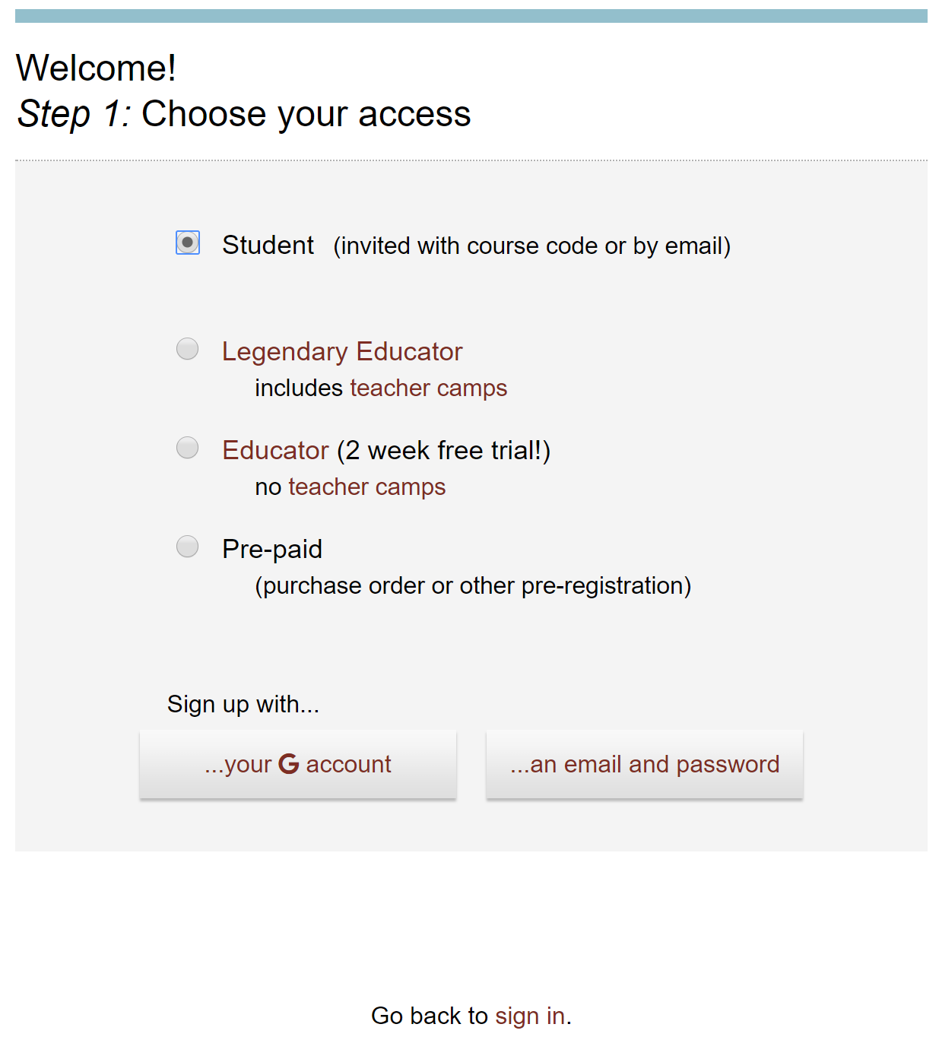
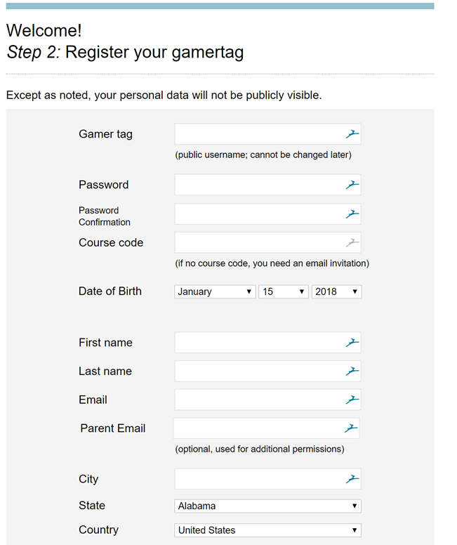
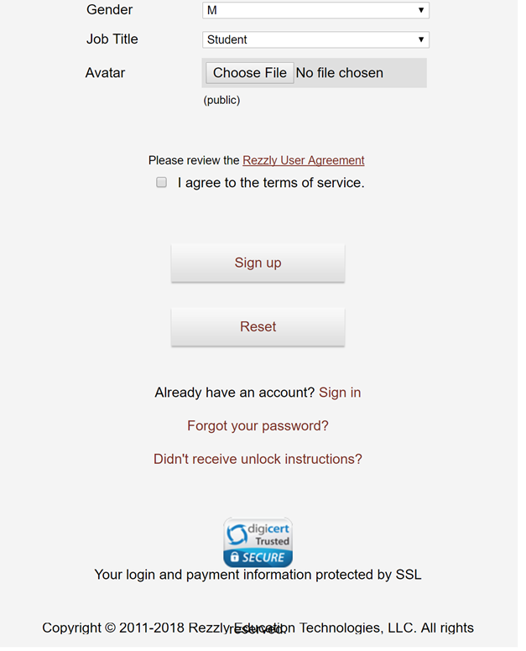
GameLab
Click Here to Accept Invitation

Slide 17
Questions on GameLab?

Slide 18
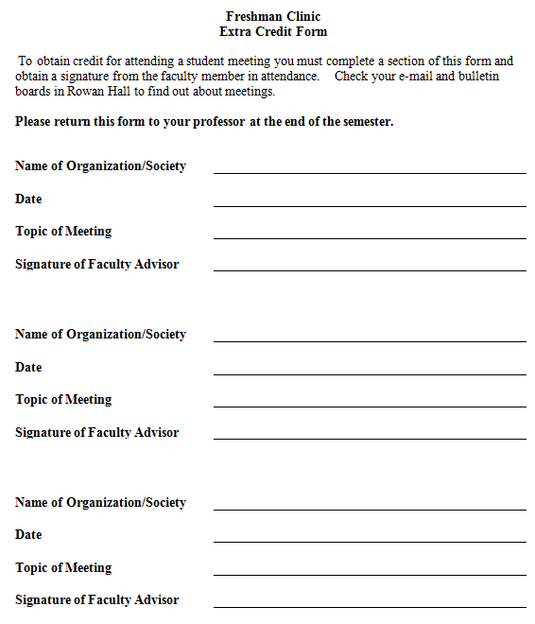
Extra Credit
Attend Engineering Student Club Meetings +…
Extra Credit Form in Syllabus
Or Use on-Line Rowan
Passport Program
  If your Professor allows
Notes:
Prof may also give EC for typical Passport activities (seminar, athletic event, concert,…)
How many students did this last year? How many got all three points? How many went up a grade? How many would have gone up a grade if...?

Slide 19

Extra Credit – Feedback from FEC I
How many students got all 3 points? show hands
  Of those, how many increased their letter grade?
For all students, if you had earned all 3, would your letter grade have gone up?
www.teenagehack.com
Notes:
How many students did this last year? How many got all three points? How many went up a grade? How many would have gone up a grade if...?
Are they glad they went to events?

Slide 20
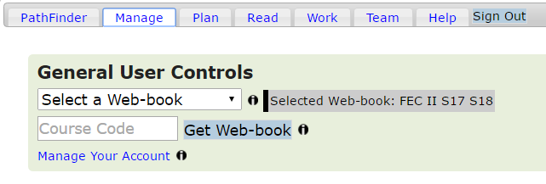
PathFinder Web-Book
Flipped Classroom
  Read→ BEFORE Exercises →
  Active Learning in Class → AFTER Exercises +
Log in and create your web-book
Use your course code to create the web-book for your FAC II section
Notes:
New Students
URL, username, and password information was emailed to you (if you were enrolled by Jan 1)
Help Tab FAQs – 2nd Quick Start Guide, 3rd Student Guide

Slide 21
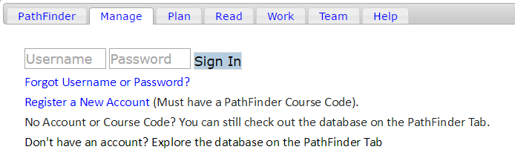
No PathFinder Account?
Helpful FAQs
First, use your course code to create a PathFinder Account.
Then, use it again to create your web-book.

Slide 22

Seek a summer internship:
College of Engineering Webpage - Outreach Office
Family, Friends of Family, Neighbors
The Spring Career and Graduate School Fair is
Wednesday, February 21, 2018 from 10:00 AM – 2:00 PM in the Rowan Recreation Center gym
www.academyofwholelearning.org
Notes:
Encourage Students to Apply for Internships for this Summer. Even if they don’t get one, the experience of trying will help them get one the following summer.

Slide 23
Break into Sections
Get to know each other and your professor
Learn what you will do this semester

Slide 24
Course Introduction
Course Project: The Global Engineer
Course Website:
http://users.rowan.edu/~jahan/hunter/global_engineer.htm
  Syllabus
  Schedule
  Team Work

Slide 25
Team Work
Project Management
Time Management
Conflict Resolution
Communication Skills
Notes:
Consider on or off campus and meeting time availablity

Slide 26
Team Work Policy
If someone is not pulling their weight on their team, they can be fired!
Please inform your Professor if someone is not pulling their weight as early as possible so that it can be dealt with promptly.

Slide 27
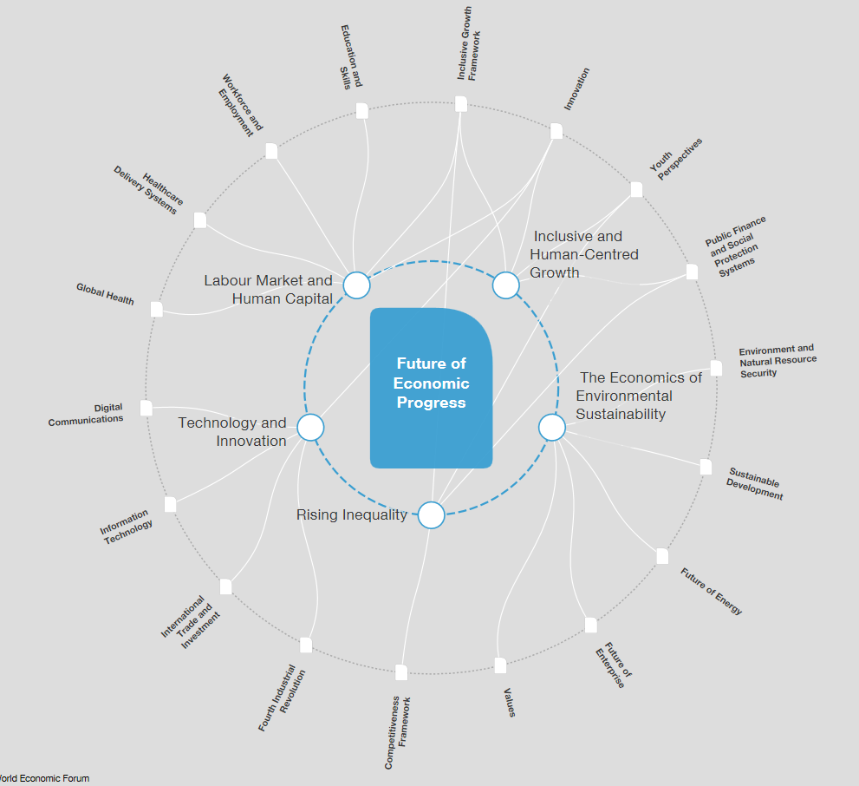
Global Engineer
World Economic Forum

Slide 28
Basic Needs for all
Notes:
water, food, energy and sanitation

Slide 29
Engineering is not just problem solving
Protecting People and their Environment
Complex Social Issues
Variety of Regulatory Environments
Disaster Recovery
Climate Change
Notes:
We harvest and extract all the resources that we need to sustain human life and culture humanempires. It is the role of the engineer, however, to minimize the effects of damage on the surrounding ecosystems, and design necessary infrastructures that are both efficient and safe.

