Slide 1
MATLAB
Freshman Engineering Clinic II
https://confluence.rowan.edu/display/IRT/RowanCloud+and+Citrix

Slide 2
Course Reminders & Deadlines
Pathfinder
Before exercises on MatLab due by 11:55 PM on Feb. 19th
3D Game Lab
2nd deadline of 700 XP midnight March 5th
GameLab is 15% of your course grade
No activity on the platform = B or less for your course grade
Universal Design Project
Memo Project Lab #3 due by 5 PM on Feb.21st
Final Report and YouTube video due by 5 pm on Feb 28th

Slide 3
Intro to MATLAB¹
MATLAB stands for MATrix LABoratory
Computing software that provides:
Ability to solve equations
Plot figures
Work with matrix functions
Has a powerful built in library of commands to make performing operations easier
1. https://www.mccormick.northwestern.edu/documents/students/undergraduate/introduction-to-matlab.pdf

Slide 4
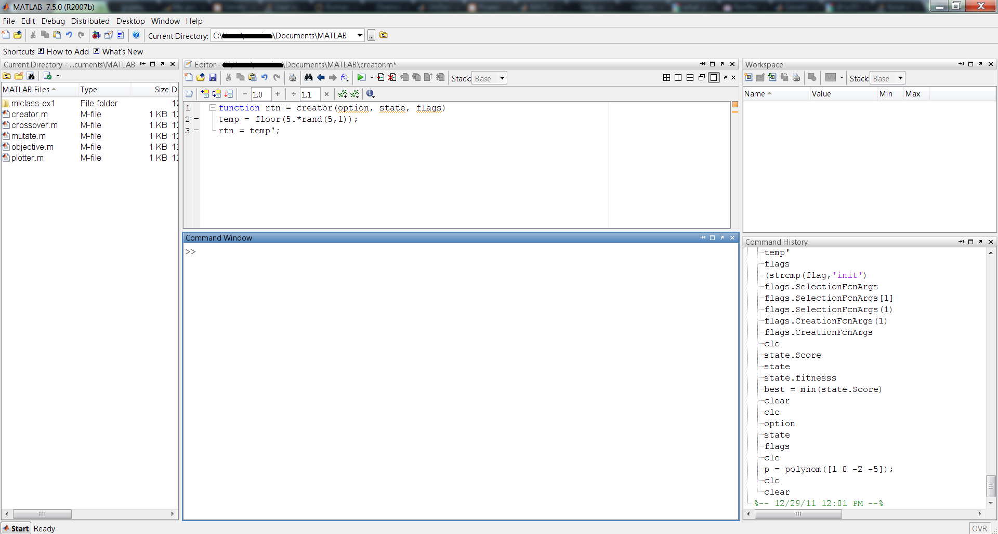
MATLAB Interface¹
1. https://scriptbucket.wordpress.com/tag/matlab-tutorials/
Notes:
Have students open up MATLAB on their computers.

Slide 5
Basic Functions of MATLAB¹
Creating Vectors/Matrices
Vectors (only one row or column)
>>x=[1,2,3,4,5,6]
>>y=[3;-1;2;4;5;1]
Matrix
A = [1, 2, 3; 4, 5, 6]
B = [7, 8, 9, 10; 0, 11, 34, 17; 25, 23, 100, 5]
Matrix Manipulations
Review as necessary (all were covered in Pathfinder)
Addition/Subtraction
Multiplication/Division
Matrix-Constant
Element-wise Operations
Indexing and the Colon Operator
Notes:
Ask students what the difference is between Vectors X and Y as well as Matrix A and Matrix B.
Answer: x is one row many columns and y is one column many rows. A has 2 rows/3 columns and B has 3 rows/4 columns.
Students should complete Warming Up #1 on the challenges sheet (before discussing manipulations)
After discussion manipulations, students should complete Warming Up # 2 and 3.

Slide 6
Basic Functions of MATLAB¹
Creating plots
>>x=[1,2,3,4,5,6]
>>y=[3,-1,2,4,5,1]
>>plot(x,y)
Plotting example - plot the sin function from 0 to 2π
1. https://www.mccormick.northwestern.edu/documents/students/undergraduate/introduction-to-matlab.pdf
Notes:
The plotting example is provided in the MATLAB README file

Slide 7
Basic Programming in MATLAB¹
Loops:
For – causes an operation (or a segment of code) to run FOR a specific number of iterations
While – causes an operation (or a segment of code) to run WHILE or UNTIL a specific condition is unmet/met
Conditionals
If/Then statements – causes MATLAB to check a condition (IF) and based on the status of that condition, perform it’s next action (THEN)
Notes:
Give non-code examples for each of these.
FOR loop: I want to perform 25 push ups. Therefore, I complete the push-up motion for 25 iterations.
WHILE loop: I want to perform push ups UNTIL I am too tired to perform any more. Therefore, I complete as many push up as it takes for my muscles to tire out.
IF/THEN: If I want to get better at doing push ups, then I need to practice doing push ups.
FOR loop: I will work on homework for 3 hours tonight. Therefore, when 3 hours has expired, I will stop doing homework.
WHILE loop: I will work on homework WHILE there is still homework left to do. Therefore, I will continue to work on homework until there is no more homework.
IF/THEN: If my homework is due soon, then I should work on my homework.

Slide 8
Try your hand at MATLAB
Don’t forget about MATLAB’s “help” and doing a quick Google search if you’re stuck

