Slide 1
Digital Image Processing
ECE.09.452/ECE.09.552
Digital Image Fundamentals
Dr. Shreekanth Mandayam
Electrical & Computer Engineering
Rowan University

Slide 2
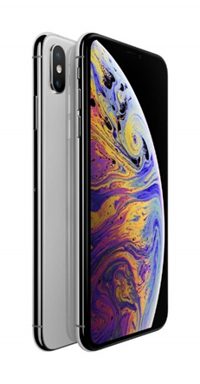
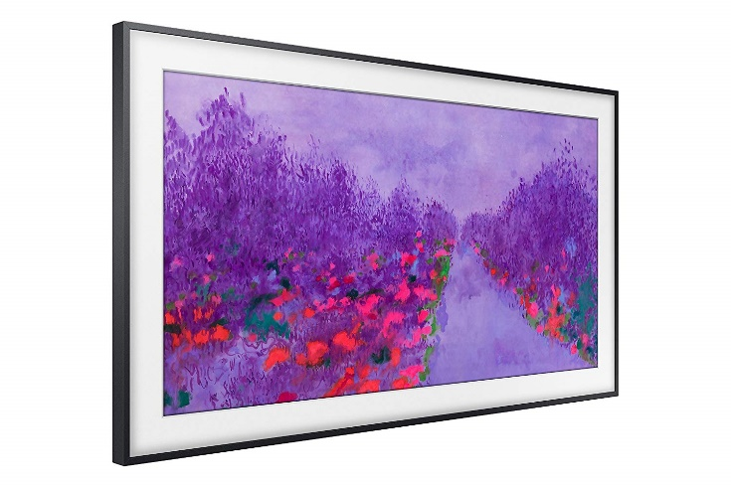
www.apple.com www.samsung.com

Slide 3
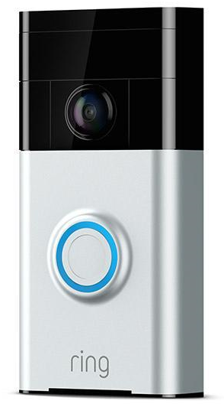
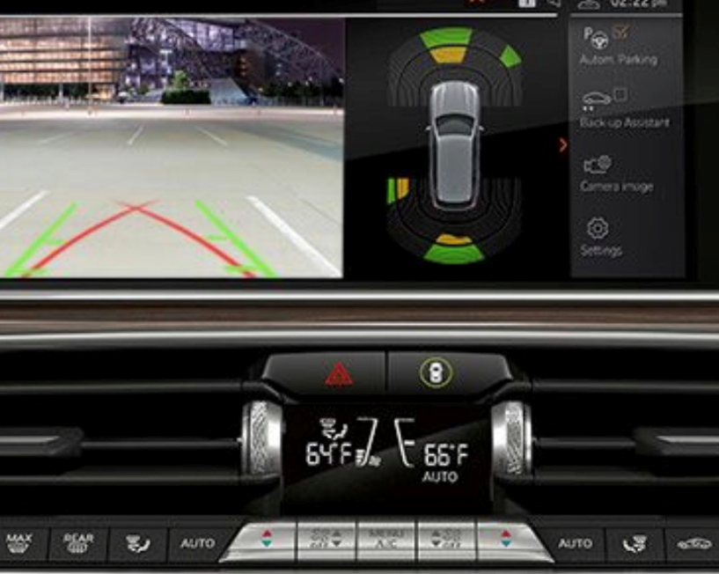

https://www.bmw.com/
https://ring.com/

Slide 4
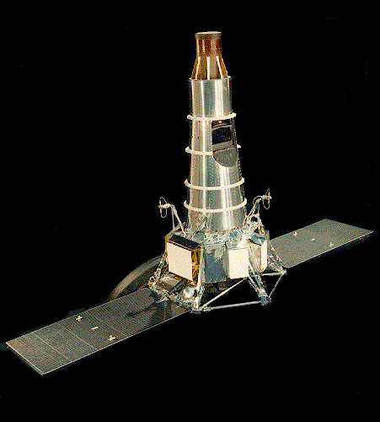
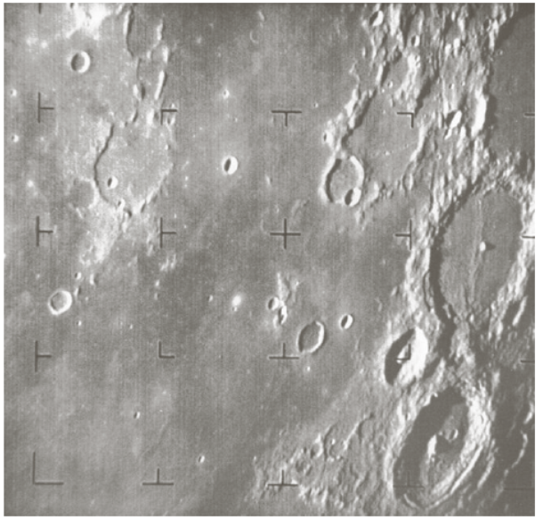
https://science.nasa.gov/missions/ranger

Slide 5
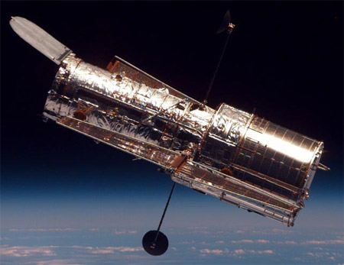

Slide 6
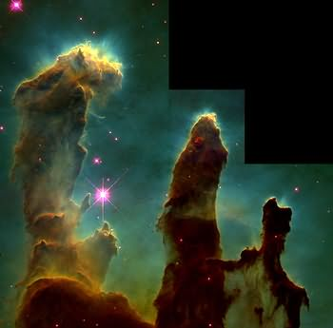
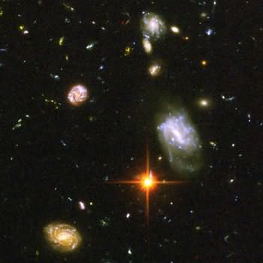
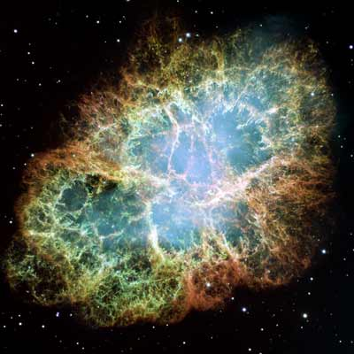
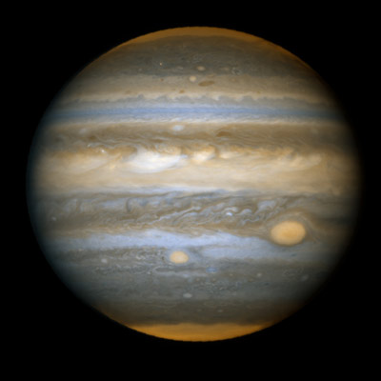
“Pillars of Creation” Eagle Nebula (M16)
Galaxies from Ultra-Deep-Field
Supernova remnant: Crab Nebula
Jupiter
http://hubblesite.org/

Slide 7
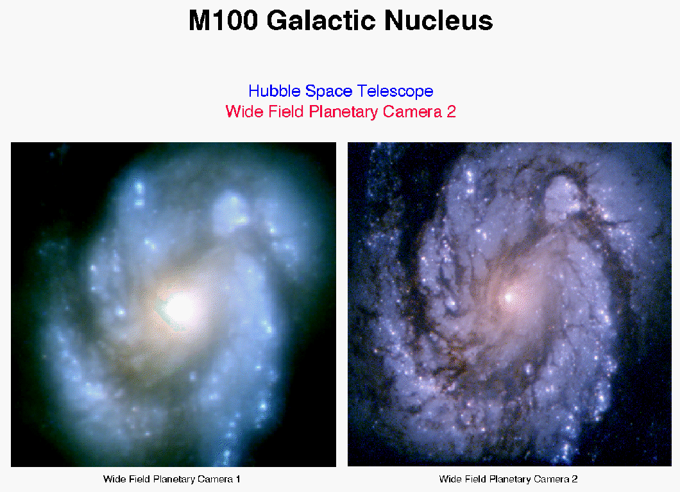


Slide 8

ABA E-13B Font

Slide 9
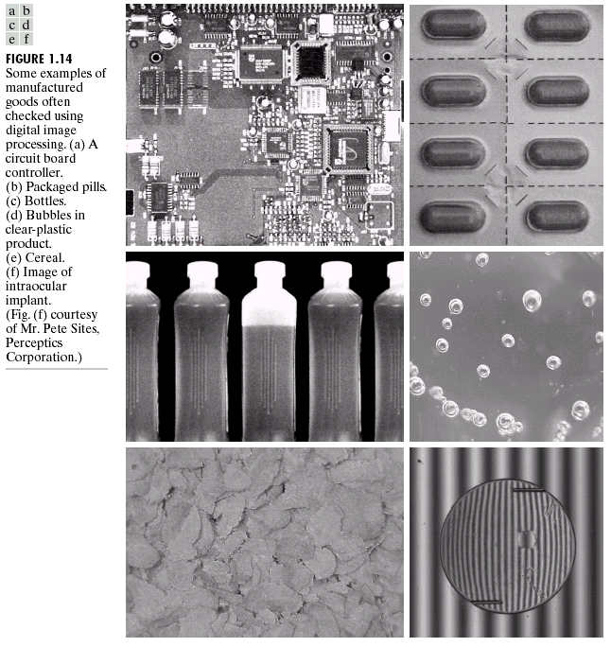

Slide 10
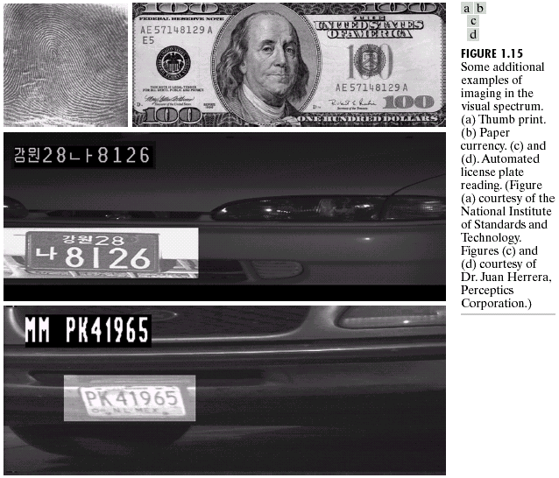

Slide 11
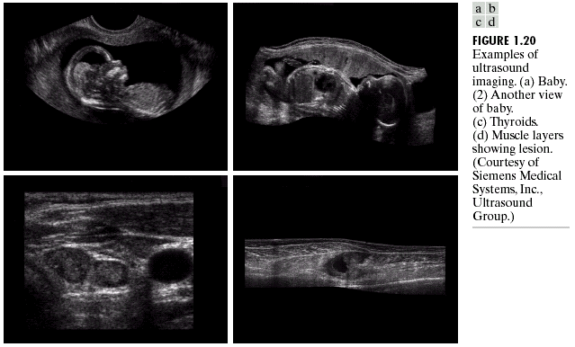

Slide 12
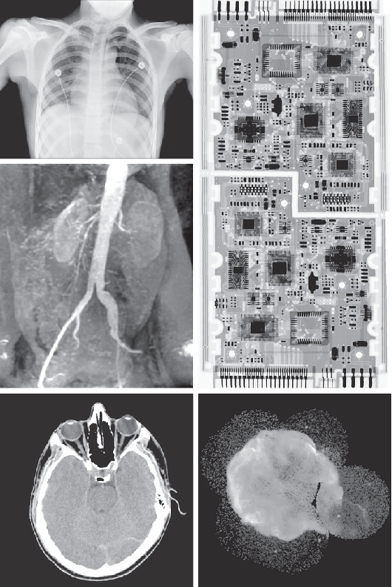
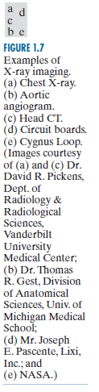

Slide 13
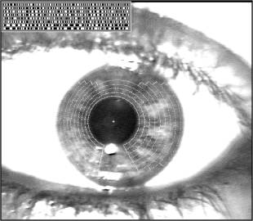
Biometrics

Slide 14
Plan
What is an image?
  Mathematical representation of monochromatic images
  What is a digital image?
Digital image processing
  Fundamental steps
  Why do we need this?
Course logistics
Self-Assessment Test
Sampling & Quantization
Pre-Lab 1

Slide 15

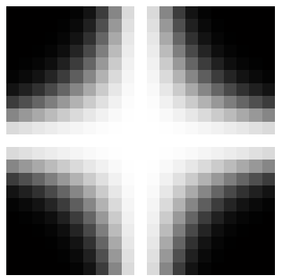
Images
column
Sample
Quantize
f(x, y)
row
y
x

Slide 16

Digital Image
y
x
Gray
Level
f(x,y)

Slide 17
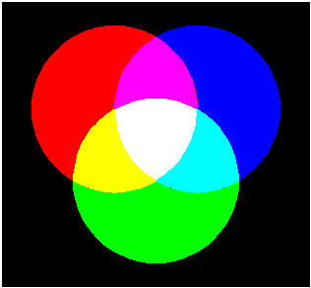
Color Images
R
M
B
W
Y
C
G
Mixtures of Light: Additive Primaries

Slide 18
B
B
G
G
R+G+B
R+G+B
R
R
B
B
G
G
R+G+B
R+G+B
R
R
B
B
G
G
R+G+B
R+G+B
R
R

Slide 19
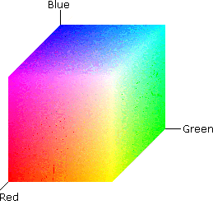
RGB Color Space

Slide 20
Fundamental Steps
Preprocessing
Representation &
Description
Segmentation
Problem
Domain
Image
Acquisition
Knowledge
Base
Recognition &
Interpretation
Result

Slide 21
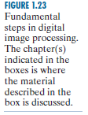

Slide 22


Slide 23
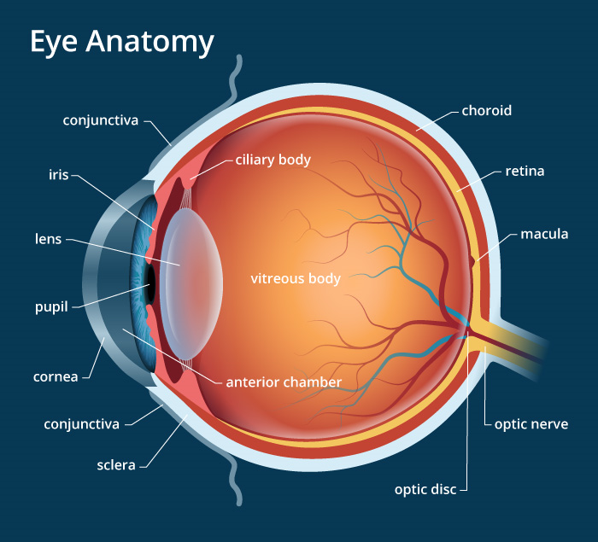
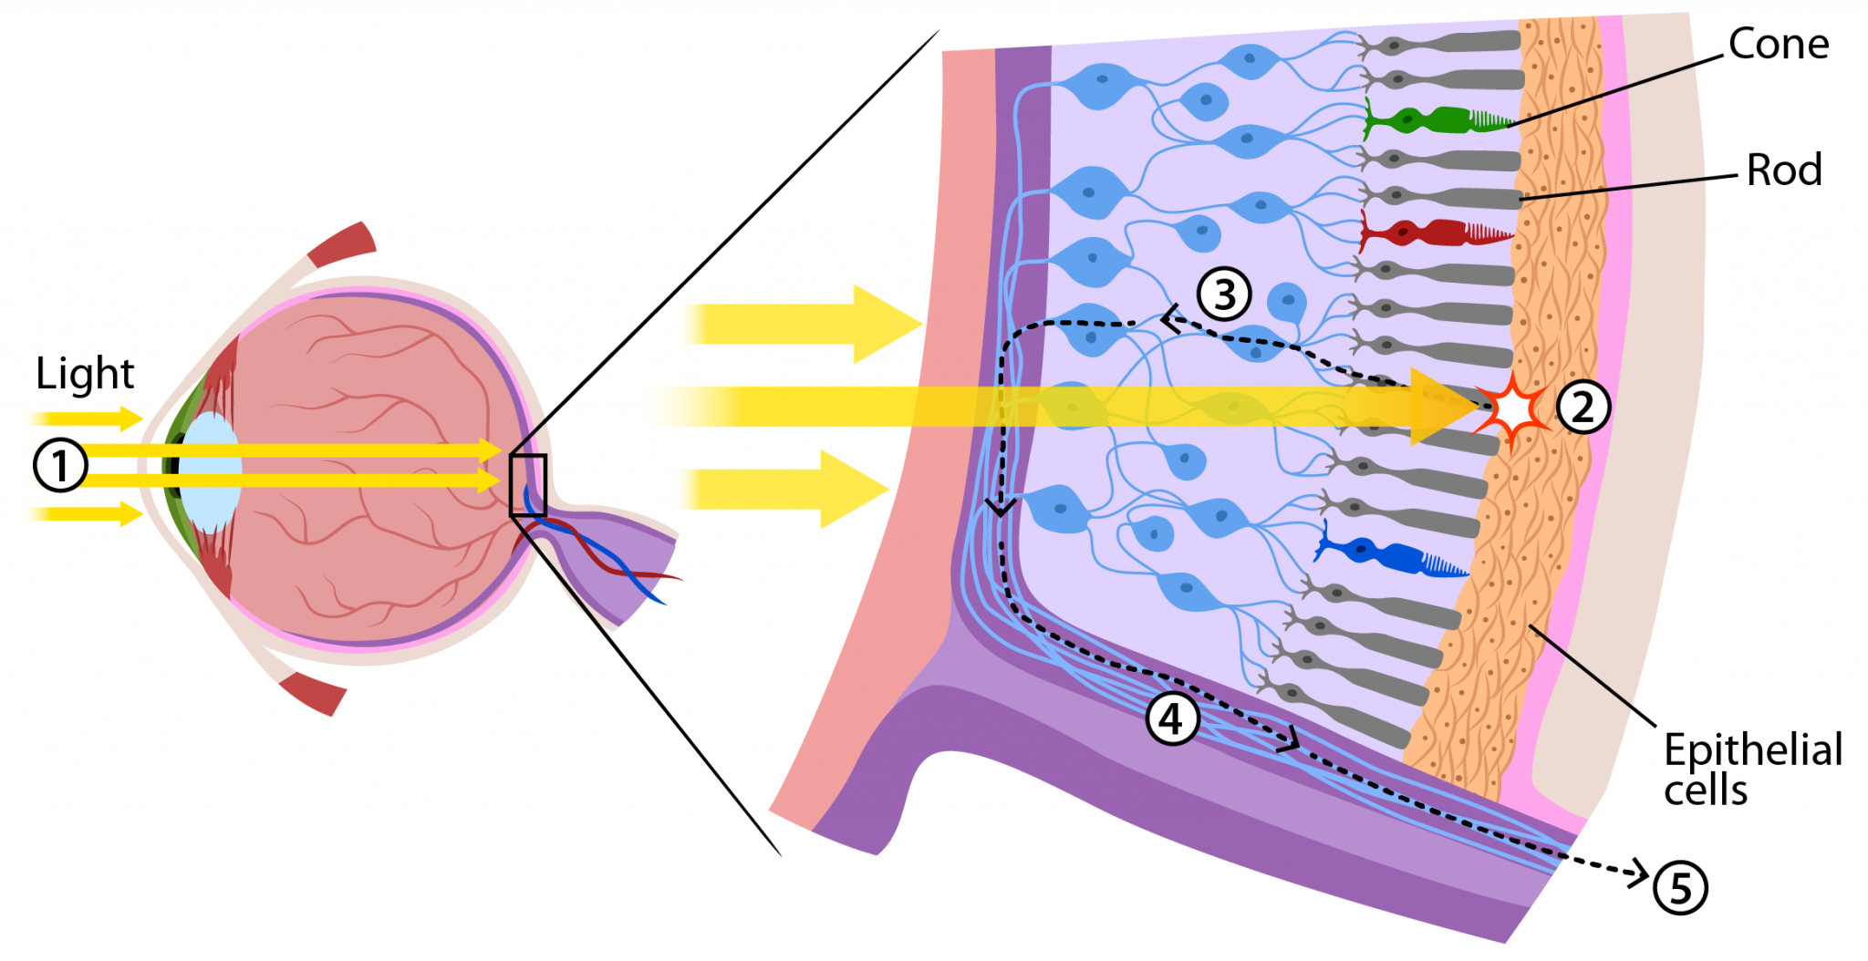
The Human Eye

Slide 24
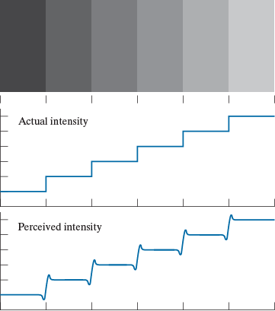
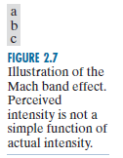
Perceived Brightness

Slide 25
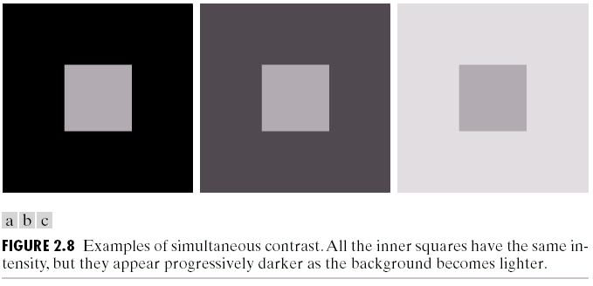
Perceived Contrast

Slide 26
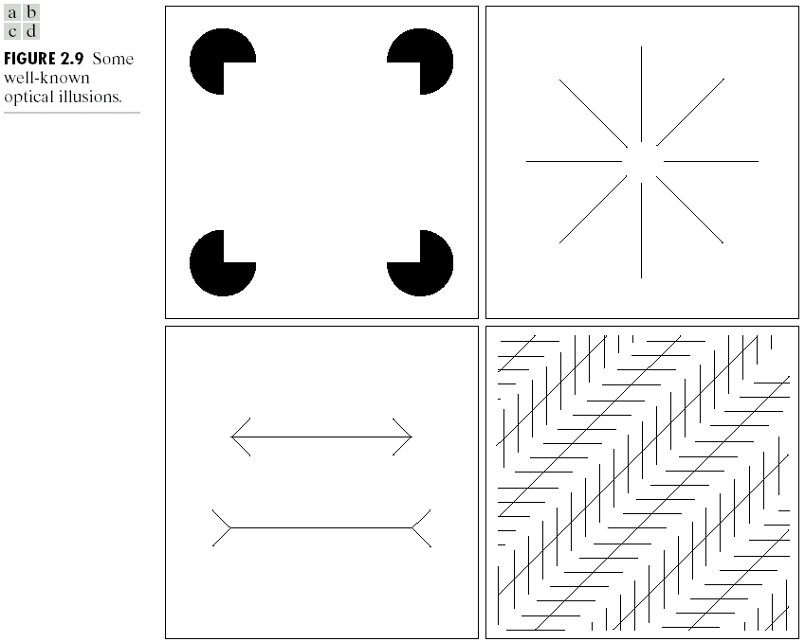
Optical Illusions

Slide 27
DIP: Details

Slide 28
DIP: Course Logistics

Slide 29
Sampling & Quantization
Sampling
  demos/demo_sampling.m
Quantization
  demos/demo_quant.m

Slide 30
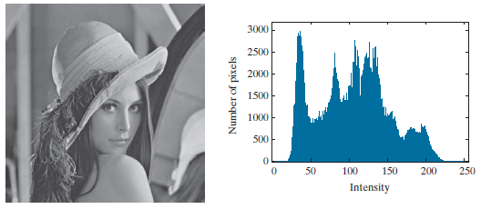

Standard Images
The Lena Image

Slide 31
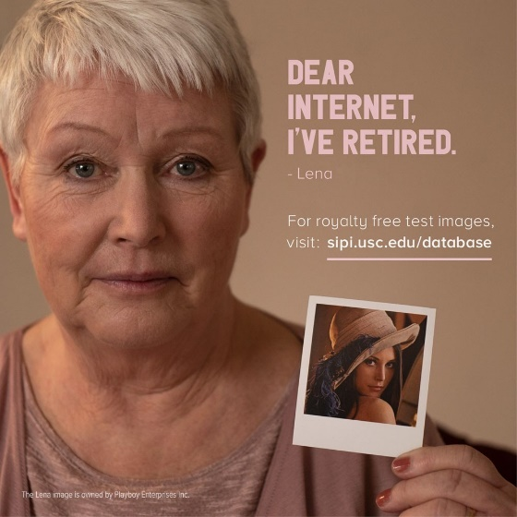
Standard Images
Losing Lena: https://vimeo.com/372265771
We will not use the Lena image in this class

Slide 32
Pre-Lab 1: Intro to Matlab IP Toolbox

Slide 33
Summary

