Slide 1
Digital Image Processing ECE.09.452/ECE.09.552
Spatial Filtering
Dr. Shreekanth Mandayam
Electrical & Computer Engineering
Rowan University

Slide 2
Plan
Recall: Pixel Operations
Point processing
Histogram equalization
Connectivity
Image Enhancement
Spatial Filtering
Detection of Discontinuities
Edge detection (Sobel, Prewitt and Laplacian masks)
individual pixels
all pixels
neighboring pixels
Low-pass
High-pass

Slide 3
DIP: Details

Slide 4
Image Preprocessing
Enhancement
Restoration
Inverse filtering
Wiener filtering
Spatial
Domain
Spectral
Domain
Filtering
>>fft2/ifft2
>>fftshift
Point Processing
>>imadjust
>>histeq
Spatial filtering
>>filter2

Slide 5
Image Preprocessing
Enhancement
Restoration
Inverse filtering
Wiener filtering
Spatial
Domain
Spectral
Domain
Filtering
>>fft2/ifft2
>>fftshift
Point Processing
>>imadjust
>>histeq
Spatial filtering
>>filter2

Slide 6
Spatial Filtering (Masking)
Portion of
a digital image
Mask
z₁
z₂
z₃
w₁
w₂
w₃
z₄
z₅
z₆
w₄
w₅
w₆
z₇
z₈
z₉
w₇
w₈
w₉
Replace
with
R
= w₁z₁ + w₂z₂ + ….. +w₉z₉

Slide 7
Low-pass Filters
Moving Average Filter
1
1
1
(1/9)*
1
1
1
1
1
1
Median Filter
demos/lowpassdemo.m
z₁
z₂
z₃
Replace
with
z₄
z₅
z₆
z₇
z₈
z₉
R
= median(z₁, z₂ , ….. , z₉)

Slide 8
Noise Models
f(x,y)
Σ
g(x,y)
n(x,y)
Degradation Model: g = f + n
SNR_{g} = 10log₁₀(P_{f}/P_{n})
Power Variance (how?)
SNR_{g} = 10log₁₀(σ_{f}²/ σ_{n}²)

Slide 9
Noise Models
N(0,1): zero-mean, unit-variance, Gaussian RV
Theorem:
N(0,σ²) = σN(0,1)
Use this for generating normally distributed r.v.’s of any variance
>>imnoise
>>filter2
demos/lowpassdemo.m

Slide 10
High-pass Filters
Basic HP Filter
-1
-1
-1
(1/9)*
-1
8
-1
-1
-1
-1
Gradient Filter
z₁
z₂
z₃
1
0
1
-1
z₄
z₅
z₆
-1
0
0
0
z₇
z₈
z₉
demos/highpassdemo.m

Slide 11
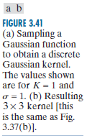
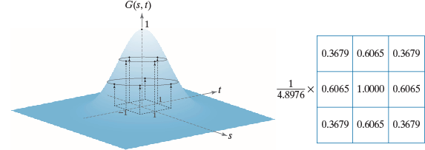
Isotropic Filters
Gaussian Kernel

Slide 12

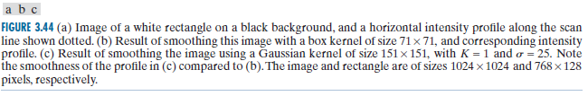
Gaussian Kernel

Slide 13
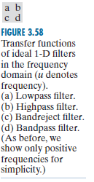
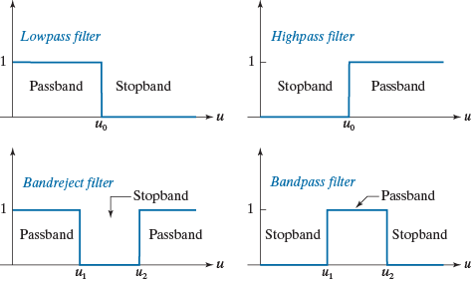
Filters Derived from LPF

Slide 14


Textbook Example

Slide 15
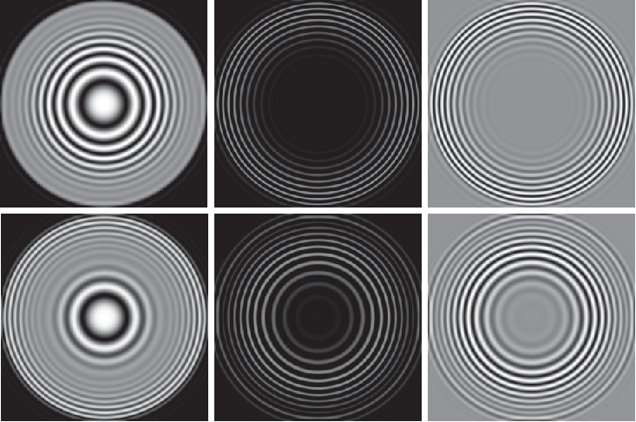


Slide 16
Detection of Discontinuities
Point Detection
-1
-1
-1
-1
8
-1
-1
-1
-1
Line Detection (Prewitt’s Gradient)
-1
-1
-1
-1
0
1
0
0
0
-1
0
1
1
1
1
-1
0
1
demos/prewitt.m

Slide 17
Edge Detection
Sobel Masks
-1
-2
-1
-1
0
1
0
0
0
-2
0
2
1
2
1
-1
0
1
demos/edgegradientdemo.m
>>edge

Slide 18
Lab 2: Spatial and Spectral Filtering
http://users.rowan.edu/~shreek/spring20/dip/labs/lab2.html

Slide 19
Summary

