Slide 1
Digital Image Processing ECE.09.452/ECE.09.552
Restoration
Dr. Shreekanth Mandayam
Electrical & Computer Engineering
Rowan University

Slide 2
Plan
Digital Image Restoration
Environmental Models
Image Degradation Model
Image Restoration Model
Point Spread Function (PSF) Models
Linear Algebraic Restoration
Unconstrained (Inverse Filter, Pseudoinverse Filter)
Constrained (Wiener Filter, Kalman Filter)
Lab 3

Slide 3
DIP: Details

Slide 4
Image Preprocessing
Enhancement
Restoration
Inverse filtering
Wiener filtering
Spatial
Domain
Spectral
Domain
Filtering
>>fft2/ifft2
>>fftshift
Point Processing
>>imadjust
>>histeq
Spatial filtering
>>filter2

Slide 5
Enhancement vs. Restoration
“Better” visual representation
Subjective
No quantitative measures
Remove effects of sensing environment
Objective
Mathematical, model dependent quantitative measures

Slide 6
Degradation Model
f(x,y)
h(x,y)
Σ
g(x,y)
n(x,y)
Degradation Model: g = h*f + n
demos/readme.txt
demos/circ.m
demos/psf.m
demos/blur.m

Slide 7
Restoration Model
Degradation
Model
Restoration
Filter
f(x,y)
f(x,y)
Unconstrained Constrained
demos/readme.txt
demos/circ.m
demos/psf.m
demos/blur.m
demos/restore.m
Inverse Filter
Pseudo-inverse Filter
Wiener Filter

Slide 8
Approach
f(x,y)
Build
degradation model
g = h*f + n
g = Hf + n
W ⁻¹ g = DW ⁻¹ f + W ⁻¹ n
f = H ⁻¹ g
F(u,v) = G(u,v)/H(u,v)
demos/degrade.m
Analyze using
algebraic techniques
Formulate
restoration algorithms
Implement using
Fourier transforms
f(x,y)

Slide 9
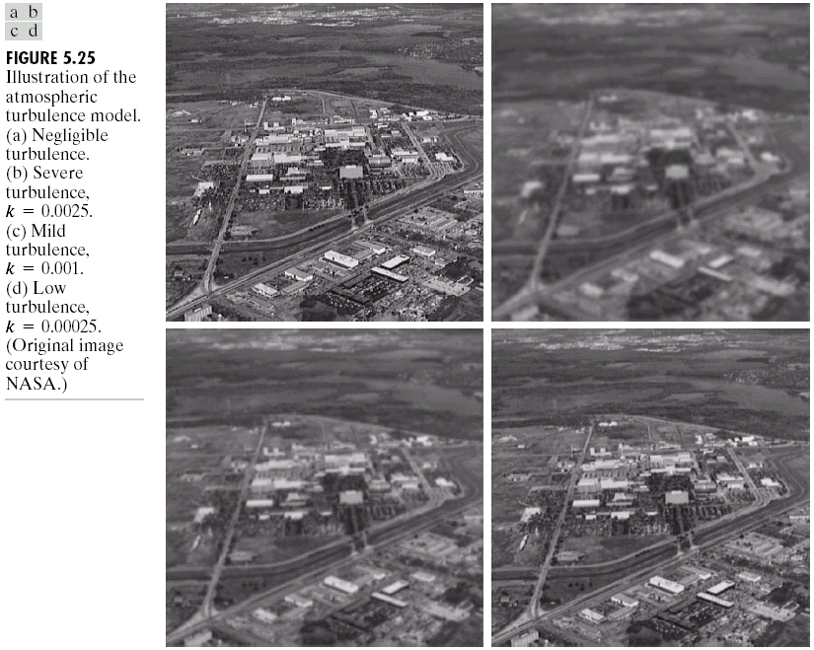
Degradation & Restoration Examples: Gonzalez & Woods
Atmospheric Turbulence Model

Slide 10
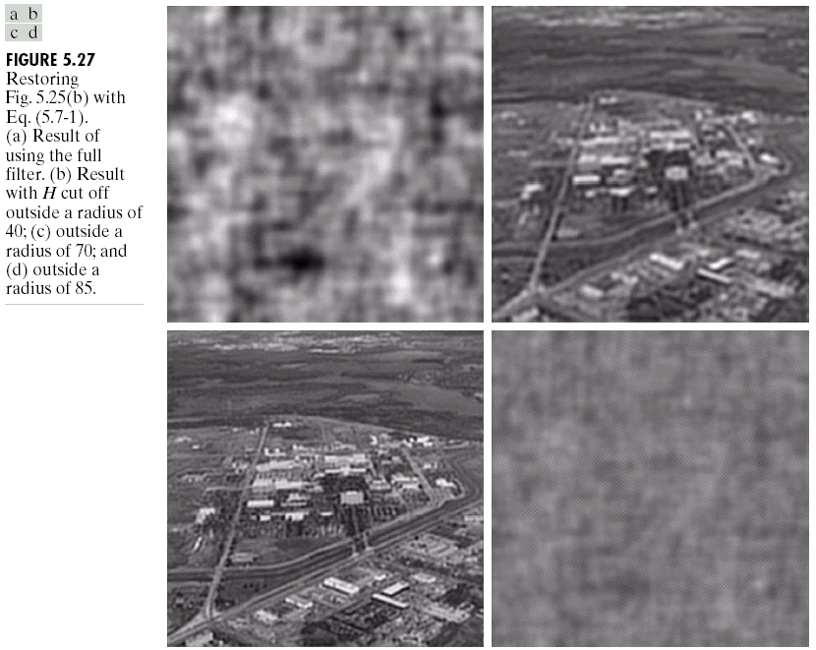
Degradation & Restoration Examples: Gonzalez & Woods
Example 5.9: Inverse Filtering

Slide 11
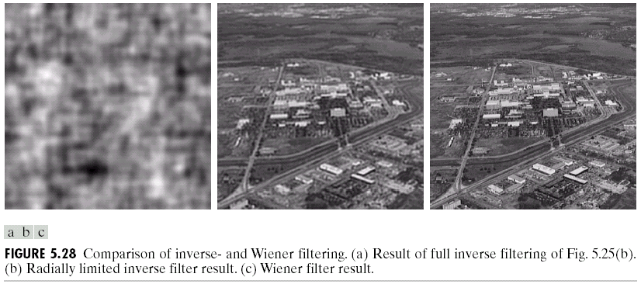
Degradation & Restoration Examples: Gonzalez & Woods
Example 5.10: Wiener Filtering

Slide 12
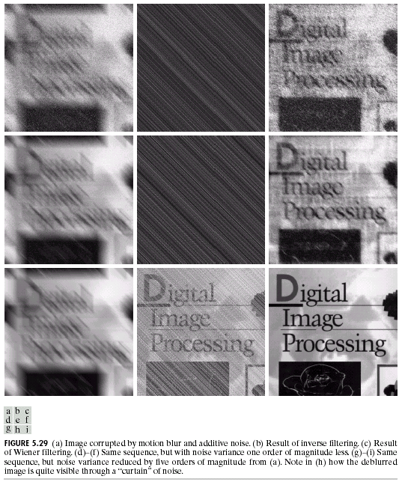
Degradation & Restoration Examples: Gonzalez & Woods
Example 5.11: Inverse and Wiener Filtering

Slide 13
Lab 3: Degradation Models and Digital Image Restoration
http://users.rowan.edu/~shreek/spring20/dip/labs/lab3.html

Slide 14
Summary

