Slide 1
Composting
Adapted from presentation of Terra Luke, 2013

Slide 2
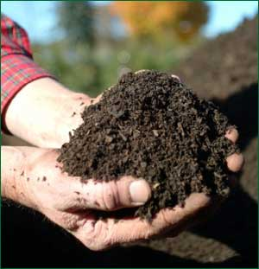
Objectives
Composting introduction
Backyard composting
Community composting
Commercial/Municipal composting
Advantages & Disadvantages
www.scgh.com

Slide 3
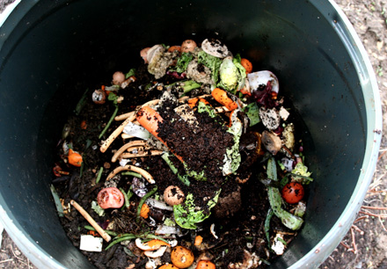
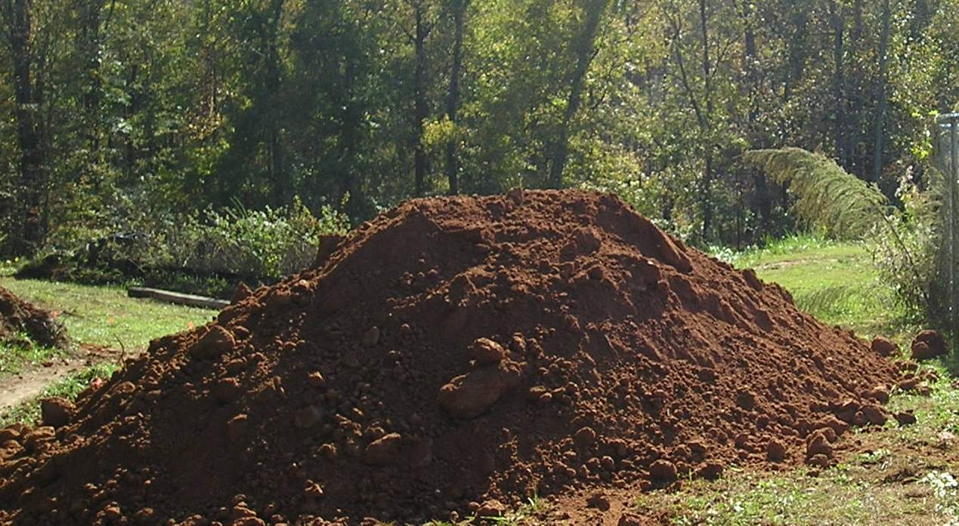
What is Compost?
Decayed organic material
Used to condition soil & add nutrients
Slow release weak fertilizer
howtocompost.org
Waysofthewildinstitute.com

Slide 4
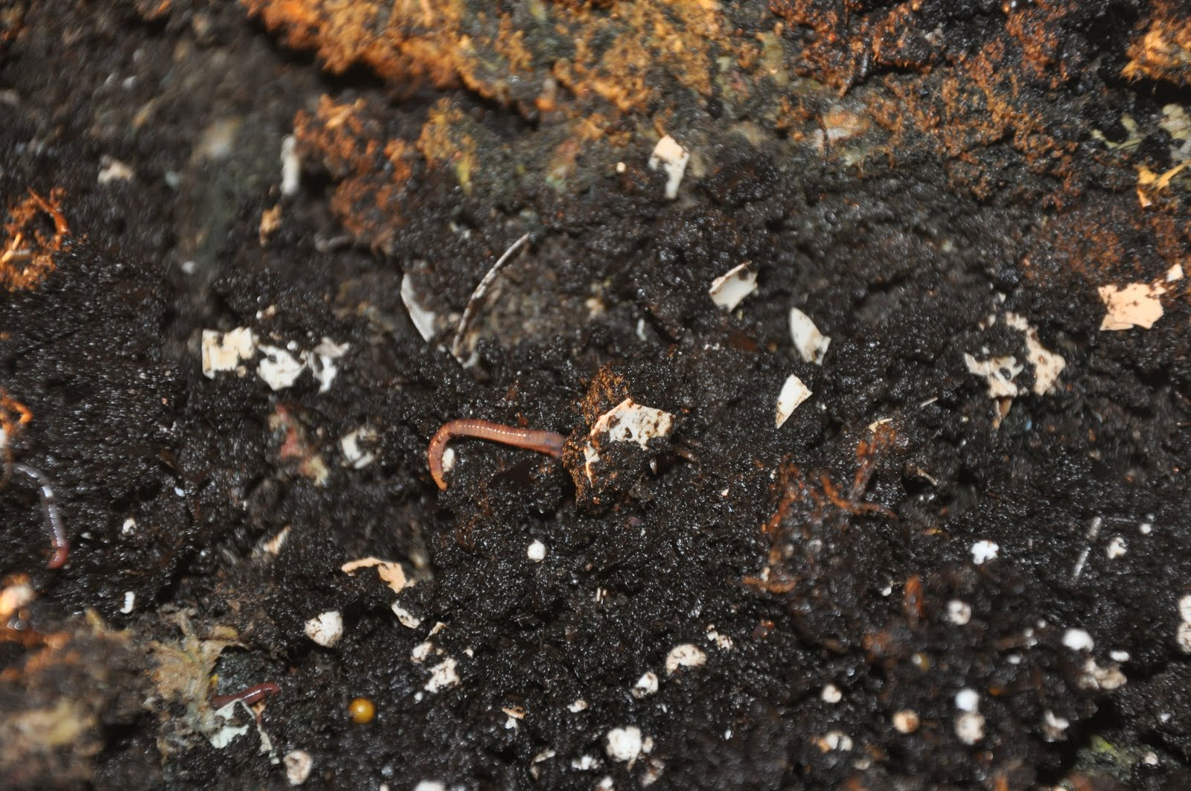
Composting Methods
Anaerobic
Aerobic
Microbes
Worms (Vermicomposting)
Yard Waste
Food Waste
Wastewater Sludge
Municipal Solid Waste
Backyard
Community
Commercial/Municipal

Slide 5
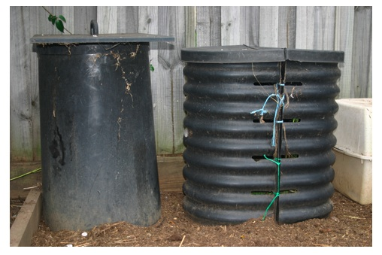
Anaerobic
Organic Material
Water
40% to 75% (solid)
80% to 99% (liquid)
Absence of Oxygen
Naturally occurring Microbes
Fermentation
Byproduct: Compost,
CH₄, …
theveggielady.com
Notes:
whatcom.wsu.edu
Composting without oxygen results in fermentation. This causes organic compounds to break down by the action of living anaerobic organisms. As in the aerobic process, these organisms use nitrogen, phosphorus, and other nutrients in developing cell protoplasm. However, unlike aerobic decomposition, this reduces organic nitrogen to organic acids and ammonia. Carbon from organic compounds, is released mainly as methane gas (CH4). A small portion of carbon may be respired as CO2.
Anaerobic composting may be accomplished in large, well packed stacks or other composting systems. These should contain 40% to 75% moisture, into which little oxygen can penetrate, or 80% to 99% moisture so that the organic material is a suspension in the liquid. When materials are composted anaerobically, the odor nuisance may be quite severe. However, if the material is kept submerged in water, gases dissolve in the water and are usually released slowly into the atmosphere. If the water is replaced from time to time when removing some of the material, odor does not become a serious nuisance.

Slide 6
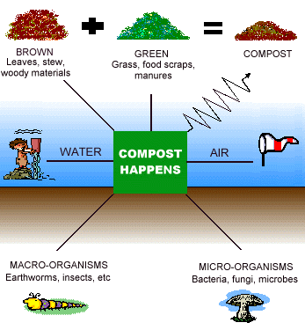
Aerobic
Organic Material
Moisture
Oxygen
Naturally occurring Microbes or Worms
Bulking agent
Respiration
Organics + O₂ + Nutrients + Microbes → More Microbes + Stable Organics + Heat + CO₂ + H₂O + NH₃ + SO₄ +…
www.uaex.edu

Slide 7
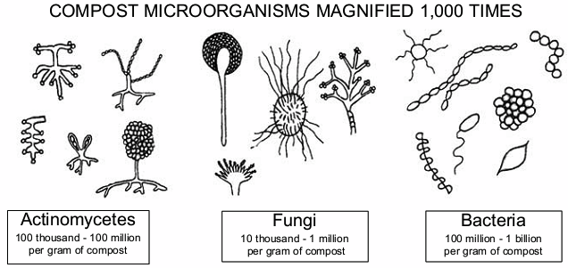
Microbes
sabacooperative.org

Slide 8
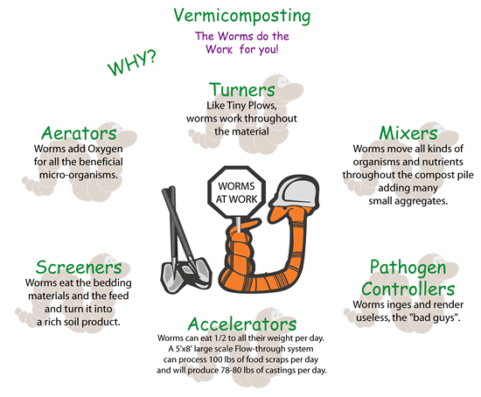
Vermicomposting
Source :mgsenvironment.blogspot.com

Slide 9
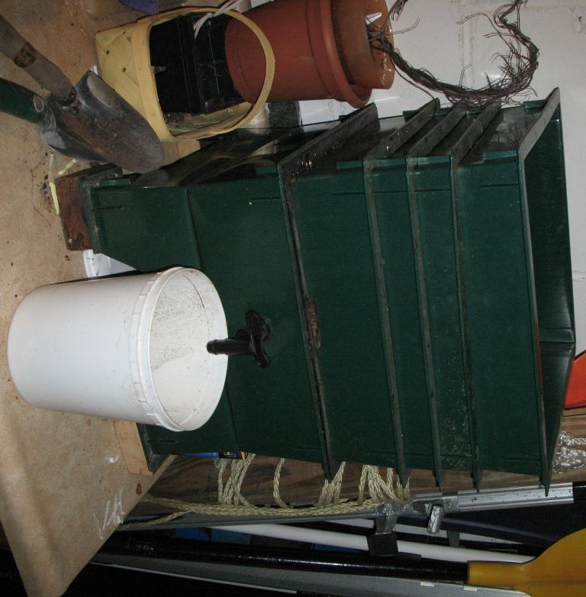
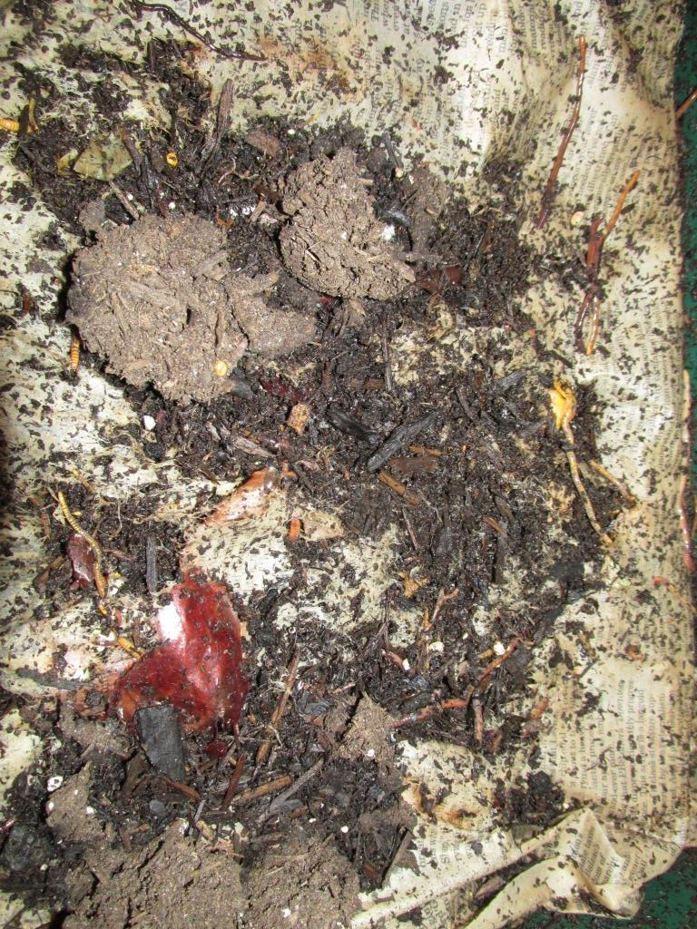
Vermicomposting

Slide 10
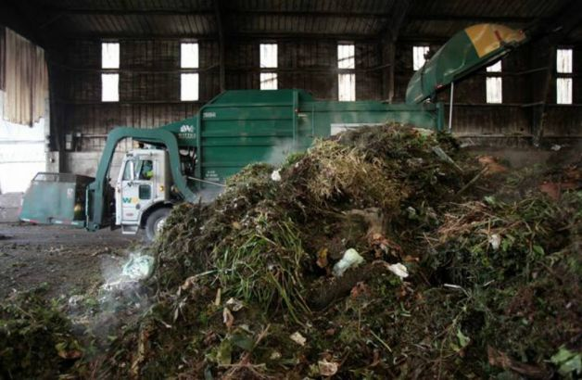
Yard Waste
Leaves
Grass
Brush
Flowering Plants
Garden Waste
ww1.hdnux.com

Slide 11
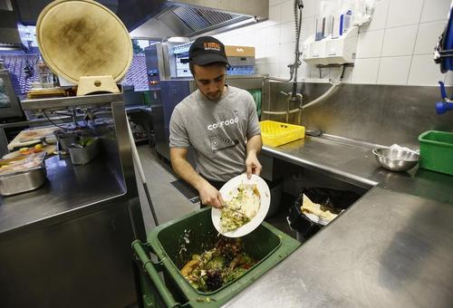
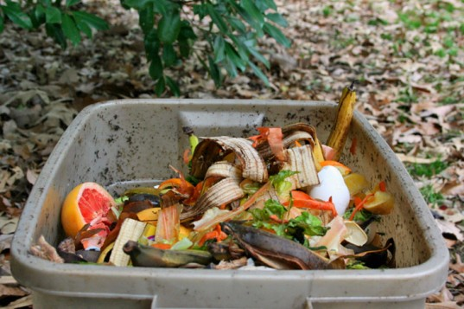
Food Waste
switchboard.nrdc.org
assets.inhabitat.com

Slide 12
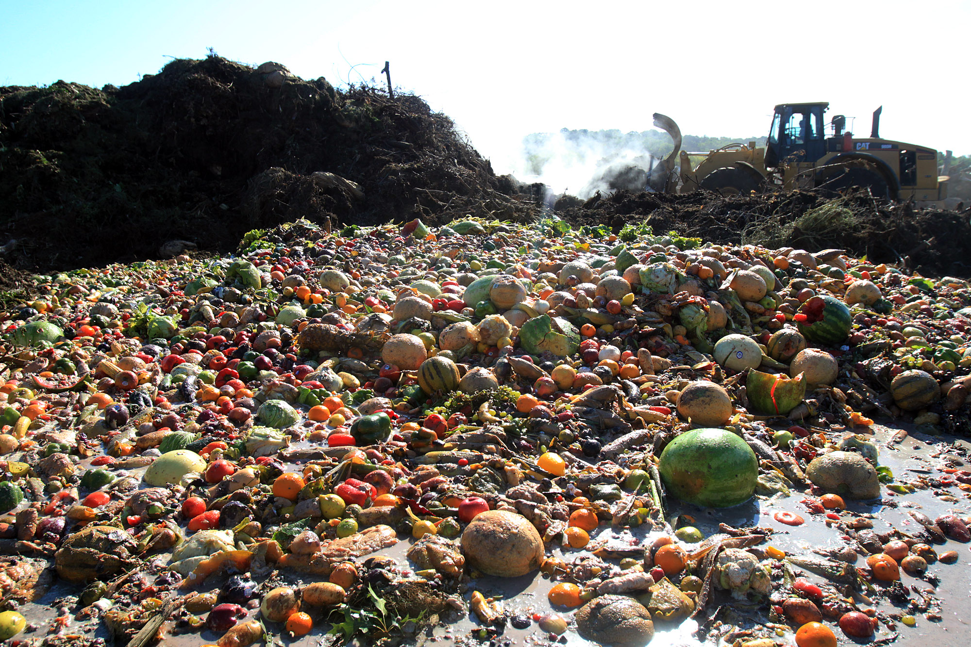
futureofschaumburg.files.wordpress.com

Slide 13
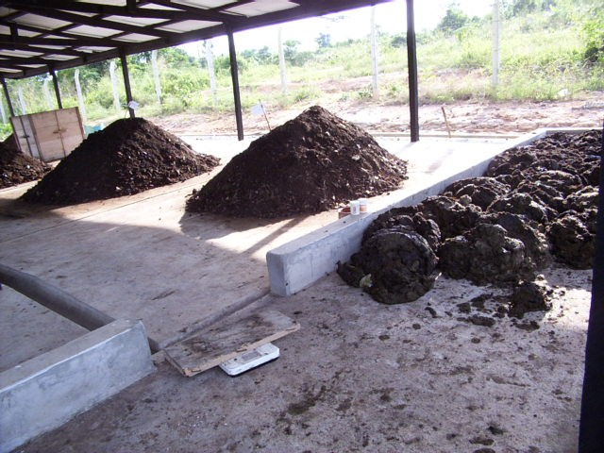
Wastewater Sludge
Notes:
Sludge is on right. Compost to left.

Slide 14
Municipal Solid Waste Composting
Less common than Yard or Food Waste composting
Source separation or post-collection processing to remove contaminants & break bags
Final product often contaminated
More processing to create marketable product, or
Use as landfill cover

Slide 15
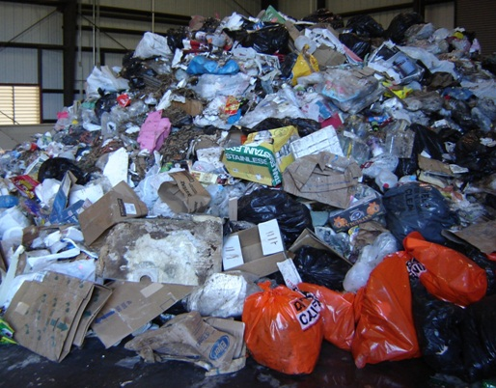
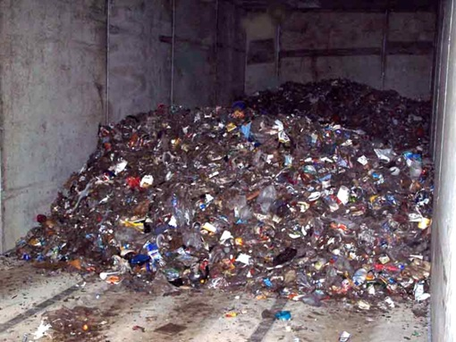
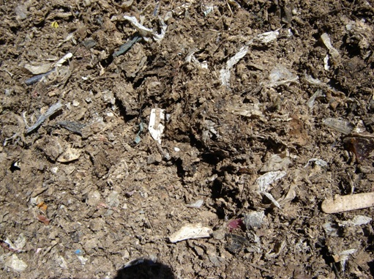

Slide 16
Design Considerations (Aerobic)
Parameter | Values | Comments
Particle size |  | Smaller → more surface area Too small → limits O₂ transfer
Carbon-to-nitrogen ratio (C/N) |  | Low → NH₃ High → Nitrogen limitation
Moisture content |  | Too little slows microbes Too much leads to anaerobic conditions
Mixing / Turning |  | If that is how oxygen is introduced
Temperature |  | Beyond 151°F, microbes are harmed
Pathogen control |  | For extended time (or higher for less time) (Sewage sludge: > 131°F ≥15 days & 5 turns)
Land requirement |  | Per 50 ton/d
pH |  | Is optimal, >8.5 & ammonia is produced
Bulking agent | Needed for wet or fine materials to create void space
Stabilization | Drop in temperature, self heating capacity, oxygen uptake, Chaetomium gracilis growth, or starch-iodine test
Notes:
Starch-Iodine test – Starch is easily degradable and thus should not be found in stable compost. This is a test for starch.
Important design considerations for aerobic composting process
Item
Comment
Particle size
For optimum results the size of solid wastes should be between 25 and 75 mm (1 and 3 in). Small size creates lots of surface area mass transfer, providing lots of food and living space for microbes. But not too small, or it will be difficult for oxygen to penetrate into the organic matrix.
Carbon-to-nitrogen (C/N) ratio
Microorganism require C, N, and P in decreasing amounts. Initial carbon to nitrogen ratios (by mass) between 20 and 30 are optimum for aerobic composting. At lower ratios, ammonia is given off. At higher ratios, nitrogen may be a limiting nutrient. The availability of C is important, as some forms of C are not readily available to the microbes (e.g., lignin)
Blending and seeding
Composting time can be reduced by seeding with partially decomposed solid wastes to the extent of about 1 to 5 percent by weight. Sewage sludge can also be added to prepared solid wastes. Where sludge is added, the final moisture content is the controlling variable.
Moisture content
Moisture content should be in the range between 40 and 60 percent during the composting process. The optimum value appears to be about 55 percent. Too little and the microbes are adversely affected Too much and anaerobic conditions are likely to develop
Mixing/ turning
To prevent drying, caking, and air channeling, material in the process of being composted should be mixed or turned on a regular schedule or as required. Frequency of mixing or turning will depend on the type of composting operation.
If turning is the mechanism by which oxygen is delivered to the organic matter, it should be done once or twice a week.
Temperature
For best results, temperature should be maintained between 122 and 131oF (50 and 55oC) for the first few days and between 131 and 140oF (55 and 60oC) for the remainder of the active composting period. If temperature goes beyond 151oF (66oC), biological activity is reduced significantly.
Control of pathogens
If properly conducted, it is possible to kill all the pathogens, weeds, and seeds during the composting process. To do this, the temperature must be maintained between 140 and 158oF (60 and 70oC) for 24 h. A temperature of 55 °C can be sufficient if maintained for longer time periods. The EPA rule for sewage sludge that is to be made available to the general public is temperature > 55 °C for at least 15 days and 5 turns of the material (if windrow composting is used)
Air requirements
The theoretical quantity of oxygen required can be estimated. Air with at least 50 percent of the initial oxygen concentration remaining should reach all parts of the composting material for optimum results, especially in mechanical systems.
Oxygen can be delivered to the compost material by turning or mixing it, or be pumping air through the pile with pressure or a vacuum.
pH control
To achieve an optimum aerobic decomposition, pH should remain at 7 to 7.5 range. To minimize the loss of nitrogen in the form of ammonia gas, pH should not rise above about 8.5.
Degree of decomposition
The degree of decomposition can be estimated by measuring the final drop in temperature, degree of self heating capacity, amount of decomposable and resistant organic matter in the composted material, rise in the redox potential, oxygen uptake, growth of the fungus Chaetomium gracilis and the starch-iodine test.
Land requirement
The land requirements for a plant with a capacity of 50 ton/d will be 1.5 to 2.0 acres. The land area required for a larger plant will be less on a ton/d basis. Another rule of thumb commonly used is 4000 yd3 of material on site per acre.
Note: 1.8 x (oC) + 32 = oF.
Adopted from Tchobanoglous et al. 1993 Pg 146 (I have made some changes)

Slide 17
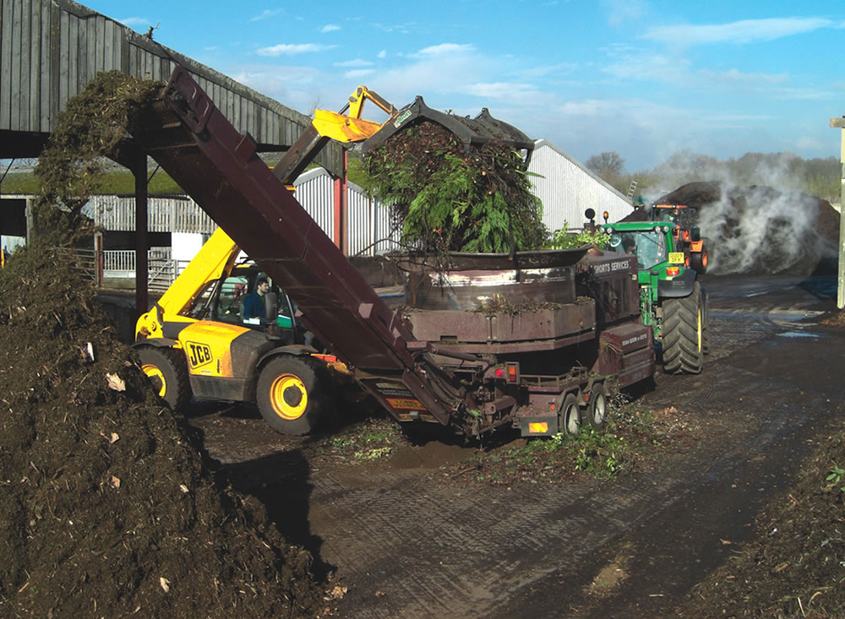
Size
Tub Grinder
www.biocycle.net

Slide 18
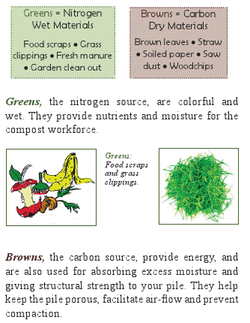
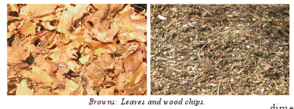
Carbon to Nitrogen
30:1
Carbon source
Nitrogen source
cwmi.css.cornell.edu/compostingathome.pdf

Slide 19
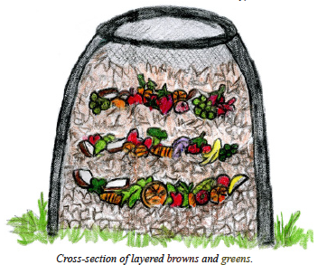
Green & Brown Balance
Online Calculator
www.klickitatcounty.org/solidwaste/fileshtml/organics/compostCalc.htm
Source: Cornell Waste Management Institute. Composting at Home

Slide 20
Example
Ideal C:N is 30:1
25-30 is good
20-40 is decent
C:N = % carbon / % nitrogen
Fruit waste: 44.52 % C & 1.4% N
Loose dry leaves: 42.22 % C & 0.9 % N

Slide 21
Example (Cont.)
What can be added to loose leaves to bring the material closer to 30:1?
Newsprint C:N= 54:1?
Fruit Waste C:N= 32:1?
Vegetable Waste C:N= 11:1?
Source: http://www.klickitatcounty.org/solidwaste/fileshtml/organics/compostCalc.htm

Slide 22
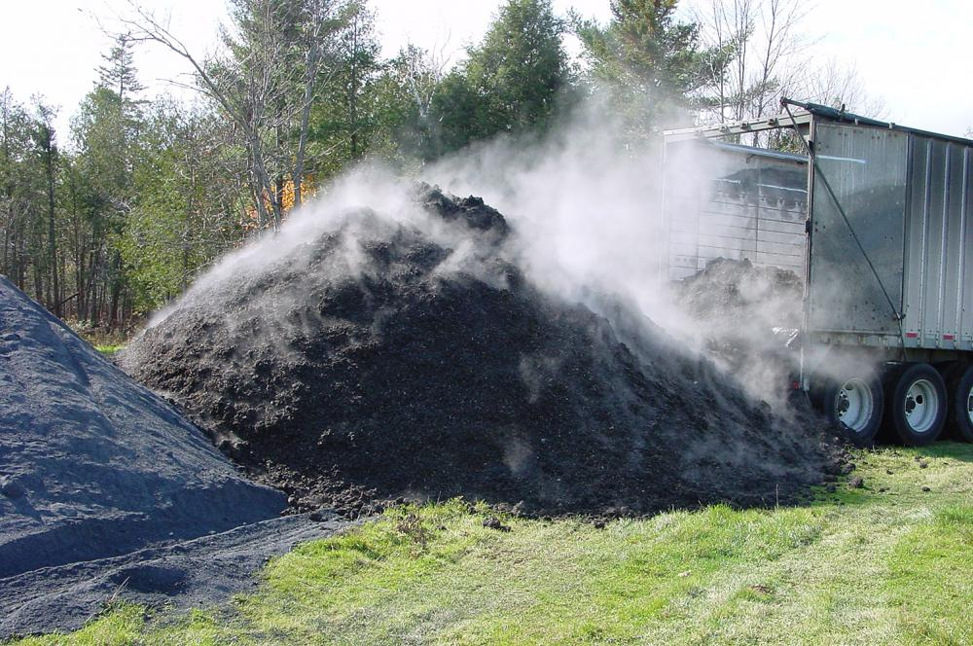
Temperature
casellaorganics.com
Pile size
Turning
Blowing Air

Slide 23
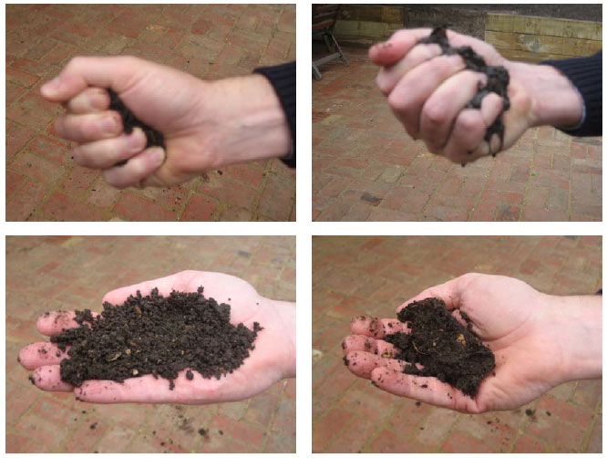
WATER
www.depi.vic.gov.au
Microbes
Propagation
Metabolizing
Movement
Oxygen Transfer
When squeezed hard moisture should be visible but not run out of hand. @ 50 to 60 % moisture content, compost will hold form when squeezed & resist crumbling

Slide 24
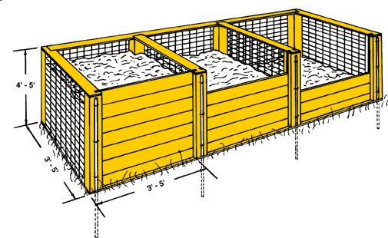
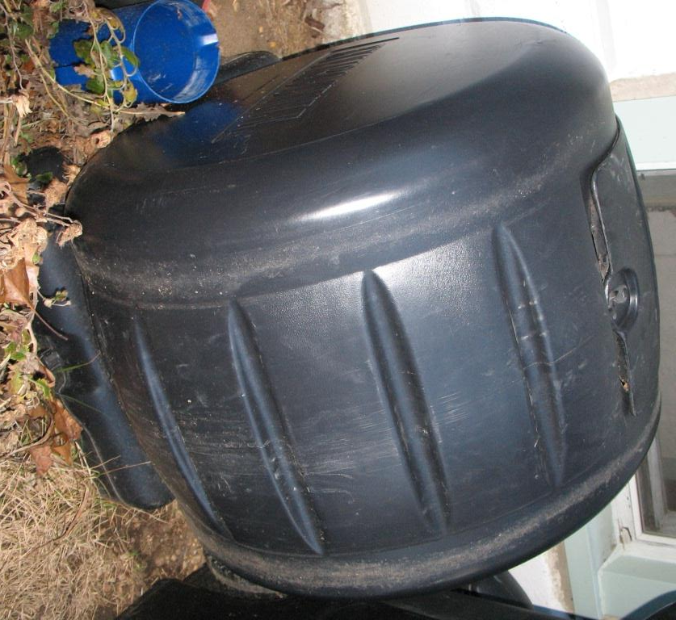
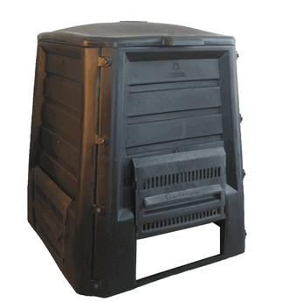
Backyard composting
University of Minnesota
extension service
Best to “let grass lie”, but can be Nitrogen source
www.mnn.com

Slide 25
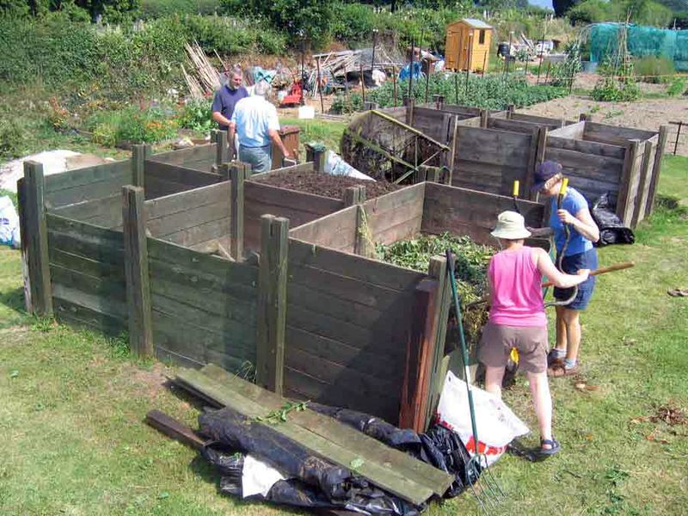
Community Composting
Apartments
Neighborhoods
Community Wide

Slide 26
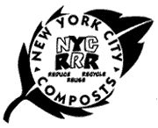
New York City – Starting a CCC
www.nyc.gov
Develop relationship with local NYC Compost Project
Eventually host compost workdays & tours
Designate a compost contact
With NYC Compost Project
Answer basic questions about site
Have actively managed compost system
One or more persons addressing problems & finishing compost
Guidance (www.nyc.gov/html/nycwasteless/html/...)
Outdoor - compost/edu_outdoor.shtml
Indoor - compost/edu_indoor.shtml
Low price bins
Notes:
CCC community Composting Center

Slide 27
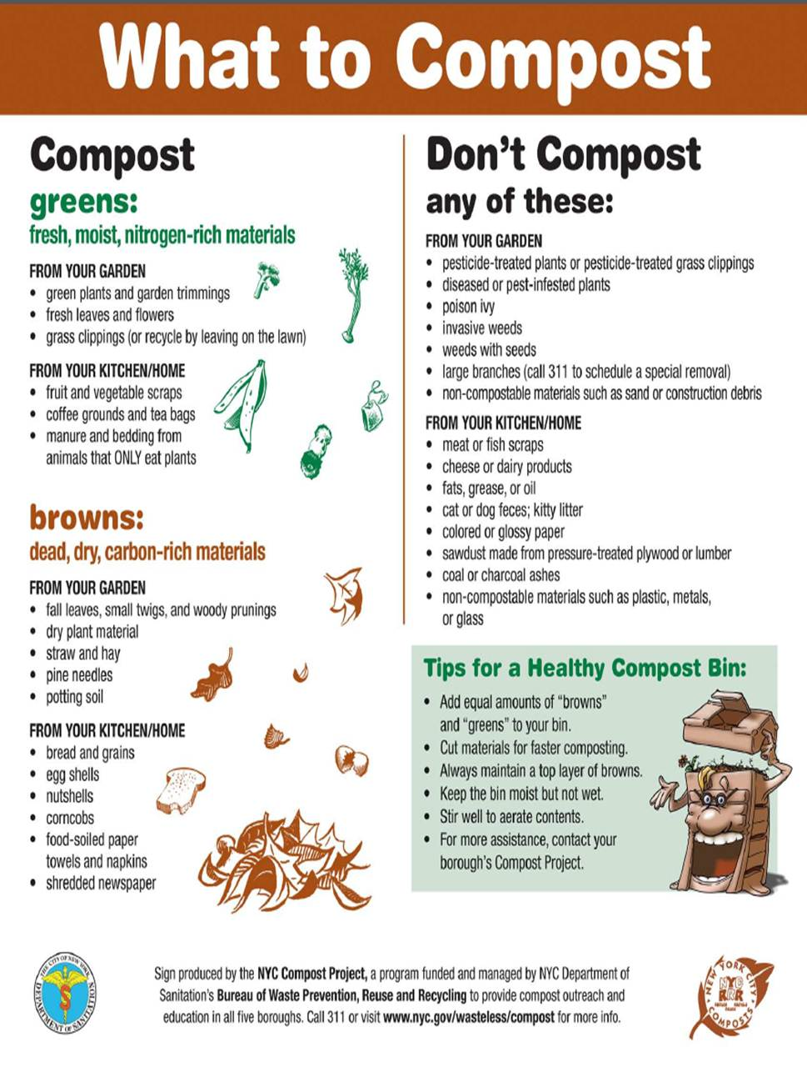
Notes:
Developed for NYV community program

Slide 28
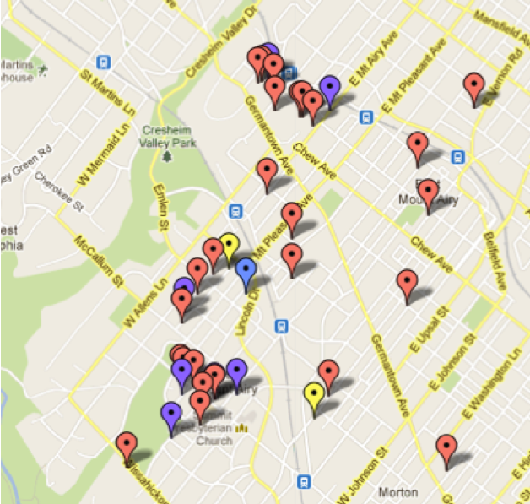
Philadelphia
Shared community sites: purple
Contact Site Host to join
Private sites: red
Check with site contact before visiting
Shared sites at capacity go “private”
Yellow sites are people looking for a shared site
Commercial sites: green
City sites: blue
Source: http://www.phillycompost.com/Map.html

Slide 29
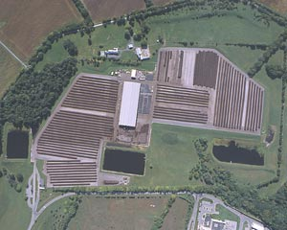
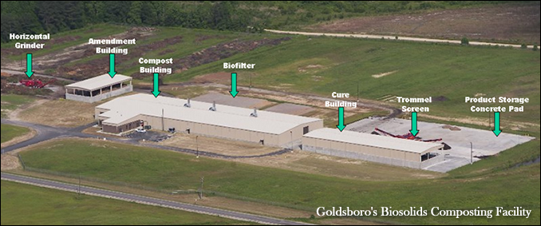
Commercial/Municipal Composting
Source: montgomerycountymd.gov
Commercial
Businesses, communities
Municipal
Yard Waste, Landscapers

Slide 30
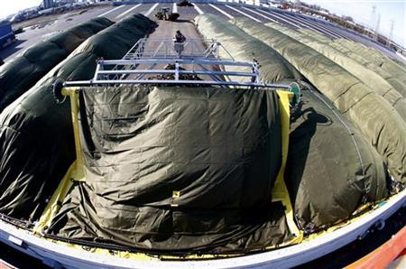
Wilmington Organic Recycling Center, DE
peninsula-compost.com
160,000 ton/yr of source separated organic waste converted to useful compost
Reduces greenhouse gas emissions equivalent to 8,800 automobiles from area roads per year
Diverts 120,000 ton/yr from landfill
Lowers disposal costs 20-50% compared to surrounding landfills
www.reuters.com
Notes:
(Reuters www.reuters.com) - On a windswept industrial site near the Port of Wilmington, a front-end loader tips a fetid mass of half-rotted food and plastic bags onto a 20-foot heap inside a large blue shed.
It's the start of a process that will turn thousands of tons of rotting food, yard waste and paper products into rich compost that will be used to help farmers grow crops and homeowners nurture their shrubs.
The compost also reduces the volume of landfill waste, saves waste-disposal fees, cuts emissions of climate-changing methane, generates carbon credits for businesses, and returns soil nutrients to their source of origin.
Composting, long valued by gardeners, is just beginning to be adopted on the industrial scale exemplified by the Wilmington Organic Recycling Center, which claims to be the biggest of its kind on the East Coast of the United States.
The $20 million center opened in November and aims to produce 100,000 tons of compost annually when it becomes fully operational in April. The compost will be derived from 160,000 tons of waste that will be diverted from bulging landfills.
Institutions such as schools, stores, supermarkets, and hospitals will pay less to compost their waste than to throw it in a landfill.
The center, built on a 27-acre brown-field site, charges clients $50 a ton to dump their waste at the compost plant, less than the state-wide rate of $61 a ton to dump waste in one of the three landfills in the state, said Scott Woods, chief executive of Peninsula Compost Group, which manages the facility.
"We are providing optimal conditions for backyard composting," said Woods.
The waste is sorted to remove large, non-degradable material, and then transferred to about a dozen long heaps where the natural rotting process, aided by special aeration and periodic turning, converts it into compost in eight weeks.
Inside the massive heaps, the temperature will rise to 160 degrees Fahrenheit (71 degrees Celsius) within a few days, killing off any fecal coloform, salmonella and weed seeds. Green GORE-TEX tarps allow each heap to breathe while helping to generate heat and shielding them from rain.
Computers monitor the temperature and oxygen content of each heap with data gathered by stainless-steel probes inserted into the rotting material.
Rising landfill fees and a growing public demand for a greener lifestyle have made composting commercially viable, according to Nelson Widell, a Peninsula partner.
"You need to be in an area where the tipping fees are high enough," he said.
Wawa, a convenience-store chain that delivers about six tons of mostly coffee grounds a month from two pilot stores, is saving $300 a month by reducing its landfill fees, said Judy Ward, chief executive of Advanced Enviro Systems, which helps Wawa and others businesses go green.
The composting of food waste has boosted Wawa's recycling to 48 percent from 20 percent of the waste stream, Ward said.
She added that the financial benefits of composting may be reduced by increased transportation costs to the new center, or by investment in new containers for the spoiled food.
While there is a growing business demand for sustainability, the financial benefits of composting underpin the new center, said Woods.
"The economic model works because it's effective and simple," he said.

Slide 31
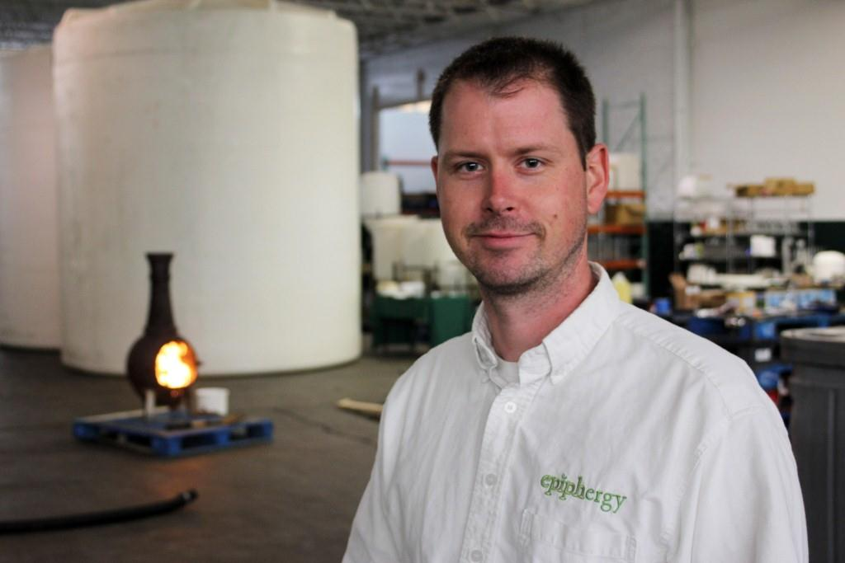
Community Composting & Epiphergy
www.communitycomposting.org
www.epiphergy.com
Community Composting, Rochester NY
Weekly Pickup of
Fruit & vegetable scraps
Meat, shellfish, fish products
Pasta, bread, cereal
Dairy products, egg shells
Coffee grounds, filters & tea bags
Paper towels & rolls
Muffin wrappers
Paper plates
Pet food
Household plants
Epiphergy
Upcycles organic waste materials
Produces biofuels, animal feed, & compost
feed w/ ~100% digestibility
Ethanol & Biodiesel
Graham A. Fennie - Founder & CEO Epiphergy
mediad.publicbroadcasting.net
Notes:
How it works
Collection
The first step in the process is collecting the compost from our subscribers. We use optimized routes to minimize fuel usage. Instead of having each household drive their own vehicle, we make the process more efficient by minimizing the distance between stops. By grouping subscribers by zip codes, we can have high density pickup areas.
Processing
All compostables are brought to the Epiphergy facility in the city of Rochester. After the pail contents are emptied and introduced into the composting process, the buckets are cleaned, sanitized, and set up to dry.
Epiphergy has developed a unique and effective model that extracts as much of the energy from the compostables as possible. Primary outputs are fuel ethanol and high quality animal feed. And of course the living, active, earthy, well-balanced compost that we are so excited to give back.
Epiphergy's process attracted us for a number of reasons. It diverts materials away from landfills where their energy and nutrients would be lost forever. This also means less forest or farmland must be destroyed to build landfills which nobody wants in their backyard. Many landfills that are capped to collect methane are not very effective as the organic materials have already broken down and released the gas. At Epiphergy, the compostables are delivered in such a short time that methane release is minimized. In addition because their facility is in the city, the distance the materials need to travel is much shorter than if they were being hauled to a landfill. What's more, their process is providing jobs, and keeping economic activity flowing here in our city.
Closing the loop
Finally, we take finished compost and bring it back to the community. Some subscribers will use the compost right in their own back yards or for their kitchen herbs. Others will donate the compost to a community garden or neighborhood association. Either way, the nutrients from your food will make their way back into the soil, helping to provide more nutritious food and closing the loop.
Compostable
Fruit and vegetable scraps
Meat, shellfish, fish products
Pasta, bread, cereal
Dairy products, egg shells
Coffee grounds, filters, & tea bags
Paper towels and paper towel rolls
Muffin wrappers
Paper plates
Pet food
Household plants
Not Compostable
Plastic of any kind
Styrofoam
Metal of any kind
Candles
Corks
Gum
Cigarette butts
Baby wipes
Pet waste
Dryer lint sheets
Vacuum cleaner bags
Hair, pet fur
Dead animals
Fireplace or BBQ ashes
Glass

Slide 32
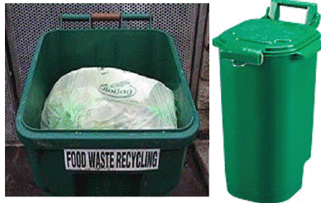
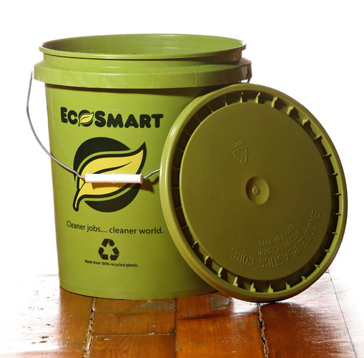
Collection

Slide 33
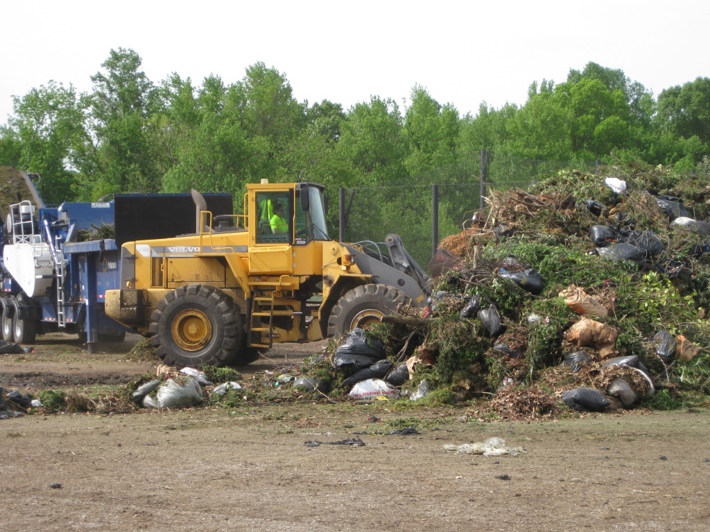
Tipping Area, Tub Shredder
www.menv.com

Slide 34
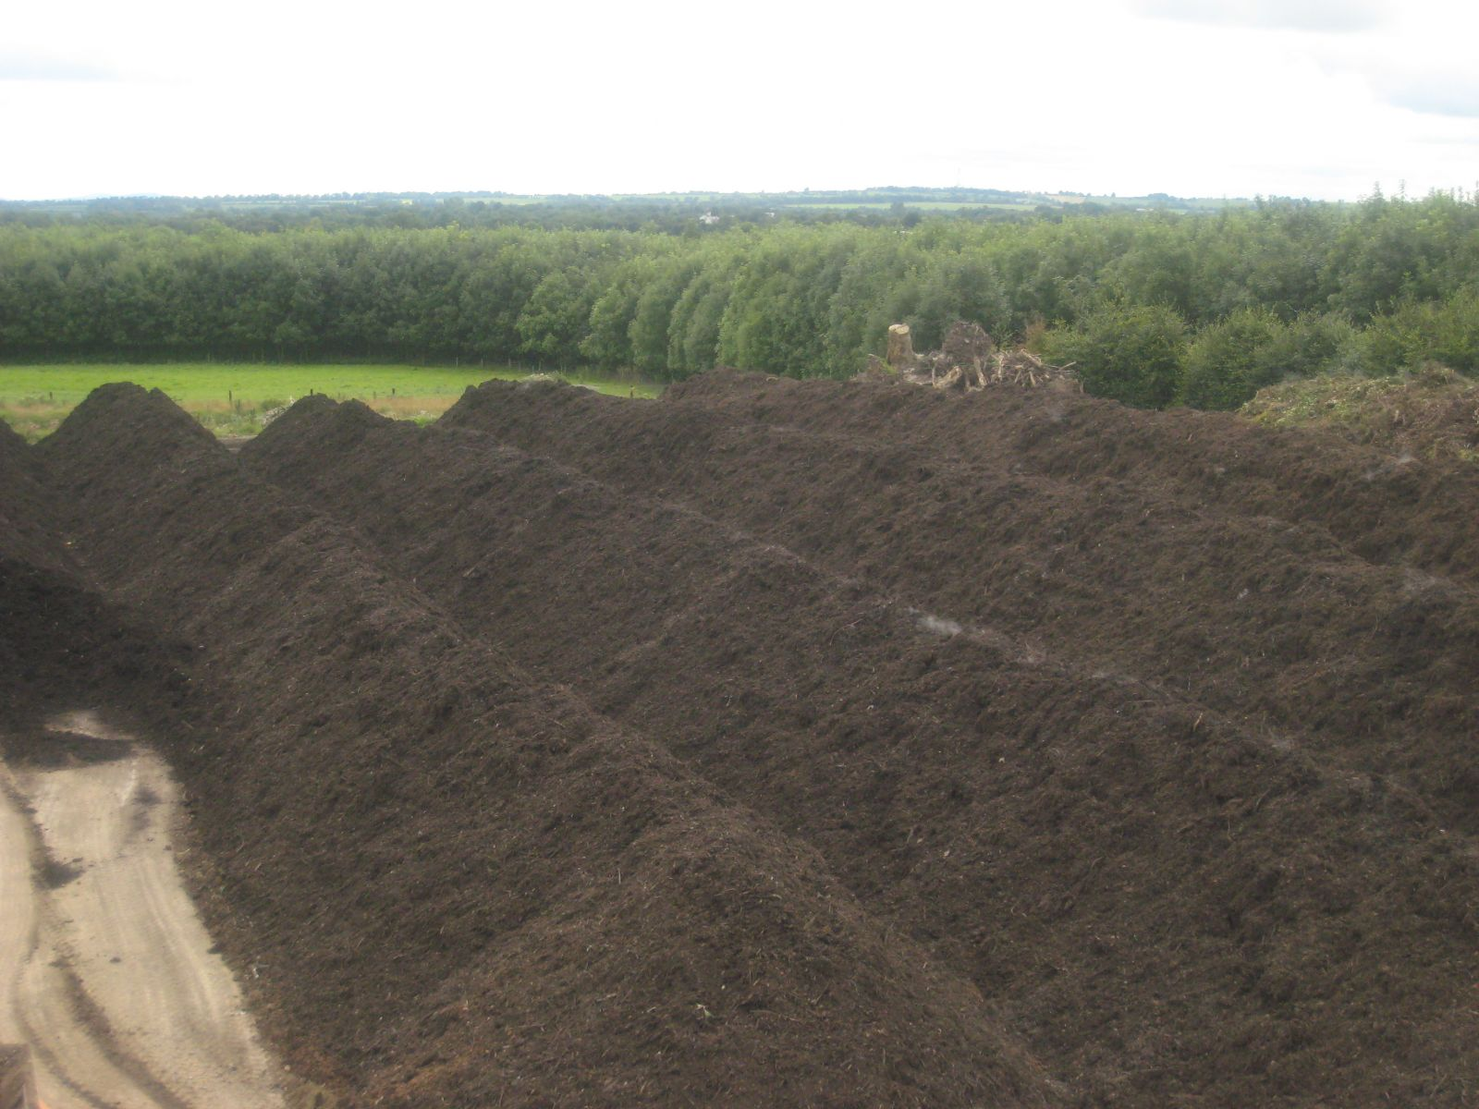
Windrows
www.enrich.ie

Slide 35
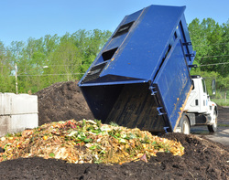
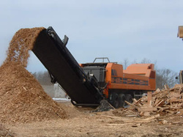
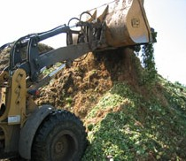
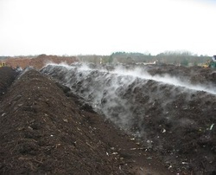
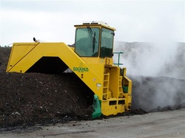
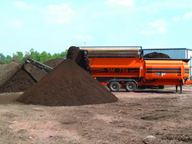
Technologies used

Slide 36
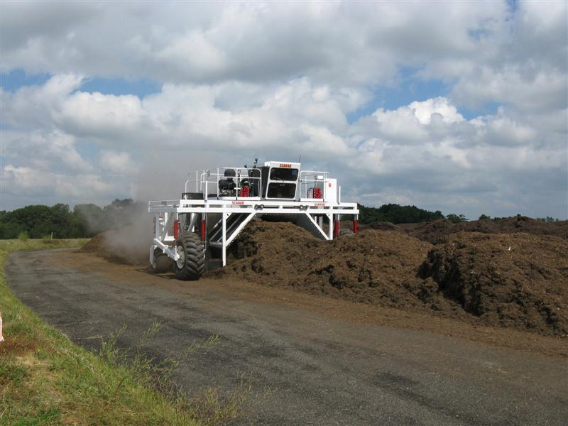
www.enrich.ie

Slide 37
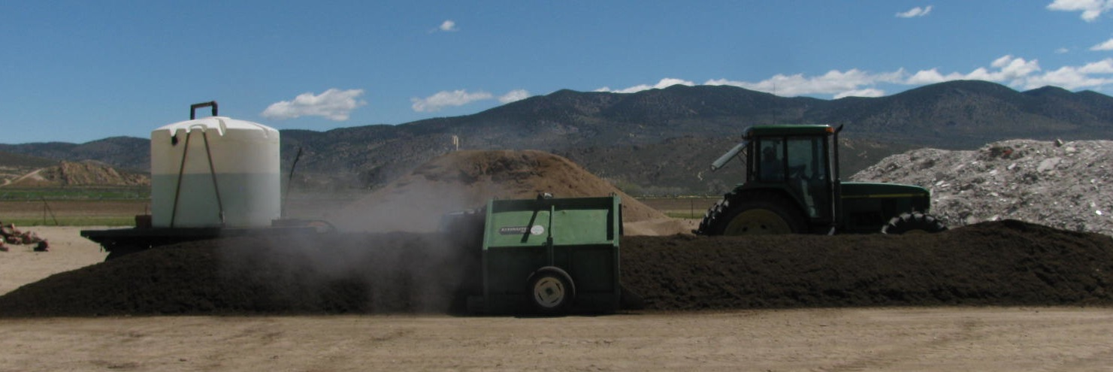
Operation
www.youtube.com/watch?v=8Q6Fl34mWGw&NR=1&feature=endscreen
codywitt.files.wordpress.com

Slide 38
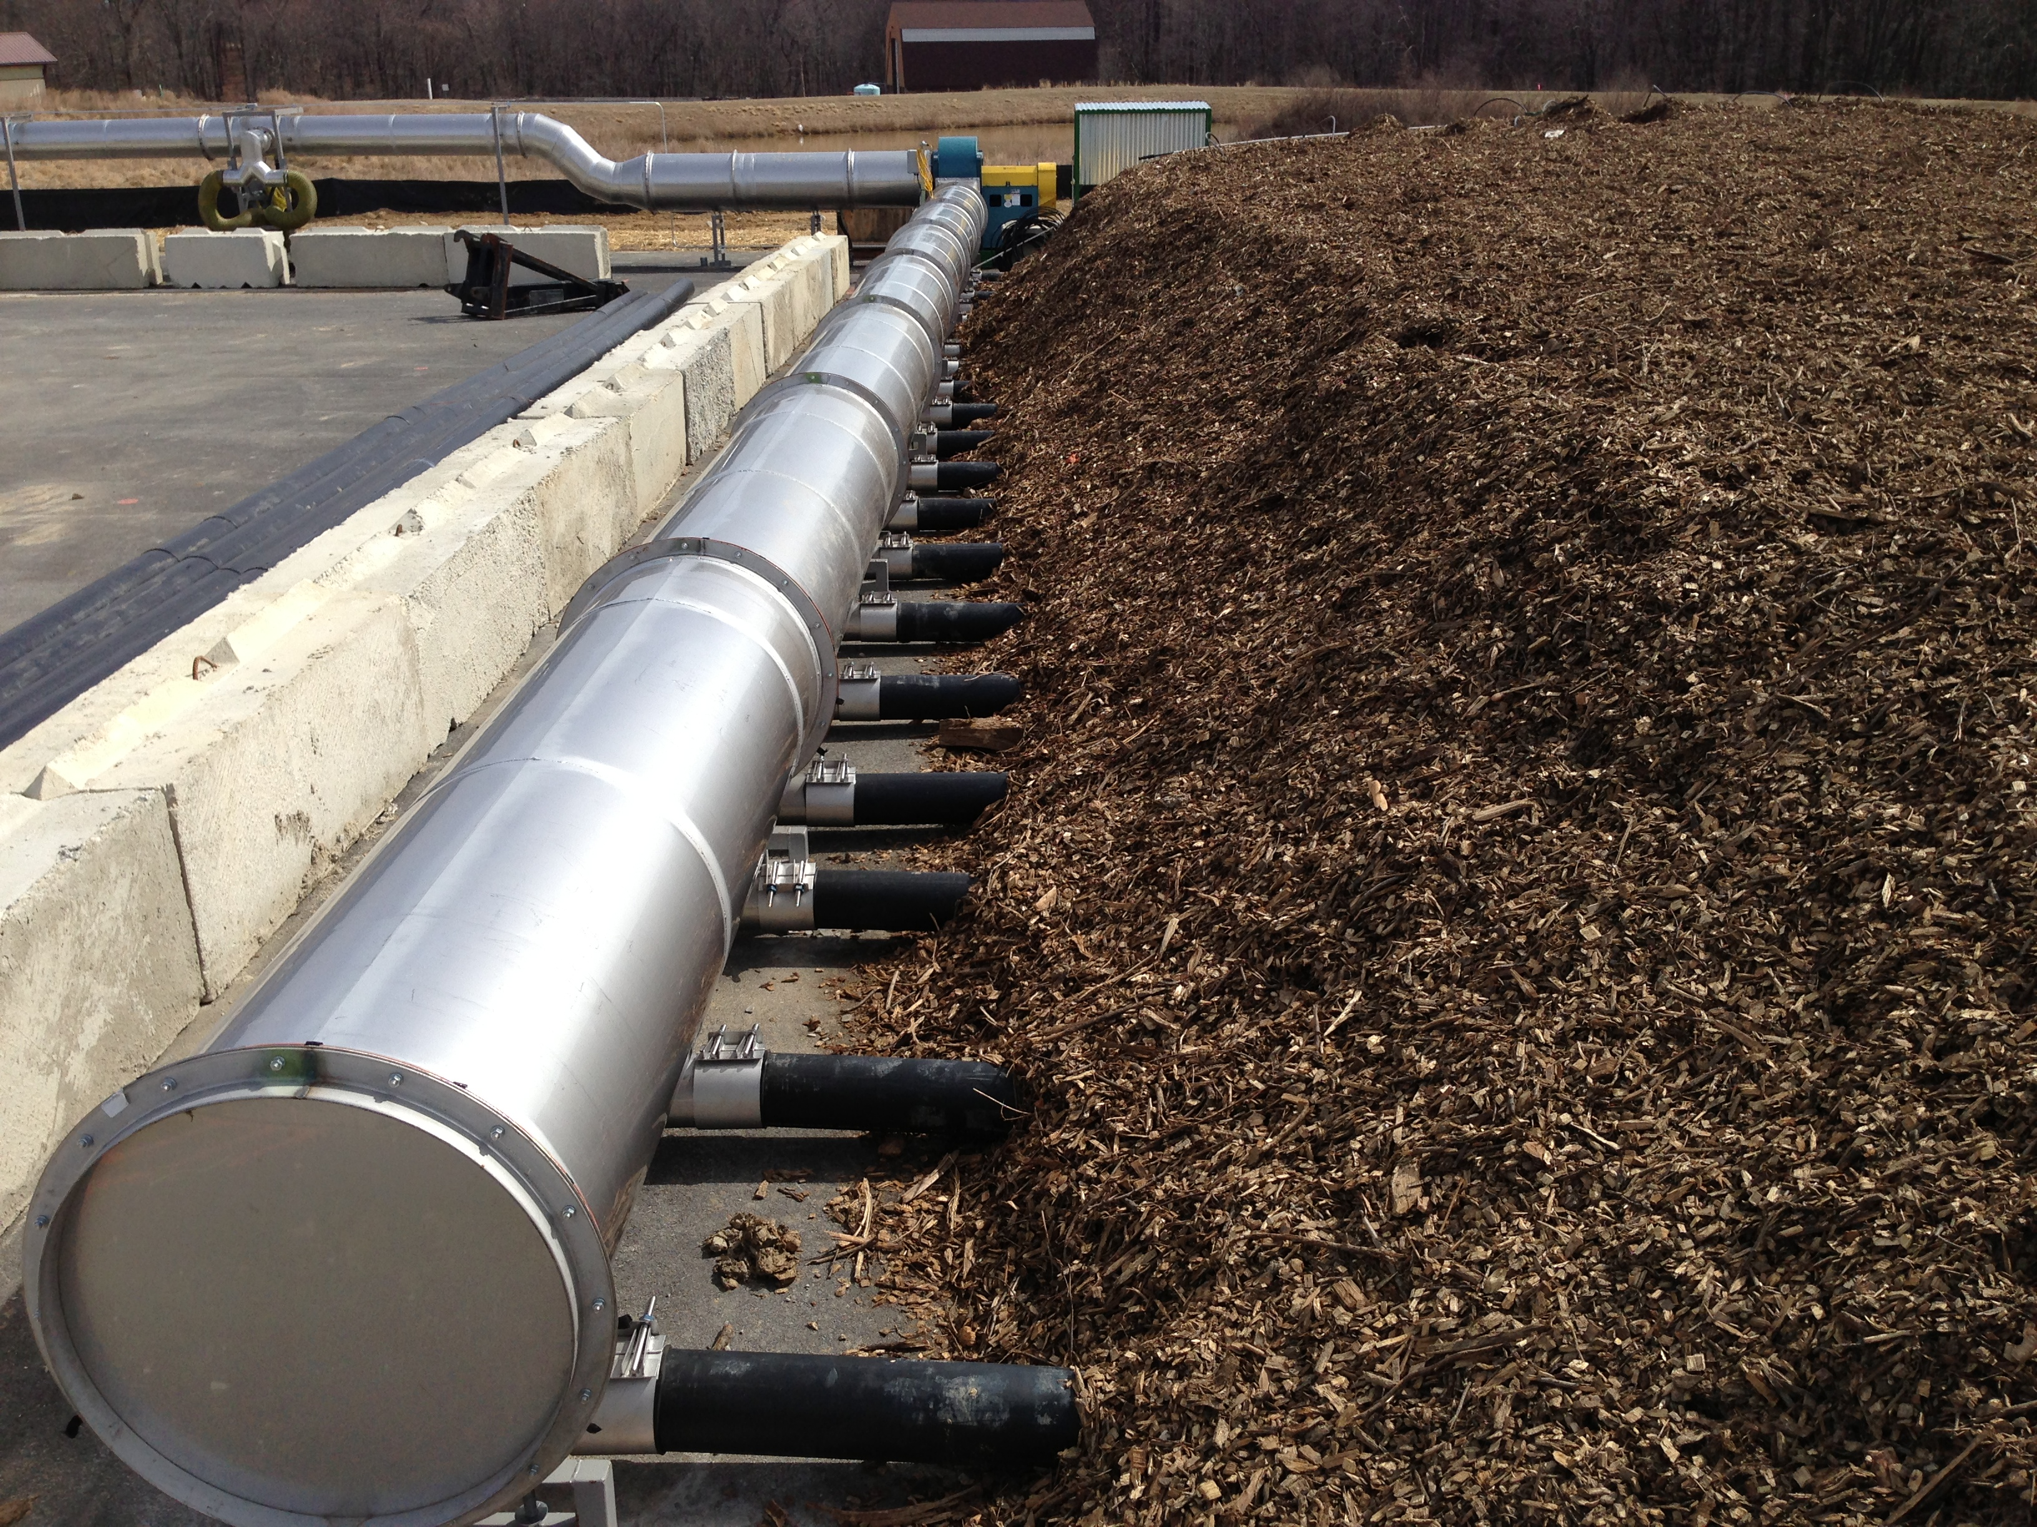
Static Pile
www.howardcountymd.gov
Notes:
Howard County
The pilot program for curbside pickup of compostable food waste in Howard County was mentioned on pages 97 and 98 of Planning for the Food System. In March 2013, a ¾ acre site at the county’s Alpha Ridge Landfill started accepting compostable material. This state-of-the-art operation “is designed to compost yard trim and food scraps in aerated, covered piles.” The waste from homes in Ellicott City and Elkridge “is supplemented by material directly hauled by residents and contractors to Alpha Ridge.” According to the county’s website, “A computer-controlled blower keeps the material saturated with oxygen, which accelerates decomposition and manages moisture levels. The cover system retains heat and high-nutrient materials while managing potential odors.” For more information, see Howard County’s Pilot Composting Facility and Food Scrap Recycling

Slide 39
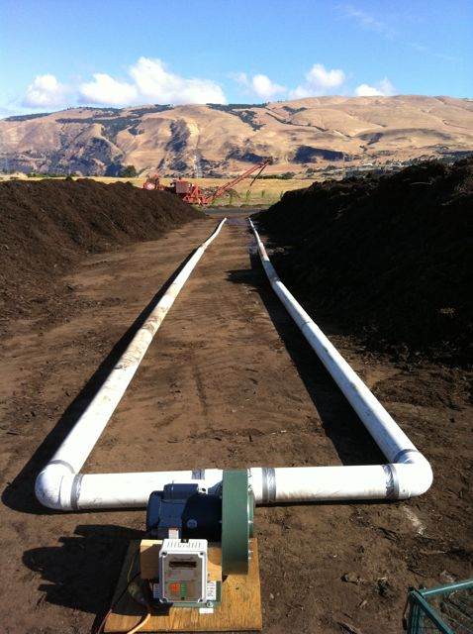
Static Pile
Dirt Hugger
The Dalles
Oregon
dirthuggercompost.files.wordpress.com
Notes:
Dirt Hugger, The Dalles, Oregon

Slide 40
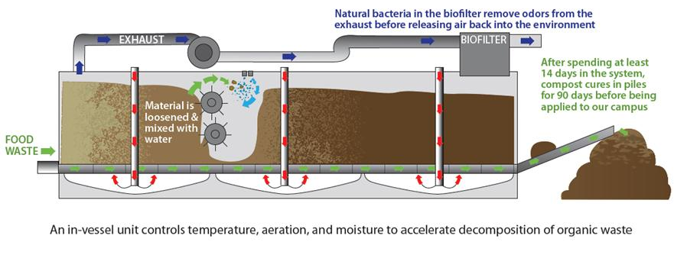
In Vessel
Better operational control
Better odor control
Lower labor costs
Smaller footprint
Faster
Higher capital costs
Higher operating & maintenance costs
www.ohio.edu

Slide 41
In Vessel - Rotating
www.tidyplanet.co.uk/our-products/the-rocket/
Rocket Composter. Rotation turns and moves material.
Cooked & Uncooked Fruit, Vegetables, Meat & Fish
Cooked & Uncooked Garden Waste
Animal Waste (including some types of bedding)
Specifications: Up to:
Length 7.0m
Width 1.4m
Height 1.8m
Capacity 3500 l/wk
Motor 1.5kWh
Heater 2 x 1kWh
Thermostatically controlled
Power 30kWh/wk
dumbartonroad.files.wordpress.com

Slide 42
Montclair University
Turning French Toast To Compost
May 5, 2009 by Jessica Kitchin
New Jersey Monthly

Slide 43
In Vessel - Stationary
SV Composter™ (Engineered Compost Systems)
Static Pile

Slide 44
Composting Time
In-Vessel Bays (Mechanical Agitation)
Windrow & Backyard
In Vessel
Curing can take up to 4 more weeks
Compost stabilizes w/further turning or air input
gwri.calpoly.edu
Notes:
COMPOSTING PROCESSING TECHNOLOGIES / Compost Council of Canada
General Description: Agitated beds compost materials in “beds” contained by long
channels with concrete walls. A turning machine, travelling on top of the beds, agitates
and moves the materials forward. Forced aeration is provided through the floor of the
channel; the top of the channel is open. Therefore, an agitated bed is technically not a
vessel, but falls into this category because it almost always (at least for residential
organics composting) is enclosed in a building. Most systems are operated in the
positive aeration mode (air blown up through the pile) to avoid leachate building up in the
aeration manifolds, reducing the flow of air. To concentrate the process air to be treated
for odours, some systems have plastic curtains around the perimeter of the bays (and in
some cases, there is a drop ceiling to further contain odourous air). This reduces overall
ammonia levels in the entire building, enabling operators to safely work around the
perimeter of the bays (e.g., loading and unloading operations). It also helps to contain
the moisture and ammonia being released from the composting materials, which
contribute to corrosion of the building.
All agitated bays operate in a similar fashion. Feedstocks are mixed and loaded in the
front end of the channel. Starting at the discharge end, the turner moves down the
channel toward the front or loading end. With each pass, material is displaced a set
distance toward the back of the channel until the materials are eventually discharged as
compost that has met time and temperature requirements for pathogen and vector
attraction reduction. Depending on the turner, material is shifted 2m to 4m with each
turning. The length of the channel and the turning frequency determine the composting
period in the channel (generally 10 to 28 days). Dimensions of individual channels vary
among the commercial systems with depths ranging from 1 m to 2.4 m and widths of 1.9
m to 3.8 m. Channel lengths typically range from about 60 to 90 m. Most applications
use multiple channels and a single turning machine. Larger facilities (expanded by
adding more bays) may have two agitating units. There are some technologies that use
a single, wide bed, e.g., 7.4 m to 12 m wide and 30 m long. An overhead bridge crane
supports and moves the turner down the bed in strips.
Agitated Bay Composting Equipment: Proprietary equipment in an agitated bay system
is typically the agitator and the aeration/overall system design. Vendors offer bays of
various widths and heights; some are housed in fabricated metal structures while others
are housed in fabric structures. All facilities processing SSO treat process air through a
biofilter. Materials typically are premixed before being loaded in the bays; most cure
material in a separate structure (open-sided or enclosed). At some installations, aeration
is provided in the curing phase.

Slide 45
Trommel Screen
www.columbiapa.net

Slide 46
Advantages
Natural fertilizer
Better soil
Backyard/ on-site composting
Less waste going to landfills ~25%
More efficient nutrient recycling
Marketable commodity
epa.gov

Slide 47
Disadvantages
Odors
Can control w/ static pile or in-vessel
Respiratory & health issues at commercial scale
Backyard
Up front costs
Effort

