Slide 1
FitBit
In a healthcare setting
Kevin Ewers

Slide 2
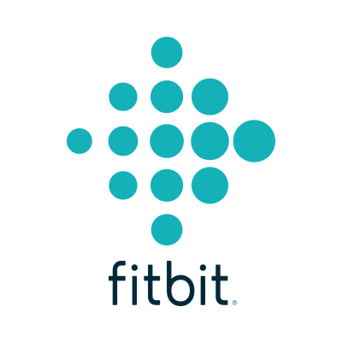
Brief History
Founded in 2007
Worth over $4 Billion
Activity trackers
Their Mission:
“To empower and inspire you to live a healthier, more active life.”
Notes:
http://money.cnn.com/2015/06/17/investing/fitbit-ipo/
Activity Tracker: A device and app working together to track more than just steps. It monitors all the activity in your life, ranging from sleeping to exercising.

Slide 3
The goal of Fitbit in health care
Patient reliability
    Honesty
We will be able to monitor the bodily functions and actions of patient
  Leads to better quality of care
  Less lies which could lead to better health care
Notes:
Reliability: Unfortunately some patients are always honest with their reports of what they have done in the past. This helps us monitor what they did

Slide 4
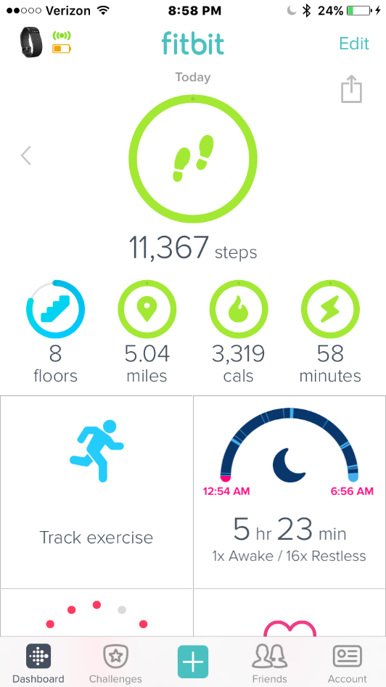
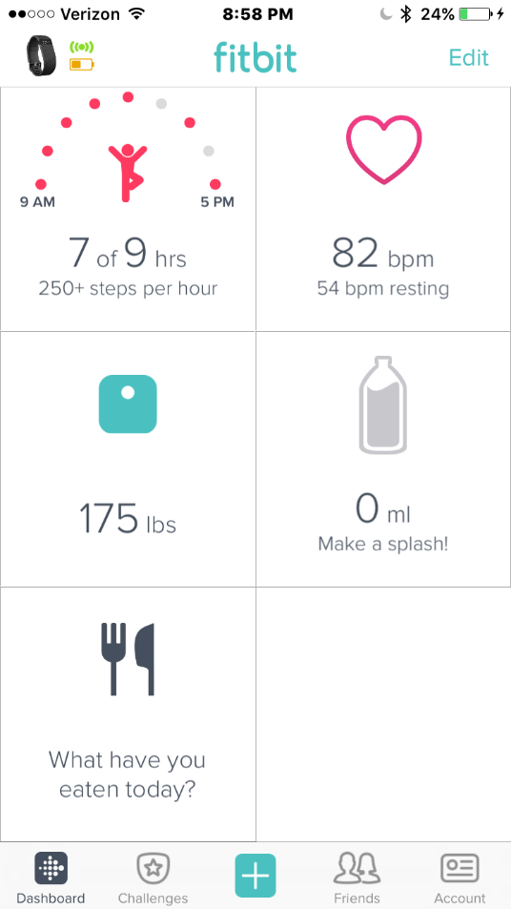
Home screen
Track exercise, sleep, daily activity, heart rate, weight, and food
Notes:
This is what you see when you open up the app. Plethora of info

Slide 5
Health Related Functions
Heart rate
Sleep
Steps
Food Monitoring

Slide 6
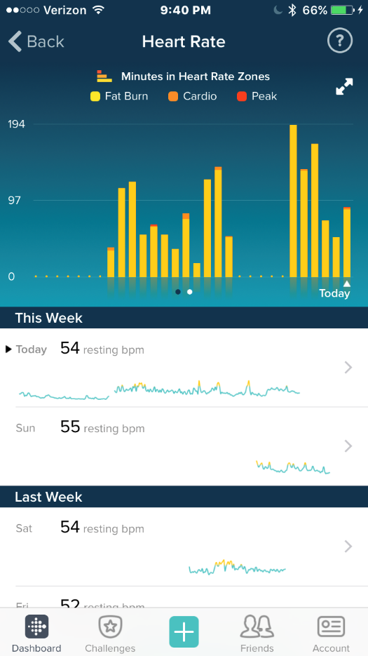
Heart Rate Monitor
Tracks average heart rate throughout day
During physical activity it is constant tracking
Presents history and patterns
Notes:
It takes your Heart rate periodically throughout the day. PurePulse LED lights measure heart rate

Slide 7
Heart Rate Monitor
Benefits to Health Care
Patient safety
  Constant vital signs
  Recorded
Record stressors
Patient confidence
Instant feedback

Slide 8
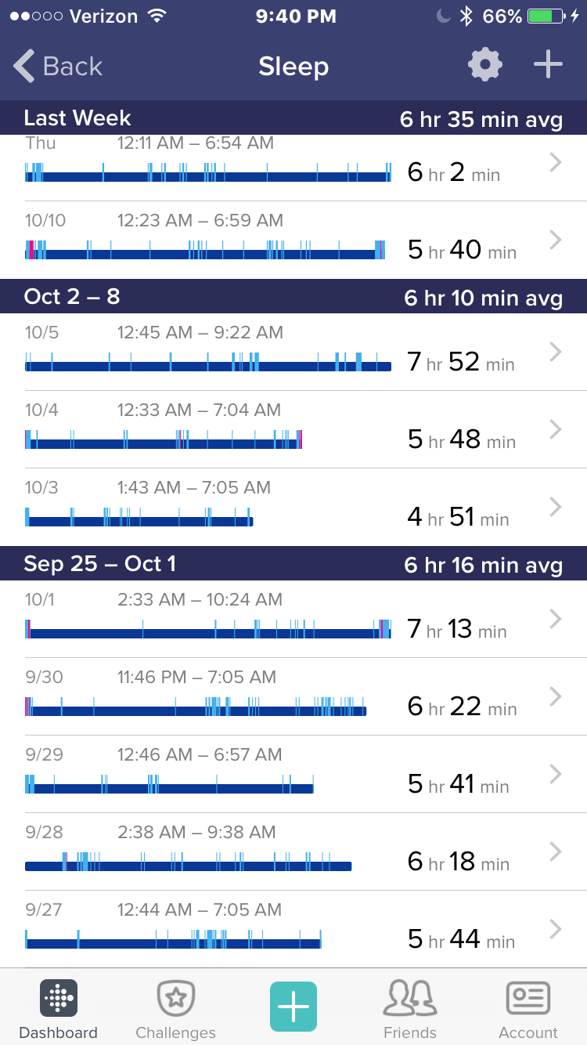
Sleep
Tracks times awoken and restless
Average hours slept for the week
Monitors sleeping patterns and habits
Notes:
Helps you reflect back on your week and notice patterns

Slide 9
Sleep Tracking
Benefits to Health Care
Injury Progress
Medication affects
Reason for lack of performance
Liability
Goal
Notes:
Post surgery sleeping patterns change
Whether they are doing poorly because of lack of sleep

Slide 10
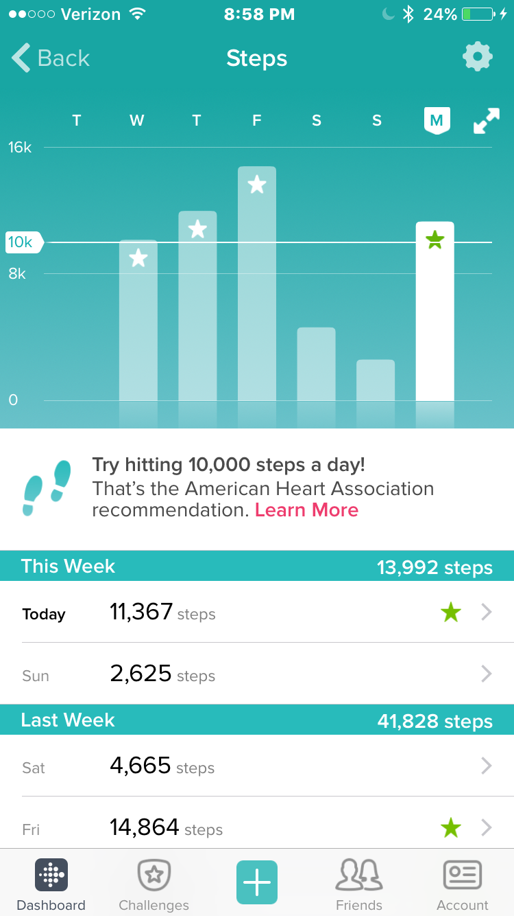
Step Tracker
Tracks steps throughout the day
Sets goals every single day
Shows progress and trends
Notes:
Slow weekends

Slide 11
Step Tracker
Benefits to Health Care
Daily Increases in activity
Monitor patient honesty
Detect reason for problems
Motivation
Notes:
Shows if patients were more active than they claimed.
Its an achievement

Slide 12

Food Monitoring
Log exact food and water intake
Provides healthy diet advice
Gives feedback on calorie taken in and burned.

Slide 13
Food Monitoring
Benefits to Health Care
Professional can access and input the information
  Still shows client their information
Encourages healthy habits through goals
Instant rewards through progress
Creates organization and healthy habits

Slide 14
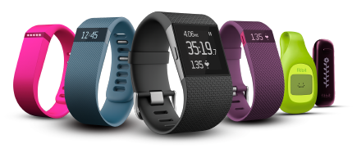
The products
Fitbit is coming out with new products every year
Each tailored for a specific task

Slide 15
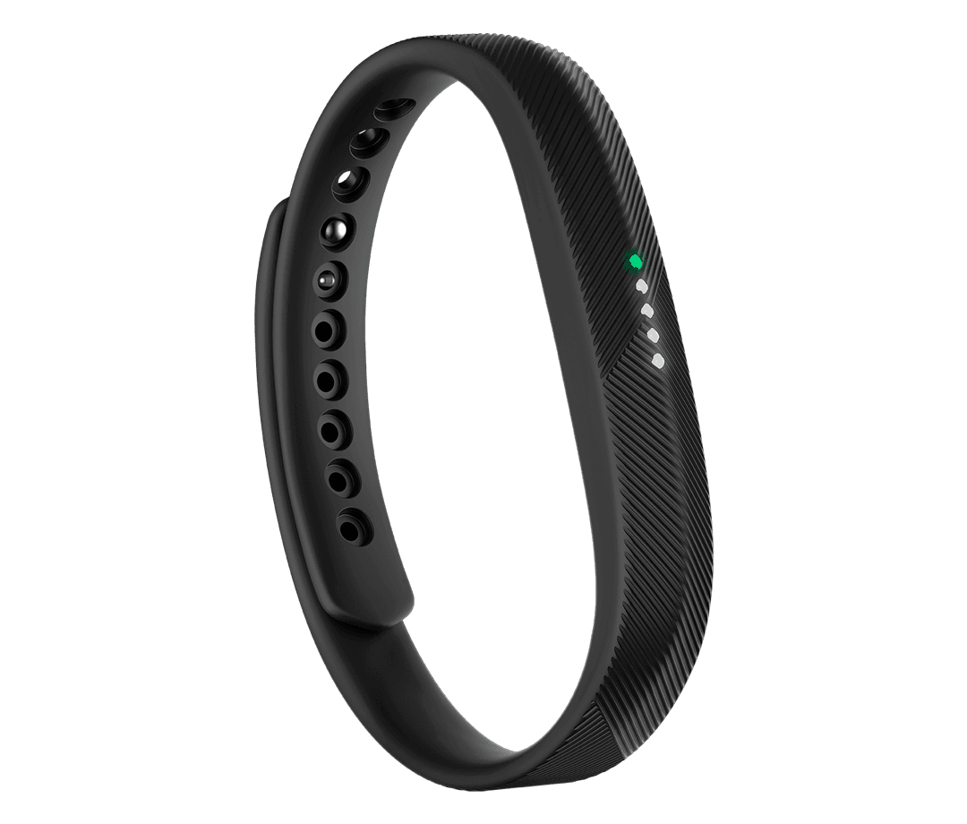
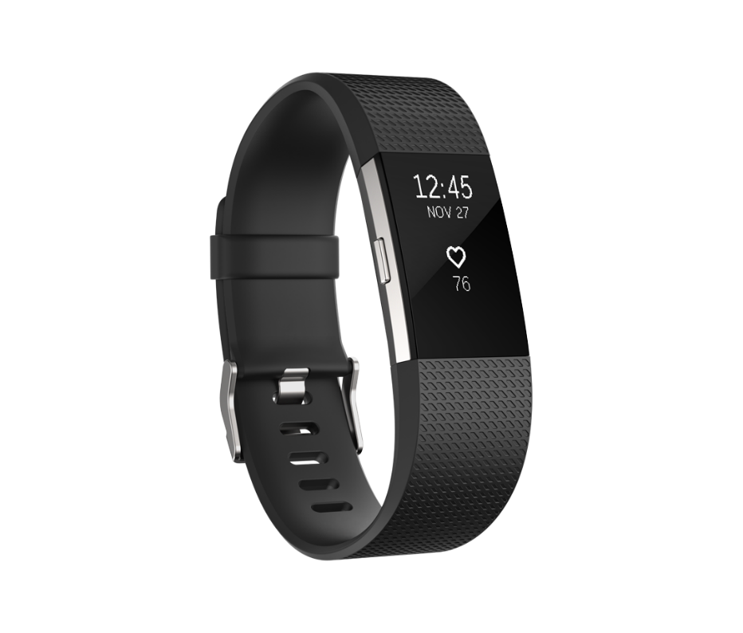
Top Models
By Use
For Every day use:
Fitbit Flex 2 $99.95
For Normal fitness activity:
Fitbit Charge 2 $149.95
Specifics on each product found here
Notes:
Battery life average is about 5 days, takes one hour to charge
Flex: very sleek and not made to be as powerful
Charge: Has a lot of on screen info for body. Sleek new look

Slide 16
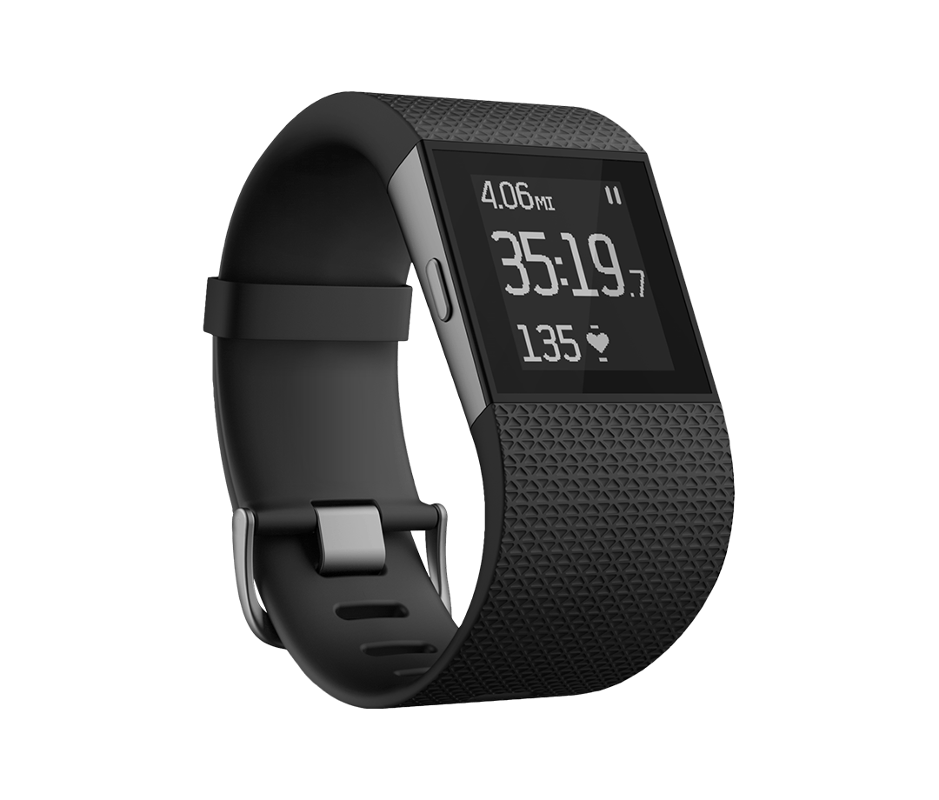
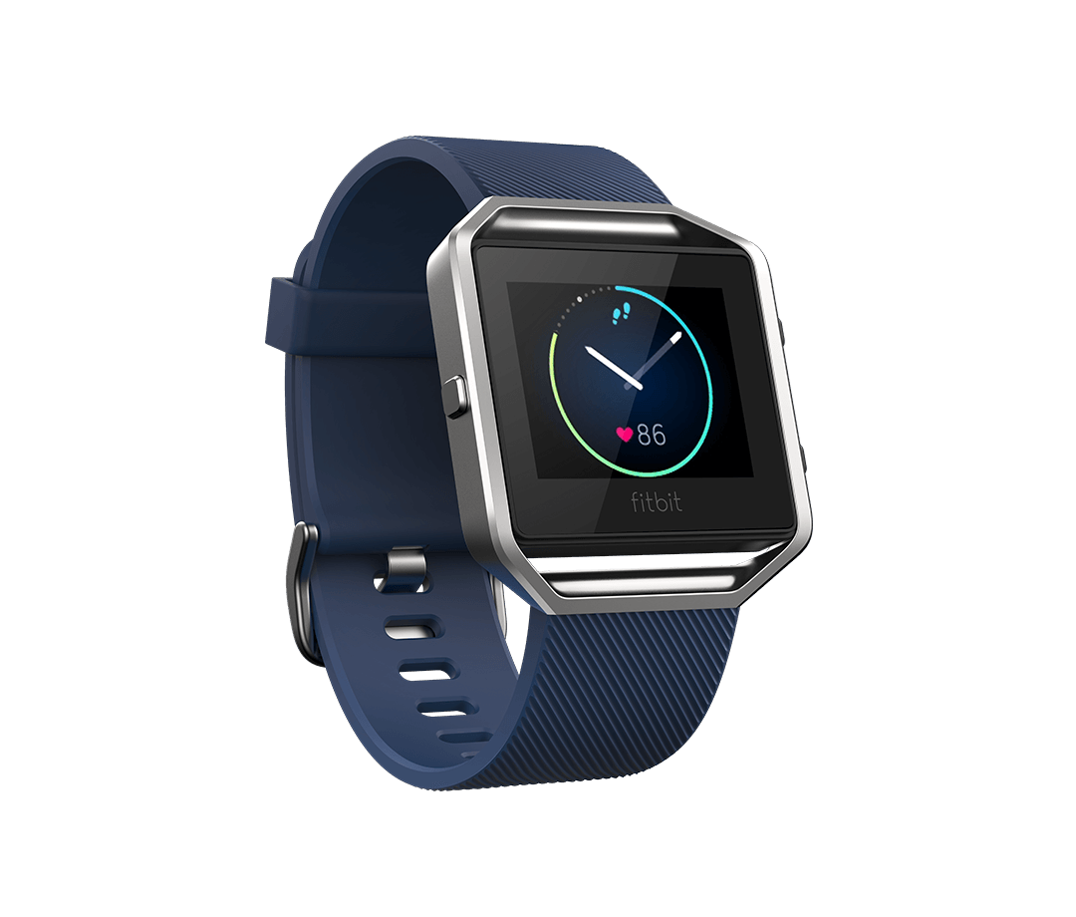
Top Models
By Use
For High Performance:
Fitbit Surge $249.95
For Fitness Watch:
Fitbit Blaze $199.95
Specifics on each product found here
Notes:
Surge: high end for those who know what they are doing
Blaze: this is the cool one for those who love health
As you can see theres multiple differenct levels you can pick from to best fit your needs
PT office wouldn’t give our blazes

Slide 17
Practicality of Use
Facility providing patient with rental FitBit
  Great since of confidence and client moral
  Liability
Investment in yourself
  If you buy this, it should be motivation to change
Great customer service
They are expensive
  But you use it 24/7

Slide 18
How will Fitbit Improve Healthcare?
Consistency is key
  Leads to results
A very popular app for a reason
  It works
Best in the business
  4 Billion dollar net worth
Notes:
Doing Something right

