Slide 1
Duchenne’s muscular dystrophy
- Kevin Ewers

Slide 2
Basics of Muscular Dystrophy
A group of over thirty genetic diseases
Characterized by the progressive weakness, degeneration of the skeletal muscles that control movement and the progressive loss of muscle mass
Serum creatinine kinase levels
More than ten times higher than the normal levels
Notes:
an enzyme that's released into the bloodstream when muscle fibers are breaking down
http://kidshealth.org/en/parents/muscular-dystrophy.html

Slide 3
Duchenne's Muscular dystrophy
200,000 US cases per year
Higher prevalence in Hispanic individuals
Slight difference
Exclusively affects young males
Caused by a lack of Dystrophin
X- Linked recessive
Notes:
Enlarged calves
https://www.mda.org/disease/duchenne-muscular-dystrophy

Slide 4
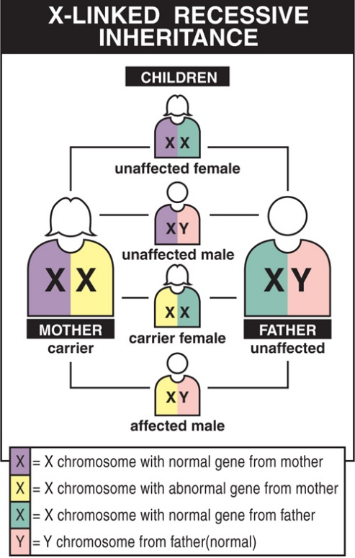
The Cause
Lack of dystrophin
Protein necessary for keeping muscle intact
Located primarily in muscles
X- Linked Recessive
50% chance of daughters being carrier
Notes:
Dystrophin is located primarily in muscles used for movement (skeletal muscles) and in heart (cardiac) muscle.
Passed on by the mother
Daughters has a 50% chance of being a carrier

Slide 5
Diagnosis
Genetic testing
Search for lack of dystrophin
Prenatal testing
To test if mother is a carrier
Looking at family history
Muscle Biopsy:
Shows a smaller amount or complete lack of dystrophin protein can confirm a diagnosis
Notes:
Passed on by the mother
Daughters has a 50% chance of being a carrier

Slide 6
Gowers Sign
Hallmark sign of DMD
Indicates weakness of proximal muscles
Stomach
Thigh
hip
Notes:
https://www.pinterest.com/pin/534661786987294988/
Gowers' sign is a medical sign that indicates weakness of the proximal muscles, namely those of the lower limb. The sign describes a patient that has to use their hands and arms to "walk" up their own body from a squatting position due to lack of hip and thigh muscle strength.
https://en.wikipedia.org/wiki/Gowers'_sign
https://j.gifs.com/662vp7.gif

Slide 7
Onset of DMD
Ages 1-3
Clumsy, minimal symptoms
At 4-6 walking on toes and fall frequently
Stick stomach out and shoulders back for balance
Ages 7-12
Children generally begin to gradually transition to a wheelchair
Teenagers
Activity of extremities and trunk require assistance. Respiratory apparatus often needed
Notes:
Toe walking
Gradual but definite decline
Once in wheelchair they often will have a renewed energy in life once accepting the fact they need the chair. Saving their energy

Slide 8
Signs and symptoms
Respiratory functions decline
Around age of 10
Diaphragm and other accessory pulmonary muscles weaken
Can lead to other more serious infections
Not severely painful
Does not effect nerves
Notes:
over the counter pain relievers are enough
Although the child may not complain of shortness of breath, problems that indicate poor respiratory function include headaches, mental dullness, difficulty concentrating or staying awake, and nightmares.
Weakened respiratory muscles make it difficult to cough, leading to increased risk of serious respiratory infection. A simple cold can quickly progress to pneumonia. It's important to get flu shots, and when infections occur, to get prompt treatment.

Slide 9
Signs and Symptoms
Pseudo hypertrophy
Appearance of enlarged muscles
Not true muscle mass
Learning Disabilities
1/3 affected
3 main areas
Attention focusing
Verbal learning
Emotional interaction
Notes:
falsely hypertrophic; specifically : being a form of muscular dystrophy in which the muscles become swollen with deposits of fat and fibrous tissue.
www.merriam-webster.com/medical/pseudohypertrophic
Not present in all those with DMD, but prevalent

Slide 10
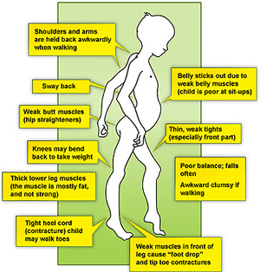
In the early stages, DMD affects the shoulder and upper arm muscles and the muscles of the hips and thighs. These weaknesses lead to difficulty in rising from the floor, climbing stairs, maintaining balance and raising the arms.

Slide 11
Managing DMD
Braces and Wheelchairs
Provide support to lower extremities
Wheelchair is inevitable
Avoiding contractures
Physical Therapy
Maintaining range of motion
Surgery for advanced contractures
Exercise
Prolong functional lifestyle
Notes:
Although the child and parents may dread the wheelchair as a symbol of disability, most find that when they start to use one, they are actually more mobile, energetic and independent than when trying to walk.
Contracture: a condition of hardening of muscle, tendons, or other tissue which leads to deformities and joint rigidity. Can be painful
Swimming is a great activity

Slide 12
Prognosis
Not favorable
No cure availably
Averages life expectancy into late thirties
Extended through exercise, diet, physical therapy, etc.
Introduction of new drug eteplirsen shows potential
Just recently passed by FDA to be drug of choice in treating DMD
Notes:
Some cases of 40s and even 50s
Only getting better
in

Slide 13
MDA
Muscular Dystrophy Association
Notes:
They gave the majority of my information have a plethora of info at your disposal

