Slide 1
The Basics of Weightlifting
Kevin Ewers
College Students

Slide 2
General Concepts
Large Muscle Groups to Small Muscle Groups
Its not all about the weight
Useless Jargon
Results take time

Slide 3
Muscle Groups
Pressing Exercises
Chest
Triceps
Pulling Exercises
Back
Biceps
Upper Body Exercises
Shoulders
Traps
Lower Body Exercises
Legs
Jump
Jump
Jump
Jump

Slide 4
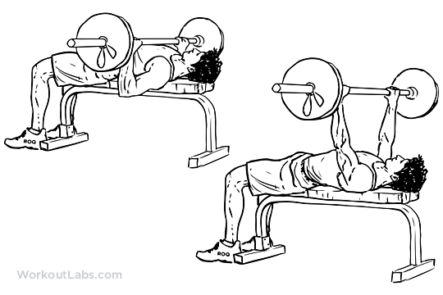
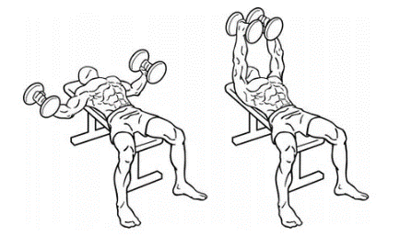
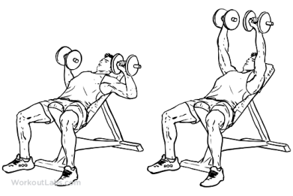
CHEST (large)
Pressing
Back
Bench Press
Most famous lift
Start light and slow
Fly’s
Focus on keeping arms with consistent
Protect shoulders
Incline Dumbbell Press
Working on upper portion of chest
Dumbbells give different a motion path than bar

Slide 5
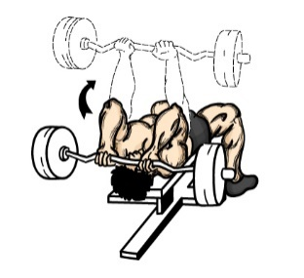
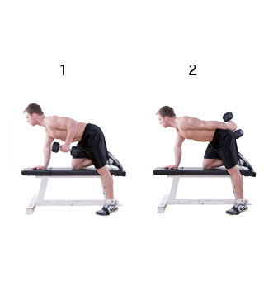
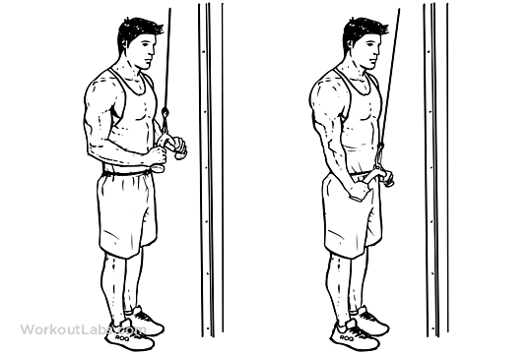
Triceps (small)
Pressing
Skull crushers
Keep upper arm stationary
Slow and deliberate motion
Bent over Triceps extensions
Keep back straight
Keep upper arm stationary
Rope pulls
Stand fully erect
Follow the same plane of motion

Slide 6
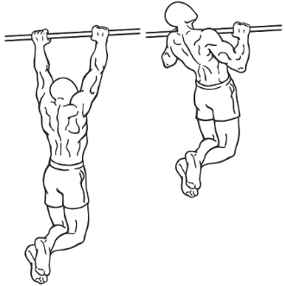
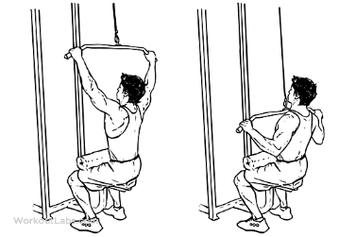
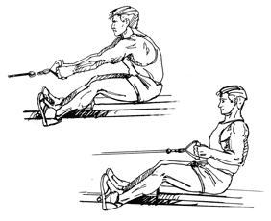
Back (large)
Pulling
Back
Pull ups
The classic pull up
Focus on full extension
Lat Pull down
Protect lower back with good posture
Don’t go heavy, emphasize form
Lateral Row
Fully extend arms
Get full squeeze in back

Slide 7
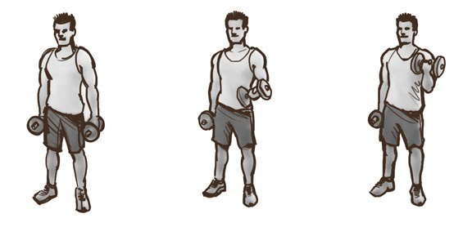
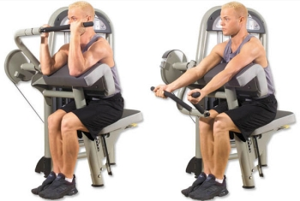
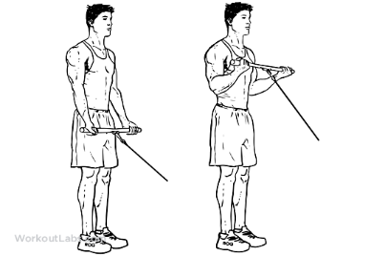
Biceps (small)
Pulling
Standard curls
Focus on external rotation
Low weight under control
Preacher Curls
Easy set up for heavier weight
Slow reps
Cable curls
Simple curl with cable
Constant resistance from cable

Slide 8
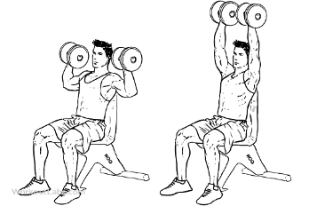
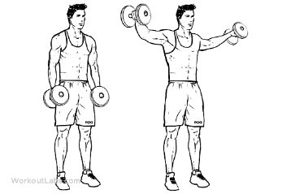
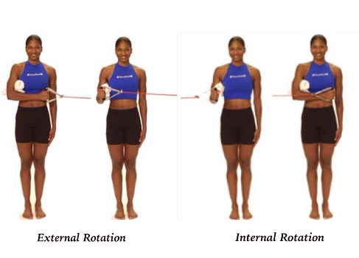
Shoulders
Upper Body
Back
Over head dumbbell press
Maintain vertical plane of motion
Do not go heavy, go steady
Lateral raises
Keep weight under control
Slight bend in arm
Internal/ External rotation
Great for shoulder stability
Don’t use the highest resistant band, start low

Slide 9
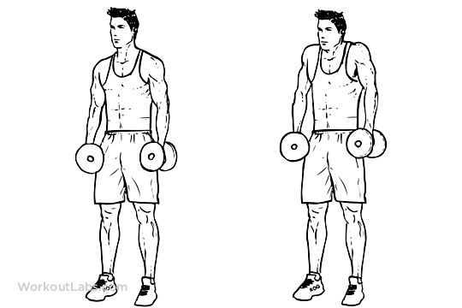
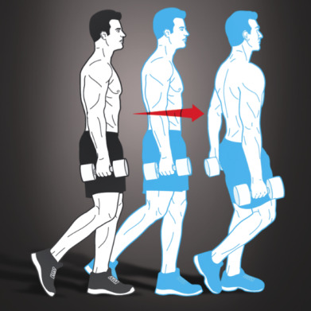
Traps
Upper Body
Shrugs
Roll up with your rear traps
Not just straight up and down
Farmers walks
Also great for grip strength
Perform shrug while walking
Walk slowly and deliberately

Slide 10
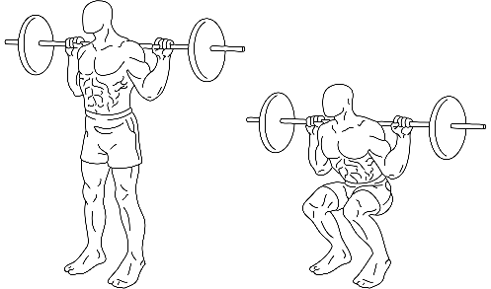
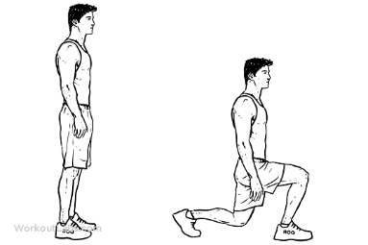
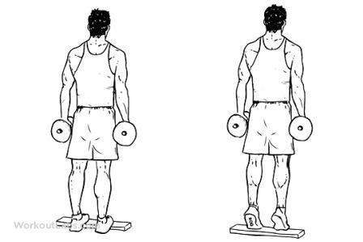
Legs
Lower Body
Back
Squats
Quads should be parallel to floor
Don’t go too heavy, get form first
Lunges
Great cardio exercise
Focus on long lunges
Calf raises
Do high reps low weight
Burn out as many as possible

Slide 11
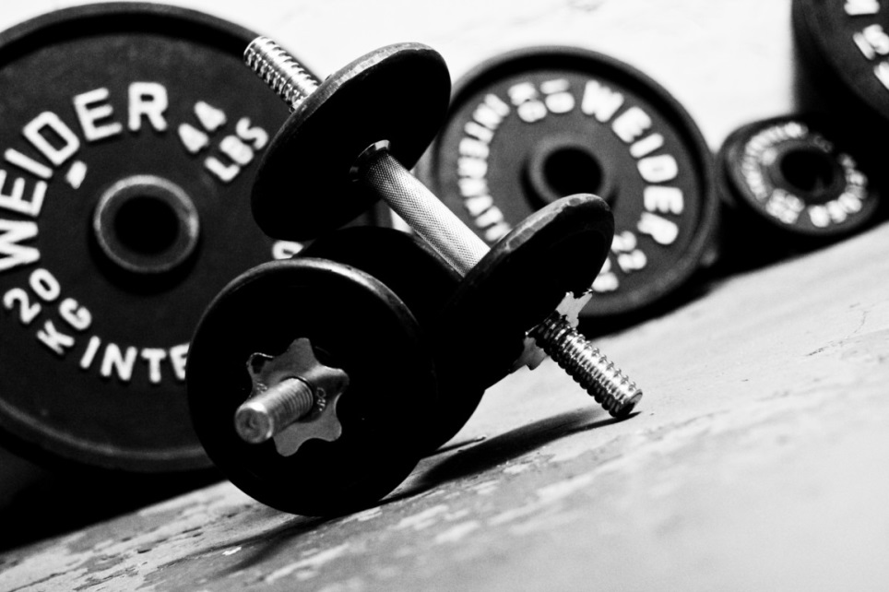
The Weights
We are not all the strongest in the room
Less is often more
Passion

Slide 12
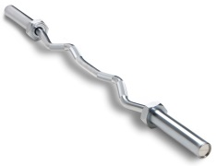
Typical Weights in the gym
2.5 lb.
5 lb.
10 lb.
25 lb.
35 lb.
45 lb.
Typical bar: 45lbs
E-zgrip bars: 10-15lbs
Simple math
Bar + 45 on each side = 135lbs
E-zgrip bar + 25 on each side = 65 lbs

Slide 13
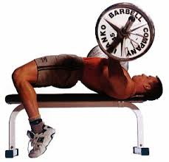
Using the right weight for YOU
Risk of injury increases
Lack of form
Leads to little muscle development
Look strong, but leads to no results. Doing too much for 1-2 reps is not as effective
Risk of injury decreases
Faster results
Watching your weight steadily increase
Feel satisfied and healthy after
Clean muscle growth
TOO MUCH
JUST ENOUGH

Slide 14
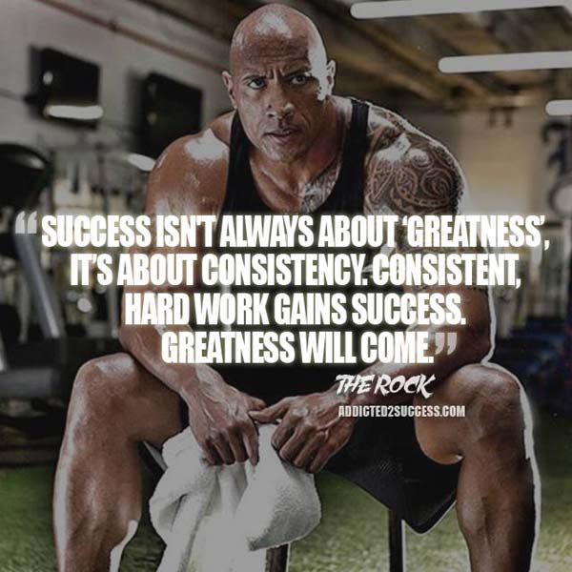
Philosophies
Know what you are training for
Athletes eat and train. They don’t diet and exercise. Ask yourself, “what are you training for?”
-Steve Cook
And know how you can get there

Slide 15
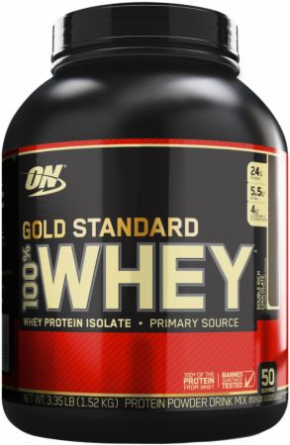
The Jargon, good and bad
Advertisements and social media
Scientific Backing
“WE GARAUNTEE YOU WILL SEE RESULTS!”
Entertaining and fun
Is this really worth $75 for 12 serving?
No!

Slide 16
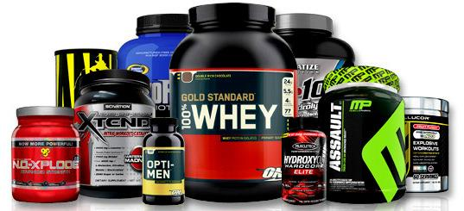
The Bad
Incredibly in depth
Counting carbs
Micros and Macros
Supplements
Natural dieting is all you need

Slide 17
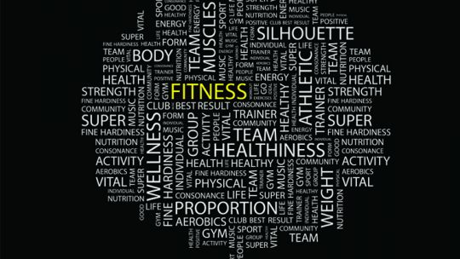
The Good
Form over weight
No good comes from poor form
Establish basics before advancing
Proper dieting
Dieting is #1 factor in
Proper muscle recovery
Safe weight loss
Wellness Training
Positive affect on all aspects of ones life

Slide 18
Results take time
Beginner: Stronger than 5%. Lifting for a couple of months.
Novice: Stronger than 20%. Lifting for six months.
Intermediate: Stronger than 50%. Lifting for 2 year +
Advanced: Stronger than 80%. Lifting for 5 years
Elite: Stronger than 95%. Lifting for over 5 years
http://strengthlevel.com/

Slide 19
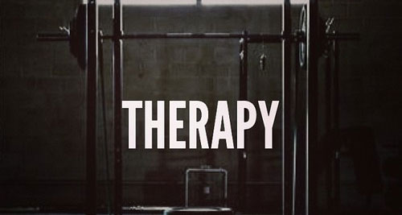
Results vary
Individuals strive for different results
Aesthetic
Strength
Mental Peace
Stress Relief

Slide 20
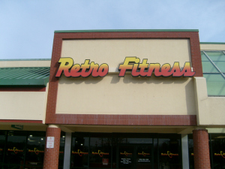
Where to go
Rowan Rec Center
Location: On campus
Free for students
Retro Fitness
Location: 864 N. Delsea Drive, Glassboro, NJ
$20 a month

Slide 21
The bottom line
Weight lifting is….
Whatever you make of it

