Slide 1
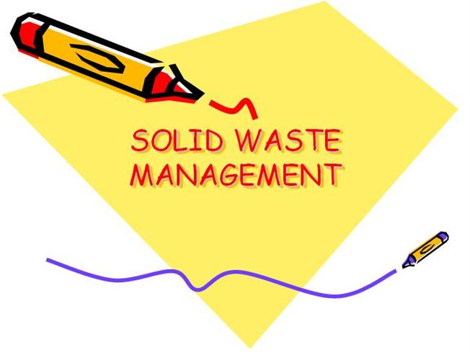
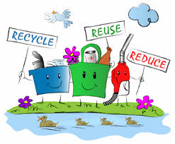
Solid waste management
Presenter: Pallabi Priyadarsini
1st yr MPH
Mod: Dr. M. R.Narayana Murthy
Professor,
Department of Community Medicine
JSS MC

Slide 2
Plan of presentation
Introduction to waste and types
Solid waste
Types of solid waste
Effects of solid waste
Waste management concept
Concept of 3R
solid waste management
storage
collection
waste handling and transport
method of disposal
Technology
Zero waste system
Recommendation

Slide 3
waste
It is defined as
Waste (also known as rubbish, trash, refuse, garbage, junk) is any unwanted or useless materials.
OR
Any materials unused and rejected as worthless or unwanted and “A useless or profile less activity using or expanding or consuming thoughtlessly or carefully.”

Slide 4
Types of waste
Solid waste
Liquid waste
Gaseous waste
Animal by product(ABPs)
Biodegradable waste
Chemical waste
Commercial waste/
Business waste
Biomedical waste
Bulky waste

Slide 5
Solid waste
It is defined as
“ non liquid, non-soluble materials ranging from municipal garbage to industrial wastes that contain complex & sometimes hazardous substances”
Solid waste also include
Garbage
Rubbish
Demolition products
Sewage treatment residue
Dead animals
Manure and other discarded material.
-- Per capita solid waste out put 0.25-2.5 Kg/day

Slide 6
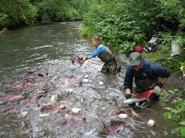
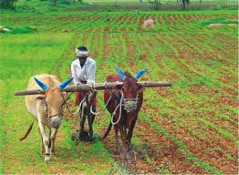
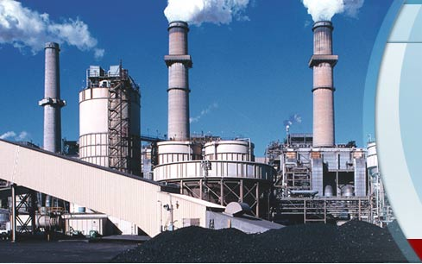
source
Agriculture
Fisheries
Household
Commerce and industry

Slide 7
types
Broadly there are 3 types of waste which as follows
Household waste as municipal waste
Industrial waste as hazardous waste
3.Biomedical waste or hospital waste as infectious waste

Slide 8
1. Municipal solid waste
Municipal solid waste consist of---
household waste
construction and demolition debris
sanitation residue
waste from streets
With rising urbanization and change in life style and food habits ,the amount of municipal solid waste has been increasing rapidly and its composition changing.

Slide 9
Charecterization of muncipal solid waste

Slide 10
Hazardous waste
Industrial and hospital waste is considered hazardous as they may contain toxic substances
Hazardous waste could be highly toxic to humans, animals and plants. They are
- corrosive
- highly inflammable or explosive
In the industrial sector the major generators of hazardous waste are the metal’ chemical’ paper, pesticide, dye and rubber goods industries.
Direct exposure to chemicals in hazardous waste such as mercury and cyanide can be fatal

Slide 11
Hospital waste or biomedical waste
Bio-medical waste means “Any waste which is generated during the diagnosis, treatment or immunization of human beings or animals or in research activities pertaining thereto or in the production or testing of biological”
-Bio-medical waste rules ,1998
It may includes wastes like sharp waste, pathological waste, pharmaceutical waste, genotoxic waste, chemical waste, and radioactive waste etc.

Slide 12
Effects of solid waste
A:Health hazard
If solid waste are not collected and allowed to accumulate , they may create unsanitary conditions.
This may lead to epidemic outbreaks .
Many diseases like cholera. Diarrhea, dysentery, plague, jaundice, or gastro-intestinal diseases may spread and cause loss of human lives.

Slide 13
contd…
In addition improper handling of the solid wastes ,a health hazard for the workers who come in direct contact with the waste.
B: Environmental impact
If the solid wastes are not treated properly decomposition and putrefaction( decay) may take place .
The organic solid waste during decomposition may generate obnozious (intolerable odour)

Slide 14
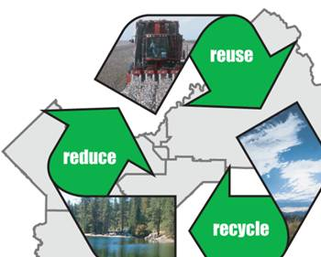
Waste management concept
The 3Rs (Reduce, Reuse, Recycle) to be followed for waste management.

Slide 15
reduce
Disposable goods: paper plate, paper bowl, Styrofoam cup, plastic spoon, roll of paper
towels, paper napkin; Durable goods: ceramic/plastic plate, metal spoon, glass/plastic drinking cup,
dish towel, cloth napkin)
Recovery of one tonne paper can save 17 trees.

Slide 16
Reuse
Instead of buying new containers from the market, use the ones that are in the house.
Don’t through away the soft drink can or bottle cover them with home made paper or paint on them and use them as pencil stands or small vases.

Slide 17
recycle
Use shopping bags made of cloth or jute which can be used over and over

Slide 19
Waste management hierarchy
There are a number of concepts about waste management which vary in their usage between countries or regions. Some of the most general, widely used concepts include:
Waste hierarchy - The waste hierarchy refers to the "3 Rs" reduce, reuse and recycle, which classify waste management strategies according to their desirability in terms of waste minimization. The waste hierarchy remains the cornerstone of most waste minimization strategies.
The aim of the waste hierarchy is to extract the maximum practical benefits from products and to generate the minimum amount of waste .

Slide 20
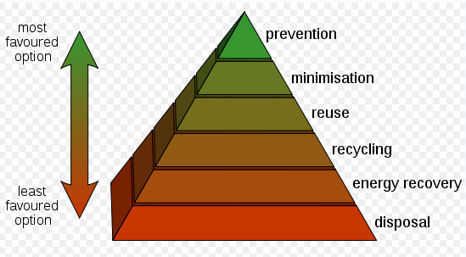
Contd…

Slide 21
Contd…
Polluter pays principle - the Polluter Pays Principle is a principle where the polluting party pays for the impact caused to the environment. With respect to waste management, this generally refers to the requirement for a waste generator to pay for appropriate disposal of the unrecoverable material.

Slide 22
Solid waste management
Waste management is the
storage
collection
transport and handling
recycling
disposal and monitoring of waste materials.

Slide 23
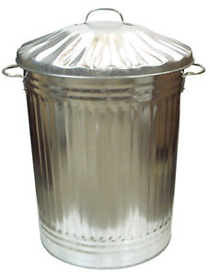
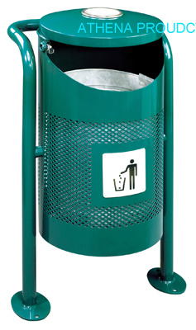
storage
Storage:
- Galvanized steel dust bin
- Paper sack
- Public bins

Slide 24
collection
Collection
- House-to-house collection
- Collection from the public bins

Slide 25
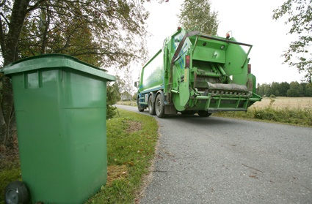
Waste handling and transport
Waste handling and separation involves activities associated with waste management until the waste is placed in storage containers for collection. Handling also encompasses the movement of loaded containers to the point of collection.
waste is transferred from a smaller collection vehicle to larger transport equipment

Slide 26
Recycling
Recycling refers to the collection and
refuse of waste materials such as empty beverage container.
The materials from which the items are
made can be processed into new
products.
Materials for recycling may be collected
separately from general waste using dedicated bins.

Slide 27
Method of disposal
Dumping
Controlled Tipping or Sanitary Landfill
Incineration
Composting
Manure pits
Burial

Slide 28
objectives
Public hygiene and health.
Reuse, recovery and recycle
Energy generation
Sustainable development
Aesthetics

Slide 29
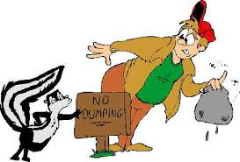
1. dumping
Low lying areas.
Mainly for dry refuses
Kolkata disposes by this
method and reclaimed land
given for cultivation.
Unsanitary method
- Exposed to flies and rodents
- Nuisance
- Dispersed by wind
- pollution of surface water

Slide 30
2. Controlled Tipping/ Sanitary Landfill
Satisfactory method
- Material placed in a trench
- compacted with earth at the end of the working day.
Modified sanitary land fill-where compaction and covering are accomplished once or twice a week.

Slide 31
3 Methods
1. Trench method
2. Ramp method
3. Area method
Refuse is compacted on its exposed surface with excavated earth (30 cm).

Slide 32
Trench method
Long trench of 6-10 feet deep and12-36 feet wide.
Refuse is compacted and covered with excavated earth.
Refuse is filled up to 6 feet.
It is estimated one acre of land per year for 10,000 population.
RAMP METHOD: suited where the terrain is moderately slopping.

Slide 33
Area method
Used for filling land depressions, disused quarries and clay pits.
Refuse is deposited, packed and consolidated in uniform layers for 6-8 feet.
Each layer is sealed with a mud cover at least 12 inches.
Sealing prevents infestation by flies and rodents.
Prevents nuisance of smell and dust.

Slide 34
Changes
- Chemical
- Bacteriological
- Physical
The temperature rises to over 60 deg. C within 7 days and kills all pathogens and hastens the decomposition process.
It takes 4 to 6 months for complete decomposition.

Slide 37
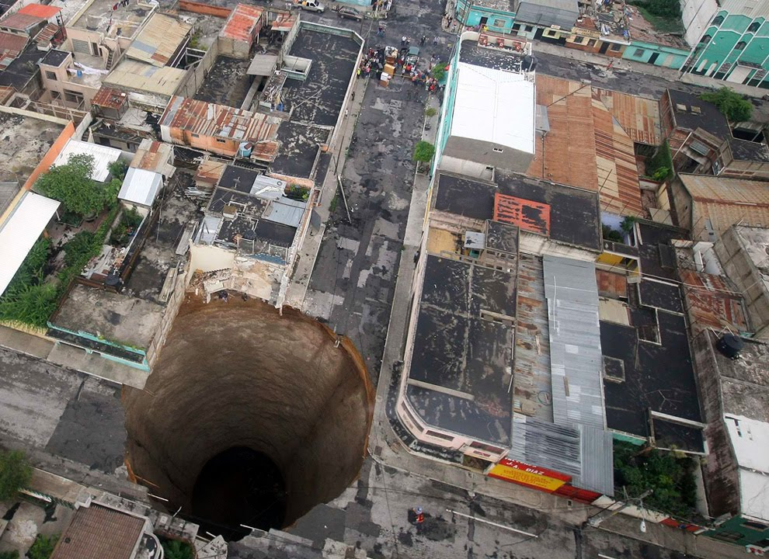
s I n k h o l e

Slide 38
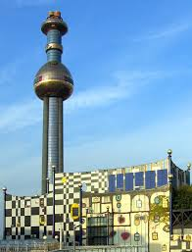
3. incineration
it is a disposal method in which solid organic wastes are subjected to combustion so as to convert them into residue and gaseous products.
This process reduces the volumes of solid waste to 20-30% of the original volume.
Also described as thermal treatment
Where land is not available
Hospital waste

Slide 39
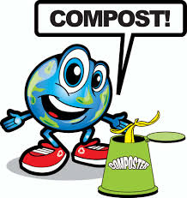
4.composting
Method of combined disposal of refuse and night soil/ sludge
Principal by products are: CO₂ , Water and heat
End product- compost
Methods
a. Bangalore method
b. Mechanical composting
c. Vermicomposting

Slide 41
a. Bangalore method (Hot fermentation process/ Anaerobic method)
IISc- Indian Council of Agricultural Research.
Trenches are dug 3ft deep, 5-8ft broad, 15-30ft long.
Composting procedure
- 1. Layer of Refuse- 15 cm
- 2. Layer of Night soil – 5 cm
Physical, chemical and biological changes takes place

Slide 42
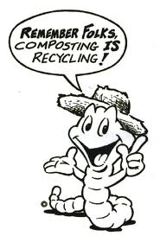
b. Mechanical composting (Aerobic method)
Compost manufactured by processing raw materials.
1. Screening
2. Pulverization (<2inches)
3. Mixing
4. Incubation
Process completed in 4-6 week
C: vermicomposting :It is a method
of disposal of kitchen and plate
wastes, which serves the dual
purpose of disposing off the
garbage as well as proving
eco-friendly.

Slide 43
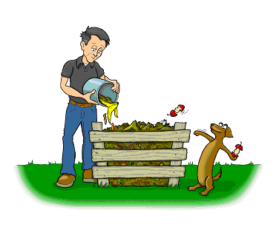
5.Manure pits
Mostly used in rural areas
Digging “manure pits” is to prevent the refuses thrown around the houses.
The garbage, cattle dung, straw, and leaves should be dumped into the mannure pits and covered with earth.
Two pits will be needed
In 5-6 month’s time the refuse is converted into manure which can be returned to the field.

Slide 44
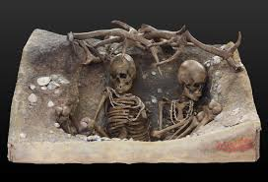
6.burial
Suitable for small camp
A trench 1.5m wide &2 m deep is excavated
The refuse is covered with 20 -30cm of earth
When the level in the trench is 40cm from ground level, the trench is filled with earth & compacted
4-6 months

Slide 45
Technology
Technologies like
RFID( Radio frequency identification) tags are now being used to collect data on presentation rates for curb-side pick-ups.
GPS tracking is particularly evident when considering the efficiency of ad hoc pick-ups (like skip bins or dumpsters) where the collection is done on a consumer request basis.
Rear vision cameras are commonly used for OH&S (Occupational Health & Safety) reasons and video recording devices are becoming more widely used, particularly concerning residential services.

Slide 46
Zero waste system
Zero waste system which was founded by PhD chemist .Paul parmer in Okland.
It is a philosophy that encourages the redesign of resource life cycle so that all products are reused.

Slide 47
Wastes per Indian cities

Slide 48
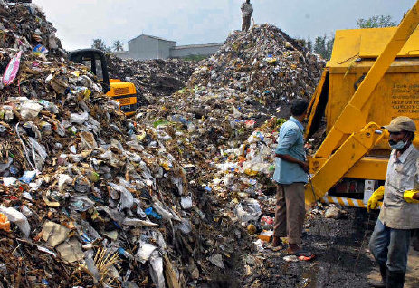
Waste management plant in mysore
There are two solid waste management plant in Mysore.
J.P Nagar
vidyaranyapuram

Slide 50
Bbmp(bruhat bangalore mahanagar palike)
BBMP represents the third level of government & forth largest municipal corporation in India .
It is responsible for the development of the city , health hygiene, licensing trade & education.

Slide 52
Waste management policies
Environment protection act, 1986
Hazardous waste rule 1989
Bio-medical waste rule 1998
Municipal solid waste rule 2000
Waste management act 1996
Solid waste policy in India 2006

Slide 53
recomendation
The improvement of people and private sector through NGOs could improve the efficiency of solid waste management.
Public awareness should be created especially at primary level.
Littering of solid waste should prohibited in cities towns and urban areas.
More over house to house collecting solid waste should be .

Slide 54
Contd…
The collection bins must be have a large enough capacity to accommodate 20% more than the expected waste generation in the area.
Municipal authorities should maintain the storage facilities to avoid unhygienic & unsanitary condition.
It is advisable to move from open dumping to sanitary land filling in a phased manner.

Slide 55
Reference
Park K. Park’s Textbook of Preventive and Social Medicine. 22nd ed. Jabalpur: Banarsidas Bhanot Publishers; 2013. Chapter 20, Communication for Health Education; p699-701
Bhalwar, Rajvir et al, 2009, Textbook of Public Health and Community Medicine, Prune, WHO/AFMC;p715-717
BK Mahajan. (2011) Text book of preventive and social medicine. 7th Edition. Jaypee Brothers Medical Publishers (P) Ltd., Daryaganj, New Delhi.;p71-73
AH Suryakantha. Community Medicine With Recent Advances. 3rd Edition. Jaypee Brothers Medical Publishers (P) Ltd., Daryaganj, New Delhi; 2013;p233-237

Slide 56
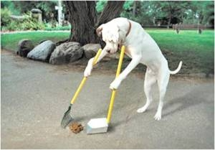
`
T
H
A
N
K
YOU

