Slide 1
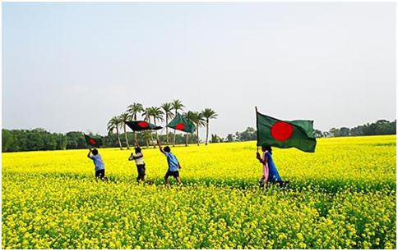
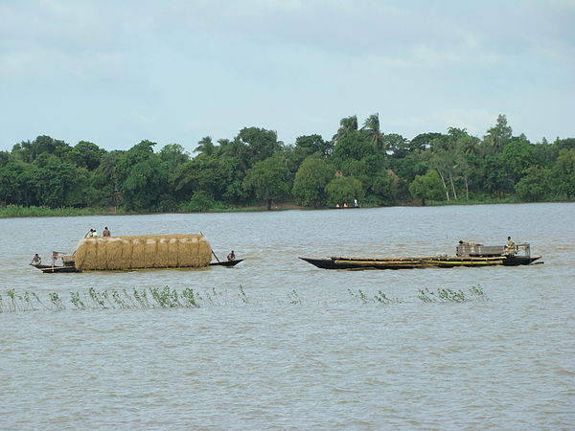
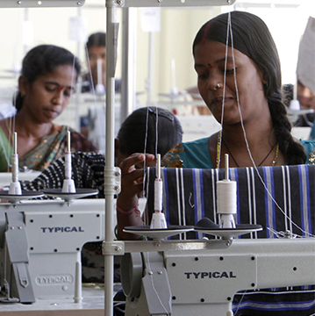
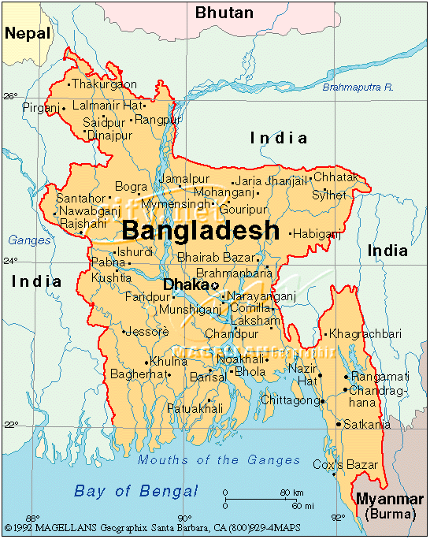
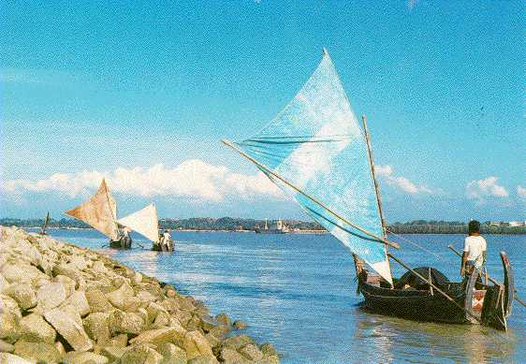
Can Algae Grow the Future for Bangladesh? Dr. Kauser Jahan Professor, Civil & Environmental Engineering Rowan University Glassboro, New Jersey

Slide 2
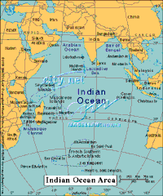
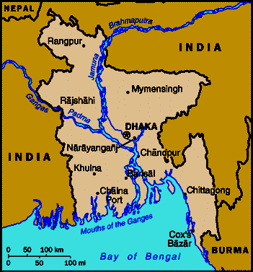
BANGLADESH
Bounded by India on the north and west, by India and Burma on the east, and by the bay of Bengal on the south.
Clearly divided into two distinct regions - the North Eastern and the South Eastern mountain ranges and the vast alluvial plainlands

Slide 3
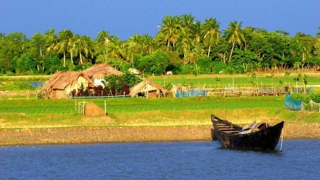
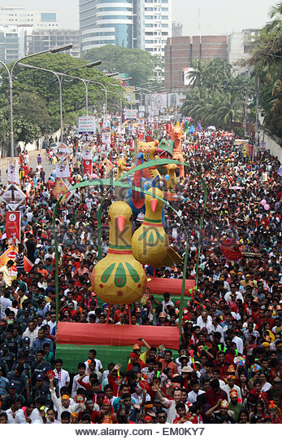
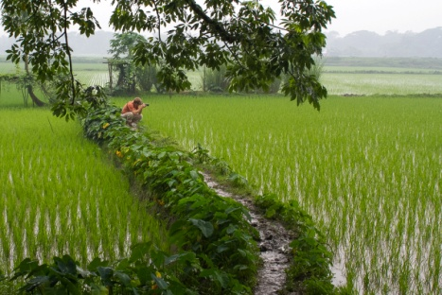
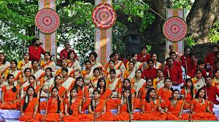
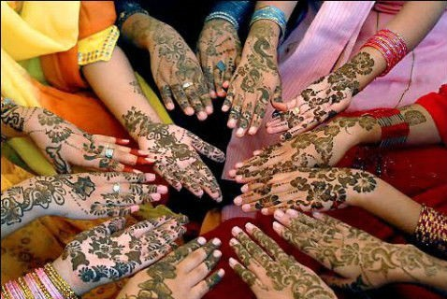
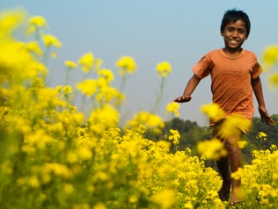
Geography/People
Area: Land area:133,910 sq km
Comparative area: slightly smaller than Wisconsin
Population: 150 Million (July 2016)
Ranks ## in the world
Capital: Dhaka
Language: Bengali/English
Currency: Taka
Average Life Expectancy: 64 years
Major Rivers: Padma, Meghana
Annual Rainfall: 2000 mm
Religions: Muslim 83%, Hindu 16%, Buddhist, Christian, Other
Literacy: age 15 and over can read and write
56% of total population
63% males and 49% females

Slide 4
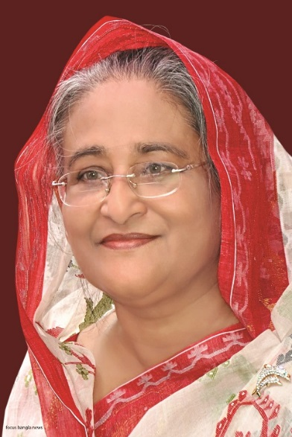
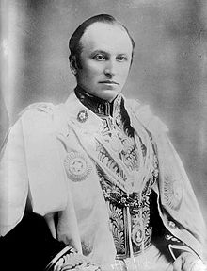
Government
The borders of modern Bangladesh were established with the partition of Bengal and India in August 1947, when the region became East Pakistan as a part of the newly formed State of Pakistan.
The British East India Company gained official control of Bengal following the Battle of Plassey in 1757. Bengal became a major trading port for bamboo, tea, sugar cane, spices, cotton, muslin, jute and indigo.
Prime Minister: Sheikh Hasina
Robert Clive's victory in Bengal marked the beginning of British colonial dominance in South Asia
Lord Curzon was the man behind the Partition of Bengal that gave modern Bangladesh its political boundaries.

Slide 5
IMPORTANT RELEVANT DATA
GDP/capita
USA $ 53,041.98
Bangladesh: $1,314
The World Bank 2015 study report shows Bangladesh has achieved significant progress in rural accessibility index compared to other developing countries of Asia and Africa.
Bangladesh secured a rural accessibility index score 86.7
Microcredit, Women’s Empowerment, Technology
USD 570 million.

Slide 6
Algae for Growing the Future of Bangladesh
Bengali: Shobuj Soibal or Sheola (Scum)
Records from the Ministry of Agricultural data show that 0.73 million hectares of land that are not suitable for any crop production can be used for algae production.
Climate conducive for algae growth. Sunlight readily available.
300 species and varieties of freshwater algae have been described from Bangladesh.
Extensive studies have been made on the freshwater blue-greens, euglenoids, chlorococcales, volvocales, zygnematales, oedogoniales, desmids, chaetophoralean algae, charalean members and red algae.
200 marine algal taxa (seaweeds) identified
Fuel
Aquaculture
Food: Malnutrition & Other Uses
Cosmetics
Women’s Empowerment
(grow your own algae for home use)

Slide 7
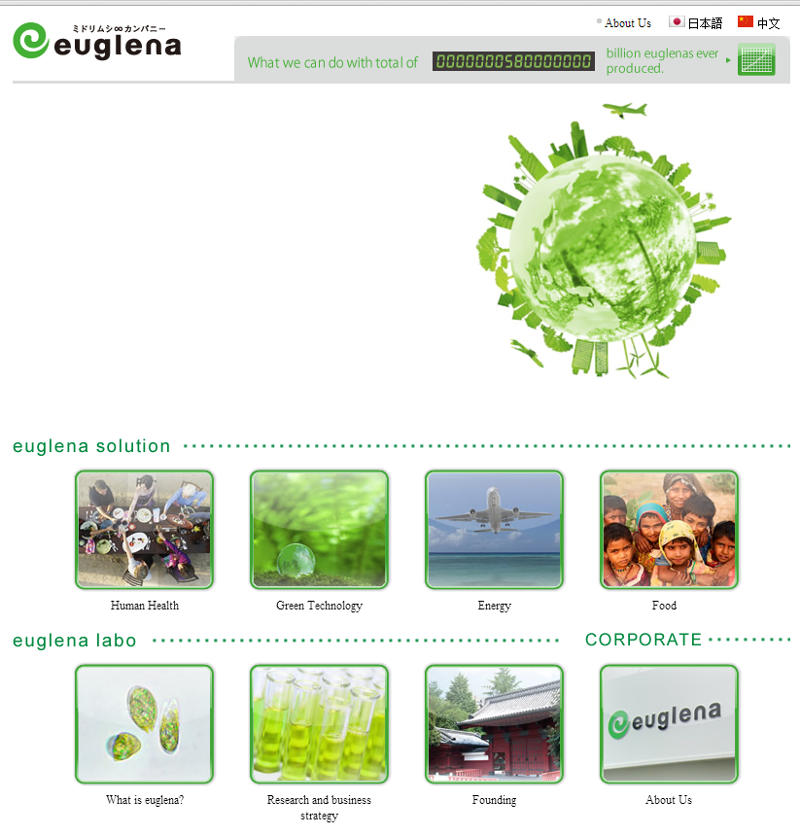
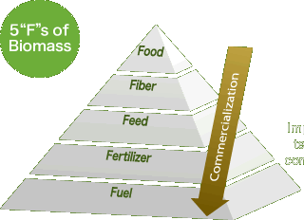
Japan Bangladesh Partnership with Euglena
Euglena, is a microalgae with the features of both plants and animals and grows in fresh water.
It can store energy by the means of photosynthesis like plants while it can also move around like other microorganisms.

Slide 8
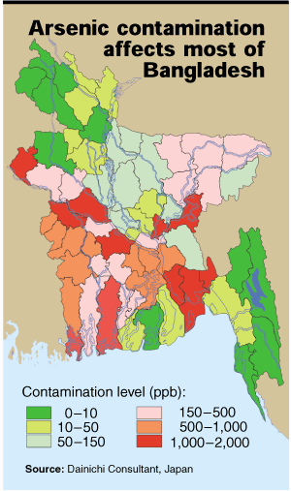
Concerns- Arsenic in Bangladesh
Bangladesh is the site of the “world’s largest mass arsenic poisoning in history”
The arsenic is naturally occurring in the alluvial and deltaic sediments in the aquifers
An estimated 75 million people are at risk of developing health effects from arsenic ingestion
Approximately 1/3 of all the wells in Bangladesh have arsenic concentration exceeding the standard of 50 ppb
Some areas have arsenic levels 40 times higher than the standard and over half the wells in the country have concentrations exceeding the World Health Organization’s standard of 0.01 mg/L
USEPA , WHO Standard
MCL 10 ppb

Slide 9
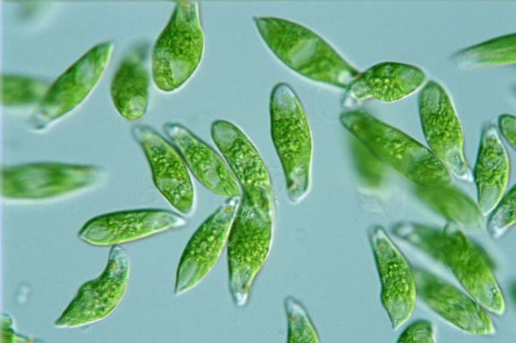
Algae can be a viable industry for Bangladesh Algae culture (freshwater and marine) will lead to jobs and empowerment Reduce fossil fuel dependency Eliminate childhood malnutrition Assist in developing other industries such as cosmetics, medicine, health and food. Social changes
Conclusions

