Slide 1
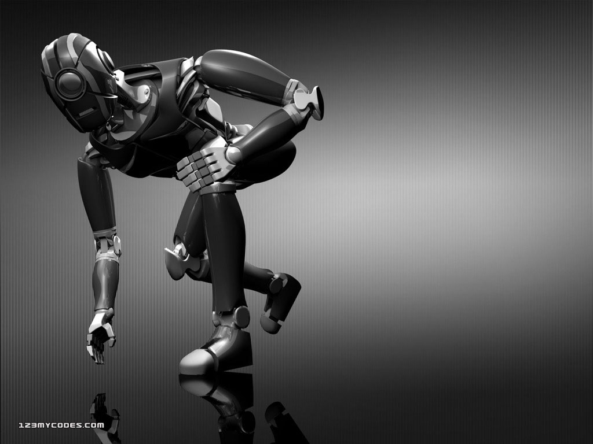
ROBOTICS
Project by-
V.Bindiya ,
Narayana IIT Olympiad School

Slide 2
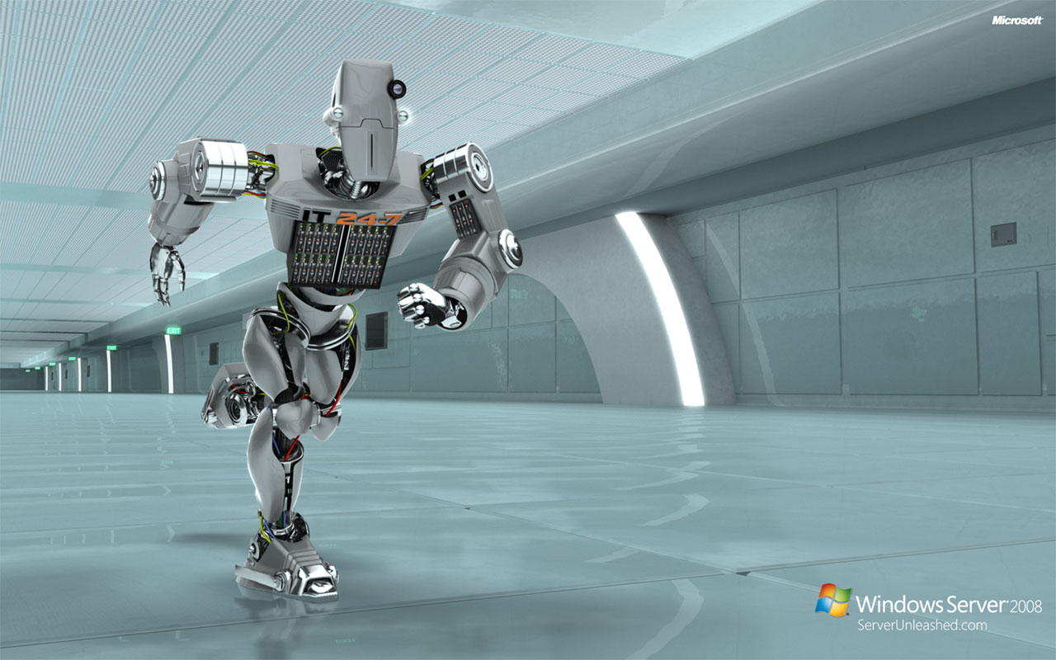
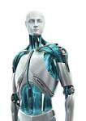
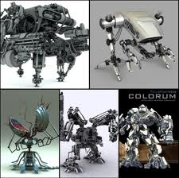
Robotics
Robotic
History
Robotic
Technology
Types of
Robots

Slide 3
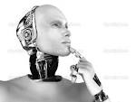
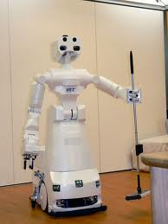
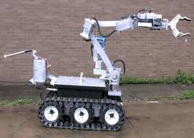
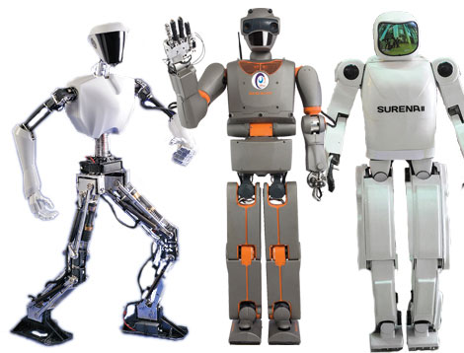
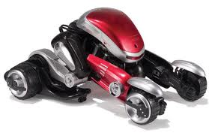
What is a Robot…?
A re-programmable, multifunctional, automatic industrial machine designed to replace humans in repetitive/high accuracy/hazardous work environment.
A mechanical device that performs human tasks, either automatically or by remote control.
It can be used as :-
An automatic machine sweeper
An automatic car for a child to play with
A machine removing mines in a war field
In space
In military , and much much more..

Slide 4
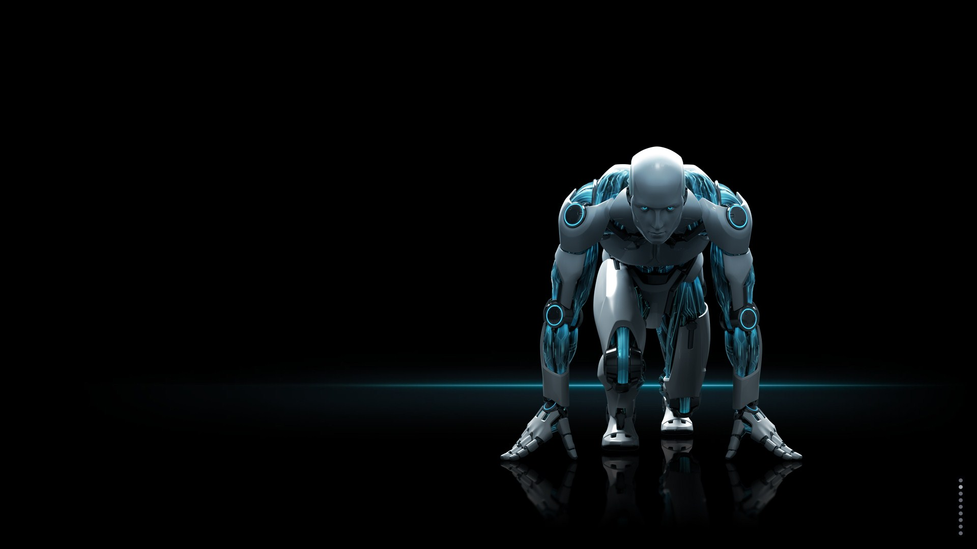
WHAT IS ROBOTICS...?
Robotics is the science of designing or building an application of robots. Simply ,Robotics may be defined as “The Study of Robots”. The aim of robotics is to design an efficient robot.
WHY IS ROBOTICS NEEDED...?
Robotics is needed because:-
To impact speed of a process
Can work in hazardous/dangerous temperature
Can do repetitive tasks
Can do work with accuracy

Slide 5
Definition
What is the Defination of a Robot?
A reprogrammable multifunctional manipulator designed to move material,parts, tools or specialized devices through various programmed motions for the performance of a variety of Tasks.
Robot Institute of America.

Slide 6
Robotic History
First use of the word “Robotics”
Three Laws of Robotics
The first robot “Ultimate”

Slide 7
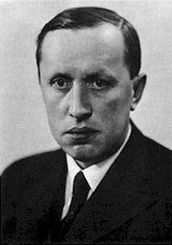
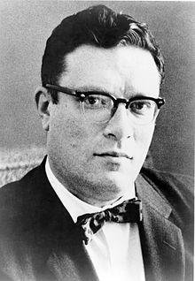
First use of the word “Robotics”
The word robot was introduced to the public by Czech writer Karel Capek(1890-1938) in his play R.U.R. (Rossum's Universal Robots), published in 1920. The play begins in a factory that makes artificial people called robots . Capek was reportedly several times a candidate for the Nobel prize for his works .
The word “Robot”comes from the word “Robota”,meaning, in Czech”, forced labor, drudgery.
The word "robotics", used to describe this field of study, was coined accidentally by the Russian –born , American scientist and science fiction writer, Isaac Asimov(1920-1992) in the 1940s.

Slide 8
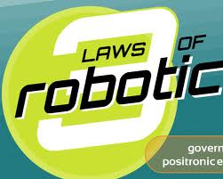
The Three laws of Robotics
Asimov also proposed his three "Laws of Robotics", and he later added a “zeroth law”.
Zeroth Law : A robot may not injure humanity, or, through inaction, allow humanity to come to harm
First Law : A robot may not injure a human being, or, through inaction, allow a human being to come to harm, unless this would violate a higher order law
Second Law: A robot must obey orders given by human beings, except where such orders would conflict with a higher order law
Third Law : A robot must protect its own existence as long as such protection does not conflict with a higher order law.

Slide 9
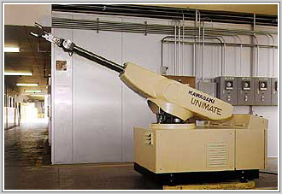
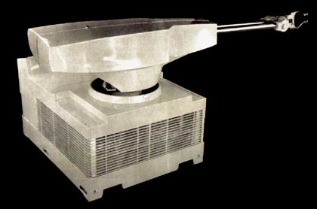
The First Robot “UNIMATE”
Unimate was the first industrial robot.
Developed for General Motors.
It was created by George Devol in the 1950s using his original patent filed in 1954 and granted in 1961.
]
The machine undertook the job of transporting die castings from an assembly line and welding these parts on auto bodies, a dangerous task for workers, who might be poisoned by toxic fumes or lose a limb if they were not careful.^{[4]}
The original Unimate consisted of a large computer-like box, joined to another box and was connected to an arm, with systematic tasks stored in a drum memory.
In 2003 the Unimate was inducted into the Robot Hall of Fame

Slide 10
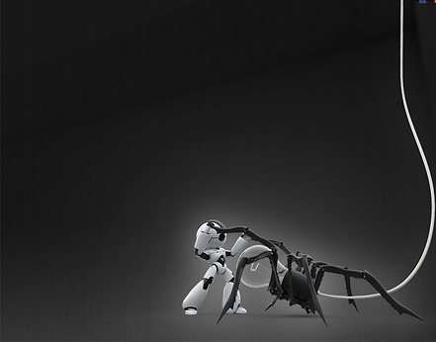
robotics technology
Most industrial robots have at least the following five parts:
Sensors
Effectors
Actuators
Controllers
Arms

Slide 11
Robot Components
1. Manipulator or Rover: Main body of robot
(Links, Joints, other structural element of the robot)
2. End Effecter: The part that is connected to the last joint hand) of a manipulator.
3. Actuators: Muscles of the manipulators (servomotor, stepper motor, pneumatic and hydraulic cylinder).
4. Sensors: To collect information about the internal state of the robot or To communicate with the outside environment.
5. Controller: Similar to cerebellum. It controls and coordinates the motion of the actuators.
6. Processor: The brain of the robot. It calculates the motions and the velocity of the robot’s joints, etc.
7. Software: Operating system, robotic software and the collection of routines.

Slide 12
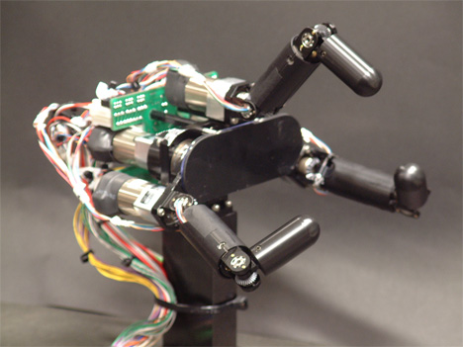
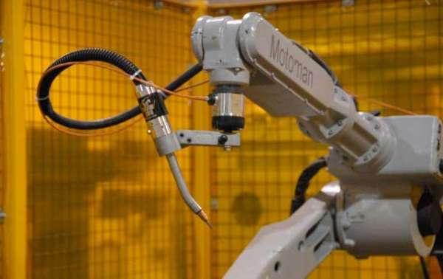
Sensor
Effector

Slide 13
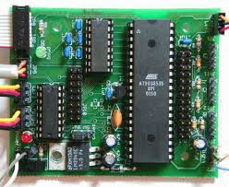
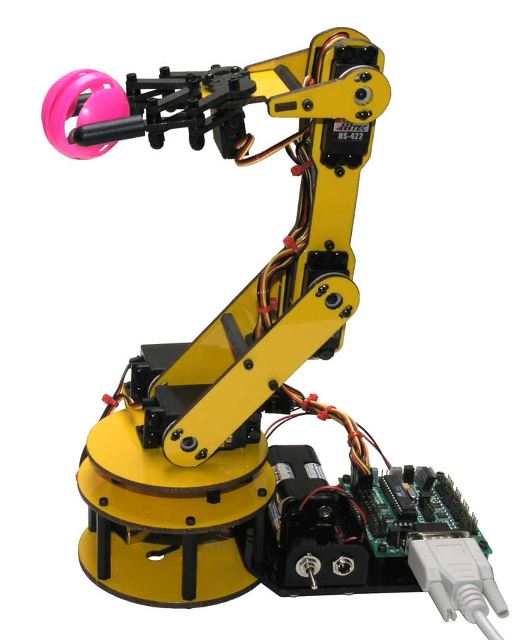
Controller
Arm

Slide 14
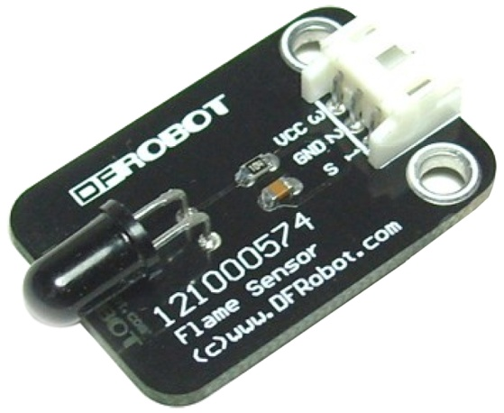
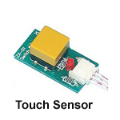
SENSORS
Sensors provide awareness of the environment by sensing things.Sensors are the core of robots.It is the system that alerts the robots..
Sensing can be in different forms like-
Light
Sound
Heat
Chemicals
Force
Object proximity
Physical orientation/position
Magnetic & Electric Fields
Resistance

Slide 15
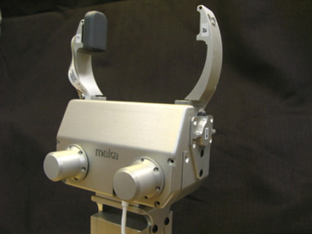
End Effectors
In robotics, an end effector is the device at the end of a robotic arm, designed to interact with the environment.
End effectors may consist of a gripper or a tool. The gripper can be of two fingers, three fingers or even five fingers.

Slide 16
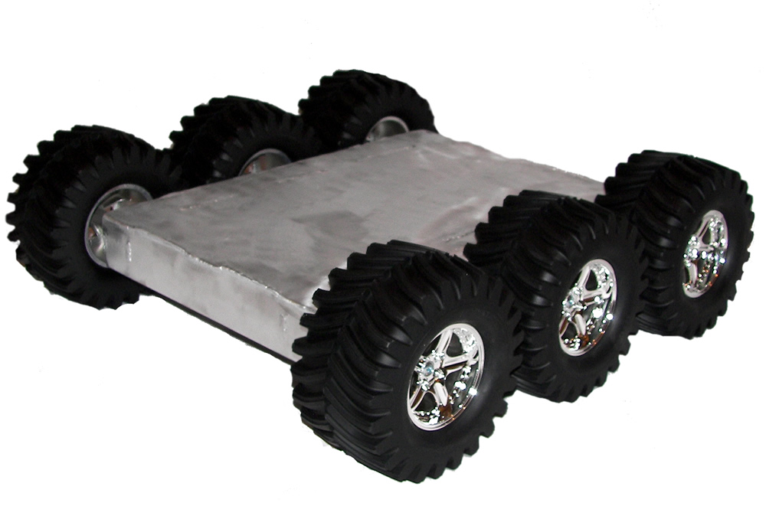
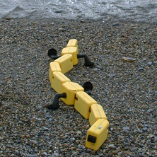
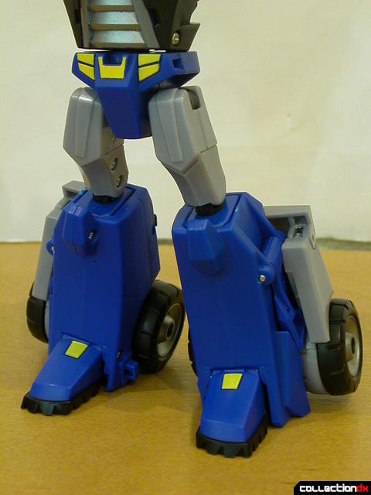
Actuators…
Locomotion-
Legs
Wheels
Other exotic means

Slide 17
Actuators…
Manipulations-
Degrees of freedom
independently controllable components of motion
Arms
convenient method to allow full movement in 3D
more often used in fixed robots due to power & weight
even more difficult to control!
due to extra degrees of freedom
Grippers
may be very simple (two rigid arms) to pick up objects
may be complex device with fingers on end of an arm
probably need feedback to control grip force

Slide 18
`
Types of Robots
The most common types of Robots are..
Mobile Robots
Stationary Robots
Autonomous Robots
Remote-Controlled Robots
Virtual Robots

Slide 19
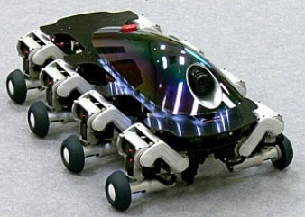
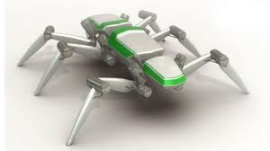
Mobile Robots
Mobile robots are of two types….
Rolling Robots-
Rolling robots have wheels to move around. They can quickly and easily search. However they are only useful in flat areas.
Walking Robots
Robots on legs are usually brought in when the terrain is rocky. Most robots have at least 4 legs; usually they have 6 or more.

Slide 20
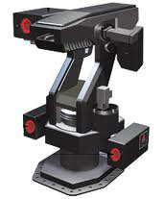
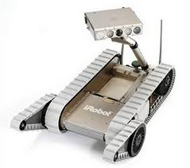
tonomous
Stationary Robots
Robots are not only used to explore areas or imitate a human being. Most robots perform repeating tasks without ever moving an inch. Most robots are ‘working’ in industry settings and are stationary .
Autonomous Robots
Autonomous robots are self supporting or in other words self contained. In a way they rely on their own ‘brains’.

Slide 21
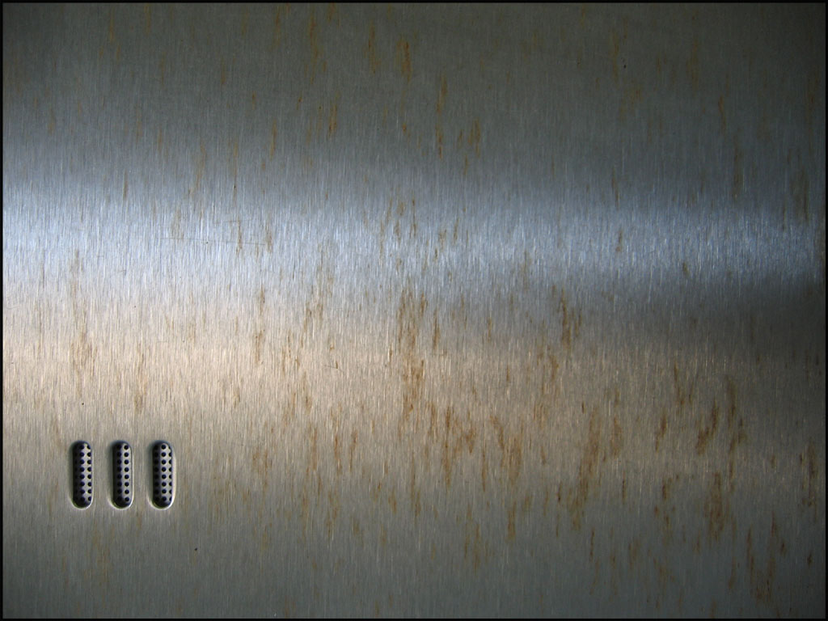
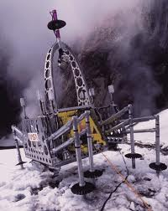
Remote-Control Robots
A person can guide a robot by remote control. A person can perform difficult and usually dangerous tasks without being at the spot where the tasks are performed.
Virtual Robots
Virtual robots don’t exits In real life. Virtual robots are just programs, building blocks of software inside a computer.

Slide 22
Advantages..
Going to far away planets.
Going far down into the unknown waters and mines where humans would be crushed
Giving us information that humans can't get
Working at places 24/7 without any salary and food. Plus they don't get bored
They can perform tasks faster than humans and much more consistently and accurately
Most of them are automatic so they can go around by themselves without any human interference.
Disadvantages..
People can lose jobs in factories
It needs a supply of power
It needs maintenance to keep it running .
It costs money to make or buy a robot

