Slide 1
Course Reminders & Deadlines
Pathfinder BEFORE exercises due 2/5 by 11:55PM
Engineering Statistics
3D Game Lab
1st deadline of 350 XP midnight, Monday Feb. 12

Slide 2
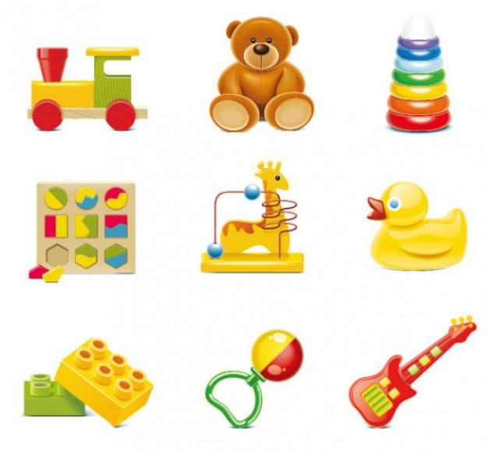
Universal Design (UD) Project
Designing a “Hand Tool” for Kids
Notes:
Adapted from University of Pittsburgh project in Human Factors Engineering. It is a 4 week project that has teams of students designing kids toys using UD and Human Factors principles

Slide 3
Project Goal
Bring together facets of universal design and apply them in a design context. Students will utilize knowledge about UD, human factors, as well as knowledge gained in FEC I
Students will be put into teams and are tasked to design a very inexpensive kid’s toy that can be inserted into fast food meals.
Constraints: inexpensive, safe, fun, and usable

Slide 4
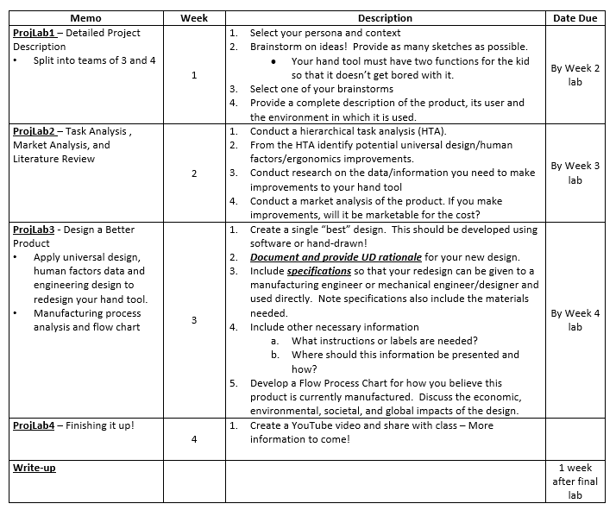
Schedule (4 weeks)
Teams will conduct work in phases and submit memos weekly on different aspects of the project.
Project culminates in a final design report and YouTube video
Criteria on memo and design reports can be found in UD Project Description document

Slide 5
Week 1 – Detailed Project Description
Objective: Gain experience in breaking down potential products into user elements, understanding the customer, and creating ideas
Description:
Select persona and context
Use Voice of Customer techniques to understand nature of project (in Drive)
Brainstorm ideas
Select a brainstorm
Describe the product, its user(s), and the environment in which its used

Slide 6
The Adventurer
Persona:
Nick loves playing outside, particularly in the wooded area behind his house. He and his friends can spend hours wandering through the woods looking for hiking trails and waterfalls.
Consider:
Nick dreams of being a professional explorer when he grows up, like Indiana Jones. He doesn't mind getting a little dirty when he plays.
Notes:
Example persona card

Slide 7
School
Description:
Kids, teachers, education and recess! Schools are open to creativity and exploring but also have rules and restrictions.
Themes:
Multi-user, Safe, High Usage
Instruction:
Infer from the persona card what your user might bring or use at school. Be sure to consider all restrictions that may apply in a school setting.
Notes:
Example context card

Slide 8
Week 2 – Task Analysis, Market Analysis, and Literature Review
Objective: Conduct a task analysis and make some initial considerations for UD issues and problems. Identify potential UD design improvements
Description:
Conduct hierarchical task analysis (HTA) – slides provided in Drive + article
Identify UD/ergonomic improvements
Conduct UD research on data needed to make improvements
Conduct market analysis and literature review
Notes:
Task Analysis – outline of human involvement in a system

Slide 9
Week 3 – Designing a Better Product
Objective: Begin the final steps of the redesign of your toy by addressing various issues and combining project labs into a final report
Description:
Create a “best” design in a CAD tool (Onshape) or by hand
Document and provide UD rationale for new design
Include design specifications
Include other necessary information (i.e., labels, important information)
Flow chart on manufacturing process

Slide 10
Week 4 – Youtube Video and Final Report
Grading: Consists of both written and oral portions. Written summary and Youtube video is worth 80% of the project grade; participation and effort is with 20% (memos, CATME included)
Final Report: No longer than 8 pages consisting of the following:
Product and User Description
How Product is Used by the Customer and Market Description
Design
Manufacturability
Appendices (HTA, Drawing/Sketch/CAD, Manufacturing Plan/Flow Chart)
Notes:
If toys are small enough, can give option to students to 3D print.

Slide 11
UD Topics and PF Schedule
Week | PF/Un-Lecture | Lab
1 | Intro to Universal Design | ProjLab Description and ProjLab1 (Detailed Project Description)
2 | Engineering Statistics 1 (Anthropometry) | ProjLab 2 (Task Analysis, Market Analysis, and Literature Review)
3 | Engineering Statistics 2 (Information Processing) | ProjLab 3 ( Designing a Better Product)
4 | MATLAB 1 | ProjLab4 (Youtube and Final Report)
Anthropometry – the study of human body measurements especially on a comparative basis; important for improving consumer acceptance and response to products and environments
Perception (Information Processing) – the process of interpreting information received from the senses. Information is defined as the reduction of uncertainty after the occurrence of an event.
Notes:
Remind faculty I’m still updating and adding content, so stay tuned for supportive materials

Slide 12
How to Write a Memo
See Pathfinder – Engineering Communication I from FEC I
Notes:
Adapted from University of Pittsburgh project in Human Factors Engineering. It is a 4 week project that has teams of students designing kids toys using UD and Human Factors principles
https://owl.english.purdue.edu/owl/resource/590/01/

Slide 13
Purpose
Bring attention to problems and solve problems
Communicates information such as
Policy changes
Price increases
Changes in current production procedures
Connect the purpose of the writer (you) with the interests and needs of the reader

Slide 14
Parts of a Memo
Heading Segment (1/8th of memo)
Content
TO: (reader’s names and titles)
FROM: (your names and titles)
DATE:
SUBJECT: (what memo is about)
Opening Segment
Context
Task Segment
Summary Segment
Discussion Segment
Closing Segment
1/4th of memo
1/2 of memo
1/8th of memo

Slide 15
Content of Memo
Opening – purpose of memo and overview of what it contains
Context – event, circumstance, or background of problem
Task – describe what you are doing to solve the problem
Summary – key recommendations (short)
Discussion – details that support ideas (facts, research, and evidence)
Closing – courteous ending that indicates action for reader

Slide 16
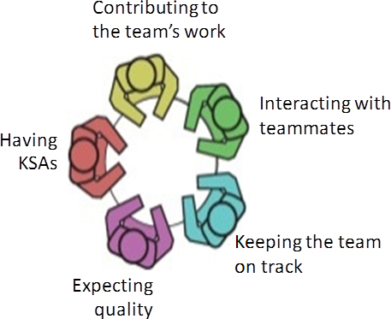
Team Policies and Expectations
See page 5 of Section 3 Syllabus on Blackboard

Slide 17
Roles for each assignment
Coordinator – organize work sessions; make sure everyone knows when and where to meet and what they are supposed to do; keep everyone on task and involved during meetings
Recorder – prepares the assignment (memo) to be turned in
Monitor – makes sure all team members understand assignment and how it was developed
Checker – double checks, revises, and submits final solution
Rotate these roles throughout project!

Slide 18
CATME Peer Evaluation
Each student will perform
One peer evaluation after the UD project, with rater practice.
One peer evaluation after the Design for the Other 90% project
One peer evaluation after the Algae of the Future project
Students should evaluate themselves and their team members!
CATME scores will contribute to overall project grade (part of 20% of UD project)

