Slide 1
Course Reminders & Deadlines
Pathfinder
Before Exercises on Engineering Econ 1 due March 5th
Before Exercises on Engineering Econ 2 due March 19th
After Exercises on Engineering Econ 2 due April 2nd
3D Game Lab
2nd deadline of 700 XP midnight March 7th
GameLab is 15% of your course grade
No activity on the platform = B or less for your course grade
CATME – Complete UD Peer Eval. (2/27-3/6)

Slide 2
Course Reminders & Deadlines
Design for the Other 90% Project
Before Exercise for Design for the Other 90% - Water Use
Tech Transfer Presentation due by 5 PM on March 19th
Tech Transfer Memo, Mat Lab and Whitepaper on April 2th
Midterm on 3/28

Slide 3
Water Resources

Slide 4
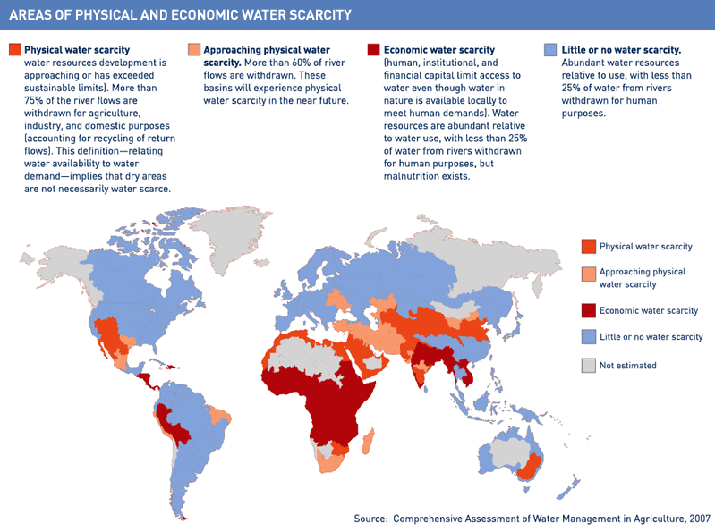

Slide 5
Water-related challenges
2.1 billion people lack access to safely managed drinking water
4.5 billion people lack safely managed sanitation services.
340,000 children under five die every year from diarrhoeal diseases.
Water scarcity already affects four out of every 10 people.

Slide 7
Right to water
In 2010 the United Nations General Assembly recognized a human’s right to water and sanitation.
Amount of water should be between 50 and 100 L/person/day
Must be safe, acceptable and affordable
Today, 1 in 9 people lack access to safe water; 1 in 3 people lack access to a toilet. More people have a mobile phone than a toilet.
Notes:
water costs should not exceed 3 per cent of household income), and physically accessible (the water source has to be within 1,000 metres of the home and collection time should not exceed 30 minutes).

Slide 8
Water from the Air In Peru

Slide 9
Right to water
How do we get people access to water?
Notes:
Think pair share

Slide 10
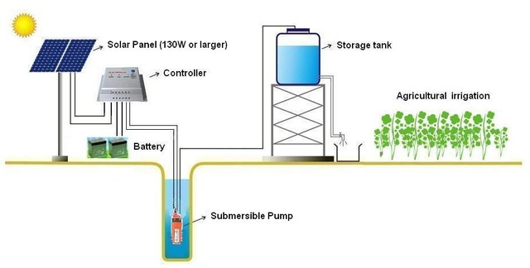
Solar Water Pumping System
https://www.aliexpress.com/item/High-Efficiency-24V-DC-Solar-Water-Pump-Submersible-Solar-Water-Pump-Solar-Deep-Well-Pump-With/32524410793.html
Notes:
https://www.aliexpress.com/item/High-Efficiency-24V-DC-Solar-Water-Pump-Submersible-Solar-Water-Pump-Solar-Deep-Well-Pump-With/32524410793.html

Slide 11
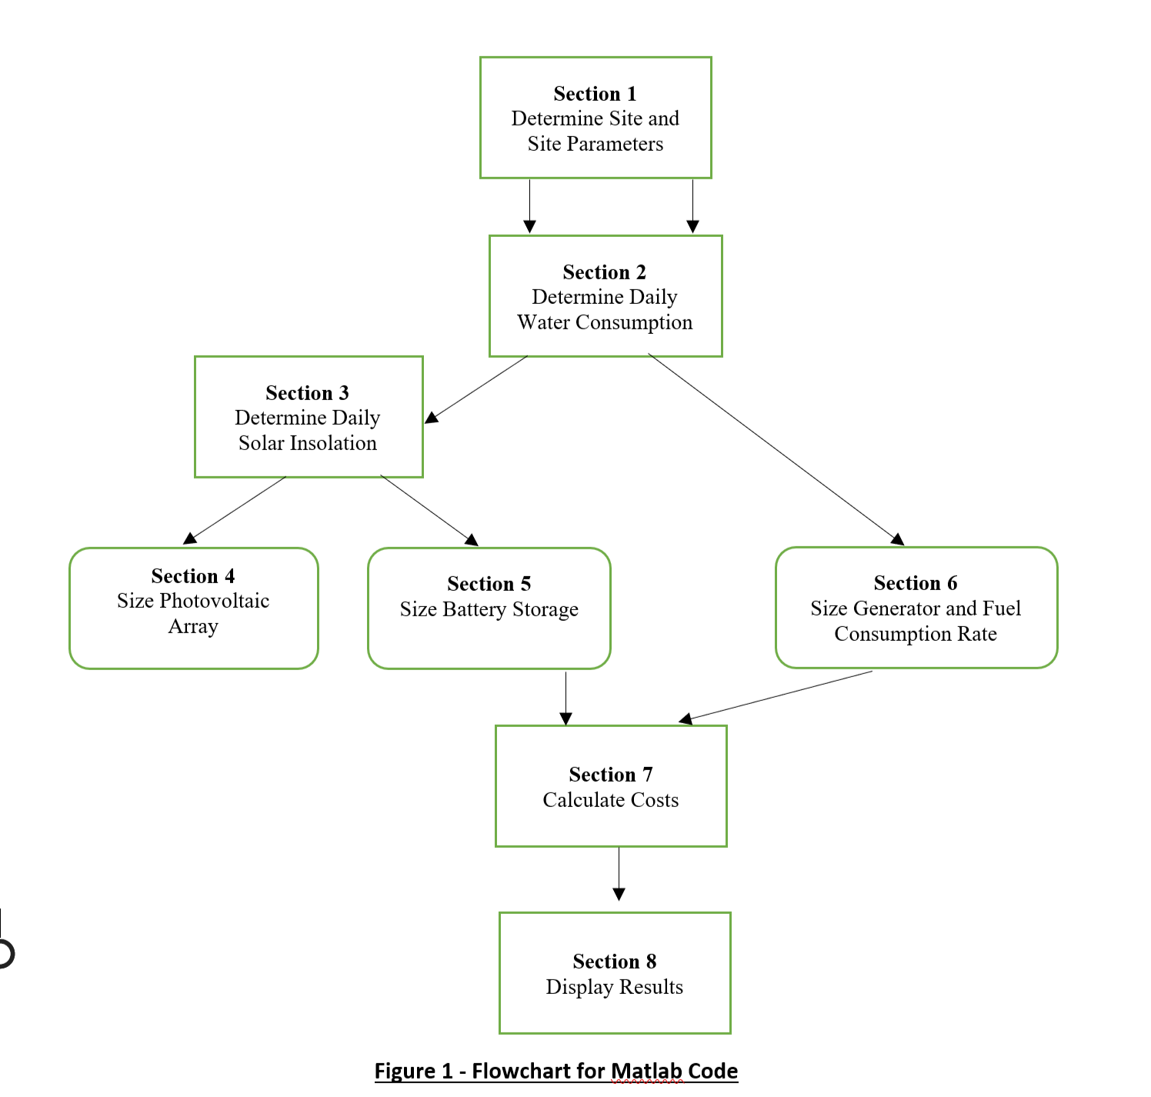
Matlab Activity
Objective: Develop Matlab Code for ‘sizing’ energy systems designed to pump drinking water for a small community in the developing world.
A stand-alone photovoltaic system with battery storage.
A fuel powered generating system.
SAVE FILE EARLY AND OFTEN AND COPY INTO ANOTHER PROGRAM JUST IN CASE
Notes:
The term ‘sizing’ refers to the process of determining the size and/or model number of system components and number of the numbers of these components. There are two types of systems that you will be sizing:

Slide 12
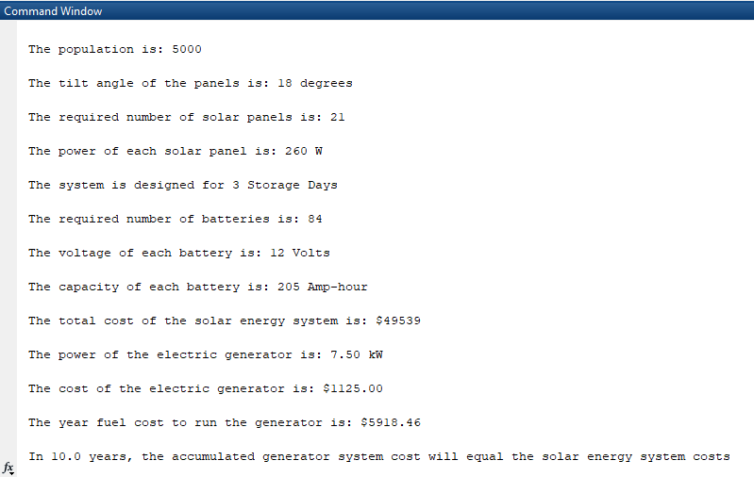
Sample Results

Slide 13
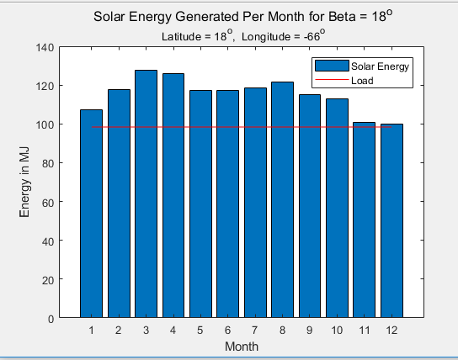
Sample Results

Slide 14
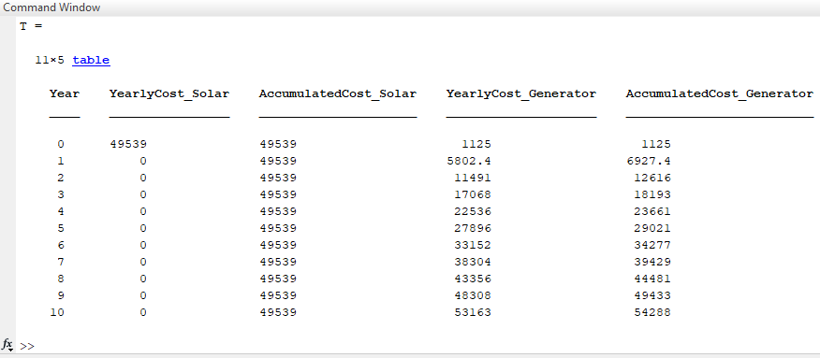
Sample Results

Slide 15
Technology Transfer

Slide 16
Tech Transfer Activity
Students form team in technology area based on interests: Water, Lighting, Refrigeration, Medical Devices, Batteries, or something else (with approval of instructor). (5 min)
Individuals research how technology works (or doesn’t) in developed and developing countries. What are the challenges and opportunities? What is state-of-the-art? How must the technology be reimagined/redesigned for the developing world? (30 min)

Slide 17
Tech Transfer Activity
Teams discuss findings and develop rough outline for a white paper. Assign research duties. (10 min)
Conduct research during remaining time and outside class.
Understand & summarize technology in developed world, i.e., US (science, types, cost, outcomes,...)
Understand & summarize technology (and challenges) in developing world. Does developed world technology need to be changed to work in developing world? What has worked to date?
Think about associated design principles, e.g., building devices with local skill/labor.
This research will culminate in a White Paper and Presentation

