Slide 1
Universal Design
Universal design caters for many users, irrelevant of gender, age, size, strength, mobility, hearing, vision etc.
Good design enables, bad design disables.

Slide 2
Scenario 1
You have been hired by a company to design a kid’s toy, one that could be included in a happy meal
What do you need to know in order to complete this task?
What factors must you consider in your design?
Notes:
Think-Pair-Share. Should take around 5 minutes. After the students have had some time to discuss these questions with a neighbor, call on someone randomly. Don’t call for volunteers! This activity provides context for the UD concepts to follow.

Slide 3
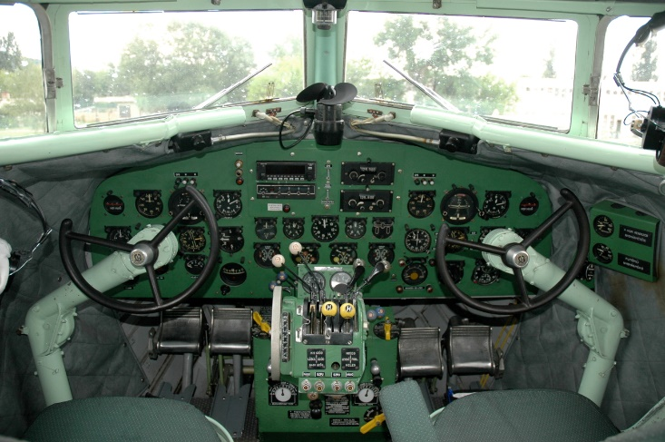
Scenario 2
In 1926, the Army designed the first airplane cockpit. It was designed around the average physical dimensions (10) of male pilots in the 1920s
With the expansion of the Air Force in 1947, performance declined and deaths increased?
Why do you think this happened?
Circular, steering-wheel type yoke in a Lisunov Li-2 (1940s), image by VargaA (GFDL)
Notes:
https://99percentinvisible.org/episode/on-average/
When this was researched, it was found that while the cockpit was designed for the “average” pilot, none of the pilots were measured as average on all 10 dimensions. When you look at just three dimensions, less than 5 percent were average. So by designing something for an average pilot, it was literally designed to fit nobody. Whether its equipment or a work environment, design must accommodate more people outside the average.
Equipment should fit a wide range of body sizes rather than being standardized around the “average person”. This situation and research birthed the science of ergonomics – the study of how to match people’s physical capacity to the needs of the job.

Slide 4
"The only important thing about design is how it relates to people.” (Pananek, 1968)
“The only thing important about design is how it relates to people.”
Victor Papanek, 1968
Notes:
Title: The only thing important about design is how it relates to people.” Victor Papenek, 1968
Image: Sculptural interpretation of a chair; attractive but obviously not comfortable

Slide 5
Universal Design
Inclusive Design
Design for All
User Needs Design
User-Centered Design
Human-Centered Design
Barrier-Free Design
Accessible Design
Adaptable Design
Transgenerational design
Design for a Broader Average

Slide 6
What is Universal Design?
Design and composition of an environment so that it can be accessed, understood and used to the greatest extent possible by all people regardless of their age, size or disability
Approach to design that honors human diversity. It addresses the right for everyone to use all spaces, products and information, in an independent, inclusive and equal way
Invites engineers to go beyond compliance with access codes, to create excellent, people-centered design

Slide 7
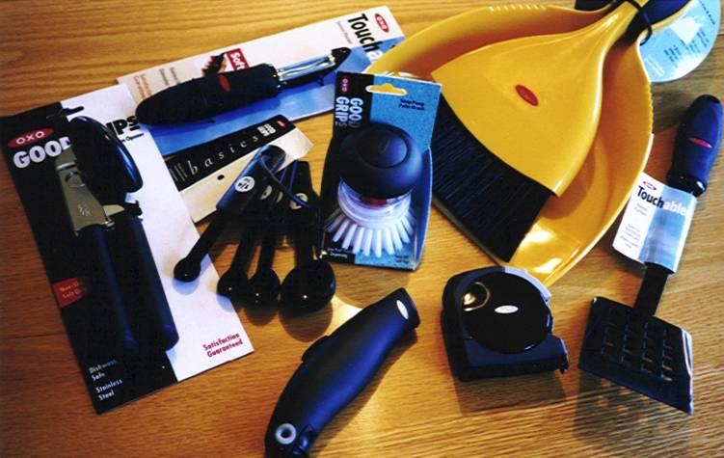
Why Universal Design?
Individual benefits
Social benefits
Aging population
Home healthcare
Independent living
Participation in society
Business benefits
Increased market reach
Enhanced customer satisfaction and retention
Market crossover
Increased customer expectations
Compliance with legislation and standards
Better products for everyone!
Notes:
Think-Pair-Share.
Think – ask your class to take a few minutes to think about why universal design is important in their chosen engineering discipline and the benefits of incorporating into design ( 3 minutes)
Pair – instruct your students to pair up and have them discuss their lists of benefits with a partner. Have them write down a comprehensive list.
Share – have the students share their ideas with the class. Keep a list on the board. Some answers are included on the slide.
About 1 in 7 Americans has a disability
About 1 in 3 American has a family member or coworker with a disability

Slide 8
Why We Need Universal Design
Notes:
Optional video to show. It’s around 10 minutes

Slide 9
The Principles of Universal Design
Equitable Use
Flexibility in Use
Simple and Intuitive
Perceptible Information
Tolerance for Error
Low Physical Effort
Size and Space for Approach and Use

Slide 10
Principle 1: Equitable Use
The design is useful and marketable to any group of users
Provide the same means of use for all users: identical whenever possible; equivalent when not
Avoid segregating or stigmatising any users
Provisions for privacy, security and safety should be equally available to all users
Make the design appealing to all users
Notes:
Principle 1: Equitable Use – The design is useful and marketable to any group of users
Provide the same means of use for all users: identical whenever possible; equivalent when not
Avoid segregating or stigmatising any users
Provisions for privacy, security and safety should be equally available to all users
Make the design appealing to all users

Slide 11
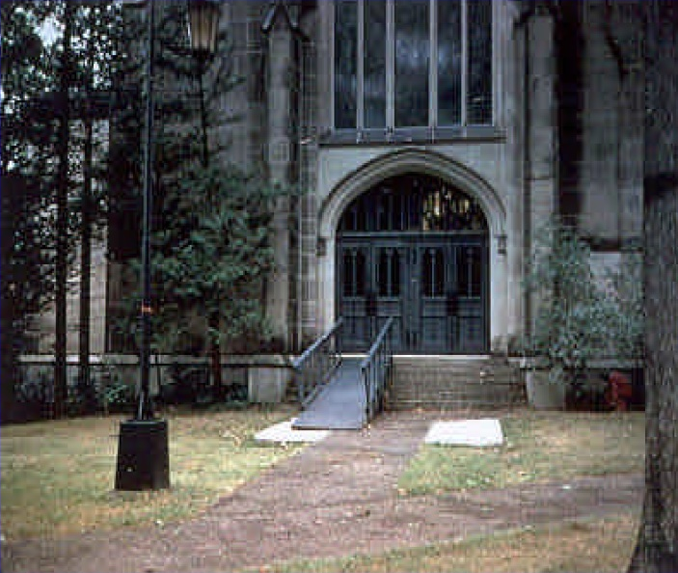
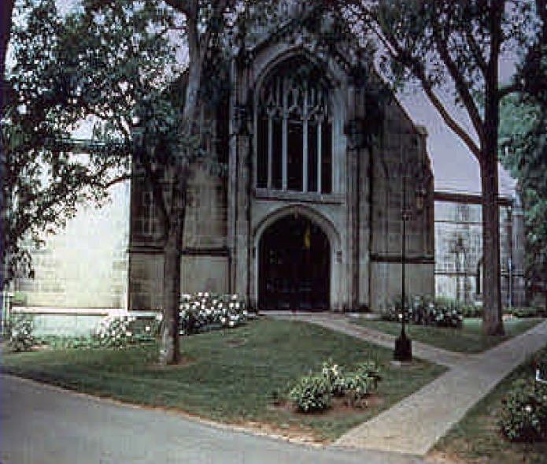
Principle 1: Equitable Use
Can everyone use the same entrance?
Notes:
Principle1: Equitable Use: The design is useful and marketable to people with diverse abilities:
Can everyone use the same entrance?
The image on the left shows the entrance to a college library. There is a metal, stigmatising ramp laid over the front steps – not a very attractive or welcoming entry.
The image on the right shows the renovated entrance. This is a good example of Universal Design. The area surrounding the entrance has been landscaped, eliminating the need for the steps and creating a gentle grade that everyone can use.

Slide 12
Principle 1: Equitable Use
Does the design provide the same means of use for all?
Notes:
Principle1: Equitable Use: The design is useful and marketable to people with diverse abilities:
Does the design provide the same means of use for everyone?
The height adjustable drinking fountain offers choice for children, adults, wheelchair users and people of very tall and short stature to individualise the drinking height and become part of the larger public.
Unlike ‘accessible’ solutions that segregate users by providing two fountains side by side – one for standing users and one for seated users – this universally designed democratic solution offers the same opportunity to all people

Slide 13
Principle 2: Flexibility in Use
The design accommodates a range of individual preferences and abilities.
Provide choice in method of use
Accommodate right-handed or left-handed access and use
Facilitate the user’s accuracy and precision
Provide adaptability to the user’s pace
Notes:
Principle 2: Flexibility in Use – The design accommodates a range of individual preferences and abilities.
Provide choice in method of use
Accommodate right-handed or left-handed access and use
Facilitate the user’s accuracy and precision
Provide adaptability to the user’s pace

Slide 14
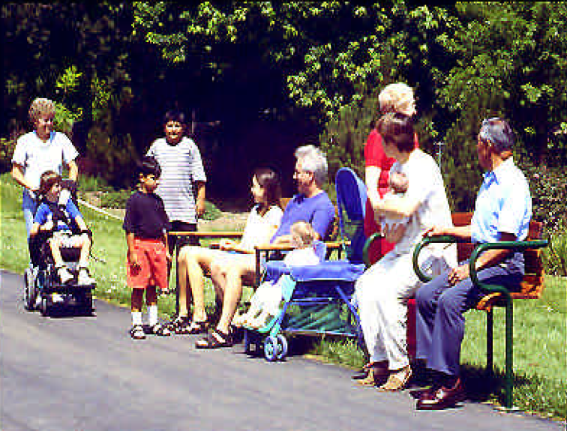
Principle 2: Flexibility in Use
Does the park seating accommodate individual preference?
Notes:
Principle 2: Flexibility in Use – The design accommodates a range of individual preferences and abilities.
Does the park seating accommodate individual preferences?
On the right, a child using a wheelchair joins a group of seated people on a wooden park bench.
There’s a mother with a baby in a pram, and an elderly person and a mother with a baby in her arms using a very high bench with arms to support sitting and standing.

Slide 15
Principle 2: Flexibility in Use
Can the design be used by left and right handed people?
Notes:
Principle 2: Flexibility in Use – The design accommodates a range of individual preferences and abilities.
Can the design be used by left and right-handed people?
The OXO Good Grips Swivel Scissors are used by grasping the non-slip rubber grip handles and by pulling back the spring loaded switch. They can be easily be used by right or left handed people and individuals who have low hand strength or arthritis. They have a swivel handle that absorbs a lot of the pressure from the users hands, which ensures that the scissors are comfortable even when cutting tougher materials.
In the image on the left, the standard stairway has a third handrail installed approximately 75cm away from the outer one., meaning the users can steady themselves by using either their right or left hand, or both hands. Lights have also been installed at foot level for safety and visibility. The level landing halfway up the flight of stairs gives people the opportunity to rest before proceeding, and there is seating installed on the top landing.

Slide 16
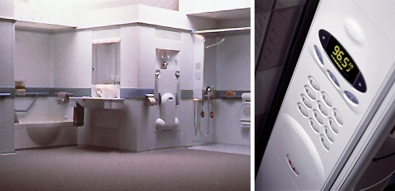
Principle 2: Flexibility in Use
Does the design work well for children, adults and older people?
Notes:
Principle 2: Flexibility in Use – The design accommodates a range of individual preferences and abilities.
Does the design work well for children, adults and older people?
This is a Metaform bathroom,
The modular sink and toilet easily adjust to accommodate the height of a standing or sitting user, allowing access by a small child, a tall adult or a wheelchair user. The arms of the toilet can be separately flipped out to assist with a right or left handed wheelchair transfer, or to provide support for people who are unsteady.
The barrier-free shower and tub are made of forgiving material for enhanced safety, accessibility and ease of living.
The president of the company said ‘We designed a universal system that does not force people to choose between accessibility and dignity’.

Slide 17
Principle 3: Simple and Intuitive
Use of the design is easy to understand regardless of the user’s experience, knowledge, language skills, or current concentration level.
Eliminate unnecessary complexity
Be consistent with user expectations and intuition
Accommodate a wide range of literacy and language skills
Arrange information consistent with its importance
Provide effective prompting and feedback during and after task completion

Slide 18
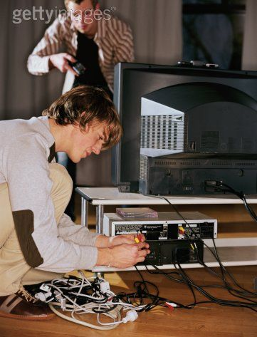
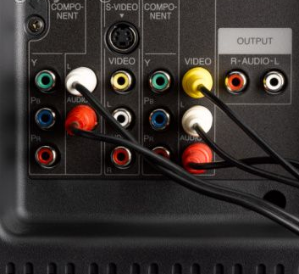
Principle 3: Simple and Intuitive
Is it easy to understand? Can you make it work?
Notes:
Principle 3: Simple and Intuitive
Is it easy to understand? Can you make it work?
The photo on the right illustrates the back of a television with colour-coded plugs and receptacles that simplify installation.

Slide 19
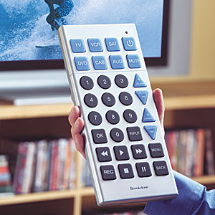
Principle 3: Simple and Intuitive
Is it easy to understand? Can you make it work?
Notes:
Principle 3: Simple and Intuitive
Is it simple to use by most people?
With giant buttons, this extra-large remote is easy to use and impossible to lose. It is simple to program, and controls TV, VCR, DVD player, satellite, cable and auxiliary A/V device. The buttons are large and high-contrast, and glow in the dark, and are therefore useable by people with visual impairments and differently sized hands.

Slide 20
Principle 4: Perceptible Information
The design communicates necessary information effectively to the user, regardless of ambient conditions or the user’s sensory abilities.
Use different modes (pictorial, verbal, tactile) for redundant presentation of essential information
Provide adequate contrast between essential information and its surroundings
Maximize ‘legibility’ of essential information and its surroundings
Differentiate elements in ways that can be described (i.e. make it easy to give instructions or directions)
Provide compatibility with a variety of techniques or devices used by people with sensory limitations

Slide 21
Principle 4: Perceptible Information
Does the design use different modes for presentation?
Notes:
Principle 4: Perceptible Information
Does the design use different modes for presentation?
The Honeywell thermostat in these two images provides tactile, visual and audible cues and instructions.
The numerals and arrow pointer are oversized and high contrast.
The clear outer ring cover has 3 dimensional indices that allow tactile feedback for users who may be blind and who rely on counting the degree increments to set the temperature.
The knob is course-knurled for secure gripping, and the thermostat can be positioned on the wall at any height for standing and seated users.

Slide 22
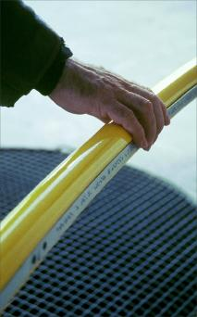
Principle 4: Perceptible Information
Does the environment help you find your way?
Notes:
Principle 4: Perceptible Information
Does the environment help you find your way?
Designer Coco Raynes created a wayfinding system in the Charles de Gaulle Airport in Paris, France.
It is intrinsically functional and multi-sensory but also compellingly attractive in design and stunningly executed.
Upon entering the terminal, the yellow raised floor markings can be followed visually, by foot or wheelchair, and make a sound when tapped.
The terminal is introduced with a simplified, tactile floor plan, on an information table angled to permit wheelchair access.
Raynes Rail is also installed, a braille and audio handrail system that makes public buildings, parks, transportation facilities and museums accessible to everyone. It contains multilingual audio units which are activated by photo sensors that do not require any physical strength or motor control. The Braille and audio messages provide directions, describe open areas, traffic patterns, and warn of ramps, stairs and turns. In museums, the audio provides cultural information.
Even though they’re attention grabbing in bright yellow, the handrails have no handicapped stigma.
All travellers benefit from this quality of attention to the critical role of orientation in public transit hubs.

Slide 23
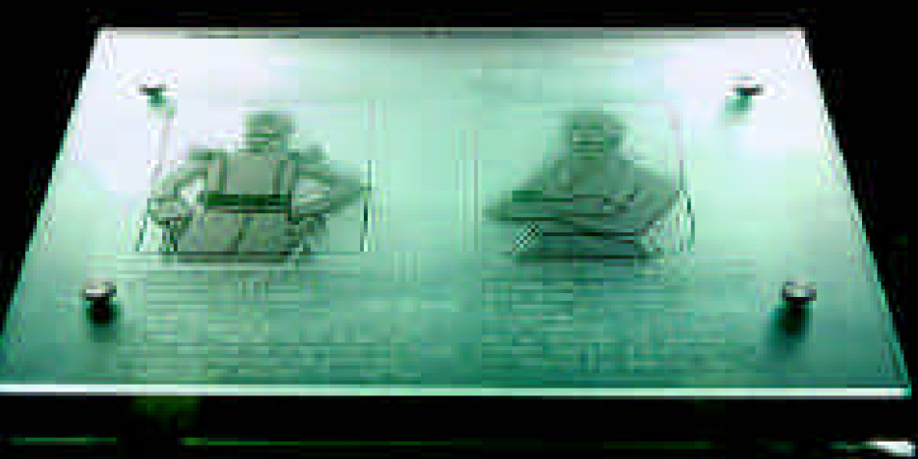
Principle 4: Perceptible Information
Principle 4: Perceptible Information
Are there different ways to enjoy the experience?
Notes:
Principle 4: Perceptible Information
Are there different ways to enjoy the experience?
These photos are of The National Museum of Columbig in Bogota.
Coco Raynes Associates has worked towards providing equal information to blind and visually impaired travelers in public spaces.
Their goal was to address all visitors, including children, visitors using wheelchairs, visually impaired, or illiterate. The added museography had to complement the existing one, and blend with the Spanish Colonial architecture. The result is a tactile and audio itinerary that allows for an autonomous visit within the general visit, highlighting typical examples of each period. While archeological pieces could be substituted by replicas for tactile discovery, paintings, pieces of equipment or furniture were more problematic. Audio commentaries presenting the pieces in their historical context became the common denominator for sighted and non-sighted visitors.
Tempered glass with etched surface was selected for all maps and display surfaces. The material is unobtrusive and economical, and the etched technique provides raised information including tactile drawings, text and Braille, on a non-glaring surface. Maps can be further enhanced with contrasting colors on the back surface. In the museum lobby, a main directory resting on a console introduces the tactile itinerary on the slanted glass surface. At the entrance of each gallery, maps with raised columns, walls and paths further guide visitors to the exhibits.
Lecterns with adapted height fit within the existing archways of the archeological galleries. Pre-Colombian replicas are displayed on the slanted glass surfaces, along with Braille and bilingual text in large characters. Tactile drawings call attention to the objects significant characteristics. The original pieces are exhibited in the adjacent display cases. A segment of Raynes Rail, the Braille and audio handrail activated by photo-sensor, further informs all visitors and also protects the edge of the glass lectern.
For the first time we attempted to translate paintings to blind visitors. In the Founder’s Gallery, two portraits of Bolivar depict the young victorious General and the mature defeated man. Tactile silhouettes depict the contrasting body language and the audio system plays excerpts of Bolivar’s writings from both periods. Nearby, another lectern faces an antique press on which the Bill of Rights was printed. A diagram highlights the machine’s technical features while the audio commentary states the Bill of Rights.
This comprehensive program has been very successful with the public. It has also established new criteria among the museums in Latin America. The tactile translation of paintings, an idea first viewed with skepticism, delighted non-sighted and sighted visitors who were able to appreciate the Bolivar portraits beyond the images, and within the historical context. For Phase Two of the program other paintings ranging from the 18th to 20th Century have already been designated.
Even though the National Museum of Columbia has very limited funds (there is no admission fee), the fact that it manages to invite all its citizens to come and share in their national heritage shows that they have set new standards in Universal Design.

Slide 24
Principle 5: Tolerance for Error
The design minimises hazards and the adverse consequences of accidental or unintended actions.
Arrange elements to minimize hazards and errors: most used elements, most accessible; hazardous elements eliminated, isolated or shielded
Provide warnings of hazards and errors
Provide fail safe features
Discourage unconscious action in tasks that require vigilance

Slide 25
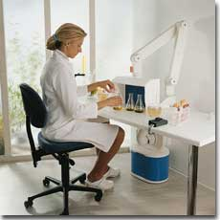
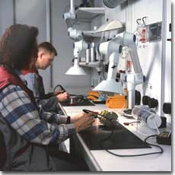
Principle 5: Tolerance for Error
Can you work safely without toxic fumes?
Notes:
Principle 5: Tolerance for Error
Can you work safely without toxic fumes?
Being able to breathe clean and healthy air is part of Universal Design.
These photos show extraction hoods designed by Nederman Inc. that filter noxious fumes from the air.
It was developed to make laboratories and similar environments more usable by people with disabilities, but it actually benefits everyone.

Slide 26
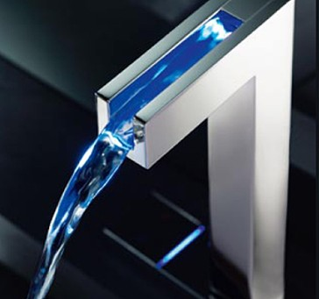
Principle 5: Tolerance for Error
How can you tell when the water is hot?
Notes:
Principle 5: Tolerance for Error
How can you tell when the water is hot?
Hansa Canyon have designed these sleek faucets with water ‘canyons’.
These canyons are lined with LEDs that are temperature sensitive, and change colour accordingly.
They are blue for cold, pink for warm and red for hot.
It’s a very functional feature, and also a safety measure.
The colours can help prevent you from scalding yourself white washing your hands or stepping into a really cold bath.

Slide 27
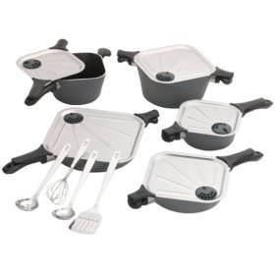
Principle 5: Tolerance for Error
Is it safe to handle?
Notes:
Principle 5: Tolerance for Error
Is it safe to handle?
Allegro cookware has a round base, to suit standard round heated sources.
However, the tops and lids have four corners, creating two natural poring spouts.
Handles located at the other two corners of the pot, align and lock with the lid handles, providing safe and balanced handling and pouring.
The flat lids contain steam vents, designed to prevent boiling over, and injuries caused by steam.
They also allow for easier and safer draining and straining while cooking.

Slide 28
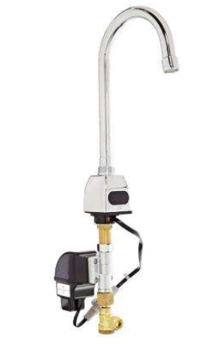
Principle 6: Low Physical Effort
The design can be used efficiently and comfortably and with a minimum of fatigue
Allow user to maintain a neutral body position
Use reasonable operating forces
Minimise repetitive actions
Minimise sustained physical effort

Slide 29
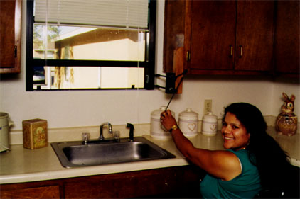
Principle 6: Low Physical Effort
Does the design help minimise the effort needed?
Notes:
Principle 6: Low Physical Effort
Does the design help minimise the effort needed?
Leviton rocker switches on the left are much easier to use than toggle switches.
Lever door handles are much easier to use than round door knobs.
Windowease, seen in the image on the right, is a retrofit product that can be installed on any window.
It has been designed so that the operating crank is low, and in reach of most users, sitting or standing, and requires minimal force to turn.
Because of its intuitive design, children as young as 3 can use it, and it can be used with little or no instruction.

Slide 30
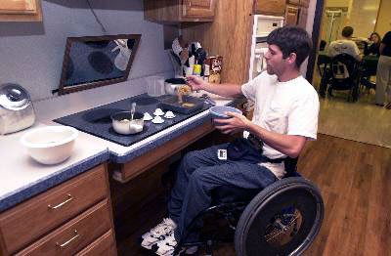
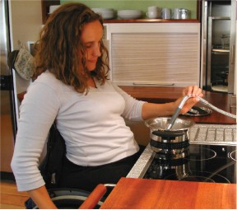
Principle 6: Low Physical Effort
Can you easily reach and use home products?
Notes:
Principle 6: Low Physical Effort
Can you easily reach and use home products?
In these images, the cooker and sink have knee space provided underneath for wheelchair users, or people who prefer to cook and clean while sitting down.
With this simple design, food preparation, cooking and cleaning can be shared and enjoyed among family members of all ages.

Slide 31
Principle 7: Size and Space for Approach and Use
Appropriate size and space is provided for approach, reach, manipulation, and use regardless of user’s body size, posture, or mobility.
Provide a clear line of sight to important elements for any seated or standing user
Make reach to all components comfortable for any seated or standing user
Accommodate variations in hand and grip size
Provide adequate space for the use of assistive devices or personal assistance

Slide 32
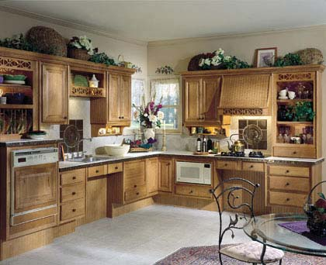
Principle 7: Size and Space for Approach and Use
Is there room to maneuver?
Notes:
Principle 7: Size and Space for Approach and Use
Is there room to maneuver?
This kitchen offers work spaces, appliances and traffic lanes that are appropriate for all ages and capabilities.
This kitchen has clear floor spaces and knee spaces that offer ease of movement and maneuverability for people in wheelchairs or scooters, and room for several people to share in meal preparation.

Slide 33
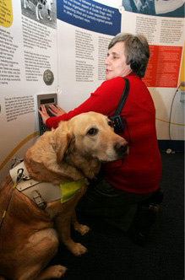
Principle 7: Size and Space for Approach and Use
Is there space to examine the art exhibit?
Notes:
Principle 7: Size and Space for Approach and Use
Is there space to examine the art exhibit? And to view the retail products?
On the left, a woman and her guide dog are in an exhibition area.
On the right, a girl is reading some books, while sitting down in a book shop.

Slide 34
Meet The Normals – Adventures in Universal Design

Slide 35
UD Case Study Assignment
Using online and library resources, research a product and describe how it conforms to the Principles of Universal Design (1 paragraph)
Then, research a product in your engineering discipline that does not conform to the Principles of Universal Design. State why it doesn’t and how you could improve the design (1 paragraph)
Notes:
If no time remains in class, assign this for hw. This assignment should not be longer than 1 page. It should include 2 paragraphs. One paragraph outlining an example of a product that follows UD principles, and one paragraph outlining a product that doesn’t, and how it can be improved.

